Slide 1
IOT BASED FALL DETECTION AND HEALTH MONITORING SYSTEM FOR SENIOR CITIZENS

Slide 2
INTRODUCTION

Slide 3
HARDWARE DESCRIPTION
Microcontroller Unit
WiFi Module
MPU6050 6-axis Accelerometer
GPS Module
GSM Module
Pulse oximeter

Slide 4
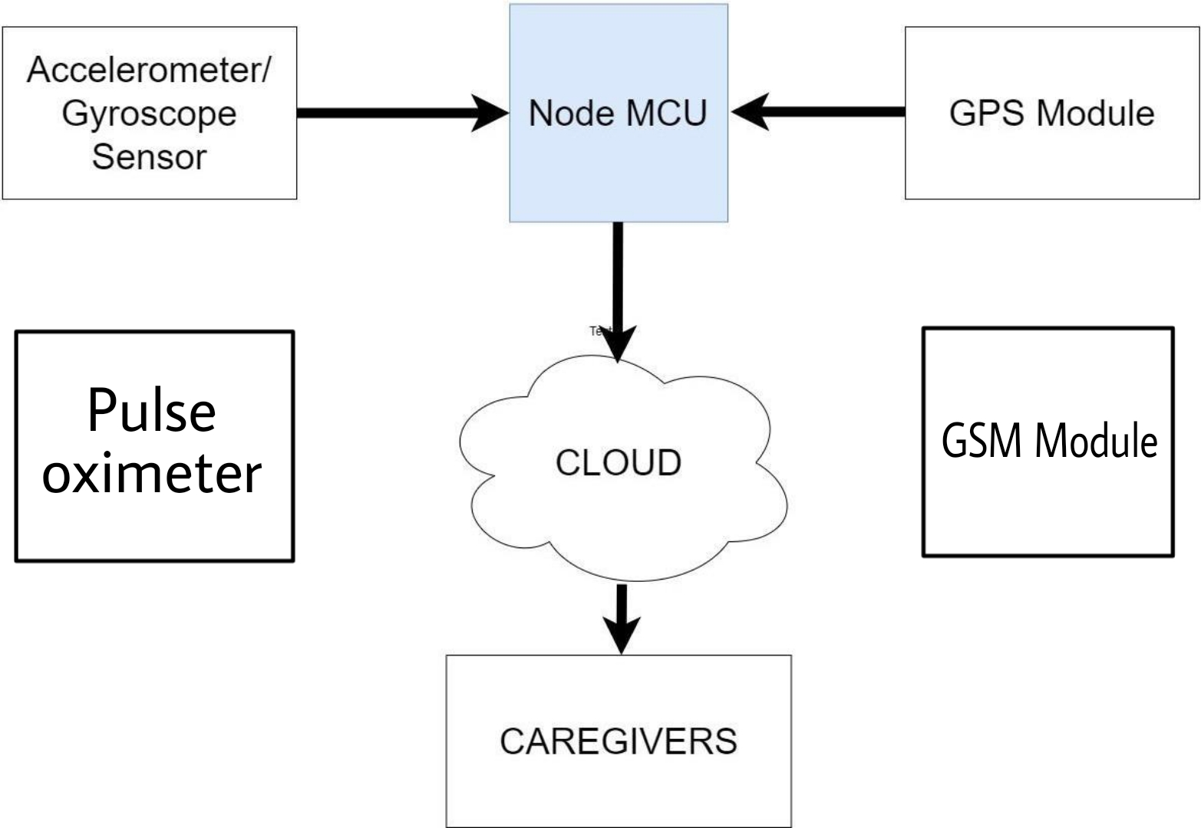
BLOCK DIAGRAM

Slide 5
WORKING
In this project, the main component is microcontroller. The I/O pins of microcontroller are connected to power supply, Accelerometer sensor and GPS Module, GSM Module and WiFi Module.
Accelerometer sensor is used to collect the angular velocity and linear acceleration values.
GPS Module is used to collects the geographic coordinate values.
GSM Module is used to connect to a network.

Slide 6
FUNCTIONALITY
First the microcontroller reads the data from the accelerometer and checks if the accelerometer values are lower than the lower threshold value.
If the accelerometer values exceed the higher threshold, then it checks for the gyroscope values to calculate the change in the orientation.
if there is a sudden change in orientation, then it waits for 10 seconds and checks if the orientation remains the same.
If yes, then it activates the Fall Detector alarm by sending the notification to the caregivers and call Ambulance.
When fall is detected then location coordinates is send to caregivers by Blynk app and pulse oximeter we will monitor the patient’s status.

Slide 7
ADVANTAGES
Less Expensive
Time

