Slide 1
Simulation with D/M/1 Assumption

Slide 2
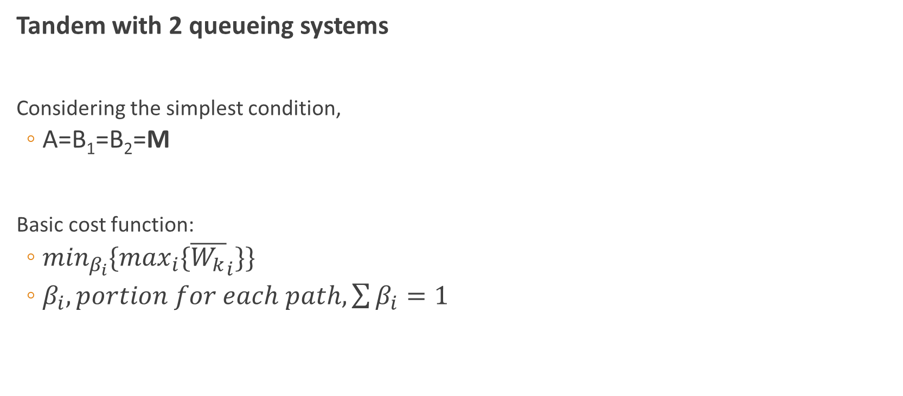
Problem Specification
Tandem with 2 queueing systems
Considering the simplest condition,
A=B₁=B₂=M
Basic cost function:
$\min_{β_{i}}\{\max_{i}\{{\overline{W_{k}}}_{i}\}\}$
$β_{i}, portion for each path, \sum{β_{i}}=1$
D/B₁/1
A/D/1
D/B₂/1

Slide 3
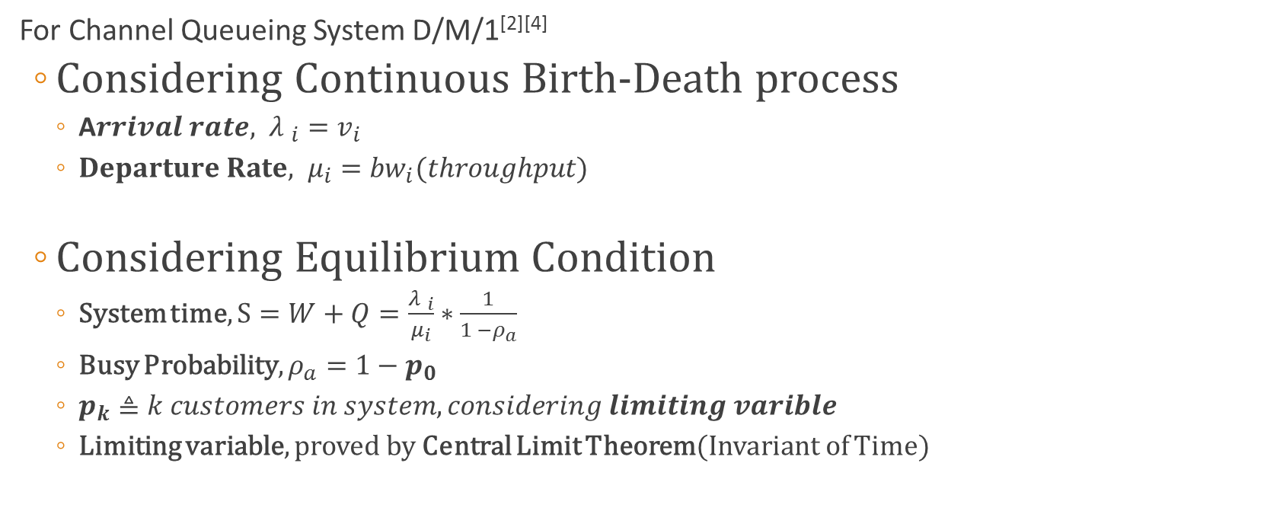
Basic Concepts
For Channel Queueing System D/M/1^{[2][4]}
Considering Continuous Birth-Death process
A$rrival rate, {λ }_{i}=v_{i}$
$Departure Rate, μ_{i}={bw}_{i}(throughput)$
Considering Equilibrium Condition
System time, $S=W+Q=\frac{{λ }_{i}}{μ_{i}}∗\frac{1}{1 −ρ_{a}}$
Busy Probability, $ρ_{a}=1−p_{0}$
$p_{k}≜k customers in system, considering limiting varible$
Limiting variable, proved by Central Limit Theorem(Invariant of Time)

Slide 4
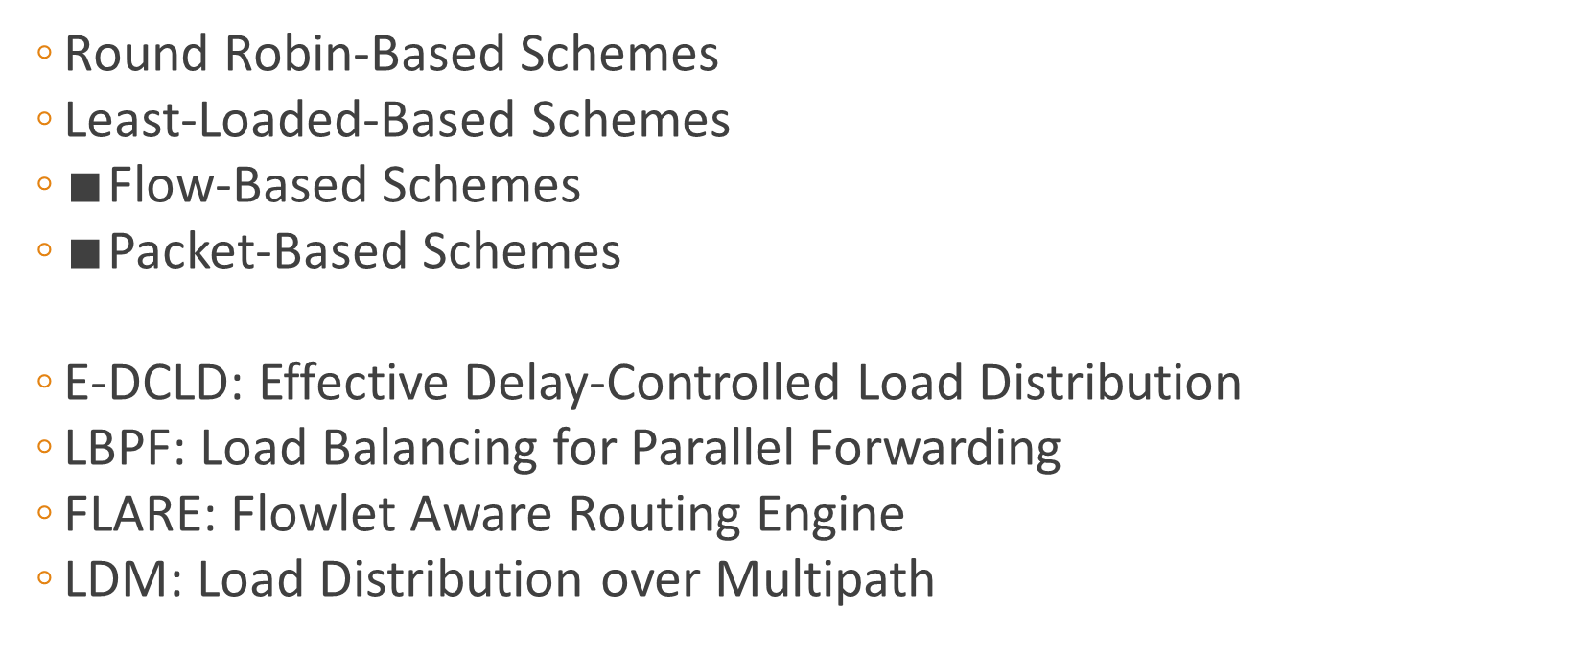
Related Work^{[2]}
Round Robin-Based Schemes
Least-Loaded-Based Schemes
$∎$Flow-Based Schemes
$∎$Packet-Based Schemes
E-DCLD: Effective Delay-Controlled Load Distribution
LBPF: Load Balancing for Parallel Forwarding
FLARE: Flowlet Aware Routing Engine
LDM: Load Distribution over Multipath

Slide 5
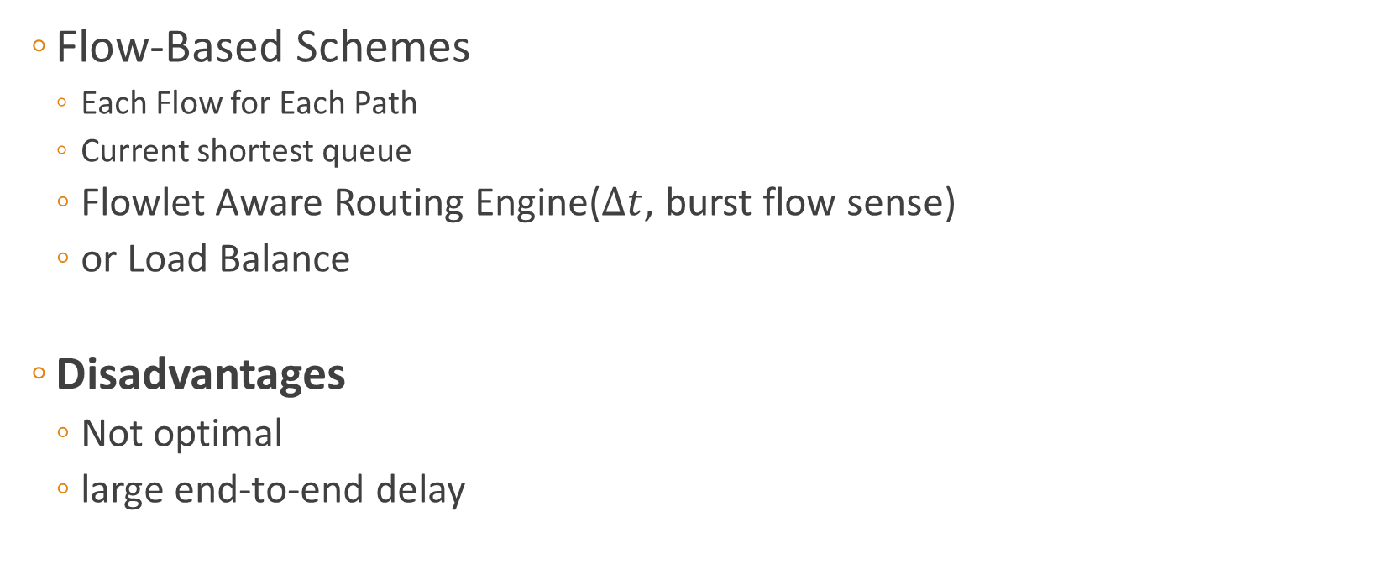
Related Work
Flow-Based Schemes
Each Flow for Each Path
Current shortest queue
Flowlet Aware Routing Engine($∆t$, burst flow sense)
or Load Balance
Disadvantages
Not optimal
large end-to-end delay

Slide 6
Related Work
Packet-Based Schemes
Each Packet for Each Path
Current shortest queue
Disadvantages
Risk of reordering

Slide 7
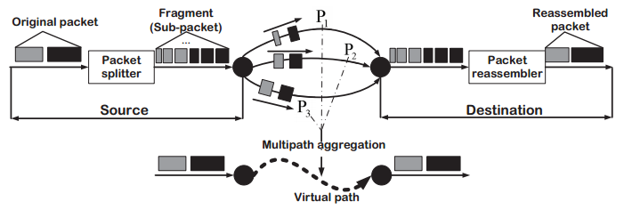
SPMLD^{[2][3]}
Each Packet For Multi-Path
(Sub-Packet based Multipath Load Distribution)

Slide 8

SPMLD^{[2][3]}
Problem formulation:
$D_{i}\left(φ_{i}\right)=F_{i}+Q_{i}\left(φ_{i}\right), 1≤i≤N_{p}$
$Q_{i}\left(φ_{i}\right)=\frac{PK∗φ_{i}}{{bw}_{i}(1−ρ_{a,i})}$
Optimization:
$\min_{φ}\max_{i}\left\{D_{i}\left(φ_{i}\right)\right\}, end−to−end delay$
$subsject to:\left\{\begin{aligned}\sum{φ_{i}=1} \\ 0≤φ_{i}≤1 \\ {0≤ρ}_{a,i}≤1\end{aligned}\right.$

Slide 9
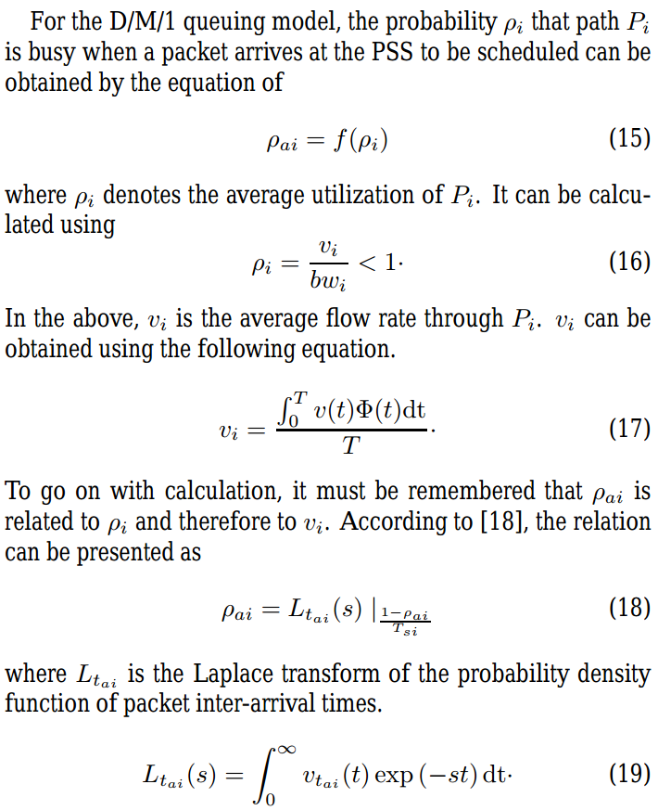
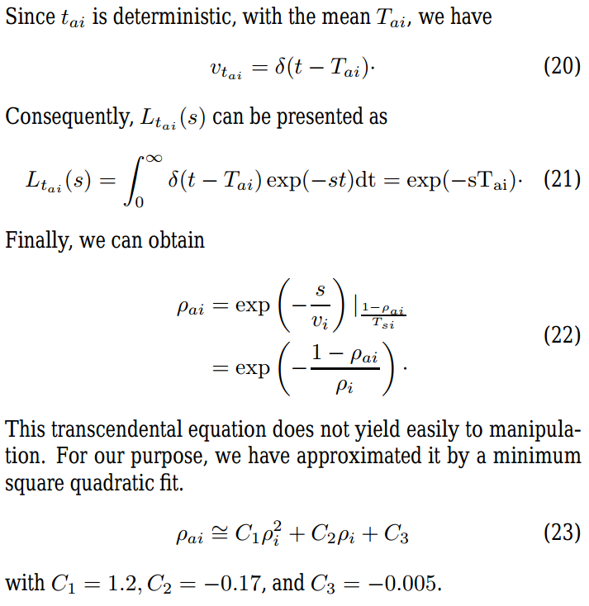
SPMLD^{[2][3]}
Solution

Slide 10
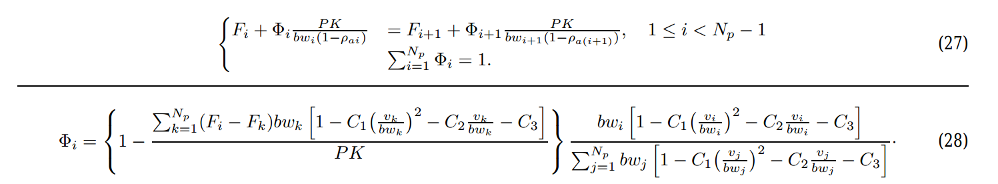
SPMLD^{[2][3]}
Solution

Slide 11
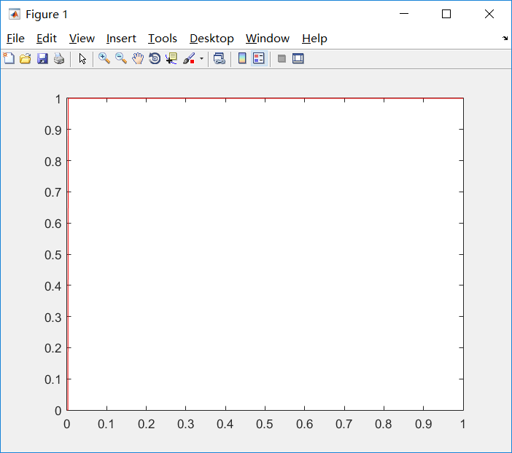
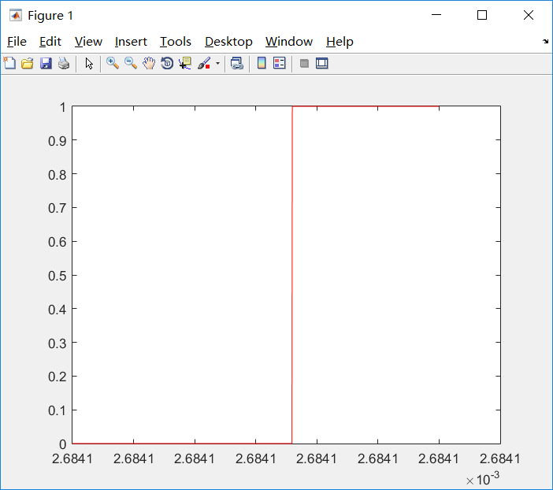

Simulation
Solution for $ρ_{a,i}$

Slide 12

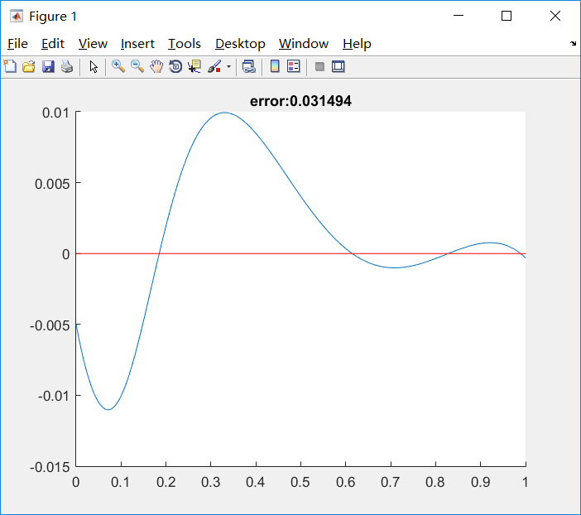
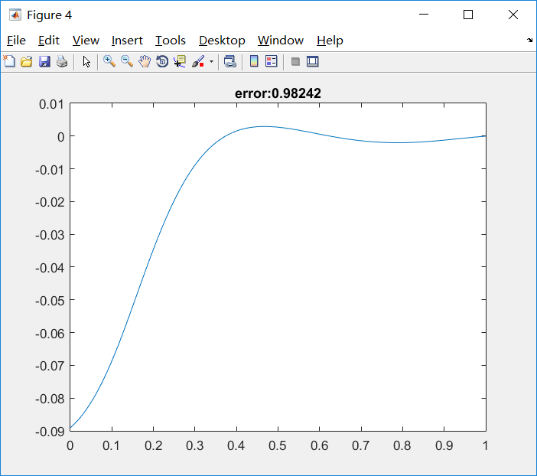
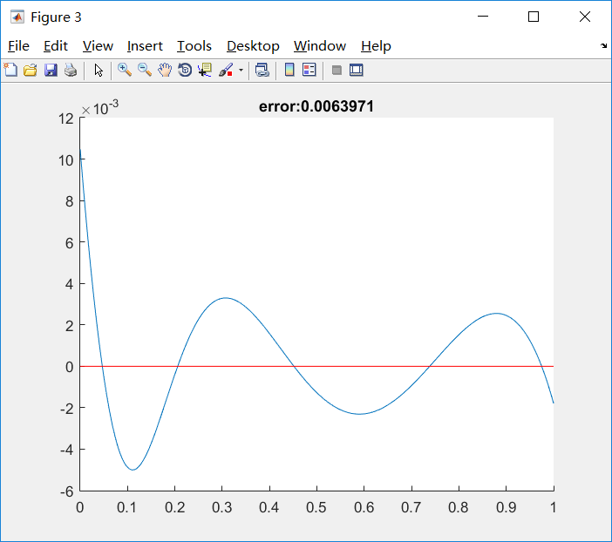
Simulation
Original Error
Polyfit Error
Fminunc Error
1.3354 -0.28657 0.010471

Slide 13
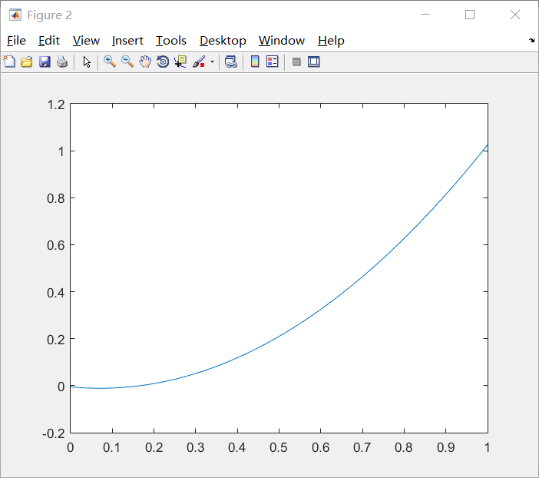
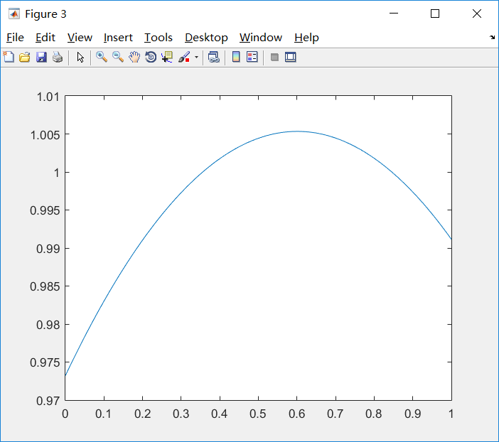
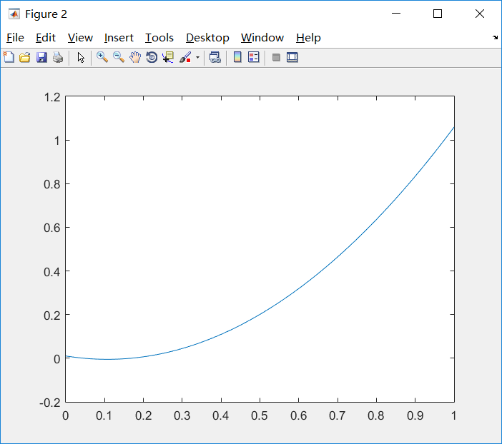
Simulation
Original Approximation
Polyfit Approximation
Fminunc Approximation

Slide 14
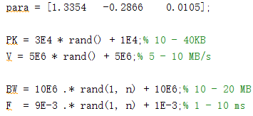
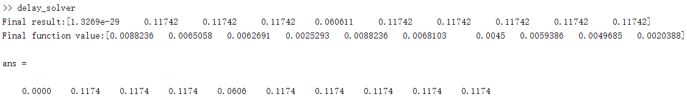

Simulation
Solution for {$φ_{i}$}
Fminimax
Original Solution
Totally wrong! Have no idea.

Slide 15
System Design
Tools :
Python, over TCP/IP Routing Table
Labview, TCP & USRP flow Routing
Packet Control Unit
… …
(Bandwidth, Propagation Delay)
Packet Splitter
Path Selector
Path 1
Packet Reassembler
… …
Path N

Slide 16
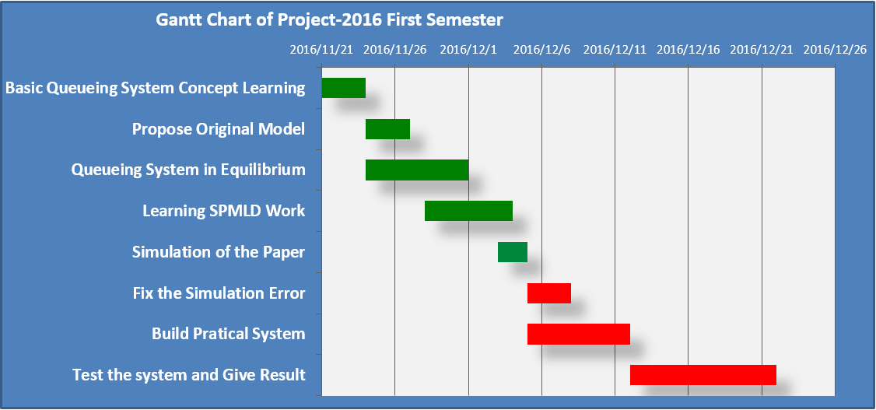
Study Process

Slide 17
Outlook
1. Overhead optimization?
Fallback to Packet-based Scheme
2. Retransmission considered?
Timeout at receiver side
3. Not in Equilibrium?

Slide 18
Thanks!
Reference
[1] Kleinrock, Leonard. Queuing Systems. 1st ed. New York, N.Y.: John Wiley & Sons, 1975. Print.
[2] Wu, J., Wu, X., & Chen, J. (2013). SPMLD: Sub-Packet Based Multipath Load Distribution for Real-Time Multimedia Traffic.
[3] Wu, J., Yang, J., Shang, Y., Cheng, B., & Chen, J. (2014). SPMLD: Sub-packet based multipath load distribution for real-time multimedia traffic.
[4] S. Prabhavat et al., “Effective delay-controlled load distribution over multipath networks,” IEEE Trans. Parallel Distrib. Syst., vol. 22, no. 10, 1730–1741, 2011.

