Slide 1

Detecting Fraud Case Study
Ian McCann, Stuart King, and Steve Kientz
Notes:
6/1/17
1
1

Slide 2
Project Scope
We will determine the likelihood of fraudulent activity by using machine learning on data available to a specific website.
We have deployed a web app which will classify new data as being potentially fraudulent as new data becomes available (live).
Our model was based on a training data set of 14,337 unique events - 1,293 of which were predetermined to be fraudulent (9%).
Notes:
6/1/17
2
2

Slide 3
Exploratory Data Analysis
44 columns of data, several large text fields.
Created several new columns based on other data:
time_to_payout: How long between the end of an event and payment is made?
time_till_event: How long has the user been active relative to the event date?
is_country_same: Is the event in the same country as the event user?
Dropped multiple columns – most venue info and most of the remaining time fields
Notes:
6/1/17
3
3

Slide 4
Feature Selection
body_length
description (only for NLP)
gts
Listed
name_length
num_order
num_payouts
org_desc (only for NLP)
sale_duration2
time_to_payout (created)
time_till_event (created)
is_country_same (created)

Slide 5
Basic Modeling
Initially ignored large text fields and ran multiple classification models to see which one had the best recall - recall is more important since false negatives indicate we missed actual fraud.
Classification models attempted:
Random Forest
SVC
KNN
Gradient Boost
Separately performed NLP on the text description field
Ultimately we chose a Random Forest Classifier with a recall score of ~0.77
Notes:
6/1/17
5
5

Slide 6
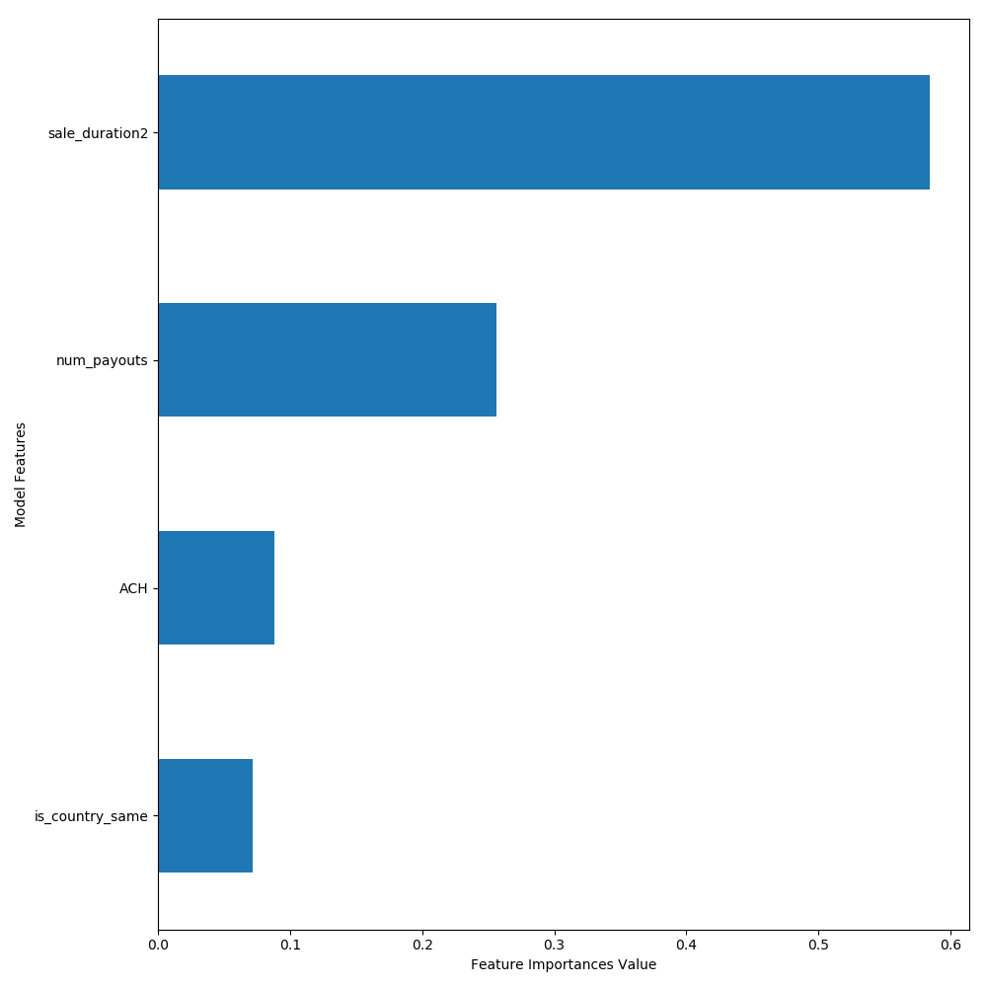
Feature Importance
From Random Forest Classifier – the most important features were:
Sale Duration
Number of payments
Method of payment
If the country of the user and country of the venue are the same
Notes:
6/1/17
6
6

Slide 7
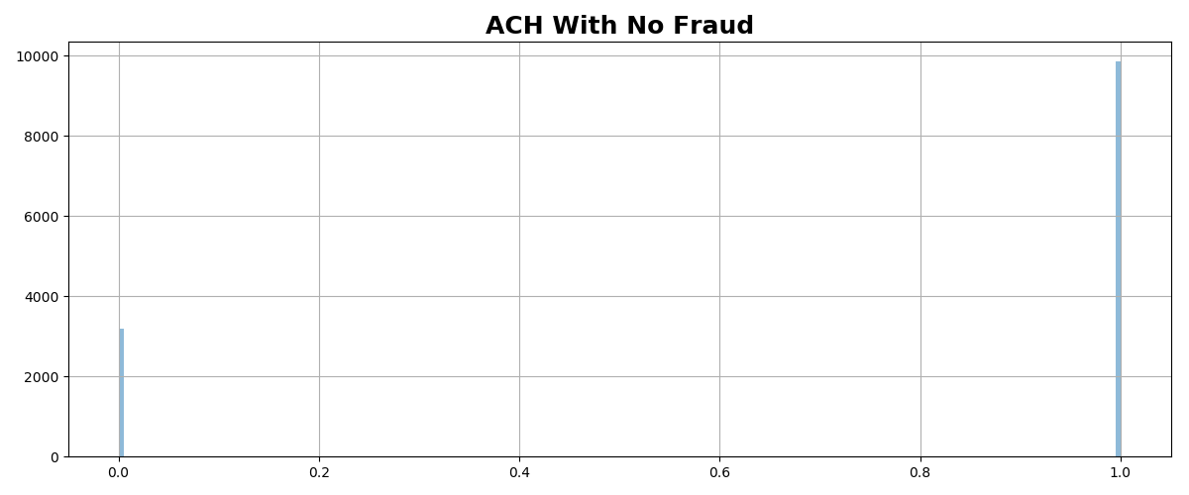
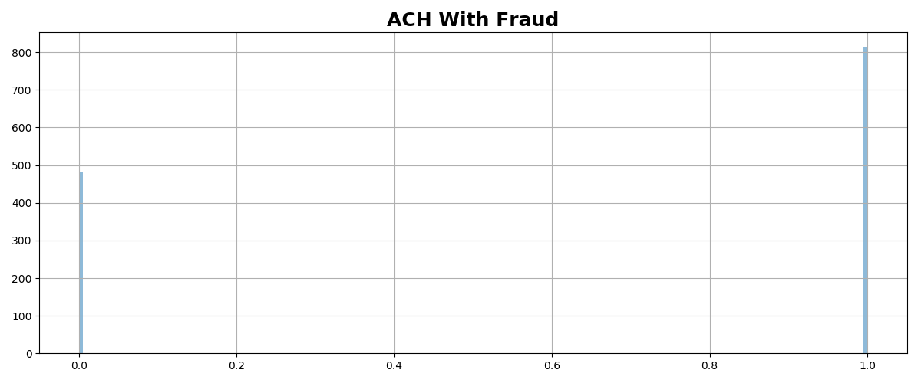
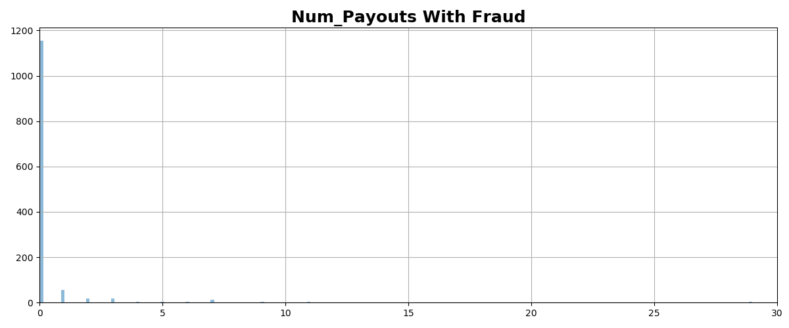
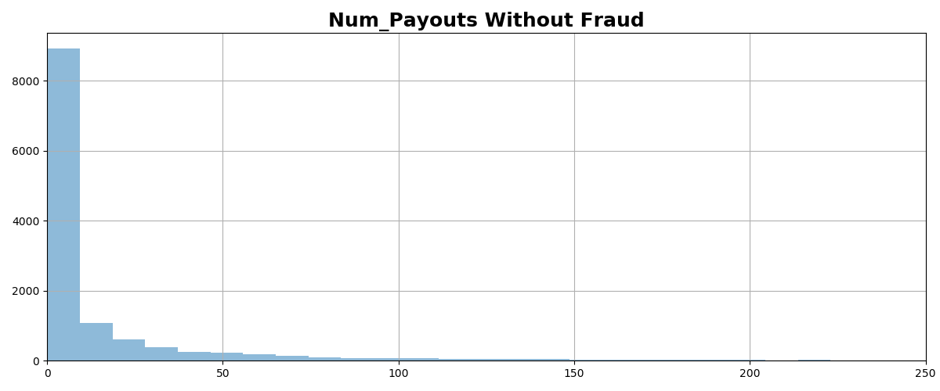
Evaluating fraud for features with greatest importance
If a check was used to pay there was almost no fraud – ACH payments were much more likely to be fraudulent. 60% of Fraud cases were ACH – the rest did not report the method of payment.
If the number of payouts exceeds two the likelihood of fraud was very low.
Notes:
6/1/17
7
7

Slide 8
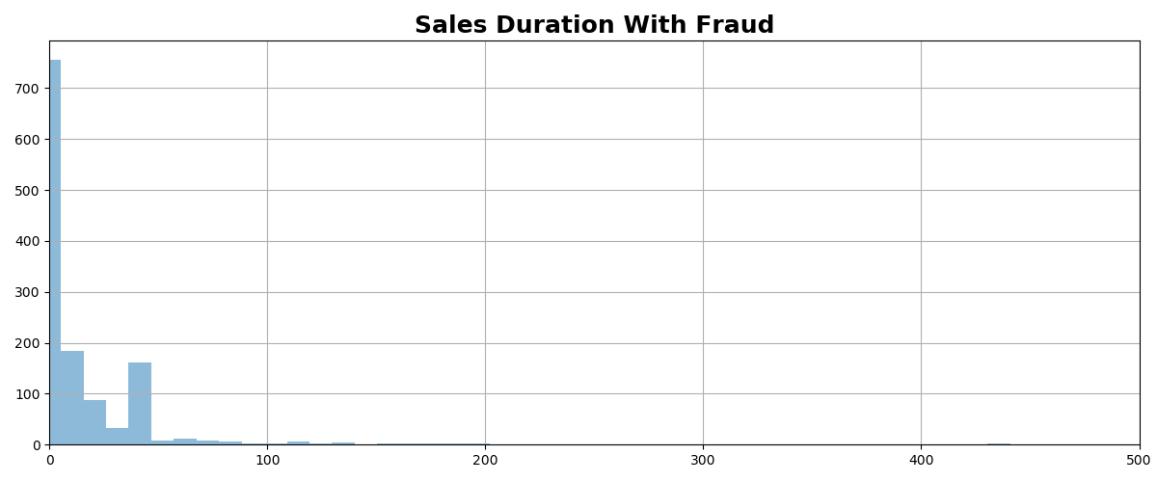
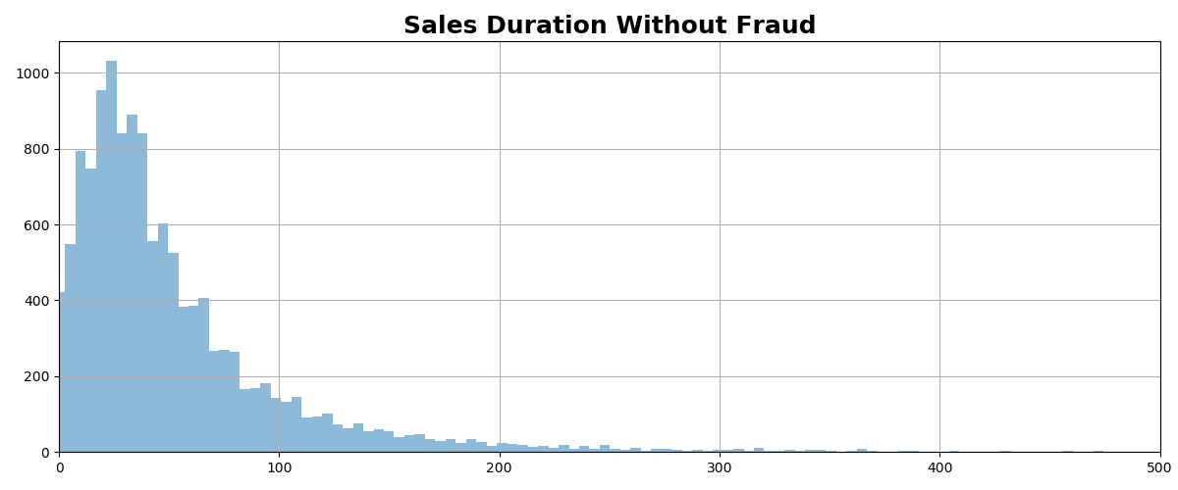
Features evaluation continued
If the sales duration exceeds 50, the likelihood of fraud was very low.
The is_country_same field is also useful – of the 1,293 fraud examples, 52.9% did not originate in the same country as the event. This is a much greater percentage than the non-fraud examples. Only 15.7% of potentially legitimate transactions originated in a different country than the event.
To summarize, fraud will likely not use a check, have a low number of payouts, have a small sales duration and will originate in a country other than the event location.

Slide 9
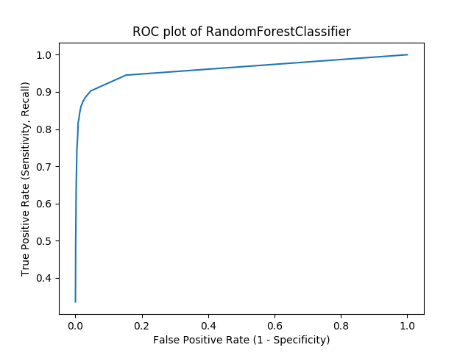
Receiver Operator Curve

Slide 10
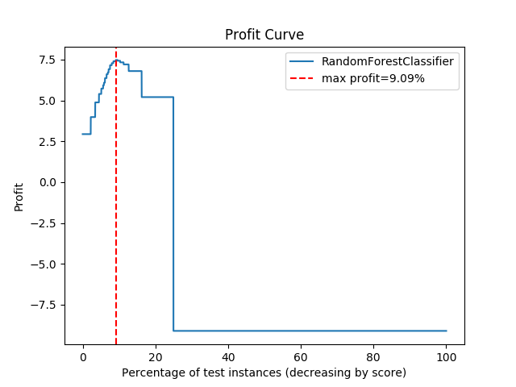
Profit Curve
Cost/Benefit Matrix
True Positive 0 | False Positive -10
False Negative -90 | True Negative 10
Random Forest Classifier
Best threshold: 0.30
Resulting profit: 7.47
Proportion positives: 0.52

