Slide 1
Intelligent Text Mining Based Financial Risk Early Warning System
---基于智能文本挖掘的金融风险预警系统
Author：
KQ Wang, QK Wu, HY Mao, MB Zhou, K Jiang, XP Zhu, L Yang, T Wang, HQ Wang
reported by Menghan Zhang

Slide 2
CONTENT
Intelligent Text Mining Based Financial Risk Early Warning System
01
文章背景
02
相关工作
The backgrounds of the paper
The related work
03
论文主要内容
Architectural development

Slide 3
文章背景
The backgrounds of the paper
随着金融企业和市场面临越来越大的风险，文本挖掘正在发挥越来越重要的作用；
由于文本与文本所产生的结果之间的复杂性，导致传统的文本挖掘技术难以满足需求；
随着互联网的迅速发展，全球信息使金融市场不时变化，金融专家很难通过手工工作快速获得这些全球信息资源的有用信息；
现有的文本分析软件大部分无法识别重要文本和金融工具之间的关系。

Slide 4
相关工作
The related work
Theoretical Foundation（理论基础）
Nobel-prize winner professor H.A. Simon’s decision making process model
决策制定过程分为四个阶段：
Intelligence: Collect and pre-process;（情报：收集和预处理）
Design: Analysis of information;（设计：信息分析）
Choice: Select the best scheme from all candidates;（选择：从所有候选中选择最佳方案）
Review: Evaluate solutions;（评估：评估解决方案）
Rational decision:（合理的决策）based on decision maker’s
psychological limitation, the knowledge limitation, the motivation limitation and the interaction limitation.
心理限制，知识限制，动机限制，相互作用的限制

Slide 5
论文主要内容
Architectural development
The Multi-agent Framework ------ 多代理框架
Text collection agent: Collect information from internet and preprocess them;
Text mining Agent: Text mining;
Relation analysis Agent: Analyze the relationship between the acquired text and objects;
Reliability analysis Agent: Analyze the reliability of the information acquired;
User Interface Agent: Give a final process to all the information and display them to users.

Slide 6
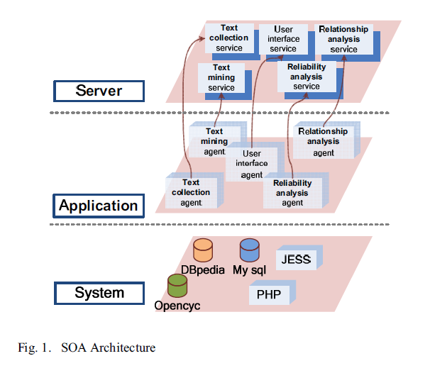
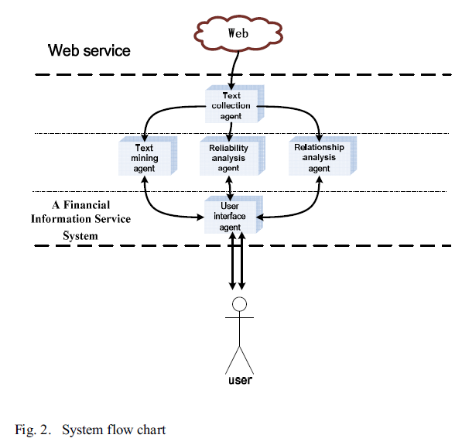
论文主要内容
Architectural development
SOA：面向服务架构的组件模型
Data Flow Chart

Slide 7
论文主要内容
Architectural development
Text Collection Agent:
a Web spider is used in this agent to search related information set by users and restorethem from internet. Then a text filter is employed to filter repeated and useless text (which is judged by factors like time).
在这个代理中使用网络爬虫来搜索用户设置的相关信息并把这些信息恢复； 然后使用文本过滤器来过滤重复和无用的文本（由时间因素来判断）。

Slide 8
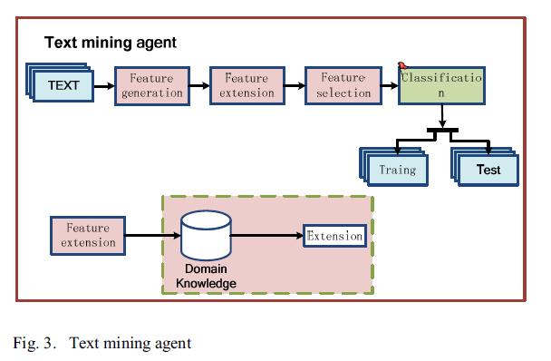
论文主要内容
Architectural development
Text Mining Agent:
The main difference between our text mining agent and traditional text mining is that there is an inference module(推理模块) in our agent. By adding the inference capability, this agent is able to produce better outputs, comparing with traditional text mining technologies

Slide 9
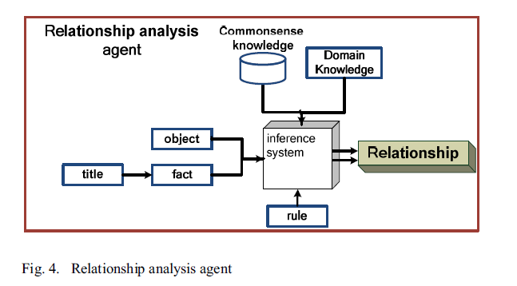
论文主要内容
Architectural development
Relationship Analysis Agent:
专业领域知识
In order to perform the relationship analyzing tasks, this agent needs know the world, i.e. it should to have a huge intensive knowledge, including “common-sense knowledge”. This is one of the hardest problems that the artificial intelligence researchers face.
推理系统

Slide 10
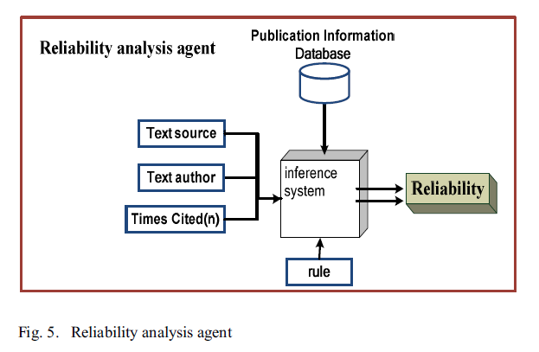
论文主要内容
Architectural development
Reliability Analysis Agent(it is developed to decide whether the text is reliable or not):
引用次数

Slide 11
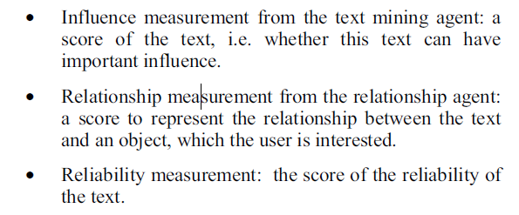
论文主要内容
Architectural development
User Interface Agent:
The outputs from the text mining agent, the relationship analysis agent and the reliability analysis agent will go to the user interface agent for final processing. These outputs are in the following three categories:
•文本挖掘代理的影响度量：文本的分数，即这个文本是否可以有重要的影响。 •关系代理人的关系测量：用于表示用户感兴趣的文本和对象之间的关系的分数。 •可靠性测量：文本可靠性的得分。

Slide 12
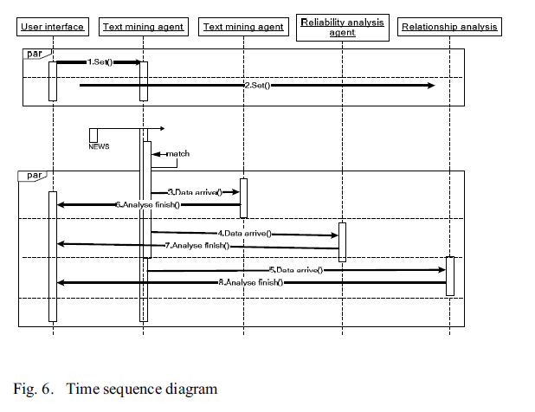
论文主要内容
Architectural development
System Operation:
Text Collection Agent
文本采集代理根据用户的规格从Internet收集数据，并将这些数据发送给文本挖掘代理，可靠性分析代理和关系分析代理以进行进一步处理。 在接收到这三个代理的分析结果后，用户界面代理将对其进行总结并向用户发送最终结果。

Slide 13
Using a fuzzy association rule mining approach to identify the financial data association
---使用模糊关联规则挖掘方法来识别财务数据关联
Author：
G.T.S. Ho, W.H. Ip, C.H. Wua, Y.K. Tse
reported by Menghan Zhang

Slide 14
CONTENT
Intelligent Text Mining Based Financial Risk Early Warning System
01
文章背景
02
相关工作
The backgrounds of the paper
The related work
03
论文主要内容
Architectural development

Slide 15
文章背景
The backgrounds of the paper
股票市场已经成为世界很多地方的重要投资项目，香港证券交易所是截至二零一零年亚洲第二大证券市场。大多数投资者只是依靠过去的经验来判断自己的判断。由于缺乏专业见解，个人经常亏损；
一个可靠的股票价格预测方法，考虑到影响波动的环境因素，具有综合的推理能力，对投资者决策过程至关重要；
由于股票市场的高度不确定性，有很多研究试图预测股票价格；过去，传统的自回归积分滑动平均模型（ARIMA）被广泛应用；
由于股票市场的动态，复杂和嘈杂环境，证明这些传统的时间序列分析难以应用。除了传统的统计方法，近年来人工智能已经被提出用于预测；
过去统计方法被用来对股票价格进行建模，但是，在这样的动荡环境下，统计模型在提供准确的结果方面并不是很有用。

Slide 16
相关工作
The related work
Walczak (1999) attempted to use neural network to look for rules in the capital market;
Interesting research like text mining on news article (Huang, Liao, Yang, Chang, & Luo, 2010) was carried out to discover the relationship between the social psyche(社交心理) and future stock prices;
Recent research (Tavakkoli, Jamali, & Ebrahimi,2010) showed how fuzzy logic can help in evaluating the financial performance of stocks.

Slide 17
相关工作
The related work
Previous work in stock price prediction using artificial intelligence:
Artificial neural networks (ANNs)：
Artificial neural networks (ANNs) are widely used in the stock price prediction systems;
Mostafa (2010) demonstrated using neural networks in forecasting stock moments in Kuwait in an empirical study(实证研究);
Although artificial neural networks can provide a robust performance in handling vast amounts of data, it is hard to provide a consistent and predictable performance for noisy data(Kim, 2006);
Yudong and Lenan (2009) demonstrated the use of a back propagation neural network(传播神经网络) to predict stock prices. Chang, Liu, Lin, Fan, and Ng (2009) also used a back(反向) propagation neural network together with a case reasoning system(案例推理系统) for stock trading prediction;

Slide 18
相关工作
The related work
Previous work in stock price prediction using artificial intelligence:
Genetic Algorithm:
Hui (2003) summarized the way to apply a simple genetic programming model to the prediction of stock prices;
Jim, Min, and Lee (2006) also developed a portfolio(组合) management system based on genetic algorithms;
The weakness of genetic programming is the difficulty in discovering the optimal constants(最佳常量) for terminal nodes(终端节点). The numbers are difficult to set by users who are not experts in artificial intelligence.

Slide 19
相关工作
The related work
Previous work in stock price prediction using artificial intelligence:
Rule-Based Theory:
Liu (2009) presented an integrated(集成) fuzzy time series model for forecasting .He summarized different fuzzy time series(序列) models and built his own. The model can be used for predicting any time series data including stock prices;
Dymova, Sevastianov, and Bartosiewicz (2010) demonstrated a new approach to set up a system using the Dempster–Shafer Set Theory.

Slide 20
相关工作
The related work
Previous work in stock price prediction using artificial intelligence:
Hybrid Models(combining two or more artificial intelligence techniques to build an integrated model):
Kim and Han (2000) stated a genetic approach in using ANNs in stock price index prediction;
Ang and Quek (2006) investigated a method to predict stock price differences by using neuro-fuzzy systems;
Kim and Shin (2007) suggested an integrated(集成) approach based on neural networks and genetic algorithms to detect(检测) short-term patterns in stock markets;
Atsalakis and Valavanis (2009) pointed out a neurofuzzy methodology(神经模糊方法) to forecast stock market short-term trends.

Slide 21
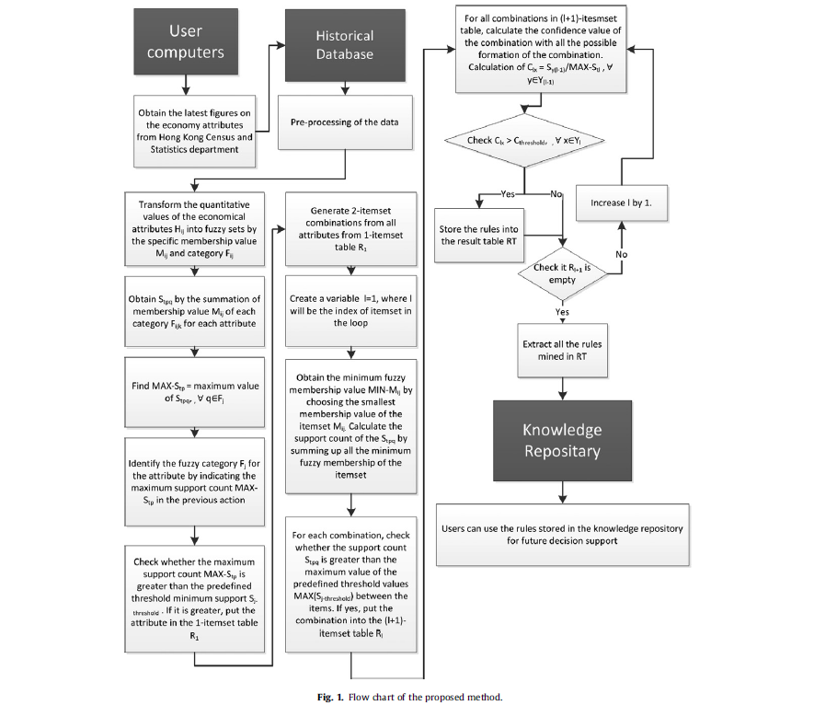
论文主要内容
Architectural development
The proposed decision support system based on a fuzzy association rule mining approach.

Slide 22
论文主要内容
Architectural development
1.Data collection and pre-processing(数据收集和预处理)
经济指标的历史数据可以从网上收集， 例如香港政府统计处提供重要经济指标，包括每季的国内生产总值及消费物价指数； 可以从香港政府网站中获得Excel表格格式的这些数据；也应该被收集所选股票的历史价格数据；雅虎金融提供了上市股票的准确和详细的历史数据。 用户可以从雅虎收集历史数据。

Slide 23
论文主要内容
Architectural development
2.Data mining engine(数据挖掘引擎)
The objective(目标) of the data mining engine is to identify the hidden patterns between the economical attributes and the stock market prices.
As the values of the sets and thresholds(阈值) directly affect the accuracy of the system, it is essential to define proper values in a flexible way.

Slide 24
论文主要内容
Architectural development
3. Decision supporting system
该机制可以提取“如果 - 然后”的规则。 挖掘的模糊关联规则将被转移到知识库。 公司中的用户可以访问知识库并检索关联规则；
关联规则为用户提供直接的决策支持。 例如，它可以显示经济属性与个别股票市场价格的水平或变化之间的关系。 因此用户可以根据证据做出决；
知识库将通过更新数据和定期运行挖掘引擎来重复更新，以保持准确性和最新信息。

Slide 25
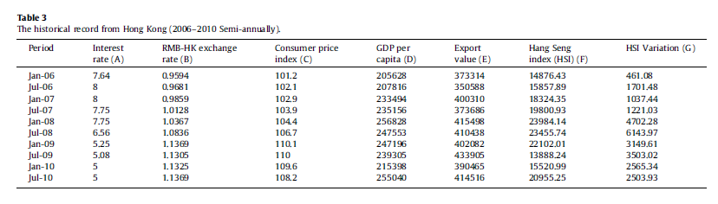
论文主要内容
Architectural development
4. Case Scenario(案例情况)
A case scenario is given to illustrate(评估) the feasibility(可行性) of the proposed algorithm mining rules from quantitative process data(定量过程数据) in the historical economic data.
The data set(数据集), including the historical Hong Kong market data was collected, with each record including different attributes as stated in Table 3.

Slide 26
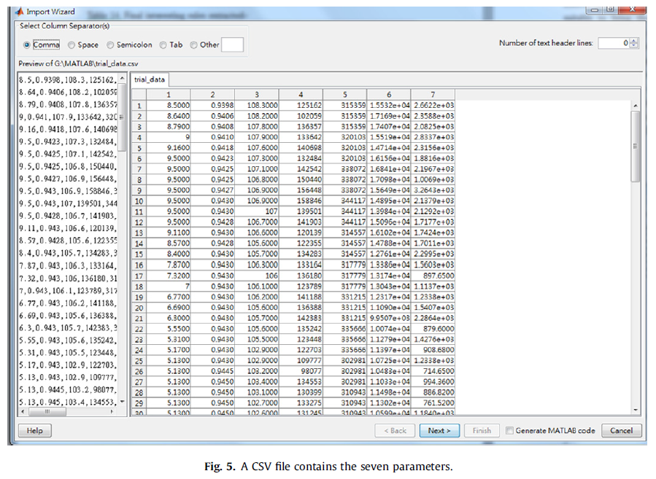
论文主要内容
Architectural development
5. Feasibility(可行性) Case Study
Several attributes like GDP and Hong Kong interest rate are selected, together with the historical records of the Hang Seng Index over 10 years. The firm collects the data on different re-lated attributes and the historical stock price that is stored in a CSV file.

Slide 27
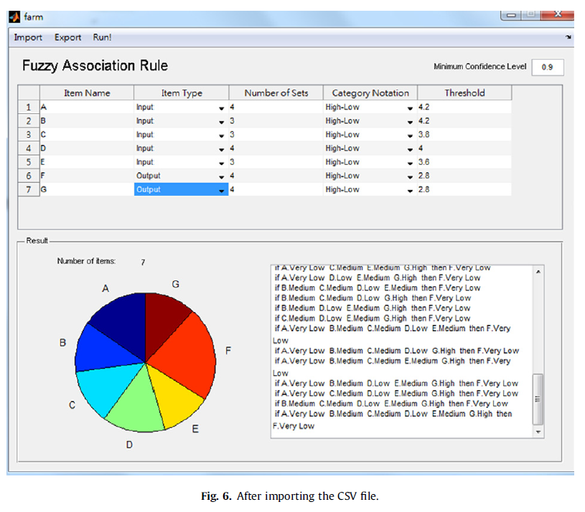
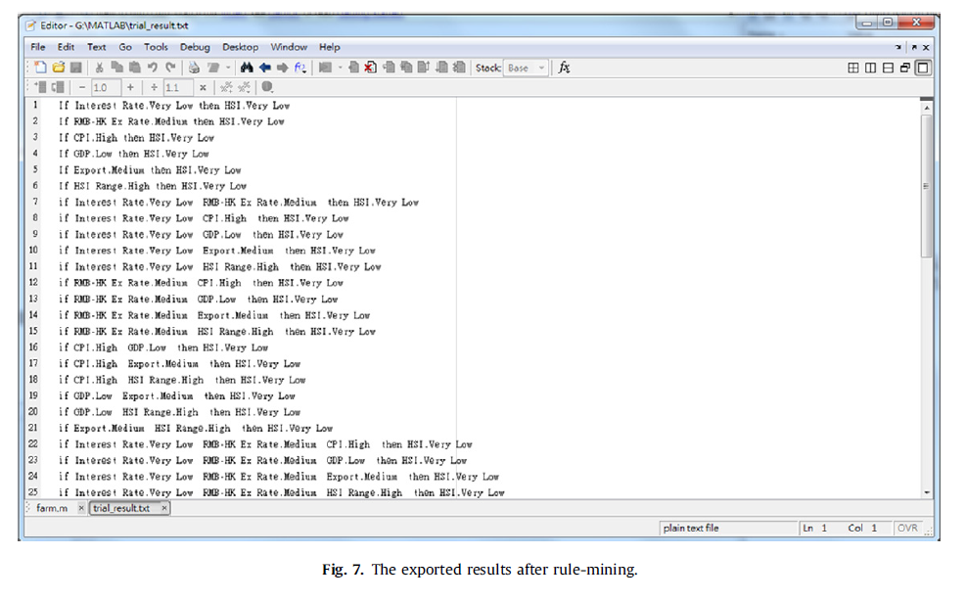
论文主要内容
Architectural development

Slide 28
论文主要内容
Architectural development
6. Conclusive remarks and future work
Further work is suggested to refine the methodology of designing suitable fuzzy sets and threshold values to enhance the reliability. It is recommended that more research is undertaken on determining suitable sets and threshold values to improve the reliability and feasibility of the decision support system.
进一步的工作是建议改进设计适当的模糊集和阈值的方法来提高可靠性。 建议进一步研究确定合适的集合和阈值，以提高决策支持系统的可靠性和可行性。

Slide 29
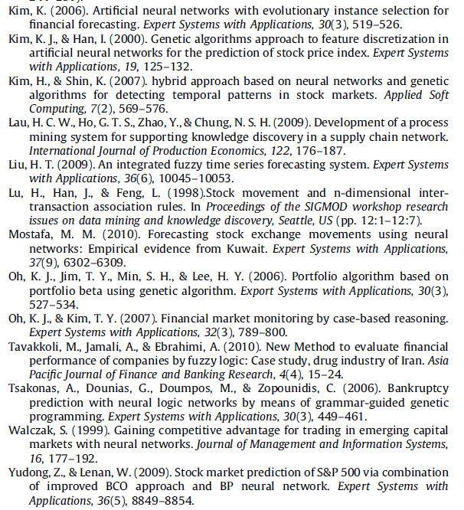
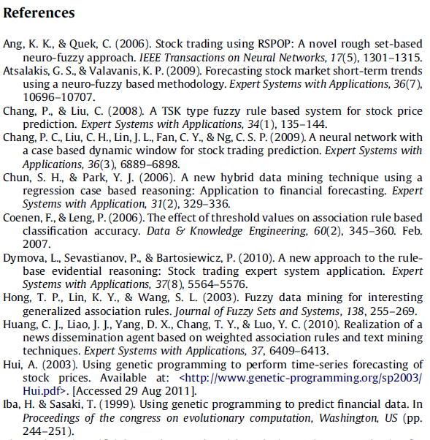
论文主要内容
Architectural development

Slide 30
THANKS

