Slide 1
Presented by- Amisha Verma
Roll no.- 2300290100040 Branch- CSE section- A
Title: Automatic Sentiment Analysis
Subtitle: Project Overview

Slide 2
ABOUT THE PROJECT
Tools and Technologies
Microsoft Power Automate: Workflow automation.
Microsoft Dataverse: Data storage and connection.
Gmail & Notifications Integrations: Data sources for sentiment analysis

Slide 3
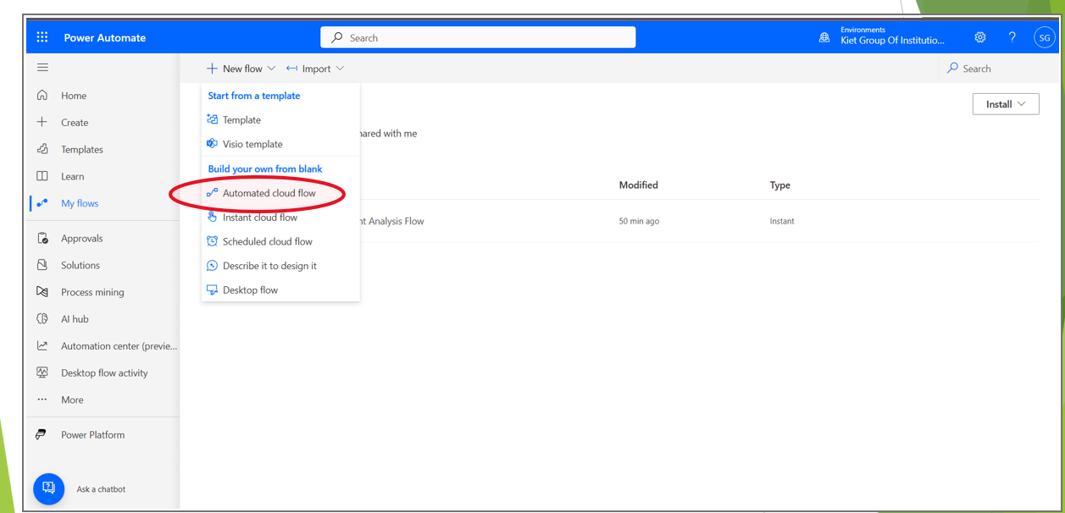
Process Steps The following slides give step-by-step explanation of this project— Create an account in Power Automate and select Automated Cloud Flow from New Flow in My Flow

Slide 4
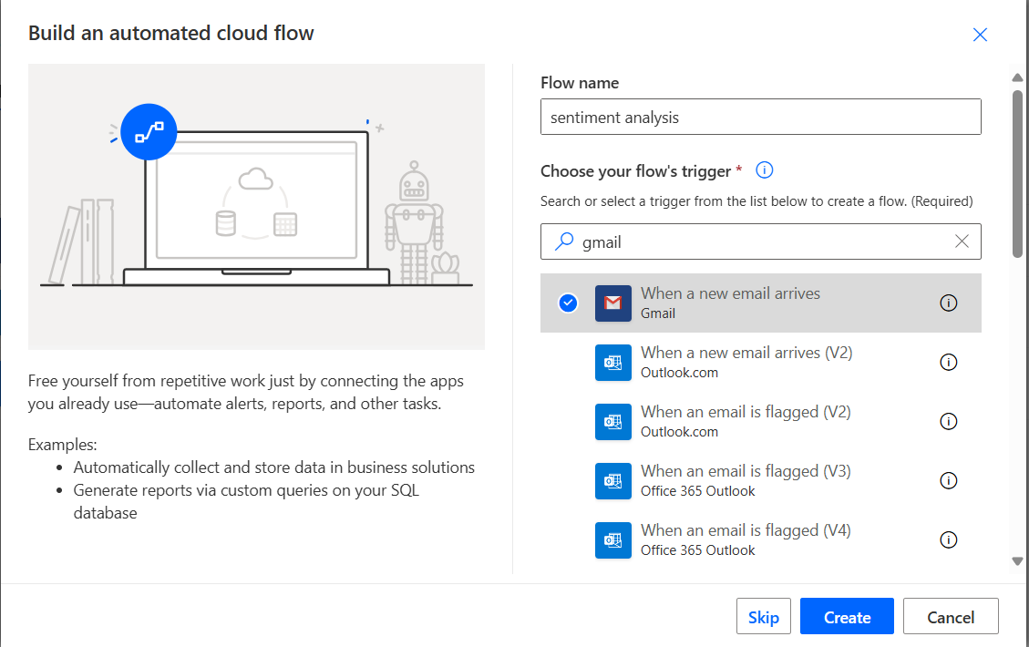
Choose a flow name then select when a new email arrives. Click Create

Slide 5
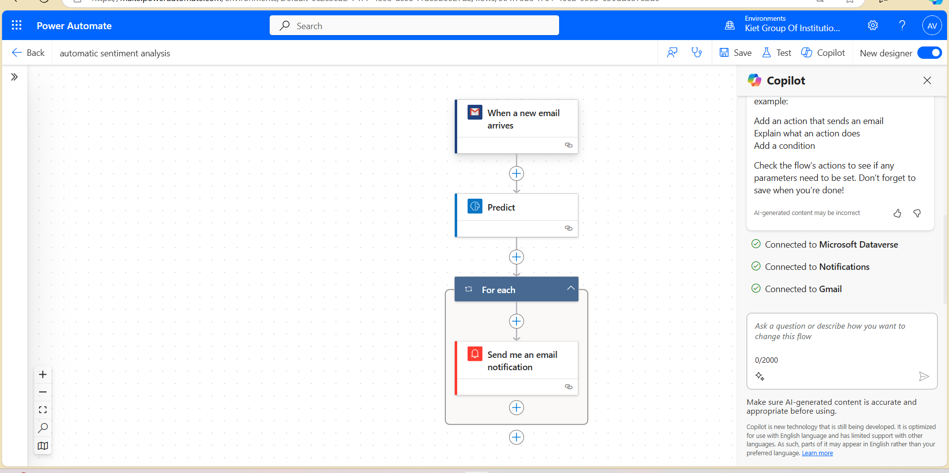
After creating a work flow for sentiment analysis, it will look like this

Slide 6
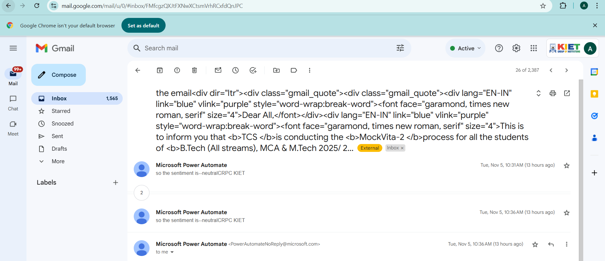
Based on the sentiment, customized notifications are sent through email or integrated apps to notify the responsible teams.

Slide 7
CONCLUSION
Automation Benefits: This project shows how Power Automate simplifies sentiment analysis, saving time and improving response efficiency.
Real-Time Insights: Automated sentiment detection allows for quick actions based on customer or team feedback.
Future Potential: Expanding data sources and refining analysis can enhance the accuracy and value of insights.

Slide 8
THANK
YOU!

