Slide 1
Presented by- Amisha Verma Roll no.- 2300290100040 Branch- CSE Section- A
Text Generation with GPT-2

Slide 2
Introduction to Text Generation
What is text generation? Briefly explain the concept of automatically generating human-like text.
Applications: Highlight a few real-world applications of text generation, like chatbots, story writing, code generation, etc.
GPT-2: Introduce GPT-2 as a powerful language model developed by OpenAI for text generation.

Slide 3
Project Implementation
Libraries Used: Mention the key libraries used in the project, like transformers, tensorflow, and gradio.
Model Loading: Briefly explain how the pre-trained GPT-2 model and tokenizer were loaded.
Text Generation Function: Explain the generate_text function, including input processing, beam search for generating text, and output formatting.

Slide 4
Gradio Interface
User Interface: Showcase the Gradio interface used for interacting with the model.
Input and Output: Describe the input textbox for user prompts and the output textbox for generated text.

Slide 5
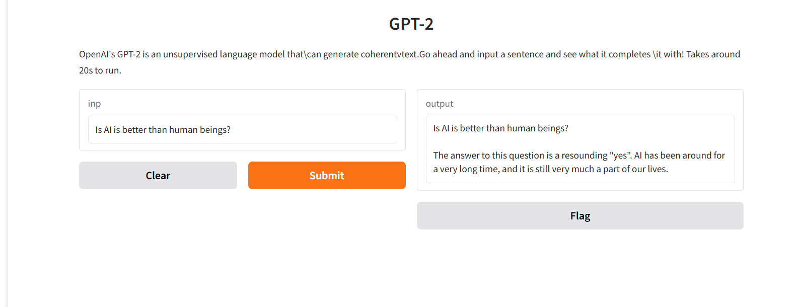
DEMO

Slide 6
THANK YOU

