Slide 1
An Attention-based U-Net Network for Anomaly Detection in Crowded Scenes
Jinpeng Fang, Xinfeng Zhang*, Baoqing Yang, Shuhan Chen, Bin Li

Slide 2
Abstract
Anomaly detection in surveillance video is of great significance for public safety. Deep autoencoder has been widely used in anomaly detection. Because of its good generalization ability, sometimes abnormal samples can still be reconstructed very well.
They introduce an attention mechanism to propose an attention-based U-Net network to detect anomalies. The network adds an attention module before the skip connection of U-Net network, so that the model pays more attention to the foreground targets.

Slide 3
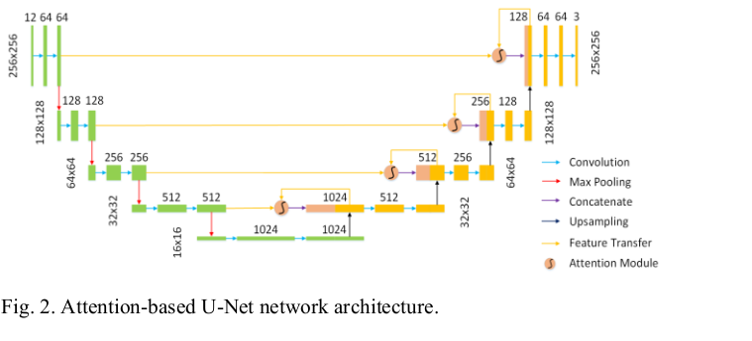
Network Architecture
The proposed anomaly detection encoder-decoder is implemented by U-Net network with an attention module, and the network structure is shown in Fig. 2. The path on the left side of the network corresponds to the encoder; the path on the right side of the network corresponds to the decoder.
In the skip connection, the feature map of each resolution in the encoder and the corresponding feature map in the decoder are sent to the attention module , and then the output of the attention module is concatenated with the corresponding feature map in the decoder.

Slide 4
EXPERIMENT
They tested the proposed attention-based U-Net anomaly detection model on two public real scene datasets: UCSD Ped1 dataset and ShanghaiTech dataset

Slide 5
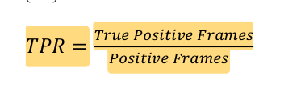
Evaluation Metric
In the work of anomaly detection, the common evaluation metric is the area under the ROC curve, i.e., AUC
Receiver Operating Characteristic (ROC) Curve: This is a common evaluation metric used to measure the performance of binary classifiers. The ROC curve plots the true positive rate (sensitivity) against the false positive rate (1-specificity) at different classification thresholds. The area under the ROC curve (AUC) is used as a measure of the classifier's performance

Slide 6
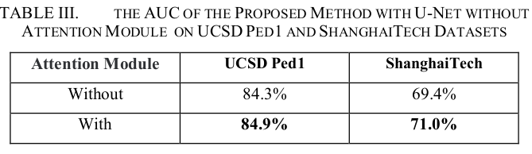
Results
To verify the effectiveness of the attention module in our method, we compare our method with a naive baseline model (based on the U-Net model without attention module) on UCSD Ped1 and ShanghaiTech datasets. From this TABLE we can see that their method with attention module achieves a higher AUC than that without attention module.

Slide 7
Conclusion
They used continuous video frames as input to the encoder-decoder architecture, and detected anomalies by calculating the difference between the predicted and real frames. The attention module helped the model focus on the foreground targets and improved the learning of normal foreground targets during training.

