Slide 1
W-Net: A Deep Model for Fully Unsupervised Image Segmentation
이스마일 압둘하킴
대학원생-컴퓨터공학

Slide 2
Introduction
Abstract
W-Net Architecture
Experiment
Conclusion

Slide 3

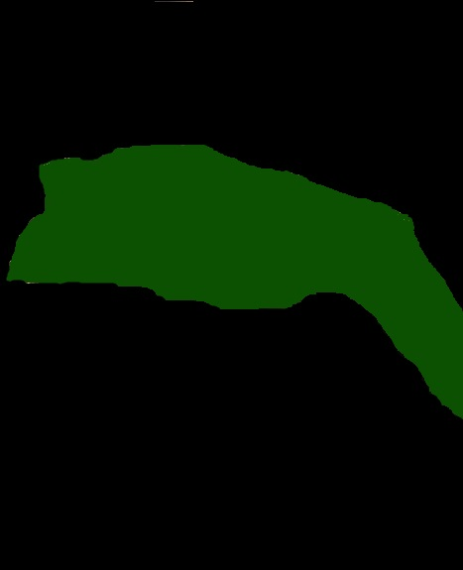
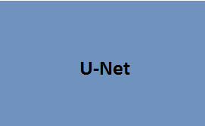
What does a U-Net do?
Learns Segmentation
Input Image
Output Segmentation Map

Slide 4
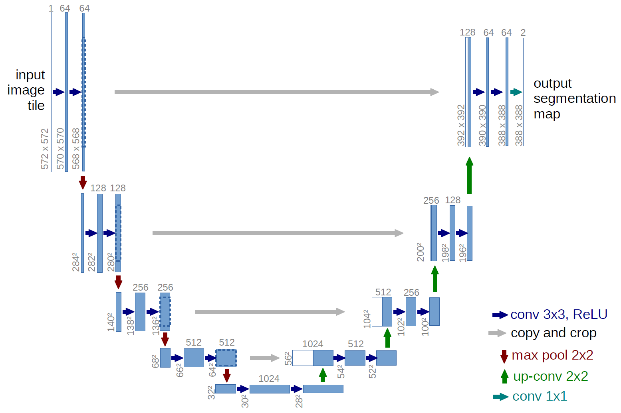
U-Net Architecture
“Contraction” Phase
- Increases field of view
- Lose Spatial Information
Ronneberger et al. (2015) U-net Architecture

Slide 5
U-Net Architecture
“Expansion” Phase
Create High Resolution
Mapping
Ronneberger et al. (2015) U-net Architecture

Slide 6
U-Net Architecture
Concatenate with high-resolution feature maps from the Contraction Phase
Ronneberger et al. (2015) U-net Architecture

Slide 7
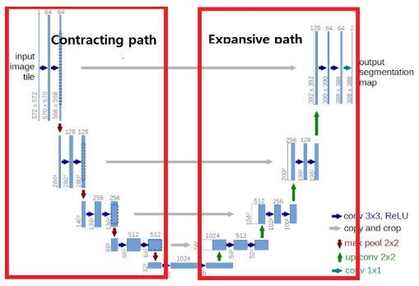
U-Net Architecture
As can be seen from the diagram , U-Net performs 4 times of maximum pooling downsampling , uses convolution for information extraction after each sampling to get feature map and then goes through 4 times of upsampling to recover the input pixel size

Slide 8
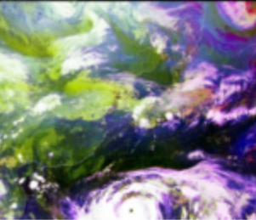
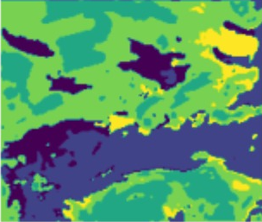
What does a W-Net do?
Learns Segmentation
W-Net Model
Input Image
Output Segmentation Map

Slide 9
Abstract
The objective of this paper is to introduce an unsupervised image segmentation approach called W-NET
As you know Image segmentation is becoming increasingly important because image labeling is time consuming, expensive as well as it is difficult to obtain in novel domains so W-Net can automatically segment images without any labeled data

Slide 10
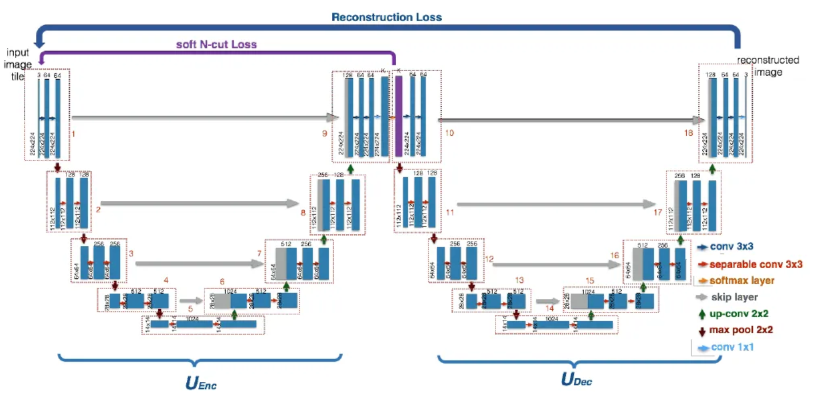
W-Net Architecture
U-Encoder: Outputs image segmentations from the unlabelled original images.
U-Decoder: Outputs the reconstruction images from the segmentations.

Slide 11
W-Net Architecture
The W-Net architecture has 46 convolutional layers which are structured into 18 modules marked with the red rectangles.
Each module consists of two 3 × 3 convolutional layers, each followed by a ReLU non-linearity and batch normalization .
The first nine modules form the dense prediction base of the network and the second 9 correspond to the reconstruction decoder

Slide 12
Losses
To optimize these 2 U-Nets, the paper introduces 2 loss functions. First, A Soft Normalized Cut Loss(soft_n_cut_loss)
a Reconstruction Loss(rec_loss), to optimize both the encoder and the decoder
Soft Normalized Cut Loss :-
The aim of this loss function is to encourage the network to learn the segment the input image into foreground and background regions.
The soft Normalized Cut Loss Involves computing the probability of each pixel belonging to a particular segment based on the dense prediction output of the Encoder.
In Simpler terms, the Soft-Cut loss function aims to simultaneously promote the similarity of pixels within the same segment and discourage the similarity of pixels across different segments.

Slide 13
Losses
Reconstruction Loss
In addition to the Soft-Cut Loss Function , the W-Net paper also uses a reconstruction loss to train the model , the reconstruction loss i s classical encoder-decoder architecture technique that ensures that the encoded representations contain as much information about the original inputs as possible

Slide 14
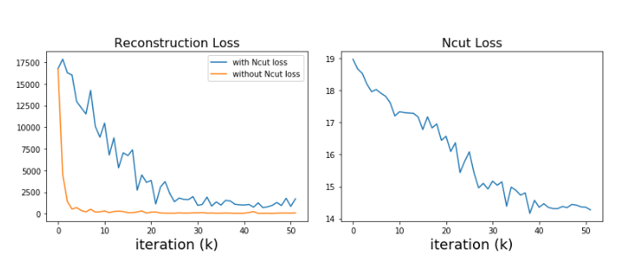
Experiments
They train W-Net on PASCAL VOC2012 dataset and then evaluated the trained network using Berkely Segmentation Database .

Slide 15
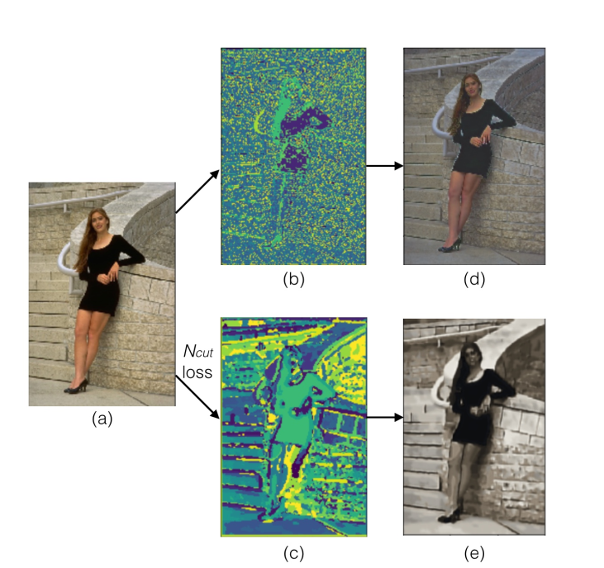
Experiments
A comparison with and without considering sof t−N cut loss during back-propagation

Slide 16
Conclusion
In this paper we introduced a deep learning-based approach for fully unsupervised image segmentation. Our proposed algorithm is based on concatenating together two fully convolutional networks into an encoder-decoder framework, where each of the FCNs are variants of the U- Net architecture.
We believe our method will be useful in cases where it is difficult to obtain labeled pixel wise supervision.

