Slide 1
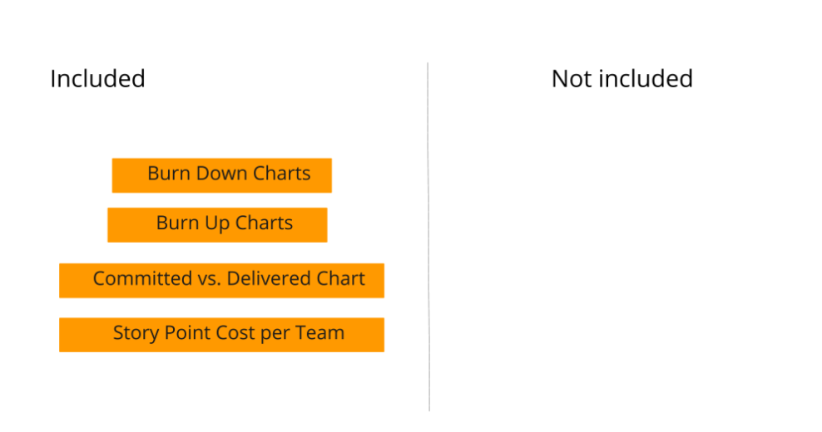
Burn Down Chart: I would use this chart to show the amount of work performed throughout an iteration or project. This way, I can show that the amount of work is decreasing over time and whether we are reaching the goal.
Burn Up Chart: I would use this chart to show the amount of work accomplished throughout an iteration or project. Even if the amount of work increases over time, it can be monitored whether the target has been achieved or not.
Committed vs. Delivered Chart: This chart compares the amount of work committed to the amount of work performed over the course of an iteration or project. In this way, the team's performance in fulfilling its commitments can be demonstrated.
Story Point Cost per Team Chart: This chart shows the cost of each story point to the team throughout an iteration or project. This is used to evaluate the team's ability to estimate and plan the amount of work.

Slide 2
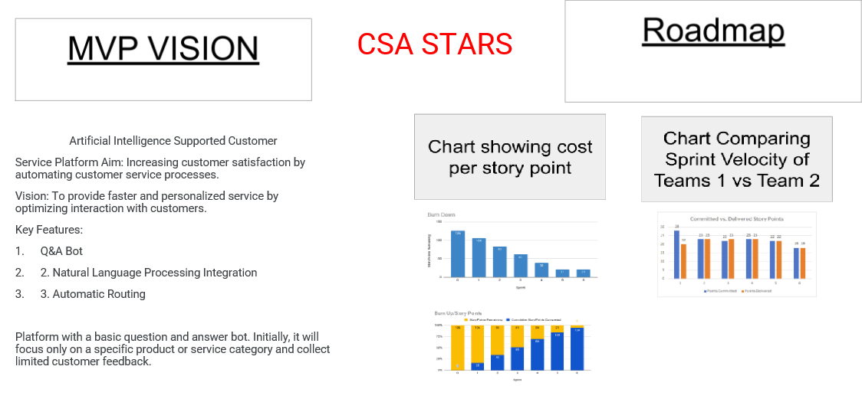

Slide 3
Questions From Management – Q1:
Dear CFO,
Thank you for your feedback. The MVP strategy focuses on the advantages of bringing a product or service to market before it is completely perfect. Our goal is to continually develop and improve our product based on customer feedback.
The MVP approach provides an opportunity to test real-world use of the product and get real customer feedback. This ensures that the final product is more effective and better suited to customer needs.
Perfection is a goal in the process of continuous improvement and iteration. By releasing the first version, we are creating a foundation to further perfect our product based on customer feedback.
I suggest we meet in a more detailed meeting to discuss the long-term benefits of the MVP strategy and review our strategic goals.
Kind regards,
Funda Tan

Slide 4
Questions From Management – Q2:
Dear CMO,
I understand your concern about not completing our plan and the work we have committed to accomplish. During the current period, it was not possible to complete all the work from the backlog due to some changes and priorities.
As a team, we thought we needed to be flexible, taking into account customer feedback and changing needs in the market. That's why we prioritized specific priorities and urgent tasks and focused on work that would have the biggest impact.
However, the flexibility and focus we created during this process did not create a situation that would prevent the completion of the work. We have completed most of the work we planned and continue to move towards our goals.
In the future, we will strive to adhere more closely to the plan through better communication and cooperation.
If you have any concerns or additional questions, please let me know.
Kind regards,
Funda Tan

Slide 5
Questions From Management – Q3:
Dear CEO,
I understand your concern and I would like to share my explanations about the situation.
The decisions we made with our team regarding authorization were taken to meet our project goals and customer expectations. These decisions were taken as a result of discussions and evaluations within the team, taking into account the current situation and resources.
I guarantee that our team members and I do our best to complete all work on time. However, we believe that we must avoid overwork in order to maintain humane working conditions for our employees and maintain their productivity. Constant overwork can have negative effects on productivity and morale and harm long-term success.
Additionally, in some cases, a 24/7 work model can increase the risk of fatigue and errors and jeopardize long-term success. Therefore, we adopted a balanced work plan and effective resource management strategies within the team.
If you would like to provide more details on this topic or have any other questions, please let me know.
Kind regards,
Funda Tan

Slide 6
Questions From Management – Q4:
Dear CTO,
There are several factors to consider when making this decision. First, we need to evaluate the progress we have made over the 6 sprints and how close we are to our goals. If we have completed most of the work necessary to achieve our goals and the remaining work is small-scale and not time-consuming, it may make sense to complete the 7th sprint.
However, if we could not achieve the goals set during 6 sprints or if the remaining work is large-scale and time-consuming, it may be more logical to turn to other priority projects rather than adding an additional sprint to complete the project. In this case, we can contribute more to company goals by using our resources in the most efficient way.
In summary, when deciding whether to add sprint 7 or move on to other projects, we must take into account the results we have achieved, the magnitude of remaining work and the overall priority of the project. When making this decision, we must also consider the company's overall strategic goals and the most effective use of resources.
If any additional information or analysis is required, please let me know.
Kind regards,
Funda Tan

