Slide 1
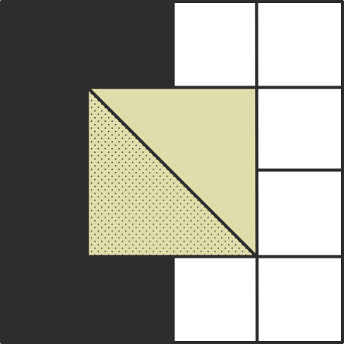

Persistancy Of Drugs
For Data Glaciers
2025 May
Internship - LISUM43
Istiyak Shaikh

Slide 2
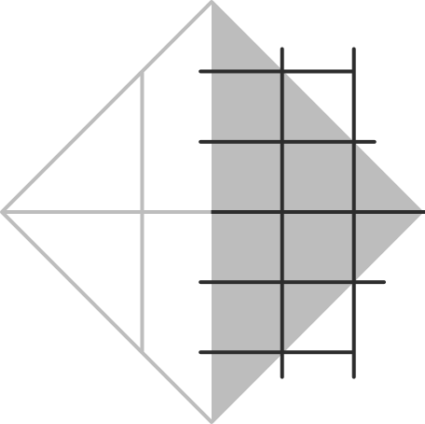

Overview
ABC Pharma wants to understand patient drug persistency—whether patients continue to take their medications as prescribed by physicians. The goal is to build a machine learning model that predicts persistency using patient demographics, clinical history, risk factors, and treatment behavior. Automating this process will help physicians and the pharma company improve adherence strategies and personalize patient interventions.
2

Slide 3

Predicting Patient Drug Persistency for ABC Pharma
Business Goal: Identify patients at risk of non-persistence to improve adherence and personalize interventions.
Value Proposition:
Improve health outcomes
Reduce cost from non-adherence
Enable proactive outreach by physicians
3

Slide 4
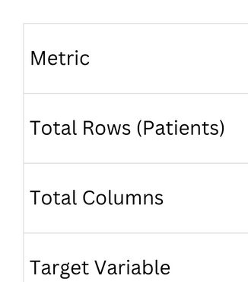
Dataset Summary
4

Slide 5
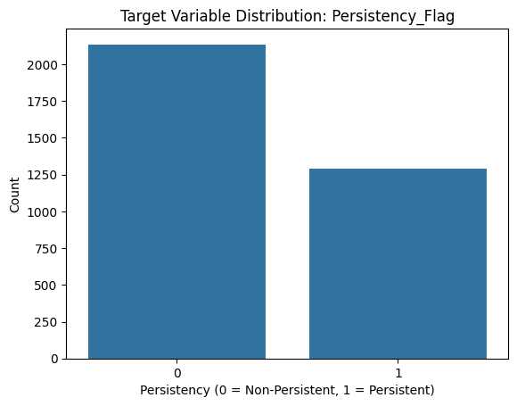
Target Variable Distribution
Persistency Status:
Persistent: 38%
Non-Persistent: 62%
🔍 Observation: The data is imbalanced toward non-persistent patients.
📈 Implication: Business should focus interventions on this larger group.
5

Slide 6
Patient Demographics
Age Buckets: Persistency slightly higher in patients >75 (1400+)
Gender: Large variation (Only 194 male data)
Race & Ethnicity: Certain groups (e.g., Hispanic) show lower persistency (98)
Region: Differences in adherence patterns across regions
Recommendation Consider regional patient support strategies.
6

Slide 7
Risk Factor Impact on Persistency
Estrogen Deficiency → Higher non-persistence
Low Calcium Intake → Imbalanced (‘Y’ - 46 , ‘N’ - 3382)
Recurring Falls → Correlates with lower adherence (‘Y’ - 69 , ‘N’ - 3315)
📌 Suggestion: Integrate clinical risk profiles into outreach targeting.
7

Slide 8
Treatment Behavior Insights
Dexa_Freq_During_Rx: Strong right-skew with outliers
Specialist vs. Non-Specialist: Patients under specialists tend to be more adherent
Treatment Bucket: Certain treatment types show lower persistency
💡 Insight: Treatment behavior is a strong signal for adherence prediction.
8

Slide 9
Outliers & Data Skew
Outliers: Detected in Dexa_Freq_During_Rx, winsorized or log-transformed
Skewed Features: Addressed via transformations
Missing Values: None (dataset is clean)
✅ Confidence: Data is model-ready after transformation and encoding
9

Slide 10
Technical Slide – Model Recommendation
Recommended Model: Gradient Boosting + SHAP
Best performance on hold-out set
SHAP values used for feature-level interpretability
Aligns with business need for actionable insights
10

Slide 11
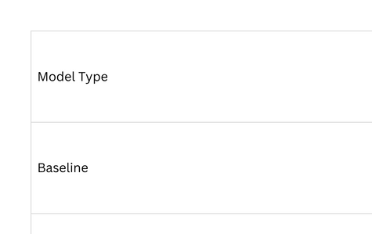
Technical Slide – Model Recommendation
11

Slide 12
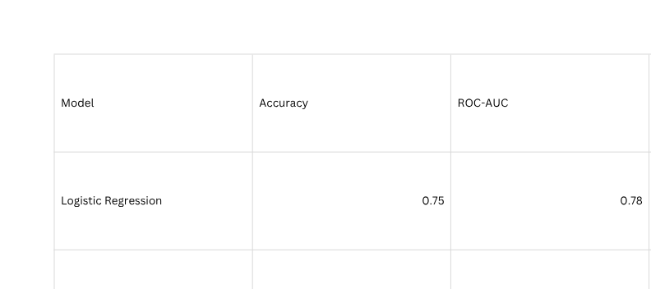
Model Selection & Logistic Regression Findings
Model Comparison Table
12

Slide 13
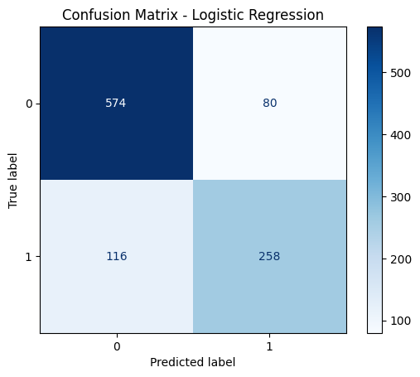
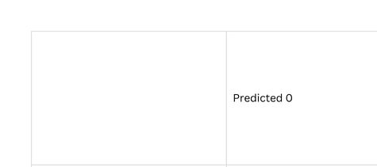
Logistic Regression Model Findings
Confusion Matrix
13

Slide 14
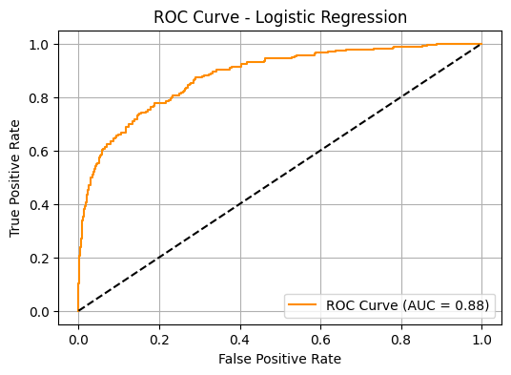
Logistic Regression Model Findings
AUC (Area Under Curve)
= 0.88 — This is quite good.
It means:
There's an 88% chance the model ranks a random positive example higher than a random negative one.
14

Slide 15
Logistic Regression Model Findings
The logistic regression model helps physicians identify patients likely to persist with their medication, enabling more personalized and effective care plans.
High interpretability of logistic regression ensures transparency, making it ideal for regulatory compliance and clear communication with stakeholders.
This transparency builds trust with healthcare providers and supports informed decision-making based on understandable model outputs.
15

Slide 16

Model Selection & Logistic Regression Findings
Model Comparison Table
16

Slide 17

Our Team
Istiyak Shaikh
Data Scientist
17

Slide 18

Thank you

