Slide 1
GENUINE SPARES
for
GENUINE SPARE PARTS
submission date:12-01-2023
By:
Kathirvel R
Prathap S
Aravindh S
Kishore S
Vishva R
Kiruthikadharshini S
Mahalakshmi M
SUPERVISOR
S.Radhika, M.E.,

Slide 2
INTRODUCTION
The project aims to provide details about Maruthi suzuki spare parts. This project hold limited features, over a period of a time,new and new functionalities will be added to the site.

Slide 3
PURPOSE
The purpose of the project is to know all the details about maruthi suzuki spare parts. This is specially made for Maruthi suzuki cars only.This document will be used by all developers and test engineers.

Slide 4
SCOPE
The scope of the project is to learn all the spare parts details about the maruthi suzuki cars.This is specially made for “Maruthi suzuki cars only”.

Slide 5
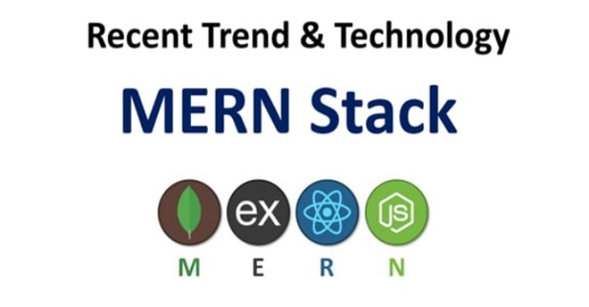
MERN

Slide 6
INTRODUCTION Of MERN Stack
MERN stands for Mongo DB ,Express, React, Node, after the four technologies that make up the stack that is used for easier and faster deployment of full- stack web applications.
Mongo DB- Document database
Express(.js)-Node.js web framework
React(.js)-a client-side javascript library
Node(.js)-the premier javascript web server

Slide 7
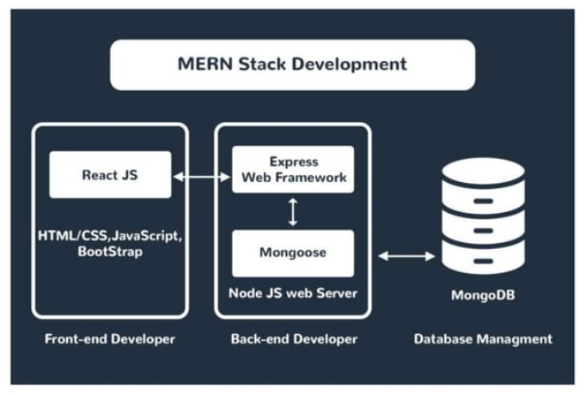

Slide 8
How does the MERN stack work?
The MERN architecture allows you to easily construct a 3-tier architecture ( fronted, backend, database) entirely using javascript and JSON.

Slide 9
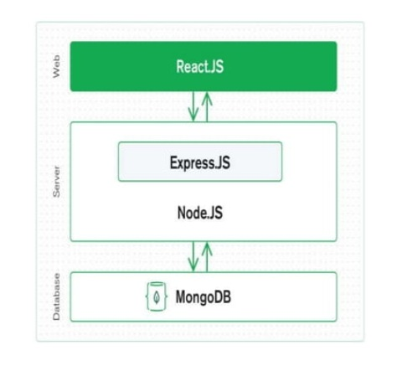

Slide 10


Slide 11
MongoDB
No SQL database used for high-volume data storage.
Open-source document –oriented database.
Mongo DB is written in C++.
It stores data in JSON format.
Can be easily used with Node.
Mongo uses BSON to query database.
Documents containing key-value pairs are the basic units data in Mongo DB

Slide 12
Why Mongo DB?
FAST- Being a document –oriented database, easy to index documents. There fore a faster response .
Scalability-Large data can be handled by dividing by dividing it into several machines.
Use of javascript-Mongo DB uses javascript which is the biggest advantage.
Schema Less-any type of data in a separate document.
Data stored in the form of JSON.
Simple Environment setup- its really simple to set up Mongo DB.

Slide 13


Slide 14
NODEJS
Javascript run-time environment built on chrome’s V8 javascript.
Node.js allows you to run javascript on the server.
It is free& open source, written in C++.
Ryan Dahl developed Node.js 2009.He embedded C++ code with chrome’sV8 Engine and gave the name as Node.js.
Node.js runs single- threaded, non-blocking, asynchronous programming, which is very memory efficient.

Slide 15
Where to use NODEJS?
Back –end services such as AP ls.
Highly scalable, data-intensive and real-time apps.
I/o bounds applications.
Single page application.

Slide 16
Where not to use Nodejs?
Node.js is not used in CPU-intensive apps which requires calculations done by CPU.

Slide 17


Slide 18
ExpressJS
Flexible Node.js framework that provides robust set of features for web and mobile application.
It provides easy routing of requests based on
HTTP methods and URLs.
It allows to set up middlewares to respond to
HTTP requests
Allows to dynamically render HTML pages based on passing arguments to templates.

Slide 19


Slide 20
REACTJS
A javascript library for building user interfaces for web and mobile applications.
React is used to build single- page applications.
React allows us to create reusable UI components.
React-router to handle the front –end routing.
React was created by jordan walke ,a Software Engineer at Facebook.

Slide 21
Why to use React?
JSX( javascript XML) makes it easier and simpler to write React components.
React js supports components. These components also promote code reusability and make the overall web application easier to understand and debug.

Slide 22
How does React Work?
Instead of manipulating the browser’s DOM directly, React creates a virtual DOM in memory , where it does all the necessary manipulating, before making the changes in the browser DOM.
React finds out what changes have been made and changes only what needs to be changed.

Slide 23
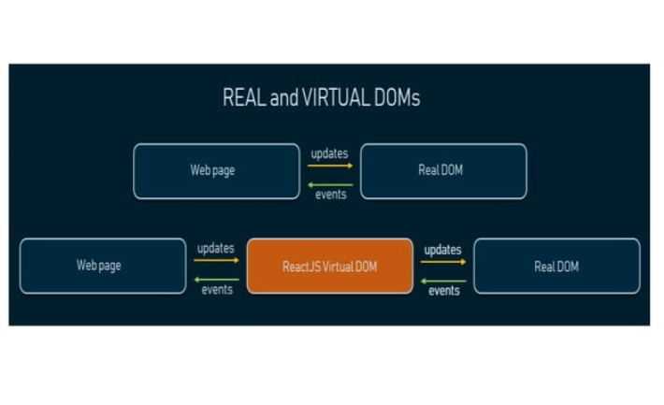

Slide 24
MODULE DESCRIPTION
HOME :
Home
Company details
Account
Products
About

Slide 25
REGISTER
First name
Last Name
Mail id
Password
Sign up

Slide 26
CUSTOMER LOGIN
Email id
Password
Sign in

Slide 27
CHANGE MANAGEMENT PROCESS
Once the SRS created and it is implemented to the project work. If there is any changes in the project work like bug, error and defects etc the SRS document also changed based on the project work done.
The SRS document will be changed by the testing engineer and client providing instructions.

Slide 28


