Slide 1
ELUCIDATING DRUG-DRUG INTERACTIONS UNDERLYING DRUG POLYPHARMACY PROFILES
UNIVERSITY OF COPENHAGEN
FACULTY OF HEALTH AND MEDICAL SCIENCES

Slide 2
Project description
First phase -> recollect DDIs information from public databases.
Treat and tidy data -> Linkage network between features
Integrate drugs and DDIs merging datasets.
Stablish a dataset that relates all identifiers.

Slide 3
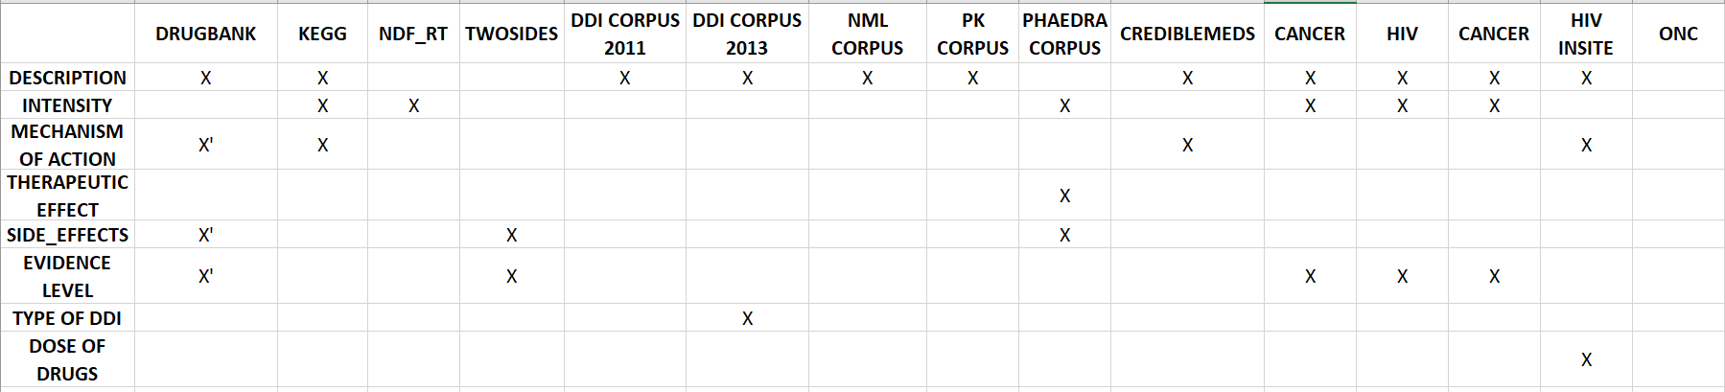
FEATURE TABLE

Slide 4
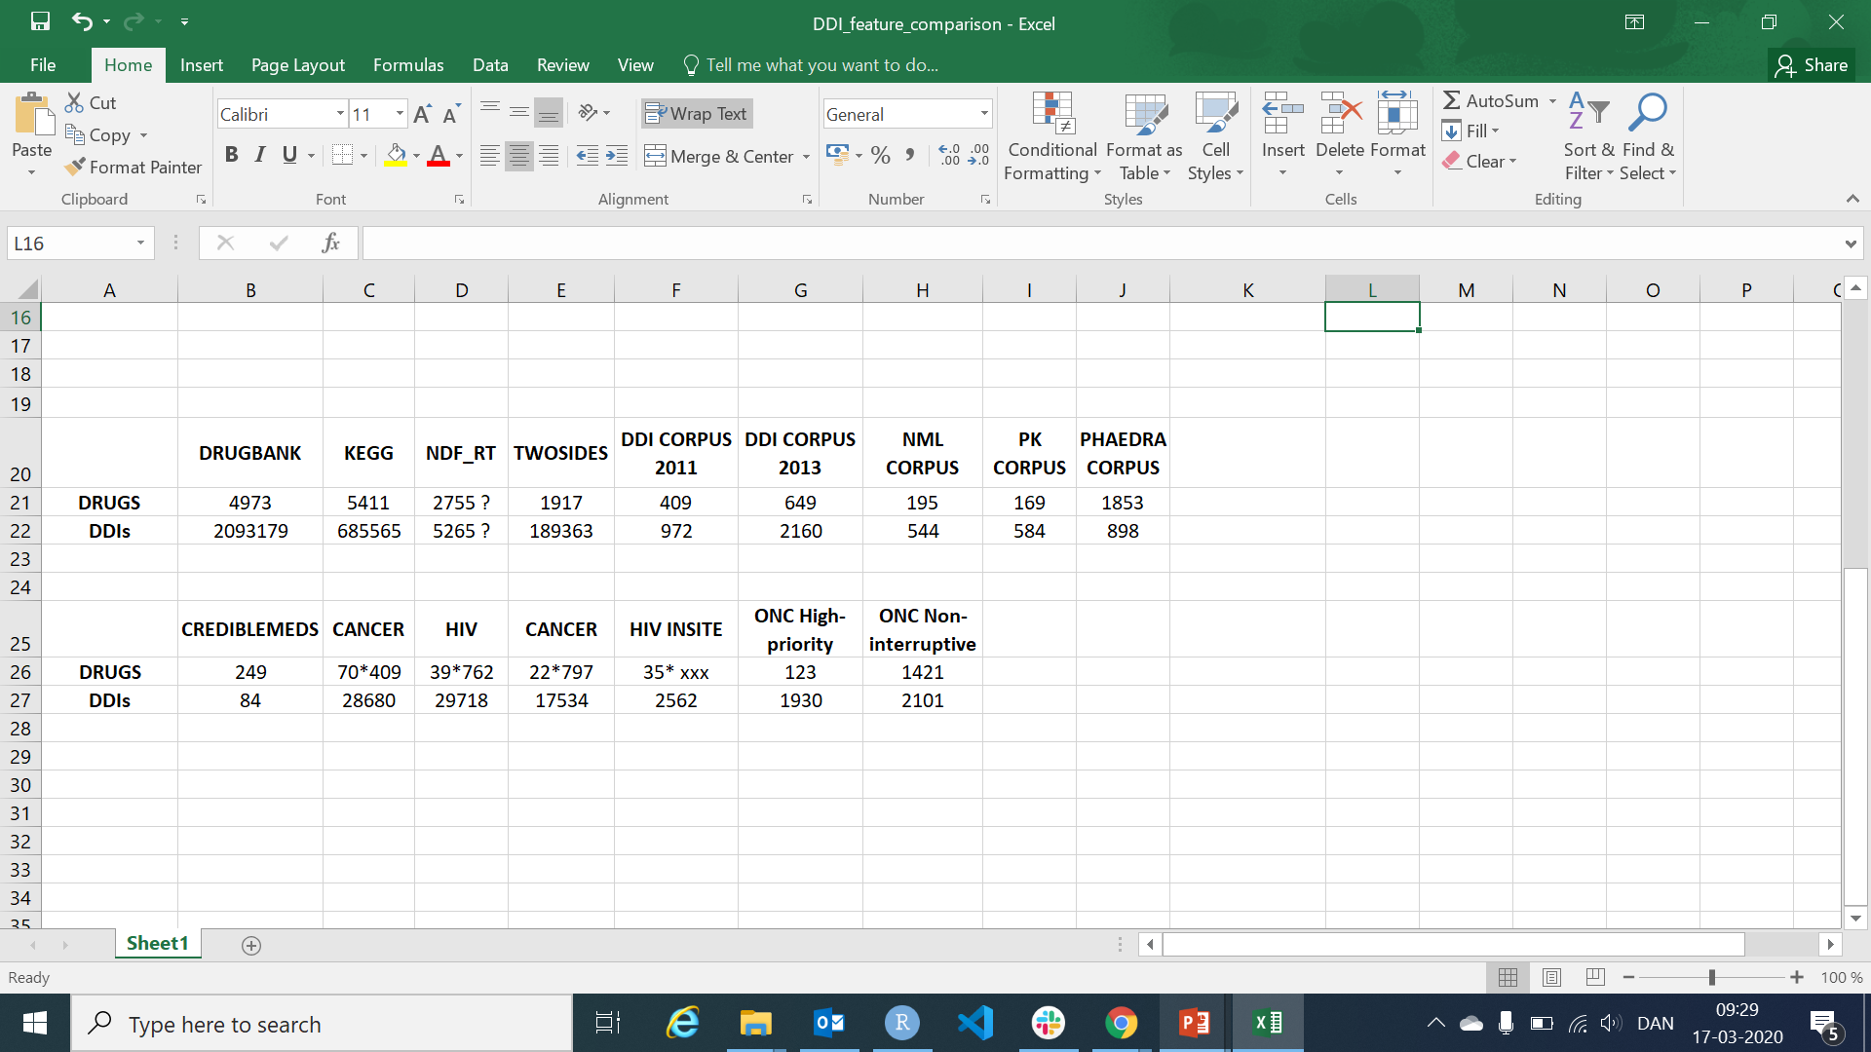
CONTENTS

Slide 5
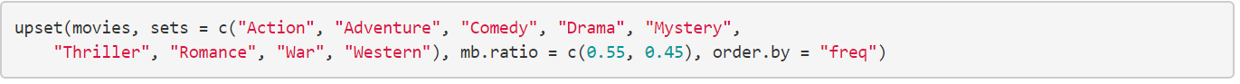
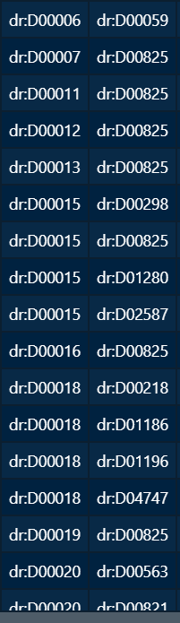
UPSETR AND IDENTIFIERS
Vector of lists ?
Library of DDIs

Slide 6
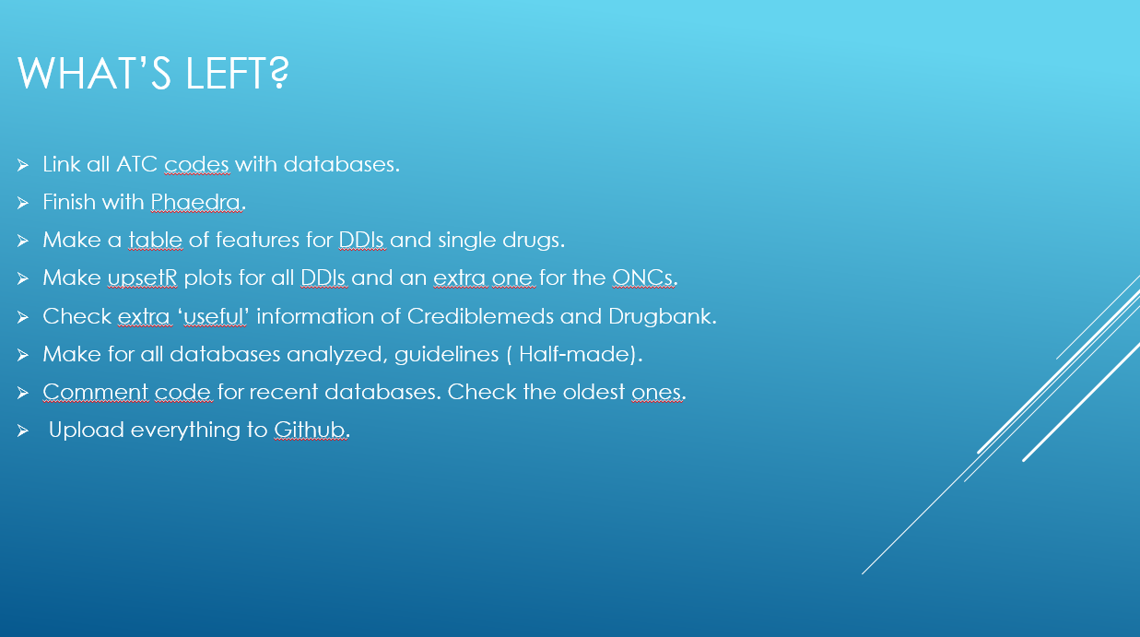
FOR NEXT WEEK
Finish the work of last week
Start with the basic ideas of analysis we discuss.

