Slide 1
ELUCIDATING DRUG-DRUG INTERACTIONS UNDERLYING DRUG POLYPHARMACY PROFILES
UNIVERSITY OF COPENHAGEN
FACULTY OF HEALTH AND MEDICAL SCIENCES

Slide 2
Summary
Part I Building a compendia of DDIs information from public databases
Part II Comparison between the different data sources: scattered DDI knowledge
Part III Evaluation of the frequency of DDI in clinical practice using Electronic Health Records

Slide 3
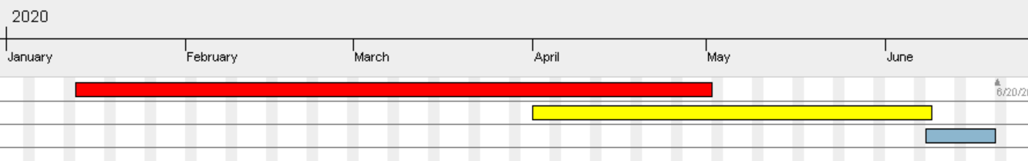
TIMELINE
Reading papers
Extracting and tidying data.
Part II
Part III
Phase 1; DDI Compendia
Phase 2; Computational analysis
Phase 3; TFG

Slide 4
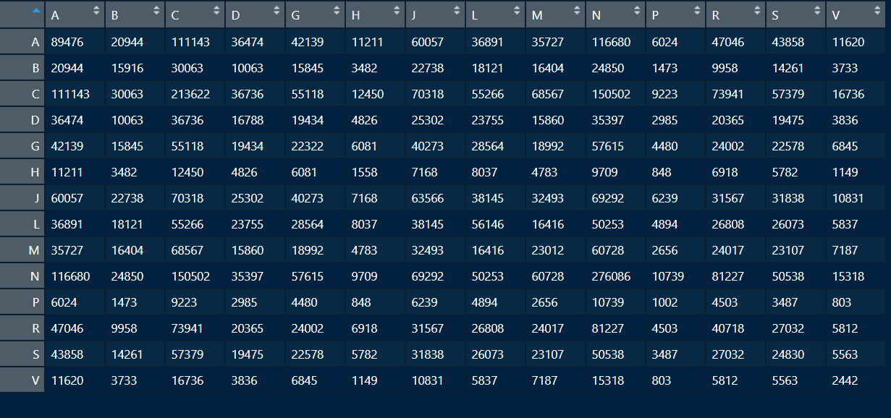
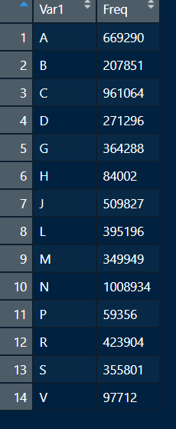
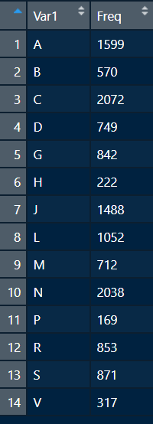
Displaying times of DDI between level 1 of ATC
Over-represented
%
Times appearing in DDIs
Seize of each level
x
Each pair of level 1 ATC

Slide 5
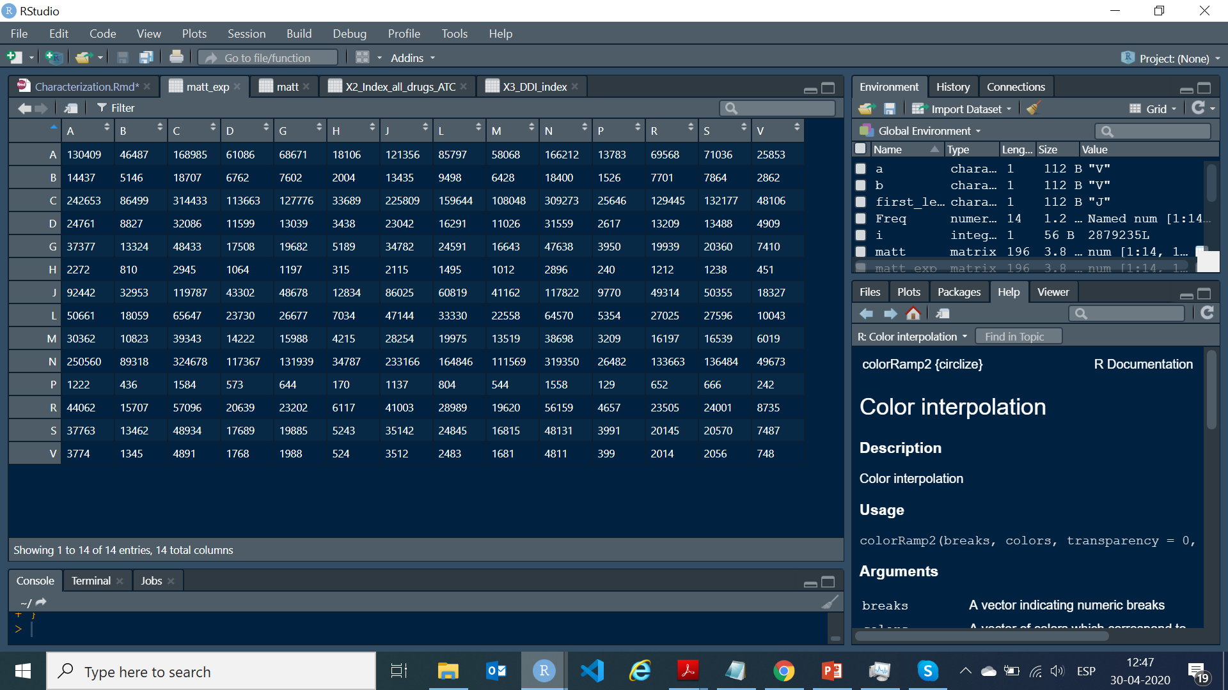
Matt_expected[A,B] = Freq(A) * 1/Total * (Size_level(A) / average(Size)) * (Size_level(B) / average(Size))
Nº interactions
Number of different ATCs
Importance of drug A
Importance of drug B
Variables
matt_observed
Size_level
Freq_level
Number of 1 level ATC -> Total

