Slide 1
ELUCIDATING DRUG-DRUG INTERACTIONSUNDERLYING DRUG POLYPHARMACY PROFILES
Jorge Hernansanz

Slide 2
INDEX
Outline of first phase of the project
Updates
Drugbank
KEGG
NDF-RT
TWOSIDES
DDI CORPUS 2013, 2011
New ones
ONC high, non-interrumptive
Crediblemeds
PK curpus, NLP corpus
What’s left?

Slide 3
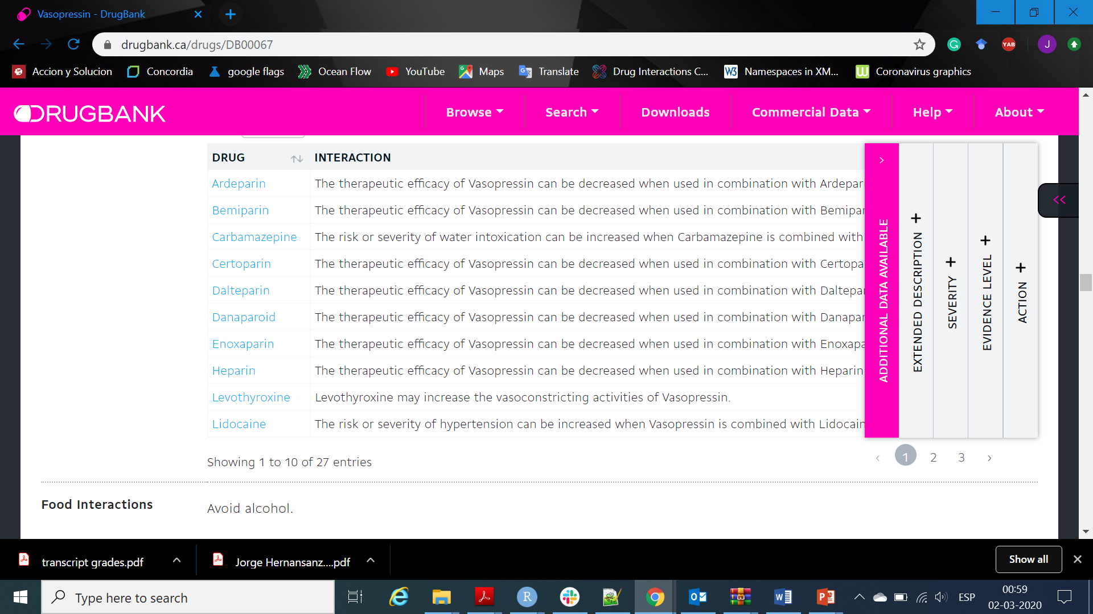
DRUGBANK
DRUGBANK:
4264 drugs
2093179 interactions

Slide 4
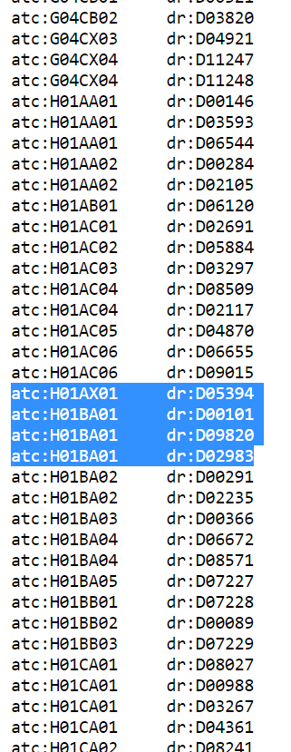
KEGG
New list of pathways and disease associated to each drug
Drugs mapped to chemical group (Same as Drugbank)
KEGG:
2859 drugs
310897 interactions

Slide 5
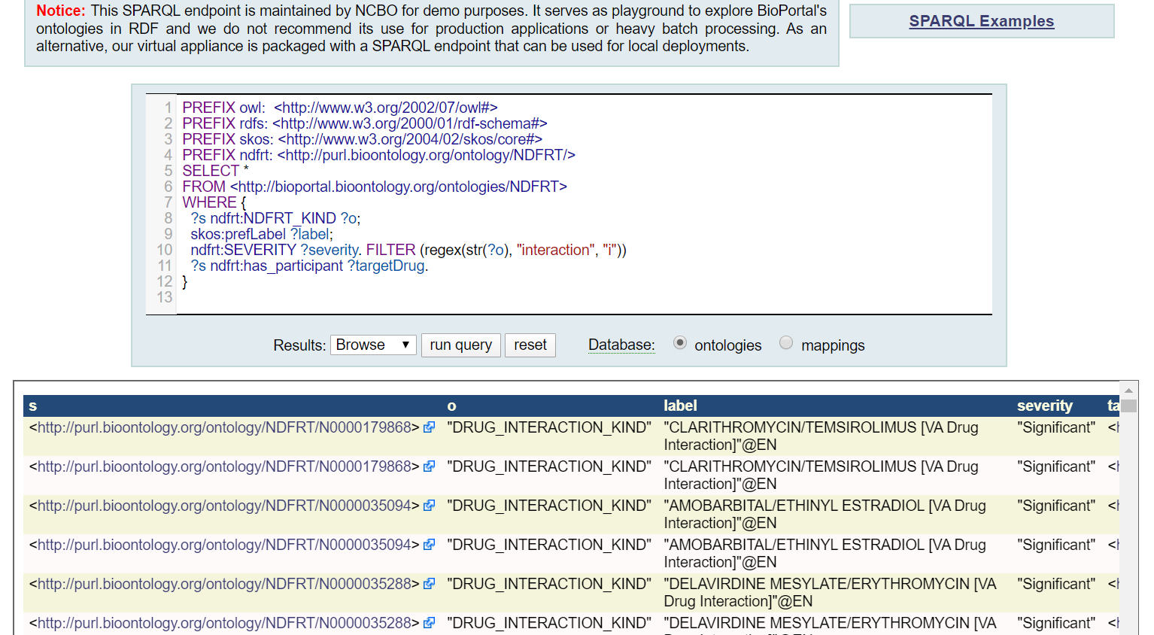
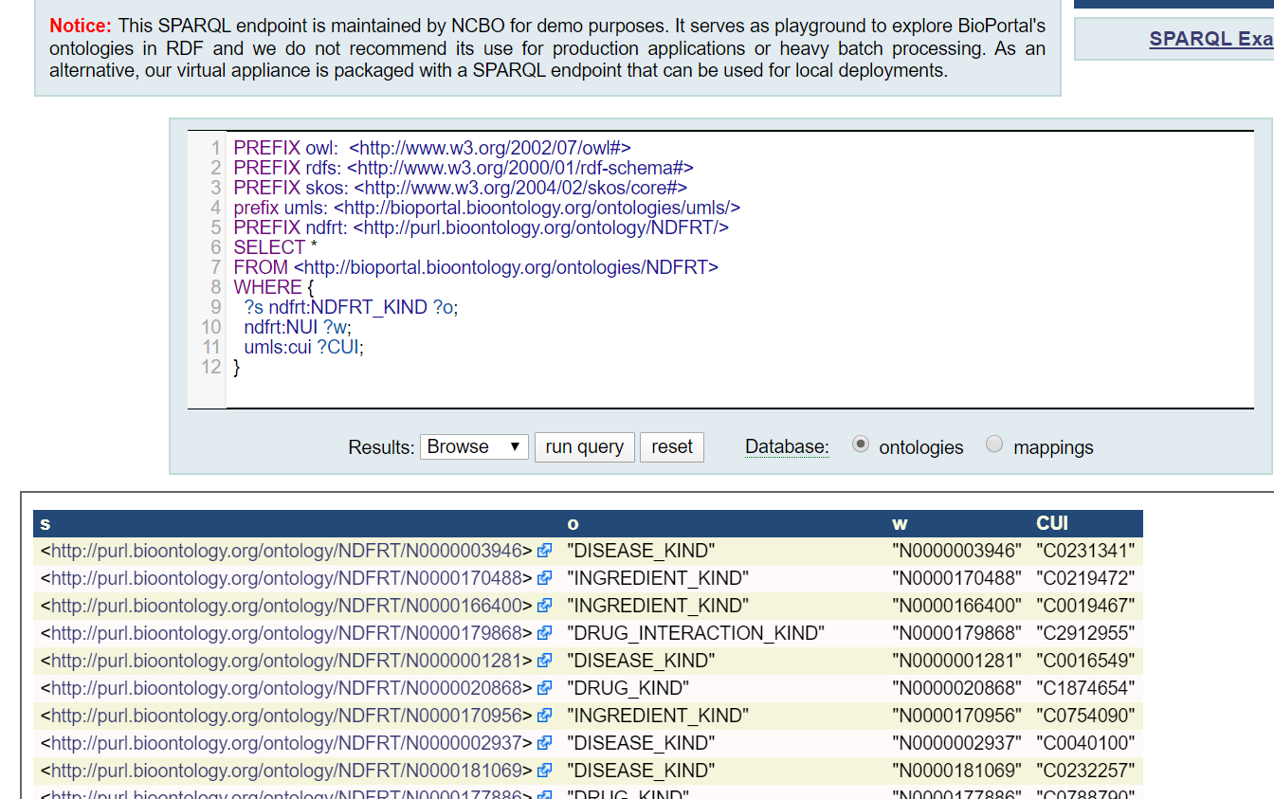
NDF-RT
Actualized to 2018
MED-RT ?
Information about physiological effect, mechanism of action, and structural class ( For individual drug).
NDF-RT:
1206 drugs
4354 interactions
NDF-RT:
4100 drugs
1856 interactions

Slide 6
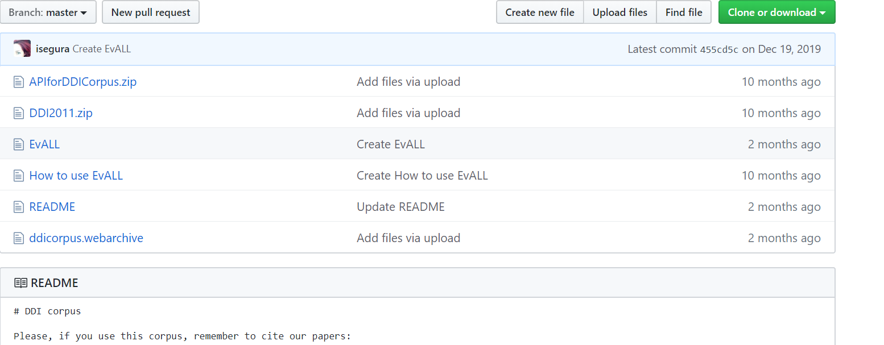
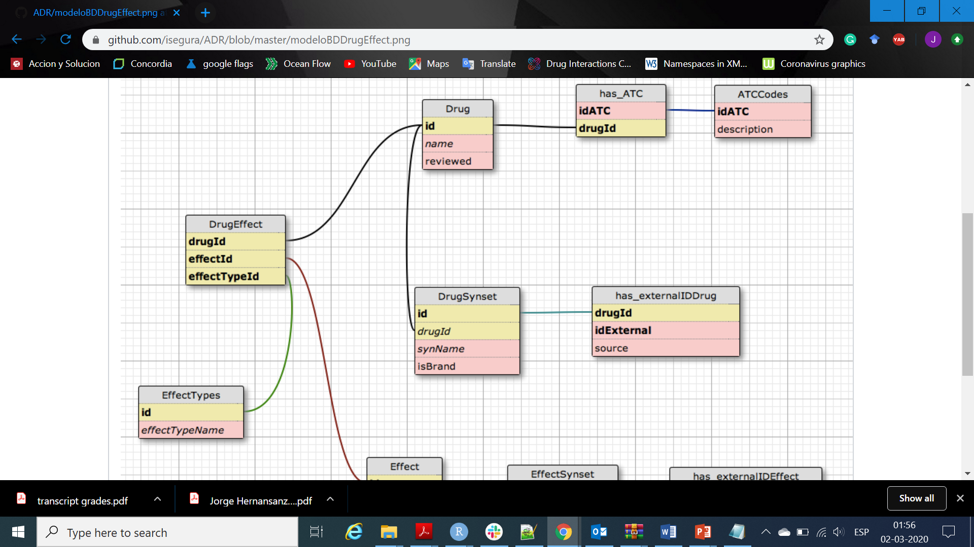
DDI CORPUS 2011, 2013
DDI CORPUS 2013:
649 drugs
2160 interactions
DDI CORPUS 2011:
409 drugs
972 interactions

Slide 7
ONC HIGH, NON-INTERRUMPTIVE
ONC HIGH:
123 drugs
1930 interactions
commercially available medication knowledge bases
Sources of information
PHS MKB
Micromedex
First Data Bank
Drugs.com
Cerner Multum
Medi-Span
ONC Non-interrumptive:
1421 drugs
2101 interactions

Slide 8
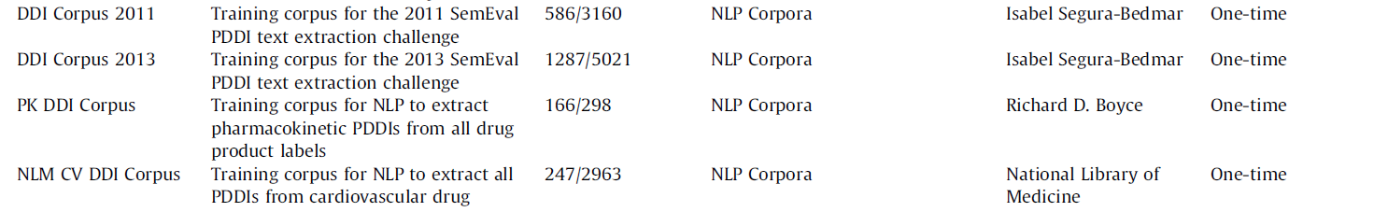
PK Corpus, NLM Corpus
PK Corpus:
169 drugs
585 interactions
NML Corpus:
194 drugs
544 interactions

Slide 9
WHAT’S LEFT?
Micromedex
SemMedDB
OSCAR
DKIB
HEP/HIV interactions
HIV insite interactions
Vigibase
NLM Phaedra
FDA
Danish interaction database

