Slide 1
ELUCIDATING DRUG-DRUG INTERACTIONS UNDERLYING DRUG POLYPHARMACY PROFILES
UNIVERSITY OF COPENHAGEN
FACULTY OF HEALTH AND MEDICAL SCIENCES

Slide 2
Project description
First phase -> recollect DDIs information from public databases.
Treat and tidy data -> Linkage network between features
Integrate drugs and DDIs merging datasets.
Stablish a dataset that relates all identifiers.

Slide 3
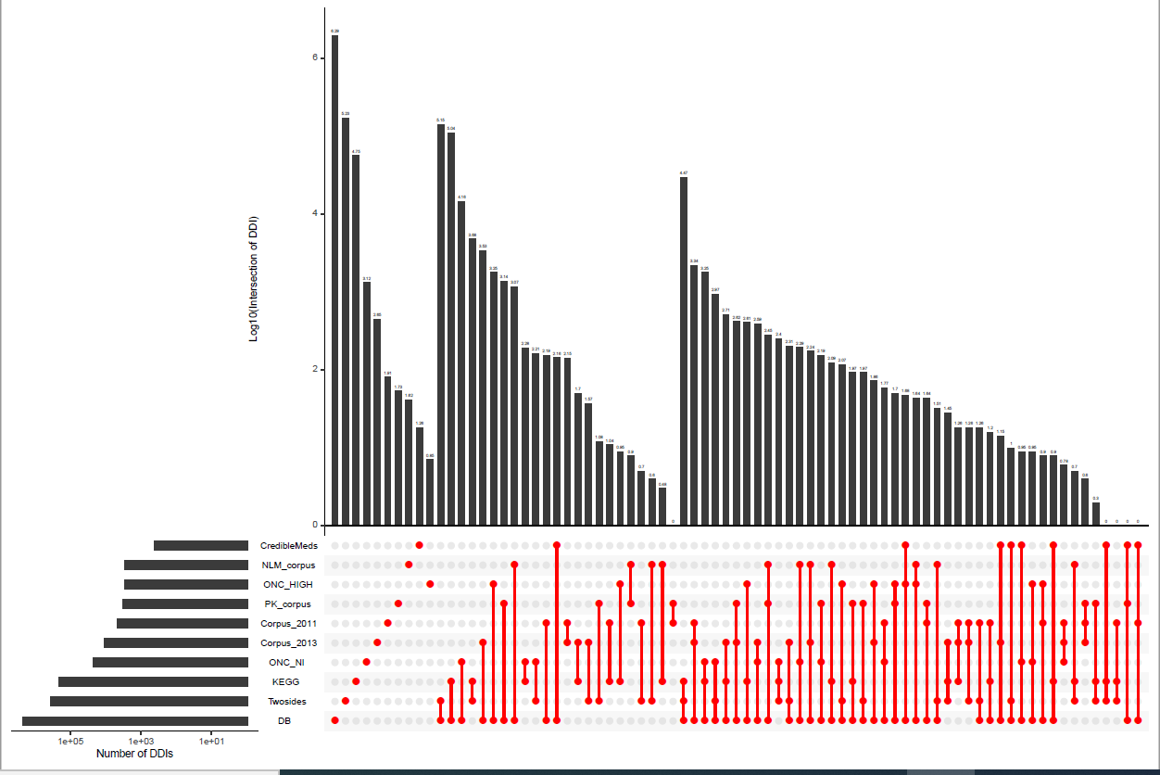

Slide 4
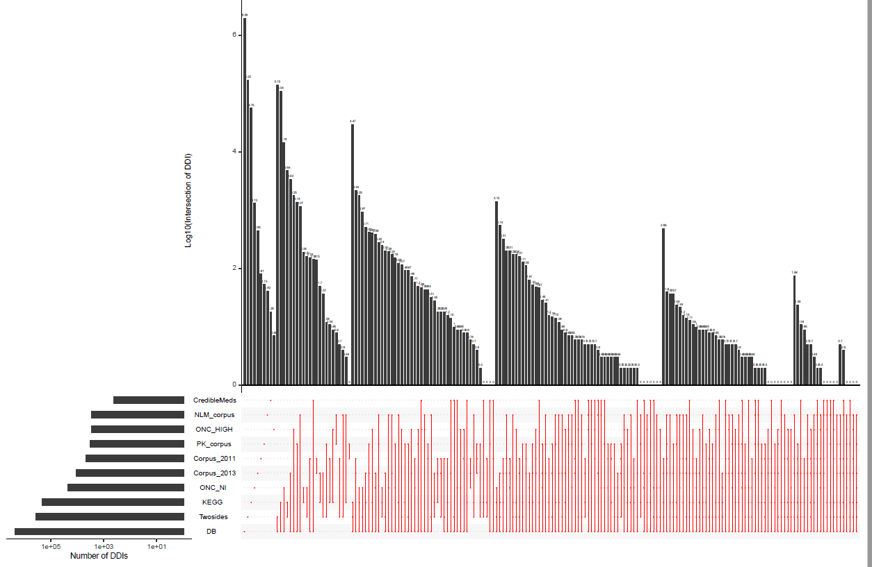

Slide 5
WHAT IS NEXT?
Continue with databases that need to be linked with identifiers.
Continue with report
Future analysis with my data?
.
.
.
.
.
.

