Slide 1
ELUCIDATING DRUG-DRUG INTERACTIONS UNDERLYING DRUG POLYPHARMACY PROFILES
UNIVERSITY OF COPENHAGEN
FACULTY OF HEALTH AND MEDICAL SCIENCES

Slide 2
Summary
Part I Building a compendia of DDIs information from public databases
Part II Comparison between the different data sources: scattered DDI knowledge
Part III Evaluation of the frequency of DDI in clinical practice using Electronic Health Records

Slide 3
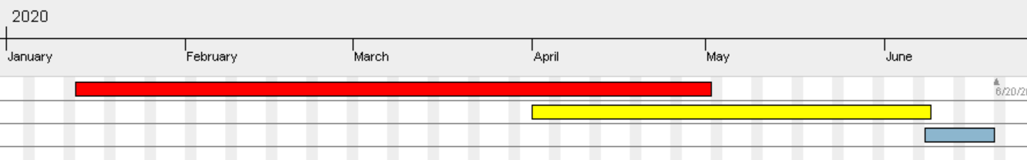
TIMELINE
Reading papers
Extracting and tidying data.
Part II
Part III
Phase 1; DDI Compendia
Phase 2; Computational analysis
Phase 3; TFG

Slide 4
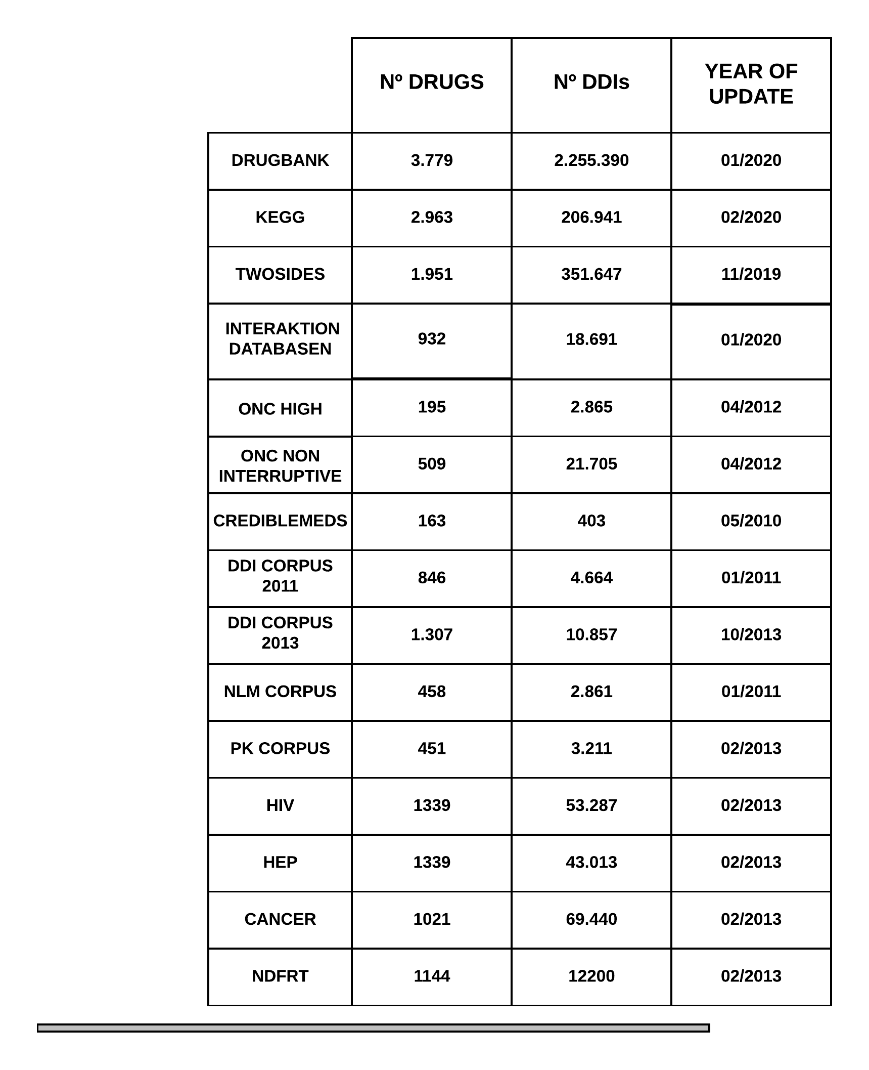
New databases added
From
4.235 unique drugs
2.494.051 unique DDIs
UNIQUE ELEMENTS
4.288
2.558.568

Slide 5
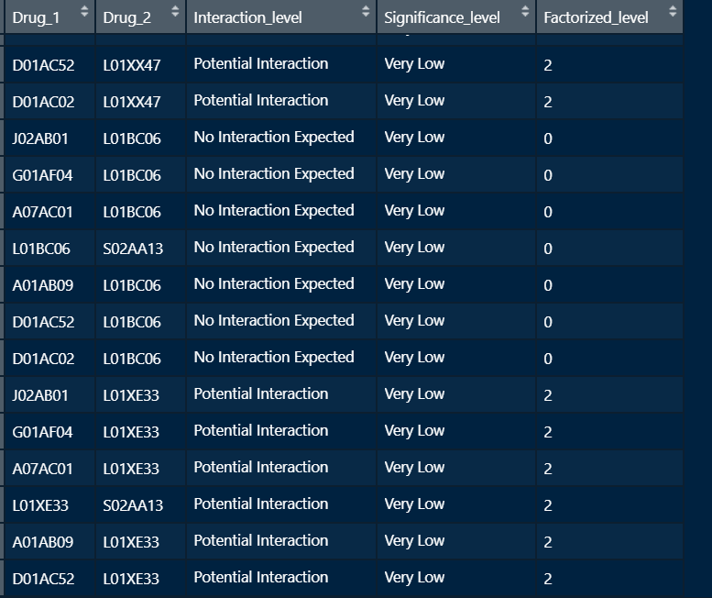
Dataset of interaction level
KEGG
NDFRT
Databasen interaction
HIV
HEP
CANCER

Slide 6
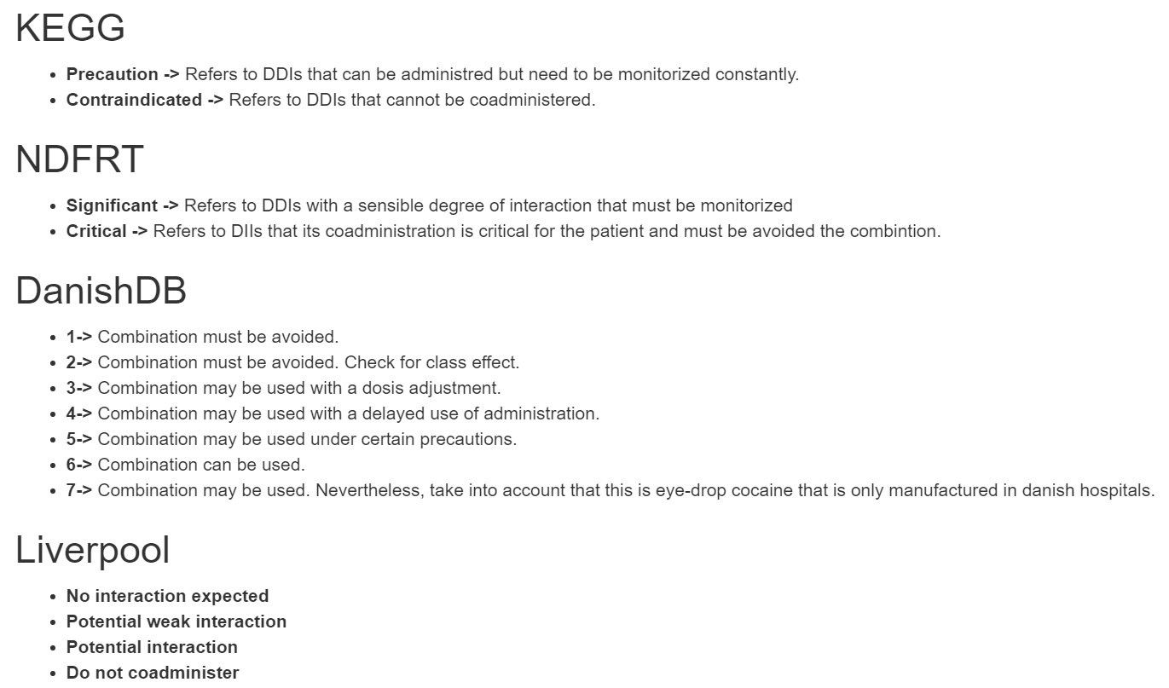
Factorization

Slide 7
CYTOSCAPE

Slide 8
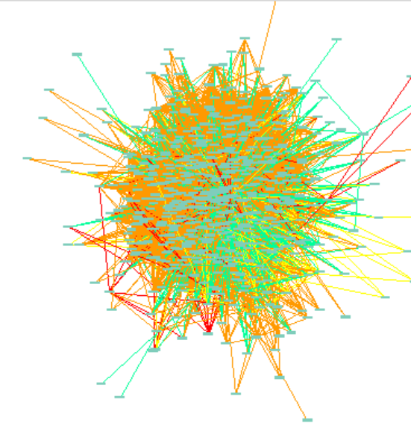
WHAT’S NEXT?
Over-represented
%
x
Each pair of level 1 ATC

