Slide 1
ELUCIDATING DRUG-DRUG INTERACTIONS UNDERLYING DRUG POLYPHARMACY PROFILES
UNIVERSITY OF COPENHAGEN
FACULTY OF HEALTH AND MEDICAL SCIENCES

Slide 2
Project description
First phase -> recollect DDIs information from public databases.
Treat and tidy data -> Linkage network between features
Integrate drugs and DDIs merging datasets.
Stablish a dataset that relates all identifiers.
Second phase -> Comparison between sources.
Visualize data in a global way.

Slide 3
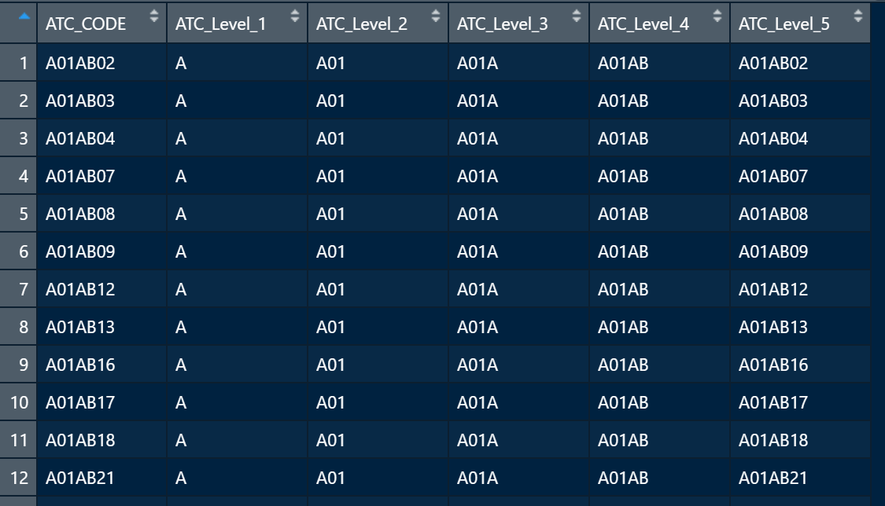
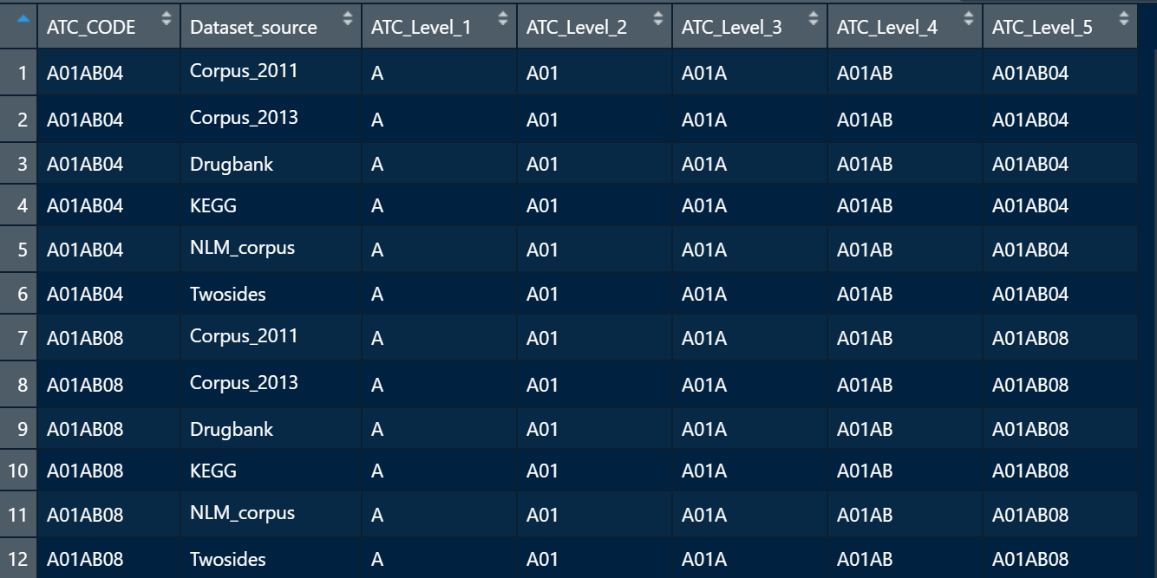
During these days
Creation of various index
Index for 4239 single drugs
Contains full ATC code and its different levels
Index for 13554 single drugs
Contains data source of each drug and its different ATC code levels.

Slide 4
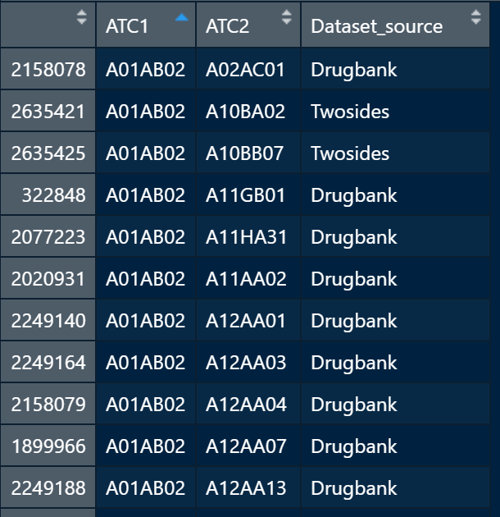
All DDIs unique for each dataset
Contains 2.879.235 when allowing duplicates between databases.
Globally contains 2.494.051 unique DDIs .

Slide 5
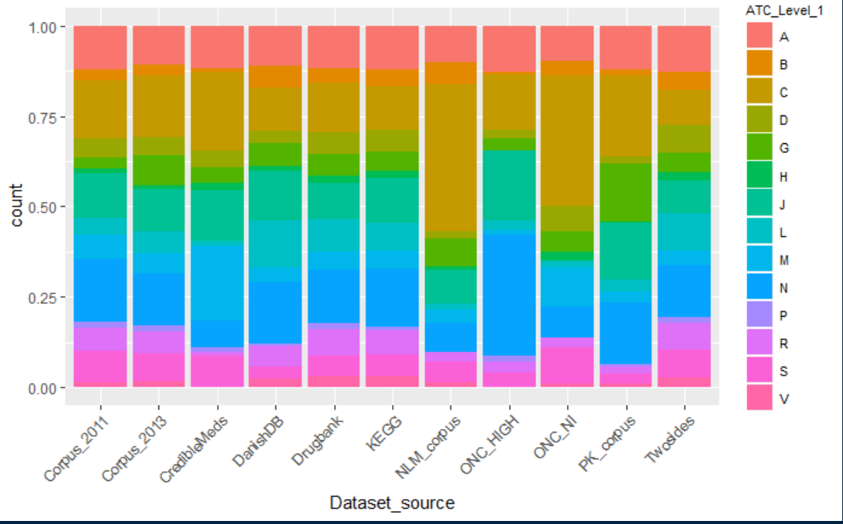
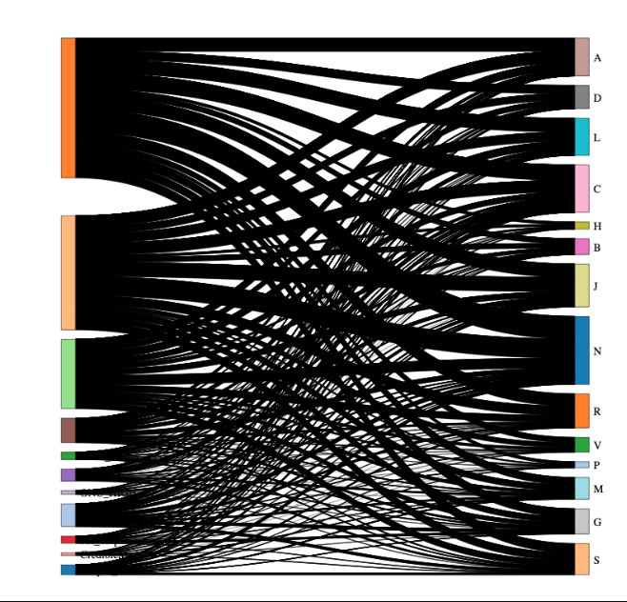
Visualizations
Represents each database with the percentages of ATC codes level 1 that are stored in each of them.
From here would be fine to define a threshold (i.e. 20%) to show specific percentages that are significant.
Sankey diagram between dataset source and first ATC code level. Needs more customization.

