Slide 1
ELUCIDATING DRUG-DRUG INTERACTIONS UNDERLYING DRUG POLYPHARMACY PROFILES
UNIVERSITY OF COPENHAGEN
FACULTY OF HEALTH AND MEDICAL SCIENCES

Slide 2
Summary
Part I Building a compendia of DDIs information from public databases
Part II Comparison between the different data sources: scattered DDI knowledge
Part III Evaluation of the frequency of DDI in clinical practice using Electronic Health Records

Slide 3
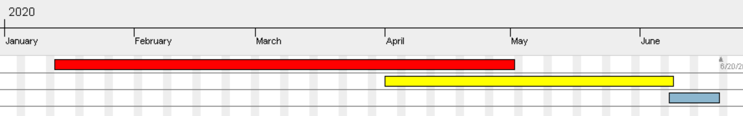
TIMELINE
Reading papers
Extracting and tidying data.
Part II
Part III
Phase 1; DDI Compendia
Phase 2; Computational analysis
Phase 3; TFG

Slide 4
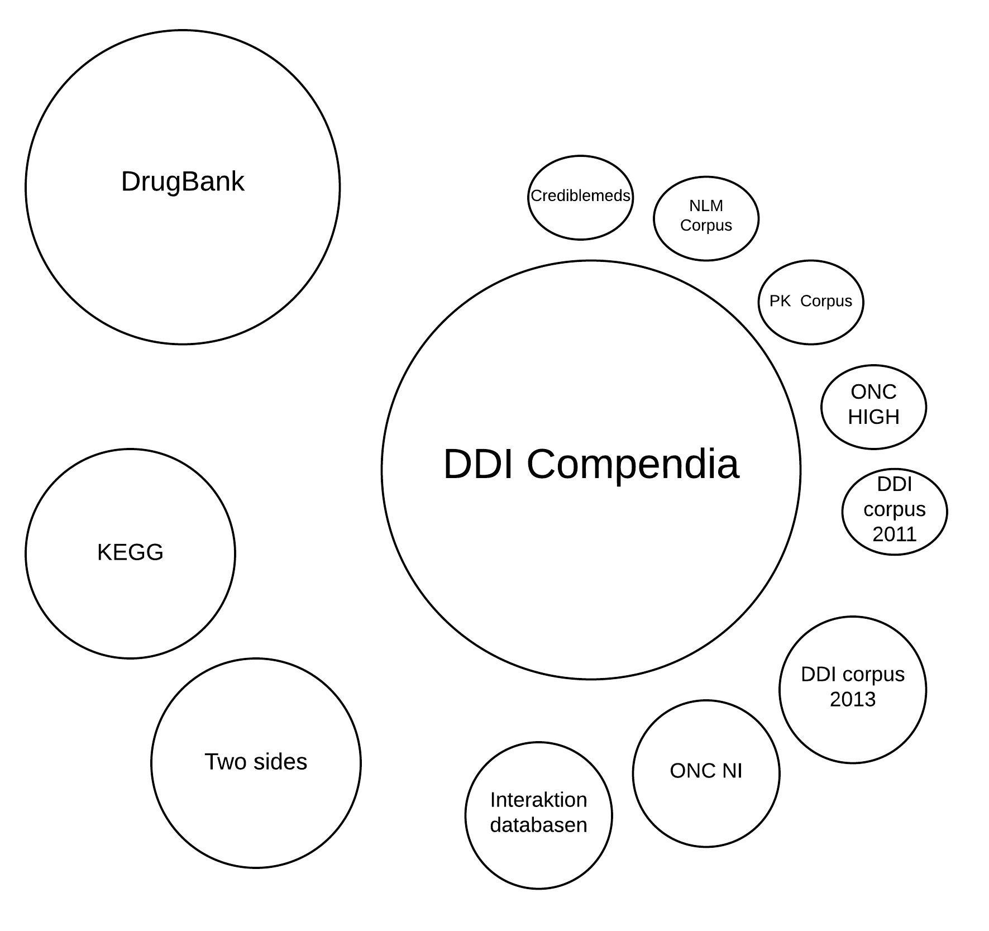
PART I: Building a ddi compendia

Slide 5
DDI Compendia
Databases analyzed
Databases pending
Would be nice
Drugbank
KEGG
Two sides
Crediblemeds
Interaktion_database
ONC-HIGH/NI
DDI Corpus 2011/2013
NLM corpus
PK corpus
HIV-INSITE
HIV interactions
HEP interactions
CANCER interactions
NDF-RT
Phaedra corpus
Flockchart table
SuperCYP
Medscape
Medline
Drugs.com
Rxlist

Slide 7
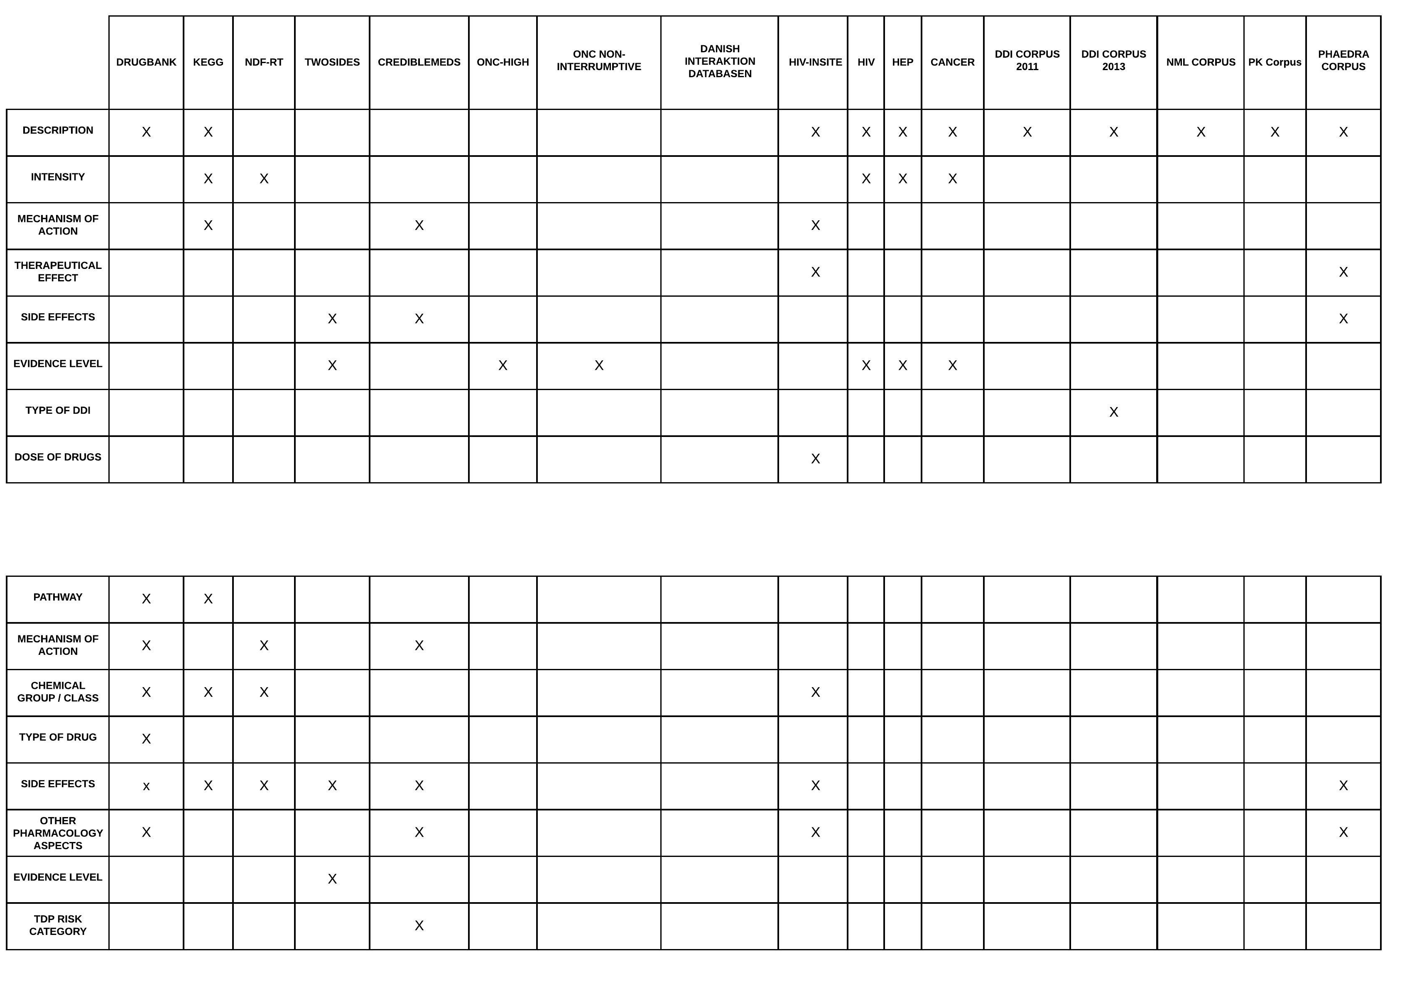

Slide 8
TOTAL NUMBERS
13.554
2.879.235
UNIQUE NUMBERS
4.239
2.494.051

Slide 9
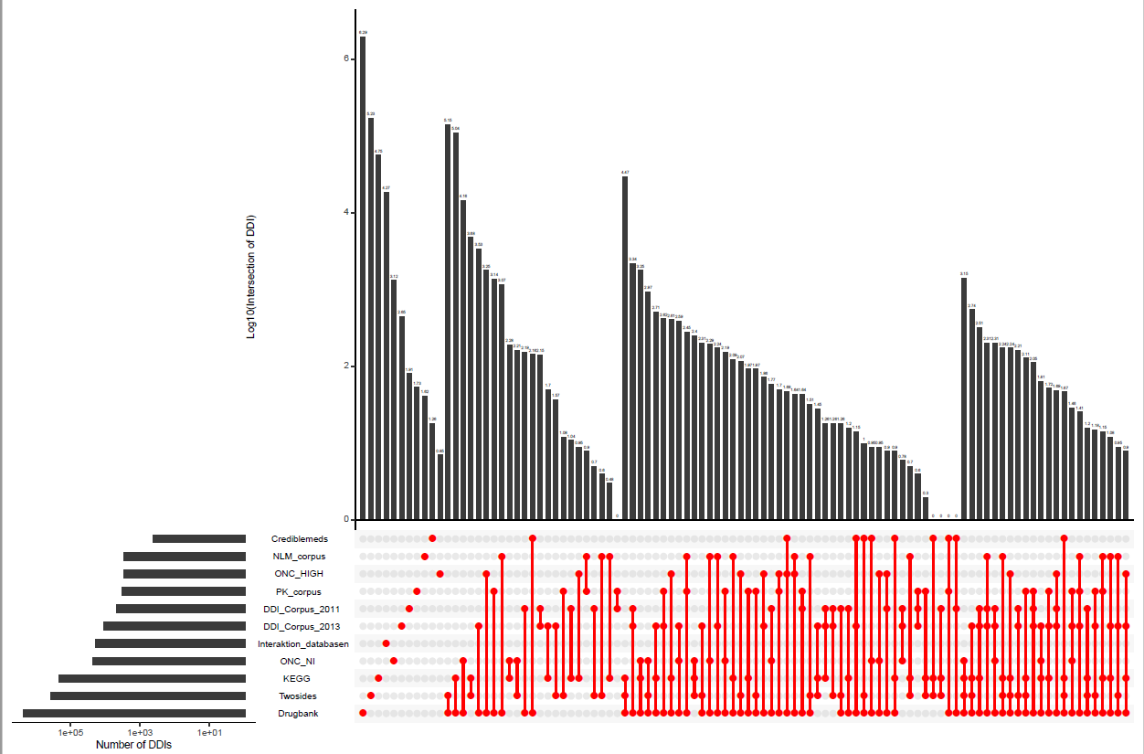
PART II: Comparison between sources

Slide 10
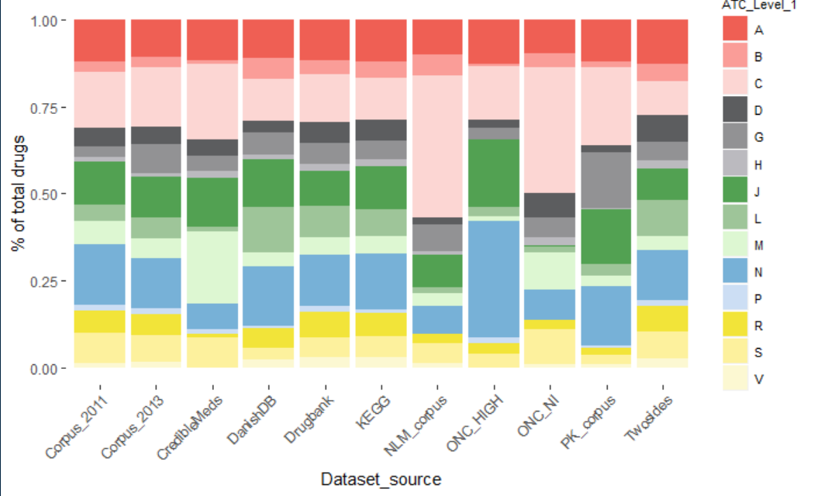
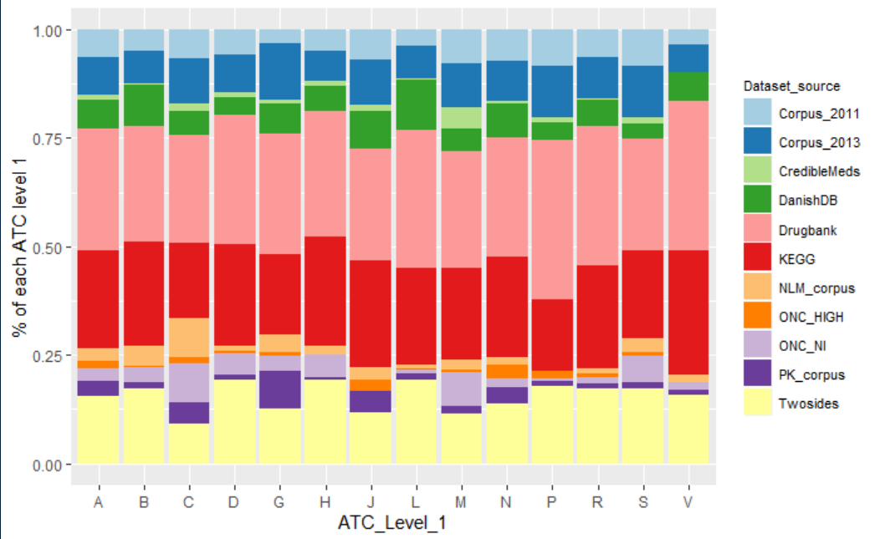

Slide 11
Here is the space for the Sankey diagram

Slide 12
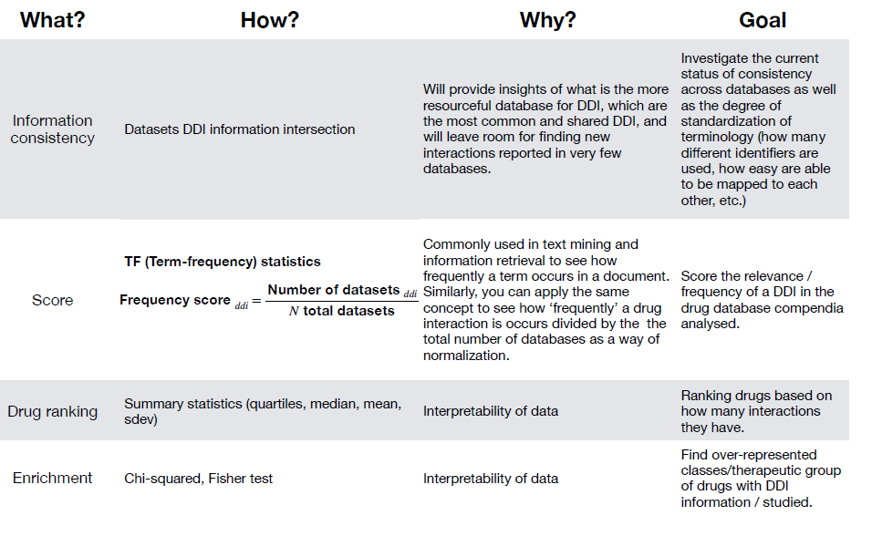
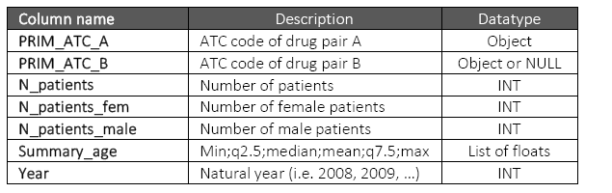
PART III: application to Clinical data

