Slide 1
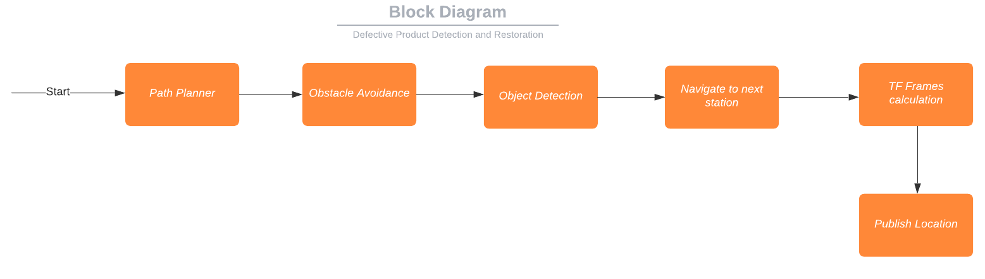
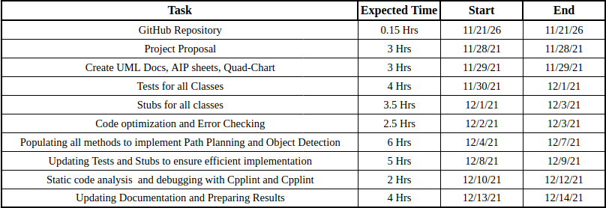
Defect Detection and Restoration
Abhishek Nalawade | Aditya Jadhav | Robert Vandemark
Overview:-
Defect detection whether in the manufacturing industry or the software industry serves to be a critical part of the production cycle. In the manufacturing process the emergence of defects due to unforeseeable reasons is an inevitable part, which is also the case in software development process.
This project attempts to implement a Defect Detection module for ACME Robotics to achieve robust defect detection and restoration using object detection and robot navigation algorithms.
Methodology:-
The purpose of Defect Detection and Restoration is to ensure excellent product quality.
We will use the fully ROS enabled TIAGo Robot model with its navigation, messages and controllers packages for our implementation of Defect Detection.
Our implementation uses Object Detection, Path Planning, Trajectory Planning and HSV Color Detection algorithms for TIAGo to navigate to inspection section and identify the defective product publishing its relative location using transfer frames.
How:-
Timeline:-

