Slide 1


Salary Prediction using United States Census Bureau Data
ABHAY JOSHI
ADITYA CHAYAPATHY
JAGADEESH BASAVARAJU
Notes:
Created By: Abhay Joshi
Notes:
1. A brief overview of the steps involved in developing a machine learning model to accurately predict the income of an individual using US census bureau data

Slide 2
Problem statement
To develop marketing profiles of individuals with a focus on $50,000 as a key number for salary.
To identify the factors that determine the individual's income.
To develop an application to predict the income of an individual.
Notes:
Created By: Abhay Joshi
Notes:
The idea is to identify the top most influential factors that help in distinguishing the two classes of individuals
Using these factors, we want to train a machine learning algorithms that accurately predicts the income of the individuals.

Slide 3
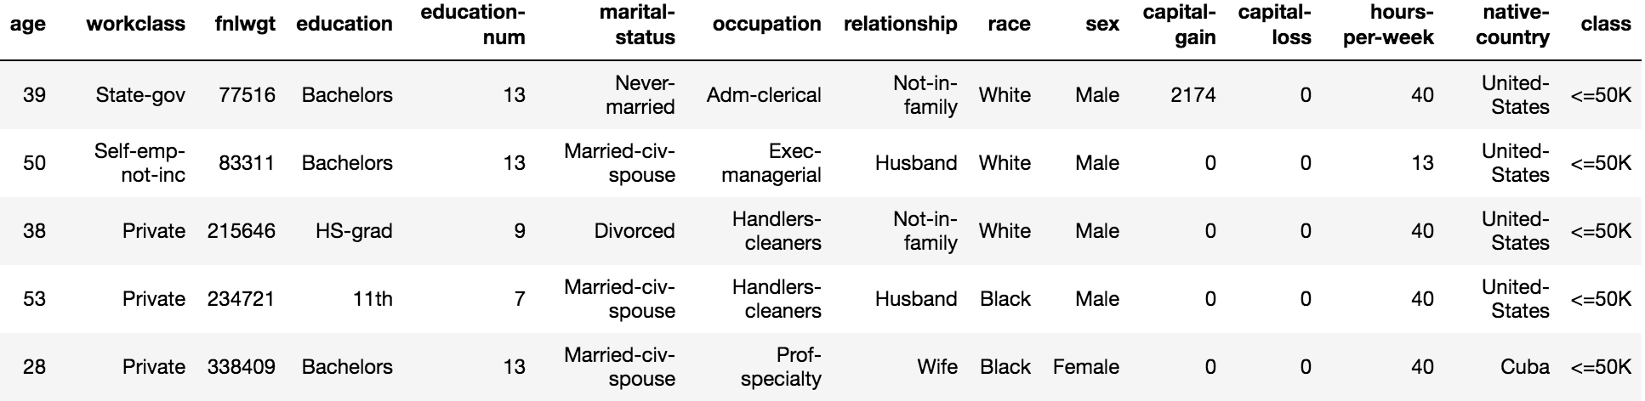
Data set
Source :
United States Census Bureau
Data cleaning:
Removed records having incomplete (“?”) data present in them.
Classes:
Above 50K (“>50K”)
Below 50K (“<=50K”)
Features:
14 features with 8 features having categorial data.
Skewed dataset (train data + test data):
34014 records belonging to “<=50K” class
11208 records belonging to “>50K” class
Data used for analysis:
<=50K – 11208 (randomly sampled from 34014 records)
>50K - 11208
Notes:
Created By: Abhay Joshi
Notes:
Each field have varying properties and varying distributions.
There are few features like ”capital-gain” that are very influential in determining income.
Dataset is highly skewed with the two classes of data present in the ratio of 1:3 approximately
In order to make a fair judgement, a 1:1 ratio of the data is used for analysis purposes

Slide 4
Initial analysis
Top 5 important features based on initial analysis through data exploration:
Capital-gain
Age
Occupation
Education-num
Marital-status
Redundant features based on initial analysis through data exploration:
Capital-loss
Fnlwgt
education
Notes:
Created By: Abhay Joshi
Notes:
Aim is to identify features that are highly influential in classification leveraging data exploration techniques through visualizations.
Also, we want to eliminate the features that are redundant to reduce the dimensionality of the data. (Reduce the curse of dimensionality)

Slide 5
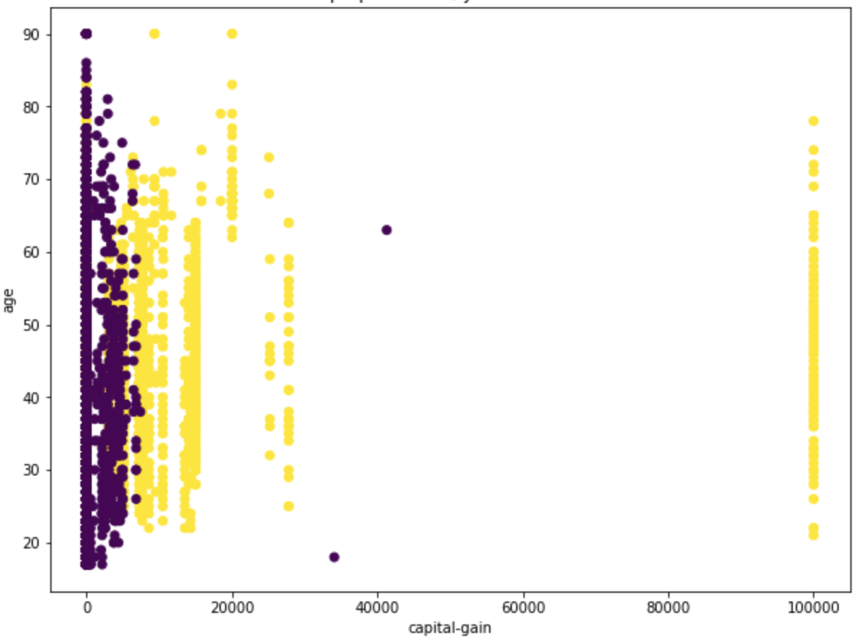
Important features
Scatter plot:
Features Covered: age, capital-gain
X axis – Capital-gain
Y axis – Age
Inferences:
There seems to be a separation between the two classes of data with the exception of a few outliers.
Individuals with high capital gain are more likely to earn more than 50K income.
>50K
<=50K
Notes:
Created By: Abhay Joshi
Notes:
There seems to be a separation between the two classes of data with the exception of a few outliers.
Individuals with high capital gain are more likely to earn more than 50K income.

Slide 6
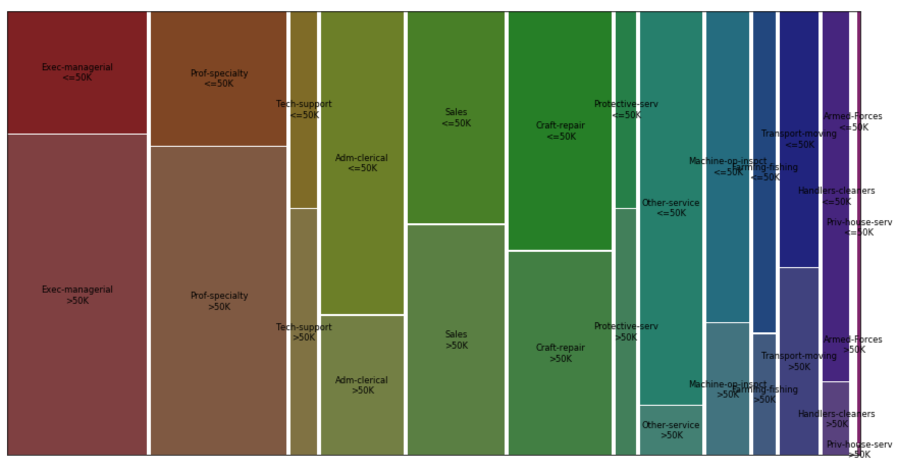
Important features CONT.
Mosaic Plot:
Features covered: occupation
Categories in the order as they appear:
Adm-clerical
Exec-managerial
Handlers-cleaners
Prof-specialty
Other-service
Sales
Transport-moving
Farming-fishing
Machine-op-inspct
Tech-support
Craft-repair
Protective-serv
Armed-Forces
Priv-house-serv
Inferences:
For most categorial data, the distribution of the two classes are highly skewed hinting that this feature can be used to distinguish among the two classes.
Individuals with occupations such as “Exec-managerial”, “Prof-speciality” are more likely to earn 50K income.
Notes:
Created By: Jagdeesh Basavaraju
Notes:
For most categorial data, the distribution of the two classes are highly skewed hinting that this feature can be used to distinguish among the two classes.
Individuals with occupations such as “Exec-managerial”, “Prof-speciality” are more likely to earn 50K income.

Slide 7
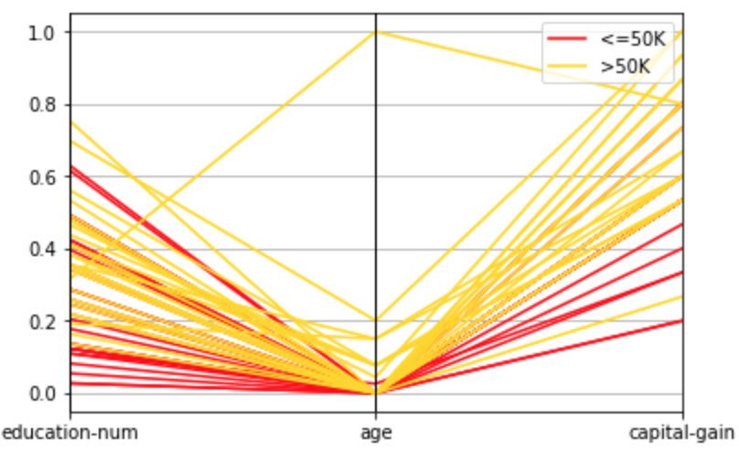
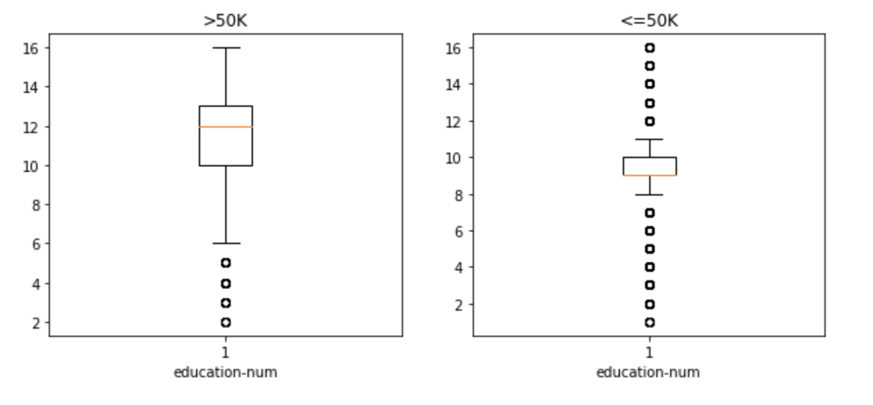
Important features CONT.
Parallel coordinate plot:
Features Covered: education-num, age, capital-gain
Each of the features are scaled to value between 0 and 1.
Box plot:
Features Covered : education-num
Inferences:
From the parallel coordinate plot, we can see that the yellow lines and the red lines can be distinguished using the combination of these three features.
From the box plot, we can see that the distribution of the education among the two classes of data vary drastically.
Individuals with high education number are more likely to earn greater than 50K income.
Older individuals are likely to earn more than younger individuals.
Notes:
Created By: Jagdeesh Basavaraju
Notes:
From the parallel coordinate plot, we can see that the yellow lines and the red lines can be distinguished using the combination of these three features.
From the box plot, we can see that the distribution of the education among the two classes of data vary drastically.
Individuals with high education number are more likely to earn greater than 50K income.
Older individuals are likely to earn more than younger individuals.

Slide 8
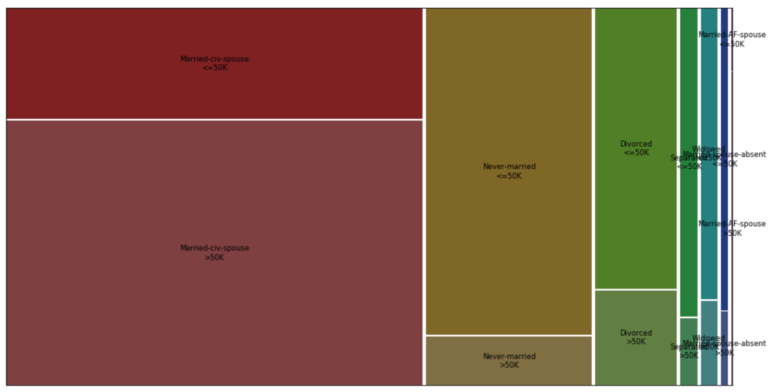
Important features CONT.
Mosaic Plot:
Features covered: marital-status
Categories in the order as they appear:
Never-married
Married-civ-spouse
Divorced
Married-spouse-absent
Separated
Married-AF-spouse
Widowed
Inferences:
For most categorial data, the distribution of the two classes are highly skewed hinting that this feature can be used to distinguish among the two classes.
Individuals with marital-status of “married-civ-spouse” are more likely to earn more than 50K income.
Individuals with marital-status of “never-married” are more likely to earn less than 50K income.
Notes:
Created By: Jagdeesh Basavaraju
Notes:
For most categorial data, the distribution of the two classes are highly skewed hinting that this feature can be used to distinguish among the two classes.
Individuals with marital-status of “married-civ-spouse” are more likely to earn more than 50K income.
Individuals with marital-status of “never-married” are more likely to earn less than 50K income.

Slide 9
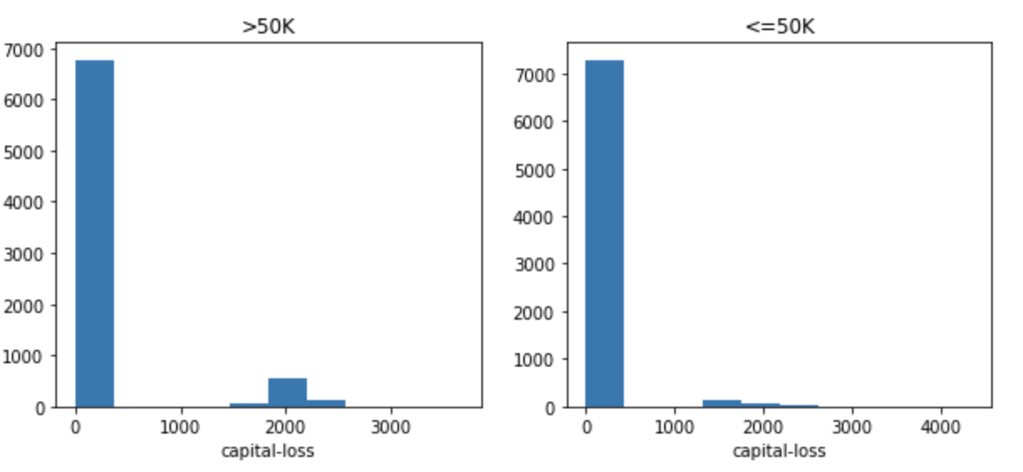
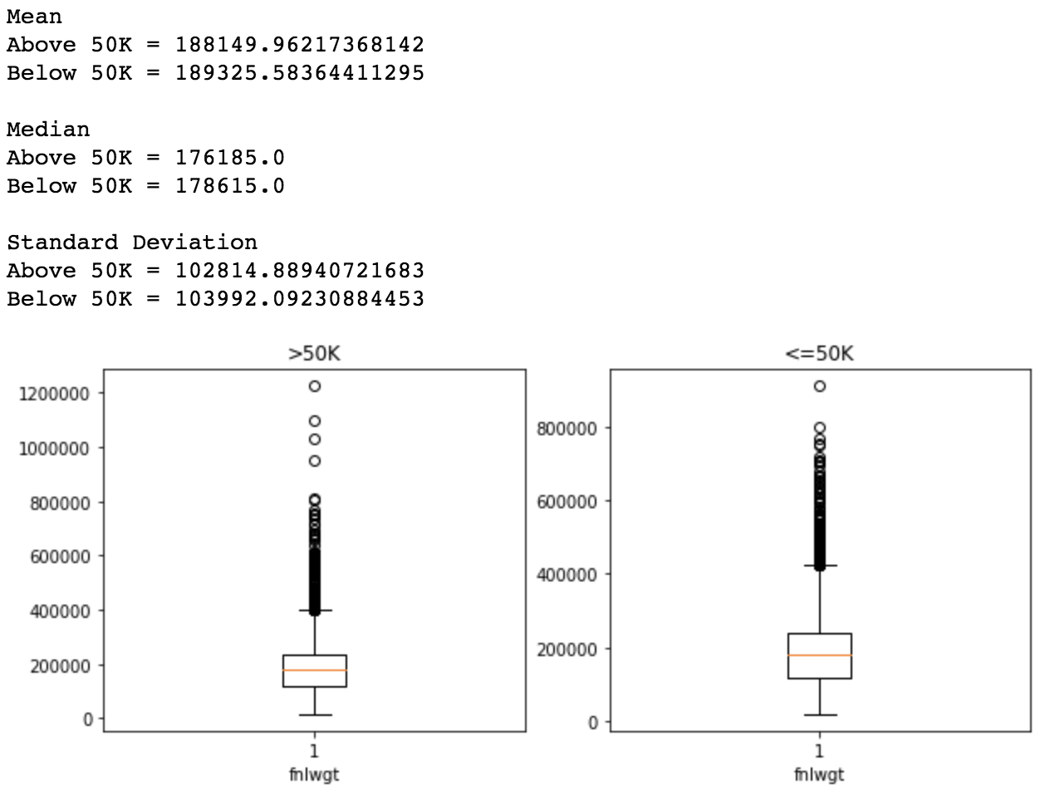
Redundant features
Education:
Similar information is encoded in ”education-num” feature. Hence, this feature can be ignored.
Capital-loss:
As seen in the figure, for both classes of data, they show similar distribution indicating that this feature may not help in distinguishing between the two classes of data.
Fnlwgt:
As seen in the figure, for both classes of data, fnlwgt has similar statistical properties. Also, their distribution is similar as it is evident from the box-and-whisker plot. Hence, this feature may not help in distinguishing between the two classes of data.
Notes:
Created By: Jagdeesh Basavaraju
Notes:
1. Similar information is encoded in ”education-num” feature. Hence, this feature can be ignored.
2. As seen in the figure, for both classes of data, they show similar distribution indicating that this feature may not help in distinguishing between the two classes of data.
3. As seen in the figure, for both classes of data, fnlwgt has similar statistical properties. Also, their distribution is similar as it is evident from the box-and-whisker plot. Hence, this feature may not help in distinguishing between the two classes of data.

Slide 10
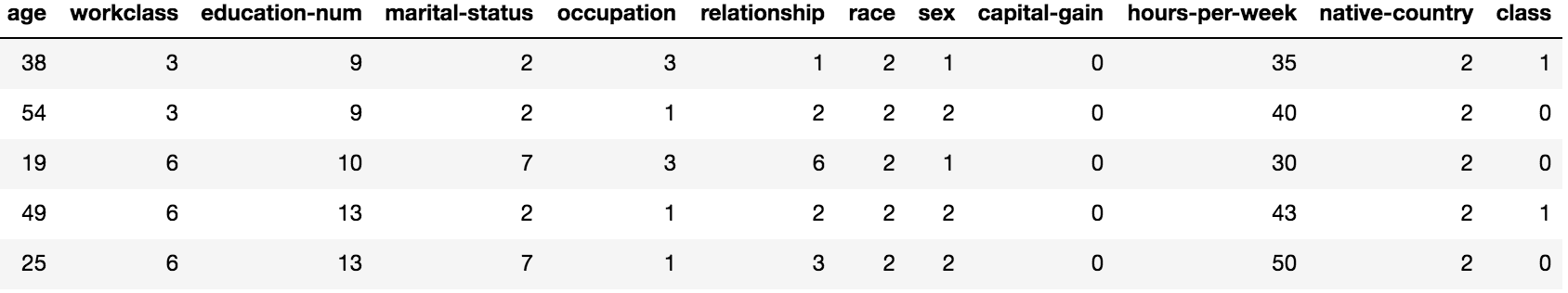
Machine learning analysis
Features excluded:
Fnlwgt
Education-num
Captial-loss
Feature Engineering:
All the numerical features are left as is.
For each categorial data, a numerical number is assigned based on the distinguishing factor of that category from our initial data exploration analysis.
Data Normalization:
Each feature is scaled to a value between 0 and 1. This is done to ensure that the ML algorithms give equal importance to each feature.
Data Division:
Data is split in the ratio of 80:20 where 80 percent of the data is used for training and 20 percent of the data is used for testing.
Notes:
Created By: Aditya Chayapathy
Notes:
To accurately predict the income class of an individual
Use minimal number of features for classification
Meaningfully, convert categorial data to numerical data by ensuring the essence of the data is captured.
Data engineering to ensure optimal performance of the ML algorithms

Slide 11

Notes:
Created By: Aditya Chayapathy
Notes:
ML models are arranged in the decreasing order of their accuracy.
F1 measure combines precision and recall to give a single measure that covers both aspects.
Ensemble techniques such as random forest and gradient boosting are giving high accuracy.
These values are test data measures.

Slide 12
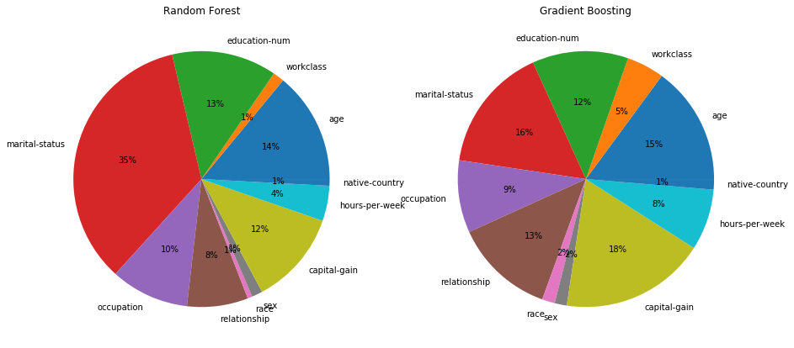
Feature Importance
Pie Chart:
Shows the importance of the features based on the top 2 accurate ML models.
ML models covered:
Random Forest
Gradient Boosting
Inferences:
Both the trained models more or less infer the same level of importance to each of the features.
As per our initial analysis, the algorithms too provide high importance to the same set of features.
Notes:
Created By: Aditya Chayapathy
Notes:
We are using the top 2 most accurate models for further analysis.
Each of them give approximately the same confidence to the important features.
2. As per our initial analysis, even the accurate trained ML models give approximately the same importance to the features we identified.

Slide 13
questions
Notes:
Created By: Aditya Chayapathy
Notes:
1. Questions?

