Slide 1
Data Viz II
American University – Spring 2021

Slide 2
“What tool do you use?”
Most common question I get
IMO, not nearly the most important

Slide 3
“What tool do you use?”
People, I think, ask this question because they think that if they could just learn “X” tool, they too will be able to make data visualizations
This is technically true – but for all the reasons we talked about in the first half of this lecture, it takes a lot more than that

Slide 4

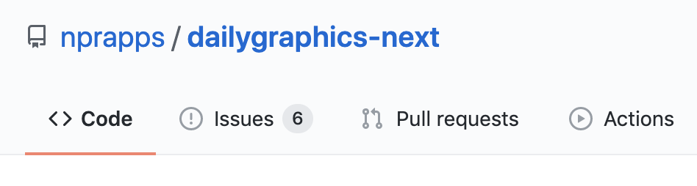


“What tool do you use?”
That being said… here’s what I use.
Daily Graphics (NPR)
D3.js
Tableau Public
Adobe Illustrator

Slide 5


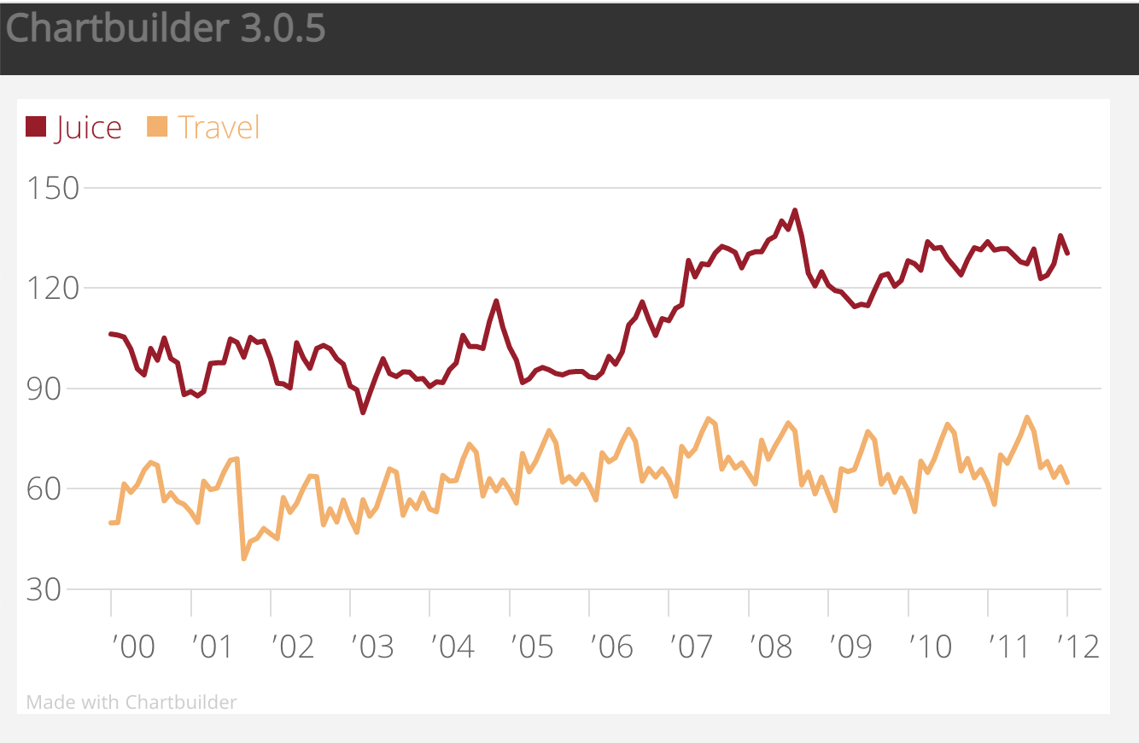
“What tool do you use?”
Here’s what else is good
Datawrapper
Various R and Python libraries
Chartbuilder

Slide 6


“What tool do you use?”
Here’s what’s not quite as good
Excel
Infogram

Slide 7
Difficulty

Slide 8
Difficulty
These two have the biggest payoff for the learning curve, so we’re going to tackle them today.

Slide 9
Datawrapper classroom survey
Tableau dataset exploration/visualizations
https://healthdata.gov/Hospital/COVID-19-Reported-Patient-Impact-and-Hospital-Capa/anag-cw7u

