Slide 1
AZ-104T00A Module 03: Azure Administration

Slide 2
Module Overview
Lesson 01: Resource Manager
Lesson 02: Azure Portal and Cloud Shell
Lesson 03: Azure PowerShell and CLI
Lesson 04: ARM Templates
Lesson 05: Module 03 Lab and Review

Slide 3
Lesson 01: Resource Manager

Slide 4
Resource Manager Overview
Resource Manager
Terminology
Resource Group Deployments
Resource Manager Locks
Moving Resources
Removing Resources and Resource Groups
Resource Limits
Demonstration- Resource Groups
Notes:
Lesson overview

Slide 5
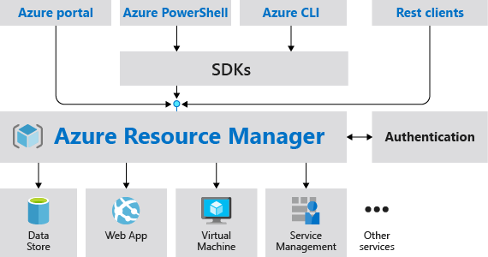
Resource Manager
Provides a consistent management layer
Enables you to work with the resources in your solution as a group
Deploy, update, or delete in a single, coordinated operation
Provides security, auditing, and tagging features
Choose the tools and APIs that work best for you

Slide 6
Terminology
A resource is simply a single service instance in Azure
A resource group is a logical grouping of resources
An Azure Resource Manager template is a JSON file that allows you to declaratively describe a set of resources
A declarative syntax is what a template uses to state what you intend to create
A resource provider is service that supplies the resources you can deploy and manage through Resource Manager

Slide 7
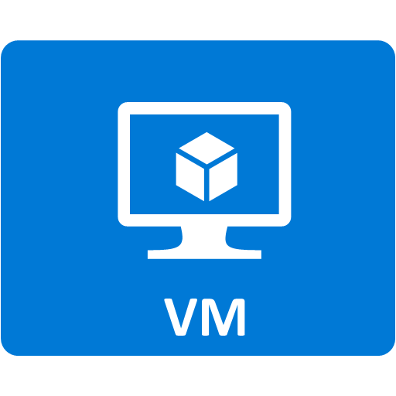


Resource Group Deployments
Resources can only exist in one resource group
Groups cannot be renamed
Groups can have resources of many different types (services)
Groups can have resources from many different regions
Deployments are incremental
Resources grouped (Web + DB, VM, Storage) in one group
OR
Web and DB resource group
Virtual machine resource group
Storage resource group
✔️ By scoping permissions to a resource group, you can add/remove and modify resources easily

Slide 8
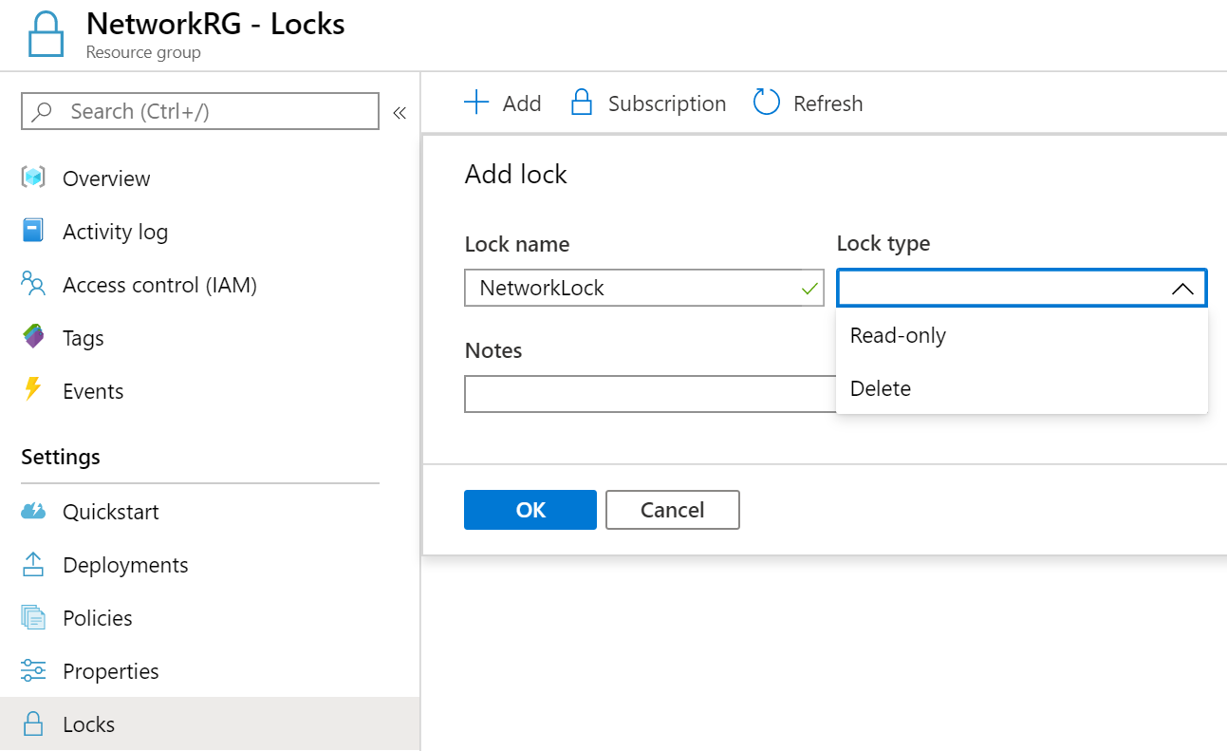
Resource Manager Locks
Associate the lock with a subscription, resource group, or resource
Locks are inherited by child resources
Read-Only locks prevent any changes to the resource
Delete locks prevent deletion
Notes:
✔ Only Owner and User Access Administrator roles can create or delete management locks.
Lock resources to prevent unexpected changes: https://docs.microsoft.com/en-us/azure/azure-resource-manager/resource-group-lock-resources

Slide 9
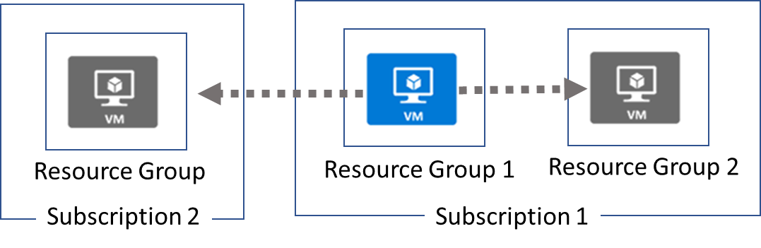
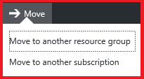
Moving Resources
When moving resources, both the source group and the target group are locked during the operation
Services that cannot be moved: AD Domain Services, ExpressRoute, and Site Recovery. Other restrictions apply.
Notes:
✔ Just because a service can be moved doesn’t mean there aren’t restrictions. For example, you can move a virtual network, but you must also move its dependent resources, like gateways. Learn more at the reference link.
Move resources to new resource group or subscription - https://docs.microsoft.com/en-us/azure/azure-resource-manager/resource-group-move-resources

Slide 10
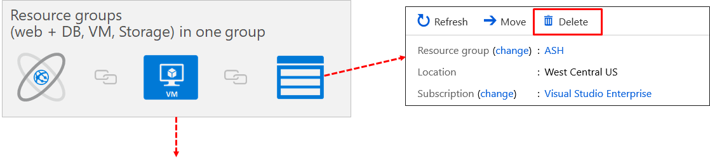
Removing Resources and Resource Groups
Remove Azure resources that you no longer use
Ensures you will not see unexpected charges
Remove individual resources or remove the resource group

Slide 11
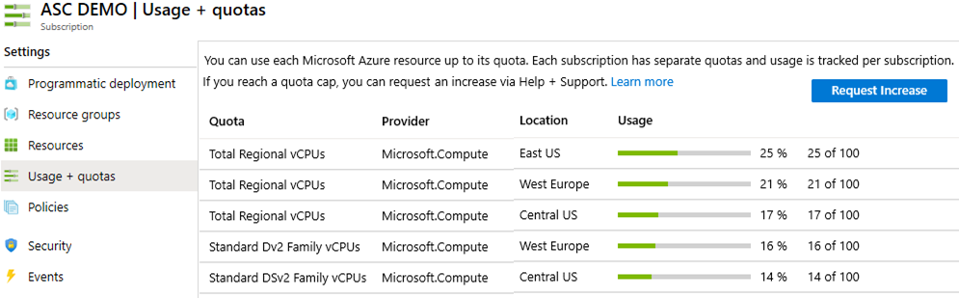
Resource Limits
Resources have a default limit also known as quota
Helpful to track current usage, and plan for future use
You can open a free support case to increase limits to published maximums

Slide 12
Demonstration – Resource Groups
Manage resource groups in the portal
Manage resource groups with PowerShell
Notes:
✔ Always consider having students walk-through the demonstrations themselves. Also, consider the overlap with the formal labs and your best use of time.

Slide 13
Lesson 02: Azure Portal and Cloud Shell

Slide 14
Azure Portal and Cloud Shell Overview
Azure Portal
Azure Mobile App
Demonstration – Azure Portal
Azure Cloud Shell
Demonstration – Cloud Shell
Notes:
Lesson overview

Slide 15
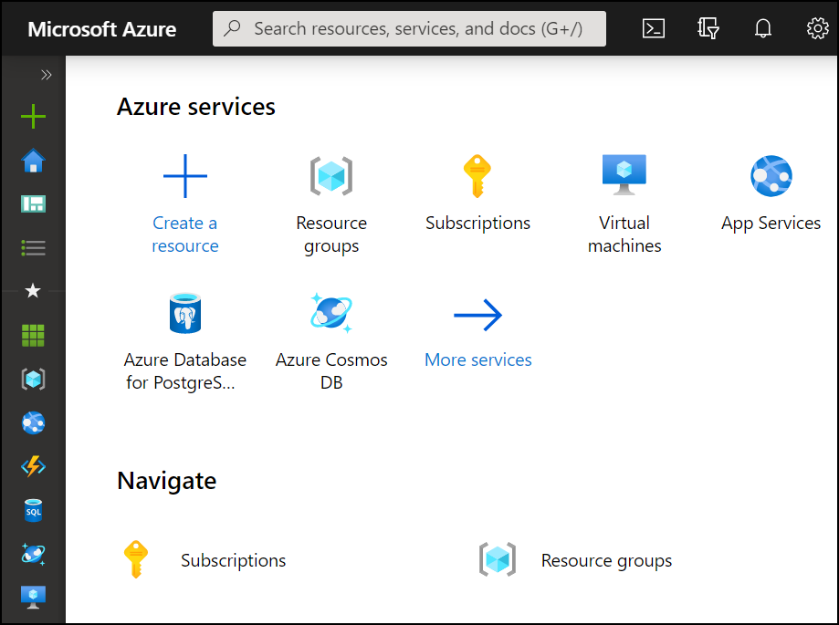
Azure Portal
Search resources, services, and docs
Manage resources
Create customized dashboards and favorites
Access the Cloud Shell
Receive notifications

Slide 16
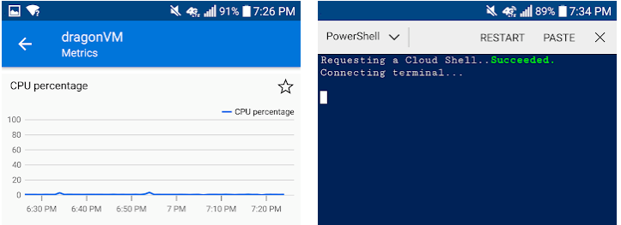
Azure Mobile App
Stay connected to the cloud
Check status and critical metrics anytime, anywhere
Diagnose and fix issues quickly
Run commands to manage your Azure resources

Slide 17
Demonstration – Azure Portal
Help and keyboard shortcuts
Customizing your experience
Notes:
✔ Always consider having students walk-through the demonstrations themselves. Also, consider the overlap with the formal labs and your best use of time.

Slide 18
Azure Cloud Shell
Interactive, browser-accessible shell
Offers either Bash or PowerShell
Is temporary and provided on a per-session, per-user basis
Requires a resource group, storage account, and Azure File share
Authenticates automatically
Integrated graphical text editor
Is assigned one machine per user account
Times out after 20 minutes

Slide 19
Demonstration – Cloud Shell
Configure the Cloud Shell
Experiment with Azure PowerShell
Experiment with Bash shell
Experiment with the Cloud Editor
Notes:
✔ Always consider having students walk-through the demonstrations themselves. Also, consider the overlap with the formal labs and your best use of time.

Slide 20
Lesson 03: Azure PowerShell and CLI

Slide 21
Azure PowerShell and CLI Overview
Azure PowerShell
PowerShell Cmdlets and Modules
Demonstration – Working with PowerShell Locally
Azure CLI
Demonstration – Working with Azure CLI Locally
Notes:
Lesson overview

Slide 22
Azure PowerShell
New-AzVm `
-ResourceGroupName "CrmTestingResourceGroup" `
-Name "CrmUnitTests" `
-Image "UbuntuLTS" `
...
Lets you connect to your Azure subscription and manage resources
Adds the Azure-specific commands – new Az module
Available inside a browser via the Azure Cloud Shell
Available as a local installation on Linux, macOS, or Windows
Has an interactive and a scripting mode

Slide 23
PowerShell Cmdlets and Modules
Get-Module
# Output
ModuleType Version Name
---------- ------- ----
Manifest 3.1.0.0 Microsoft.PowerShell.Management
Manifest 3.1.0.0 Microsoft.PowerShell.Utility
Binary 1.0.0.1 PackageManagement
Script 1.0.0.1 PowerShellGet
Script 2.0.0 PSReadline
Cmdlets follow a verb-noun naming convention; shipped in modules
Modules are a DLL file with the code to process each cmdlet
Load cmdlets by loading the module containing them
Use Get-Modules to see a list of loaded modules
Notes:
Ask about the classes experience with PowerShell and Azure PowerShell

Slide 24
Demonstration – Working with PowerShell
Install the Az module
Install NuGet (if needed)
Trust the repository
Connect to Azure and view your subscription information
Create resources
Notes:
✔ Always consider having students walk-through the demonstrations themselves. Also, consider the overlap with the formal labs and your best use of time.

Slide 25
Azure CLI
az vm restart -g MyResourceGroup -n MyVm
Cross-platform command-line program
Runs on Linux, macOS, and Windows
Can be used interactively or through scripts
Commands are structured in _groups_ and _subgroups_
Use find to locate commands
Use --help for more detailed information
Notes:
Ask about the students experience with CLI.

Slide 26
Demonstration – Working with the CLI
Install the CLI
Verify the CLI installation
Login to Azure
Create a resource group
Verify the resource group
Notes:
✔ Always consider having students walk-through the demonstrations themselves. Also, consider the overlap with the formal labs and your best use of time.

Slide 27
Lesson 04: ARM Templates

Slide 28
ARM Templates Overview
Template Advantages
Template Schema
Template Parameters
Template Variables
Template Functions
Template Resources
Template Outputs
QuickStart Templates
Demonstration – QuickStart Templates
Demonstration – Run Templates with PowerShell

Slide 29
Template Advantages
Improves consistency
Express complex deployments
Reduce manual, error prone tasks
Express requirements through code
Promotes reuse
Modular and can be linked
Simplifies orchestration
ARM
Template
Development
Production
Quality
Assurance
Notes:
Use the same template across deployments so the resources are identical.

Slide 30
Template Schema
{
"$schema": "http://schema.management.
azure.com/schemas/2019-04- 01/deploymentTemplate.json#",
"contentVersion": "",
"parameters": {},
"variables": {},
"functions": [],
"resources": [],
"outputs": {}
}
Defines all the Resource Manager resources in a deployment
Written in JSON
A collection of key-value pairs
Each key is a string
Each values can be a string, number, Boolean expression, list of values, object

Slide 31
Template Parameters
"parameters": {
"adminUsername": {
"type": "string",
"metadata": {
"description": "Username for the VM."
}
},
"adminPassword": {
"type": "securestring",
"metadata": {
"description": "Password for the VM."
}
}
}
Specify which values are configurable when the template runs
This example has two parameters: one for a VM’s username (adminUsername), and one for its password (adminPassword)

Slide 32
Template Variables
Define values that are used throughout the template
Makes your templates easier to maintain
This example provides variables that describe networking features for a virtual machine
"variables": {
"nicName": "myVMNic",
"addressPrefix": "10.0.0.0/16",
"subnetName": "Subnet",
"subnetPrefix": "10.0.0.0/24",
"publicIPAddressName": "myPublicIP",
"virtualNetworkName": "MyVNET"
}

Slide 33
Template Functions
"functions": [
{
"namespace": "contoso",
"members": {
"uniqueName": {
"parameters": [
{
"name": "namePrefix",
"type": "string"
} ],
"output": {
"type": "string",
"value": "[concat(toLower(parameters('namePrefix’)),
uniqueString(resourceGroup().id))]"
} } } } ],
Reusable procedures
Makes the template easier to maintain
This function creates a unique name - use when creating resources that have globally unique naming requirements

Slide 34
Template Resources
{
"type": "Microsoft.Network/publicIPAddresses",
"name": "[variables('publicIPAddressName')]",
"location": "[parameters('location')]",
"apiVersion": "2018-08-01",
"properties": {
"publicIPAllocationMethod": "Dynamic",
"dnsSettings": {
"domainNameLabel": "[parameters('dnsLabelPrefix')]"
}
}
}
Define the Azure resources that make up your deployment
This example that creates a public IP address resource
Name is a variable
Location is a parameter

Slide 35
Template Outputs
Define any information you'd like to receive when the template runs
This example receives a VM's IP address or FQDN
Hostname is the output
The FQDN value is read from the virtual machines public IP address settings
"outputs": {
"hostname": {
"type": "string",
"value": "[reference(variables(
'publicIPAddressName’)).
dnsSettings.fqdn]"
}
}

Slide 36
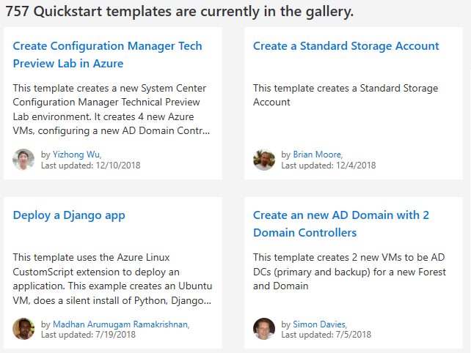
QuickStart Templates
Resource Manager templates provided by the Azure community
Provides everything you need to deploy your solution or serves as a starting point for your template
https://azure.microsoft.com/en-us/resources/templates/
Notes:
https://azure.microsoft.com/en-us/resources/templates/

Slide 37
Demonstration – QuickStart Templates
Explore the QuickStart gallery
Explore a template
Notes:
✔ Always consider having students walk-through the demonstrations themselves. Also, consider the overlap with the formal labs and your best use of time.

Slide 38
Demonstration – Run Templates with PowerShell
Connect to your subscription
Create the resource group
Deploy the template into the resource group
Verify the template deployed
Notes:
✔ Always consider having students walk-through the demonstrations themselves. Also, consider the overlap with the formal labs and your best use of time.

Slide 39
Lesson 05: Module 03 Lab and Review
Notes:
Pick the lab(s) most appropriate for your audience.

Slide 40
Lab 03a - Manage Azure resources with the Azure Portal
Lab scenario
You need to explore the basic Azure administration capabilities associated with provisioning resources and organizing them based on resource groups, including moving resources between resource groups. You also want to explore options for protecting disk resources from being accidentally deleted, while still allowing for modifying their performance characteristics and size.
Objectives
Task 1: Create resource groups and deploy resources to resource groups
Task 2: Move resources between resource groups
Task 3: Implement and test resource locks

Slide 41
Lab 03b - Manage Azure resources with Templates
Lab scenario
Now that you explored the basic Azure administration capabilities associated with provisioning resources and organizing them based on resource groups by using the Azure portal, you need to carry out the equivalent task by using Azure Resource Manager templates.
Objectives
Task 1: Review an ARM template for deployment of an Azure managed disk.
Task 2: Create an Azure managed disk by using an ARM template.
Task 3: Review the ARM template-based deployment of the managed disk.

Slide 42
Lab 03c - Manage Azure resources with PowerShell
Lab scenario
Now that you explored the basic Azure administration capabilities associated with provisioning resources and organizing them based on resource groups by using the Azure portal and Azure Resource Manager templates, you want the equivalent tasks with Azure PowerShell. To avoid installing Azure PowerShell modules, you will leverage the Azure Cloud Shell.
Objectives
Task 1: Start a PowerShell session in Azure Cloud Shell
Task 2: Create a resource group and an Azure managed disk with Azure PowerShell
Task 3: Configure the managed disk by using Azure PowerShell

Slide 43
Lab 03d - Manage Azure resources with the Azure CLI
Lab scenario
Now that you explored the basic Azure administration capabilities associated with provisioning resources and organizing them based on resource groups by using the Azure portal, Azure Resource Manager templates, and Azure PowerShell, you need to carry out the equivalent task by using Azure CLI. To avoid installing Azure CLI, you will leverage Bash environment available in Azure Cloud Shell.
Objectives
Task 1: Start a Bash session in Azure Cloud Shell
Task 2: Create a resource group and a managed disk by using Azure CLI
Task 3: Configure the managed disk by using Azure CLI

Slide 44
Module Review
Module Review Questions
Microsoft Learn Modules (docs.microsoft.com/Learn)
Core Cloud Services - Manage services with the Azure portal
Control and organize Azure resources with Azure Resource Manager
Build Azure Resource Manager templates
Automate Azure tasks using scripts with PowerShell
Manage virtual machines with the Azure CLI

