Slide 1
A n s I b l e
Simple IT Automation

Slide 2
Agenda
What is Ansible?
Why Ansible?
Ansible Vocabulary
Ansible configuration hierarchy
Ansible Playbooks
Modules
Conditionals and Control Flow
Ansible in Cloud
Ansible Tower
Demo.

Slide 3

introduction

Slide 4
What is ansible?
Ansible is an open-source automation tool that allows you to automate the configuration, deployment, and orchestration of IT infrastructure.
It uses a simple, human-readable language (YAML) to define automation tasks and can manage infrastructure on-premises or in the cloud.
Ansible is a powerful tool that can help you automate your IT infrastructure and improve the efficiency of your operations.

Slide 5
What is ansible?
Ansible also has a robust inventory system that allows you to manage your infrastructure and group hosts based on different criteria.
It supports role-based access control (RBAC), which means you can define different levels of access for different users.

Slide 6
Why Ansible?
Easy to learn and use
Agentless architecture
Supports multiple platforms
Large and active community

Slide 7
Ansible Vocabulary
Inventory
Playbook
Module
Role
Play
Facts
Handler
Vault
Ad-hoc command

Slide 8
Ansible configuration hierarchy
Defaults
Inventory
Playbook
Task
Extra variables
Command-line options
Role defaults
Role vars
Host facts

Slide 9
Ansible Playbooks
An Ansible playbook is a YAML file that defines a set of tasks to be executed on one or more hosts.
Playbooks are the heart of Ansible automation, and allow you to define the desired state of your infrastructure in a declarative way.
Here are the key components of an Ansible playbook:
Hosts
Variables
Tasks
Modules
Handlers
Roles
Conditionals
Loops
Templates

Slide 10
Ansible Modules
Ansible modules are the building blocks of automation in Ansible.
They are small pieces of code that Ansible uses to perform specific tasks, such as managing files, installing packages, configuring network devices, and deploying applications.
There are three types of modules in Ansible:
Core modules
Extras modules
Custom modules
Ansible provides over 2,500 modules that cover a wide range of tasks, making it a powerful tool for automation and orchestration.

Slide 11
Ansible Conditionals & Control Flow
Ansible provides a number of conditionals and control flow statements to enable complex playbooks and tasks to be created.
Here are some examples of Ansible conditionals and control flow statements:
When conditional
Loop control flow
Until conditional
Failed_when

Slide 12
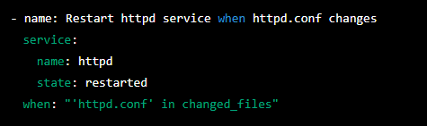
Conditionals & Control Flow
When conditional - This allows a task to be executed only when a certain condition is met.
Example:

Slide 13
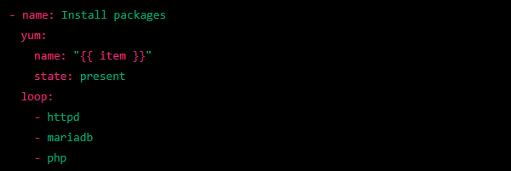
Conditionals & Control Flow
Loop control flow: This allows a task to be executed repeatedly for each item in a list..
Example:

Slide 14
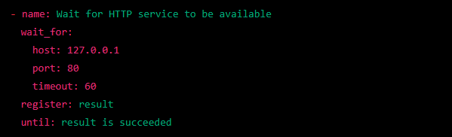
Conditionals & Control Flow
Until conditional: This allows a task to be repeated until a certain condition is met.
Example:

Slide 15
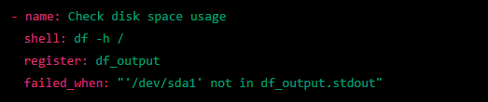
Conditionals & Control Flow
Failed_when: This allows a task to be marked as failed based on the result of the task.
Example:

Slide 16
Ansible in Cloud
Ansible is a popular choice for automating cloud infrastructure because it allows you to manage infrastructure as code, define the desired state of your infrastructure, and automate the deployment and management of cloud resources.
Ansible can also be used to automate tasks related to cloud security and compliance. Ansible has a wide range of security and compliance modules that can be used to enforce policies and audit compliance in your cloud environment.
Ansible can be used in cloud environments to manage the infrastructure and automate tasks on cloud platforms like Amazon Web Services (AWS), Microsoft Azure, and Google Cloud Platform (GCP).

Slide 17
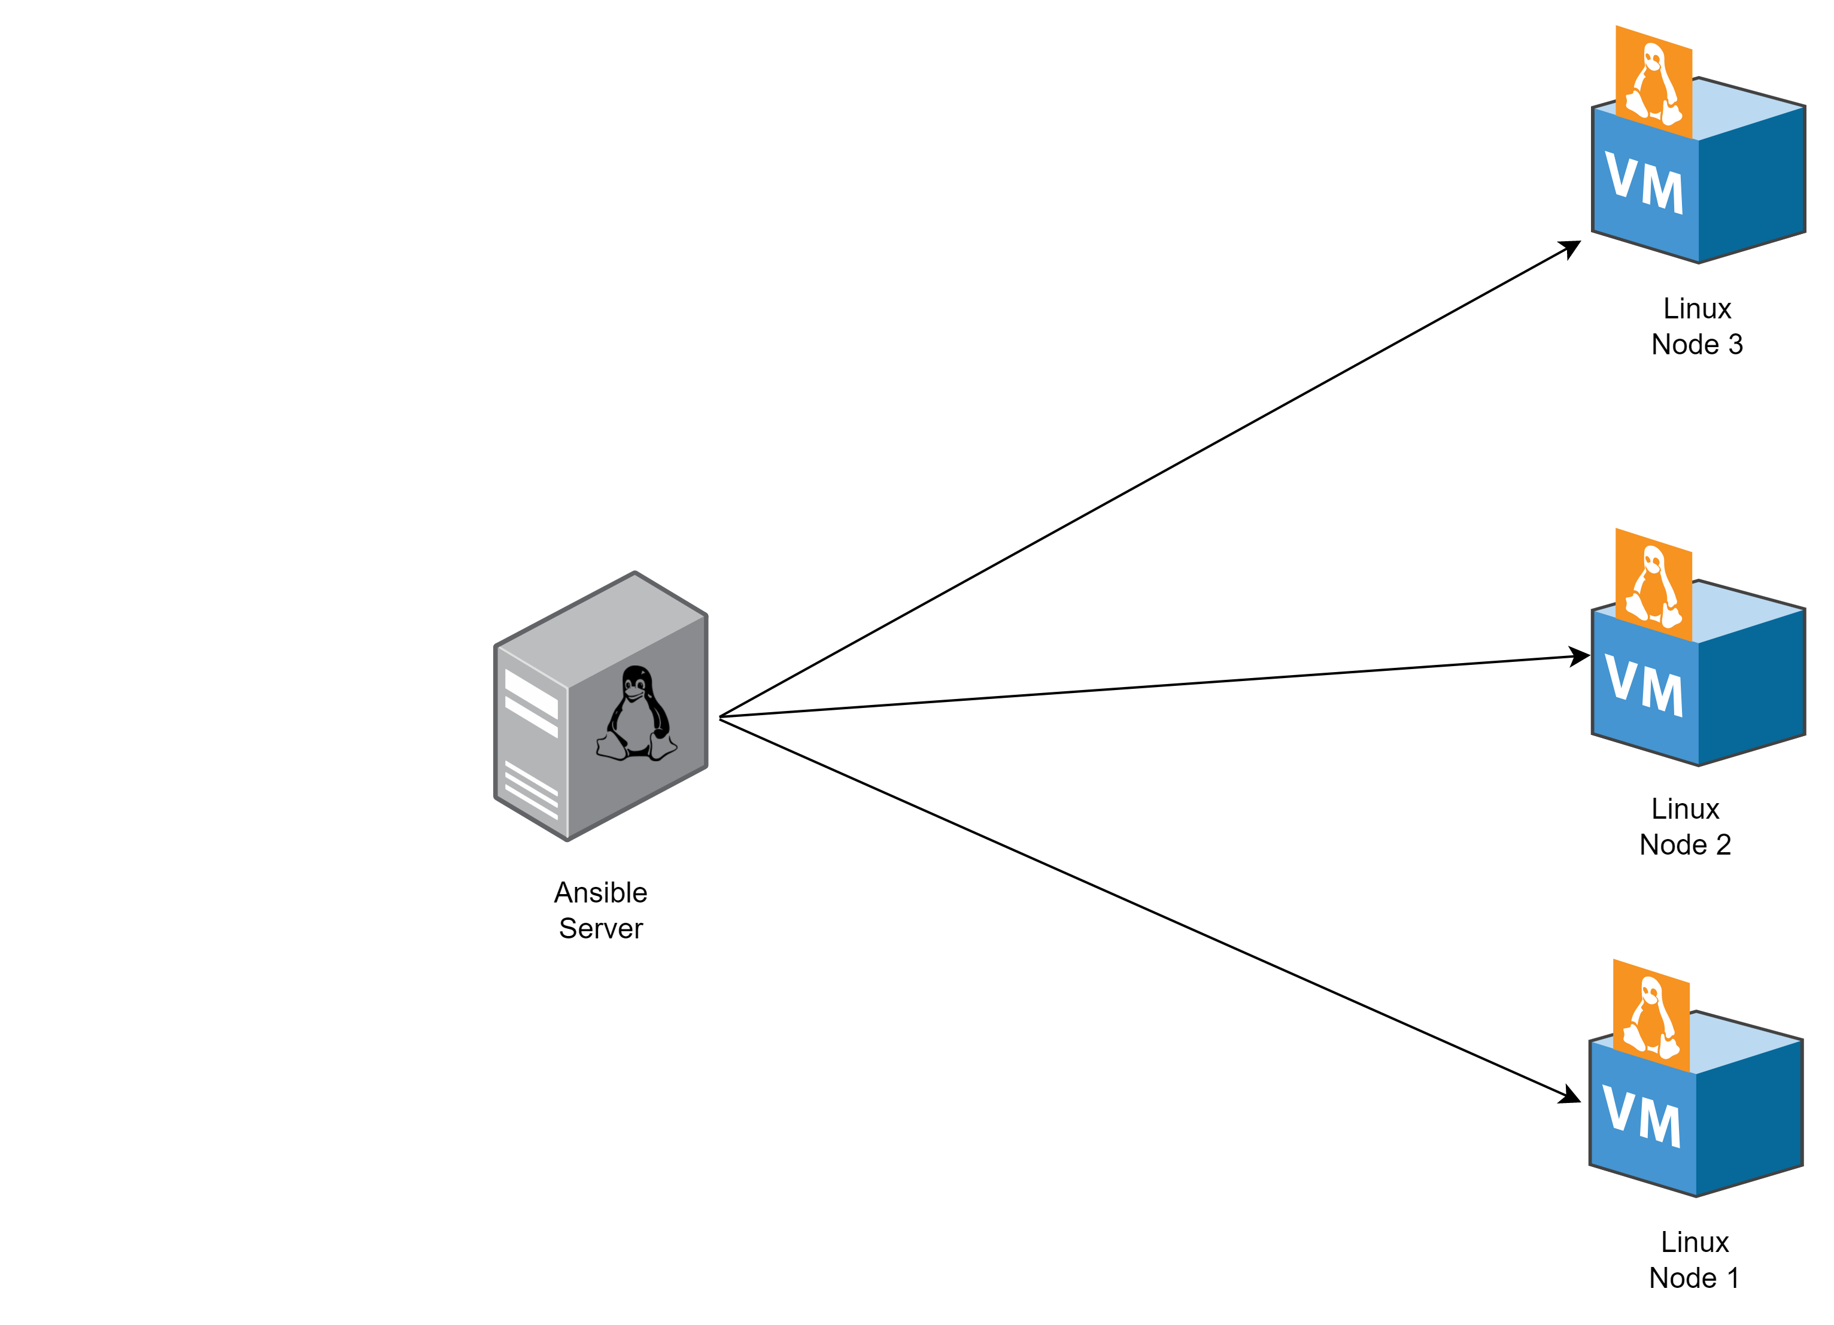
Lab setup

Slide 18
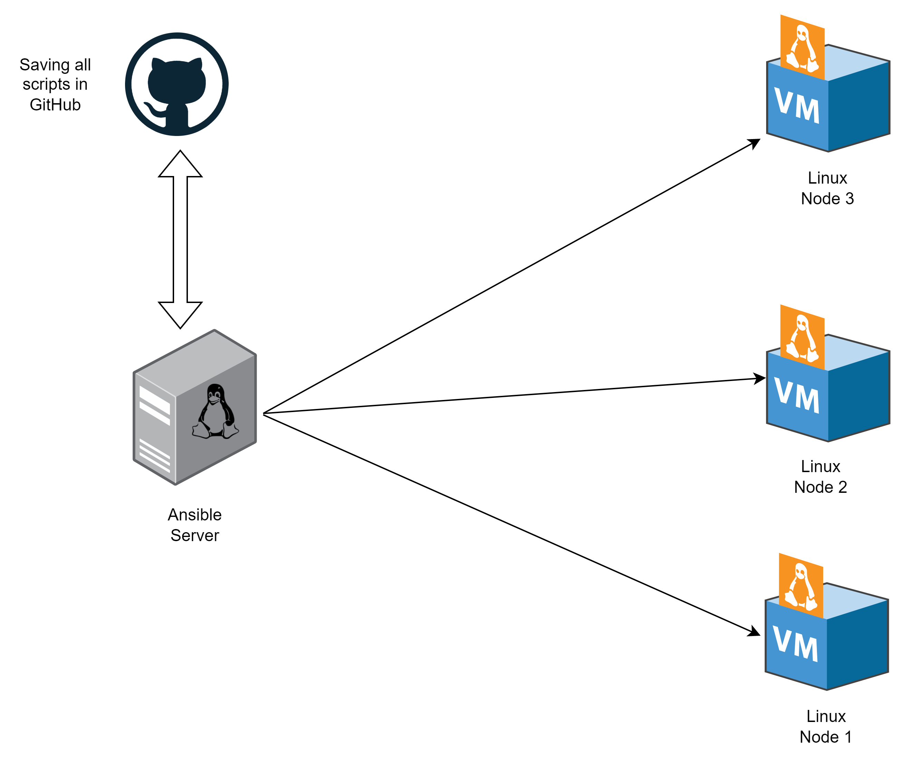
Lab setup

Slide 19
And now, to put all of these concepts into action, let's dive into a live demo

Slide 20

Thank you

