Slide 1
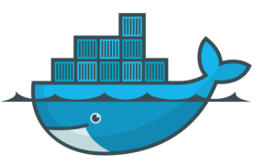
Containerization with Docker
A transition from Hard work to Smart work.

Slide 2
Today’s Agenda
Introduction to containers
Containers vs Virtual Machines
Docker, Docker images, DockerHub, Dockerfile
Building an image out of a container
Let’s build an image with Dockerfile!
Introduction to Kubernetes
How do we use containers on real environments?

Slide 3
What is Virtualization?
Virtualization is the technique of importing a Guest operating system on top of a Host operating system.
This technique was a revelation at the beginning because it allowed developers to run multiple operating systems in different virtual machines all running on the same host.
This eliminates the need for extra hardware resource.

Slide 4
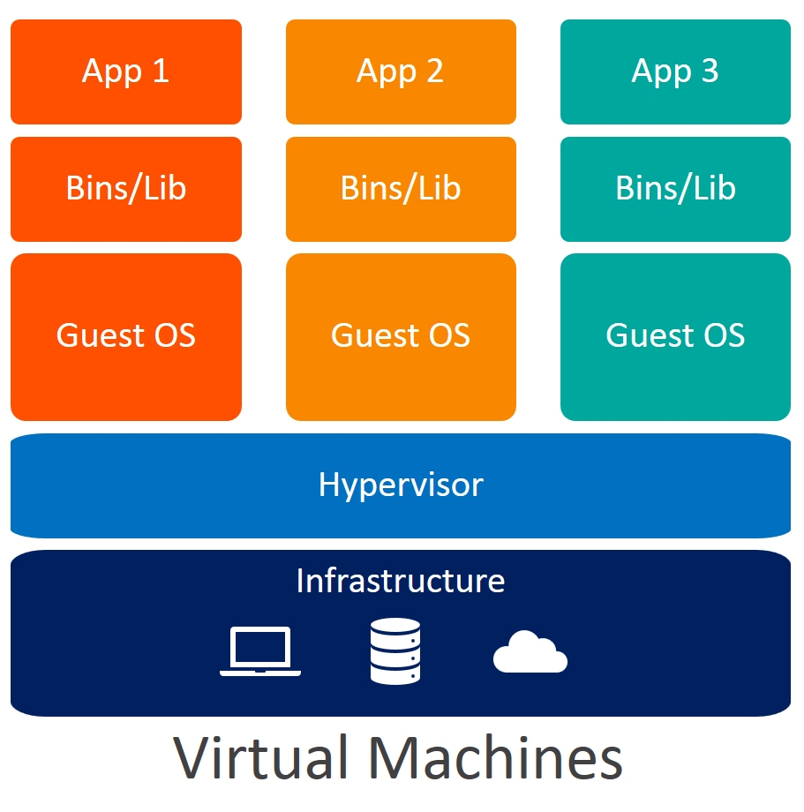
What is a Virtual Machine?
Virtual machines are heavy software packages that provide complete emulation of hardware devices like CPU, Disk and Networking devices.
Virtual machines may also include a complementary software stack to run on the emulated hardware.
These hardware and software packages combined produce a fully functional snapshot of a computational system.

Slide 5
Containerization
Containerization is the packaging together of software code with all it's necessary components like libraries, frameworks, and other dependencies so that they are isolated in their own "container.“
A container is a standard unit of software that packages up code and all its dependencies so the application runs quickly and reliably from one computing environment to another.

Slide 6
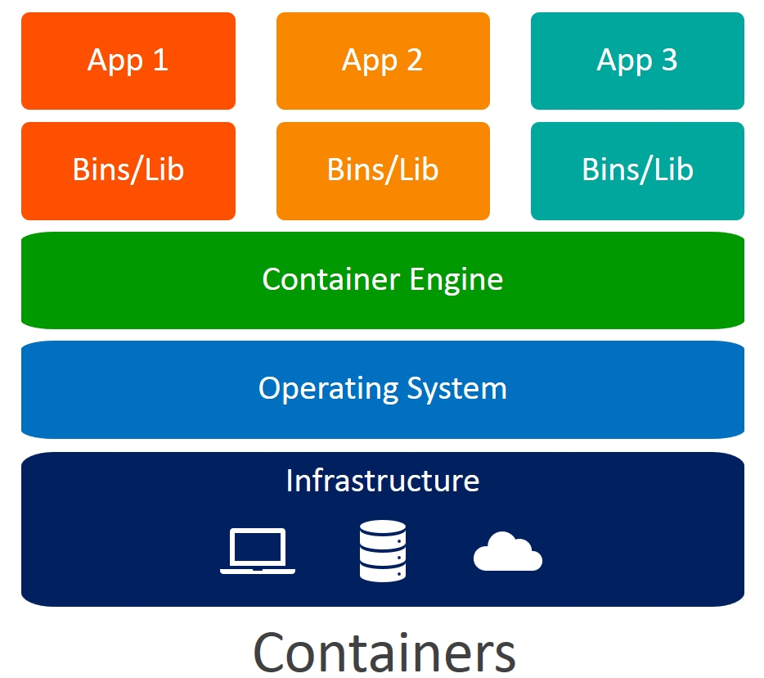
Containerization over Virtualization:

Slide 7
Containerization over Virtualization:
Containers on the same OS kernel are lighter and smaller
Better resource utilization compared to VMs
Boot-up process is short and takes few seconds

Slide 8
When to use Containers?
Consider containers in particular if the following is a priority
Start time
Efficiency
Licensing
Code reuse

Slide 9

It works on my machine!!!

Slide 10
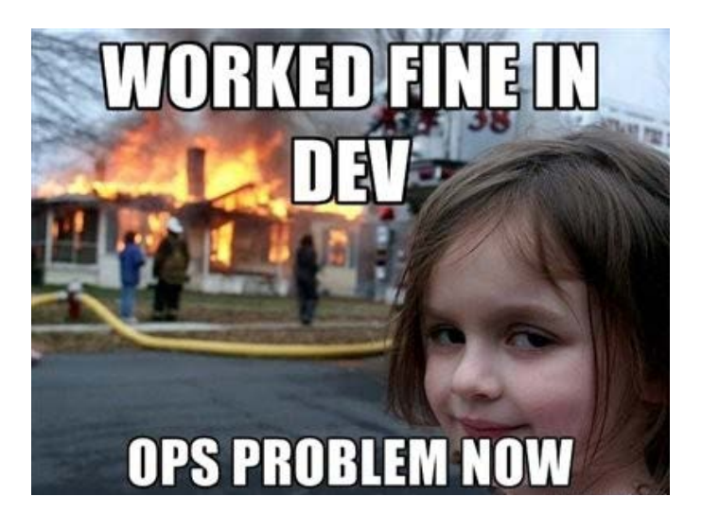
It works on my machine!!!

Slide 11


Slide 12
Docker
Docker is a containerization platform that packages your application and all its dependencies together in the form of Containers to ensure that your application works seamlessly in any environment.
Docker containers that run on Docker Engine:
Standard
Lightweight
Secure

Slide 13
Why Docker
Docker creates simple tooling and a universal packaging approach that bundles up all application dependencies inside a container which is then run on Docker Engine.
Docker Engine enables containerized applications to run anywhere consistently on any infrastructure, solving “dependency issues” for developers and operations teams, and eliminating the “it works on my laptop!” problem.

Slide 14
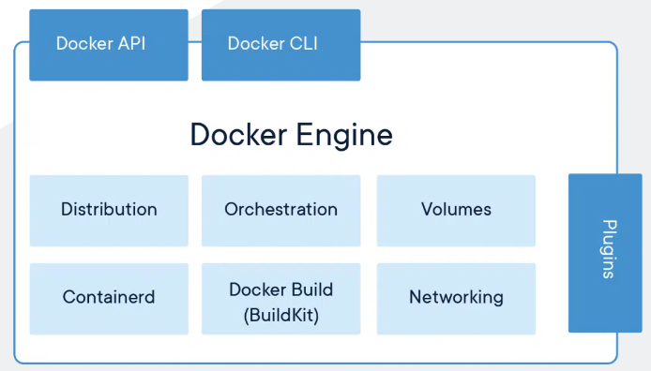
Docker Engine

Slide 15
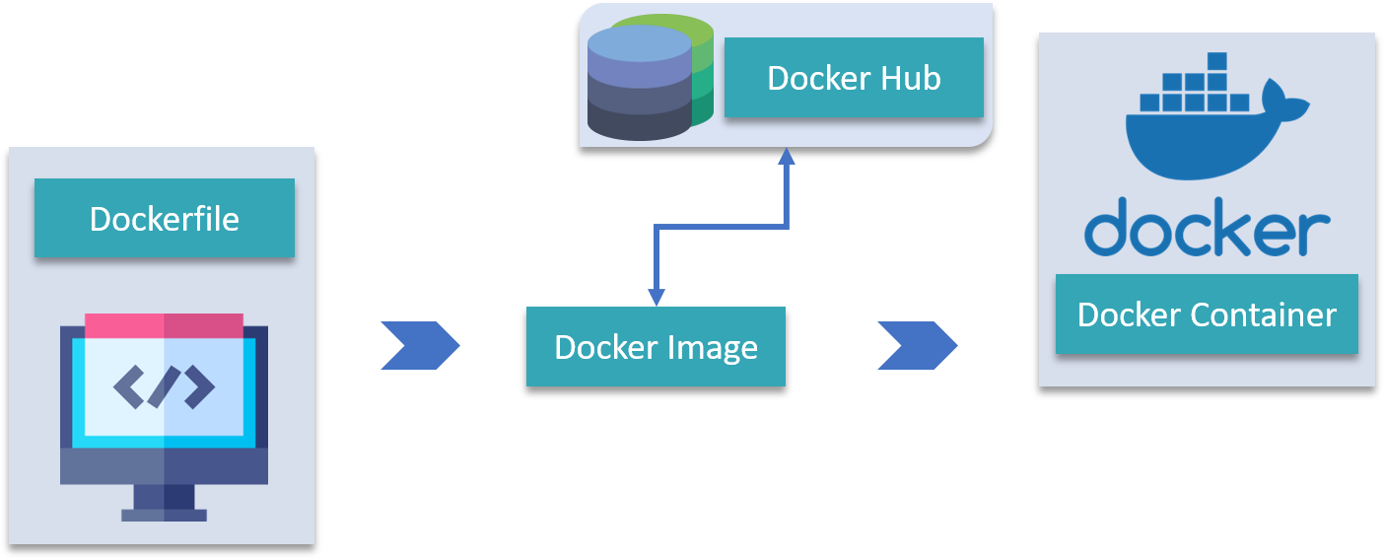
Terminologies of Docker
Docker Image
Dockerfile
Docker Containers
Docker Hub
Docker Compose
Docker Client
Docker Daemon

Slide 16
Concept

Slide 17
Concept

Slide 18
Concept

Slide 19
Concept

Slide 20
Concept

Slide 21
Concept

Slide 22
Concept

Slide 23
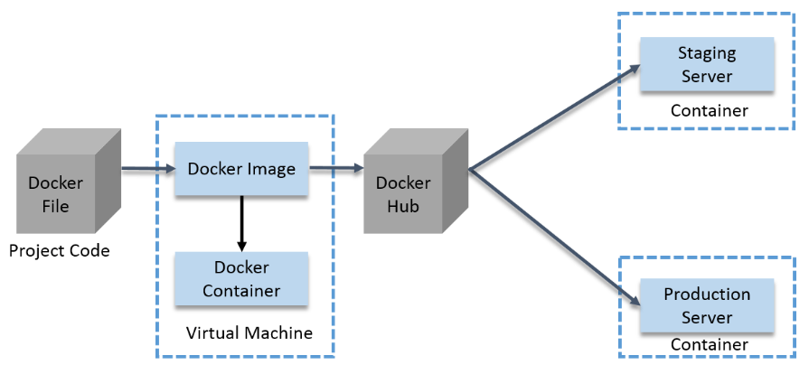
How a Docker Container Works?

Slide 24
Introduction to Kubernetes
Kubernetes is a container management technology developed in Google lab to manage containerized applications in different kind of environments such as physical, virtual, and cloud infrastructure.
It is an open source system which helps in creating and managing containerization of application.
Kubernetes comes with a capability of automating deployment, scaling of application, and operations of application containers across clusters.

Slide 25
Features of Kubernetes
Features | Features
Continues development, integration and deployment | Environment consistency across development testing and production
Containerized infrastructure | Loosely coupled infrastructure, where each component can act as a separate unit
Application-centric management | Higher density of resource utilization
Auto-scalable infrastructure | Predictable infrastructure which is going to be created

Slide 26
What can Kubernetes do for you?
Kubernetes helps you make sure that the containerized applications run where and when you want, and helps them find the resources and tools they need to work.
Kubernetes is a production-ready, open source platform designed with Google's accumulated experience in container orchestration.

Slide 27
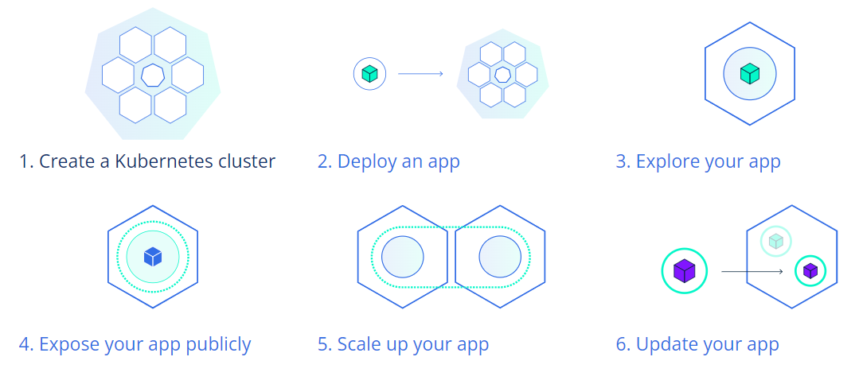
Kubernetes Basics Modules

Slide 28


Slide 29
THANK YOU

