Slide 1

Jitendra Singh Tomar

Slide 2
Index
Introduction
What is Terraform?
Why Terraform?
Terraform Architecture
How Terraform Works
Terraform Basics, Extensions
Terraform Config files
Terraform Commands
Demo

Slide 3

About me
Over all 10+ years of experience including 6+ years of training experience and 4+ years of production experience.
Experience in both Induction & Lateral crowd handling.
Microsoft Certified Trainer on Microsoft Azure.
Other expertise:- AWS cloud, Windows Servers, RHEL, PowerShell scripting, Python.
Skilled in automation.

Slide 4
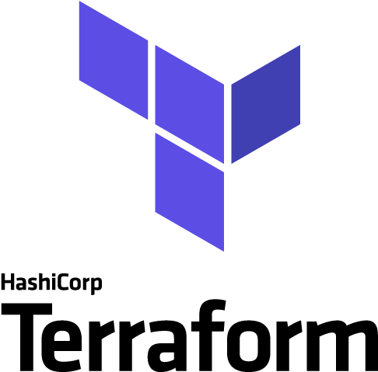
What is Terraform?
Terraform is an open-source infrastructure as code (IAC) tool that allows you to define and manage your cloud resources declaratively, using a high-level configuration language.
Terraform is a powerful and flexible tool for managing cloud infrastructure that can help you streamline your workflows, reduce costs, and increase the agility and reliability of your systems.

Slide 5

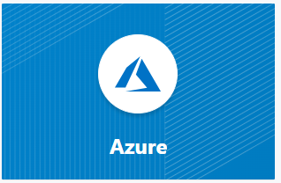
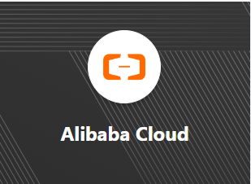
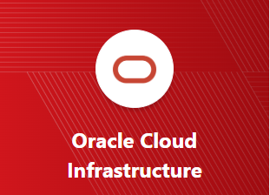
With Terraform
You can
Create
Modify
Destroy
Cloud resources like
Public cloud providers
Private cloud environments
Hybrid cloud environments
Networking infrastructure
Databases, Containers etc…

Slide 6
Why Terraform?
Multi-cloud support
01
Declarative syntax
02
Allows you to manage resources across different clouds with a consistent workflow.
Making it easy to understand and maintain your code.
Idempotent updates
03
Infrastructure as code
04
Terraform ensures that updates to your infrastructure are idempotent.
Meaning that your infrastructure is treated like any other code artifact.
Resource graph
05
Large ecosystem
06
Allows it to perform updates in the correct order and handle dependencies automatically
This can save your time and effort by leveraging existing community-contributed resources.

Slide 7
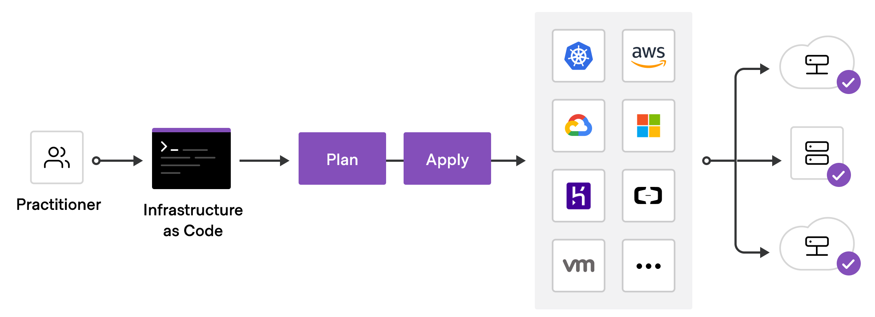
Terraform Architecture

Slide 8
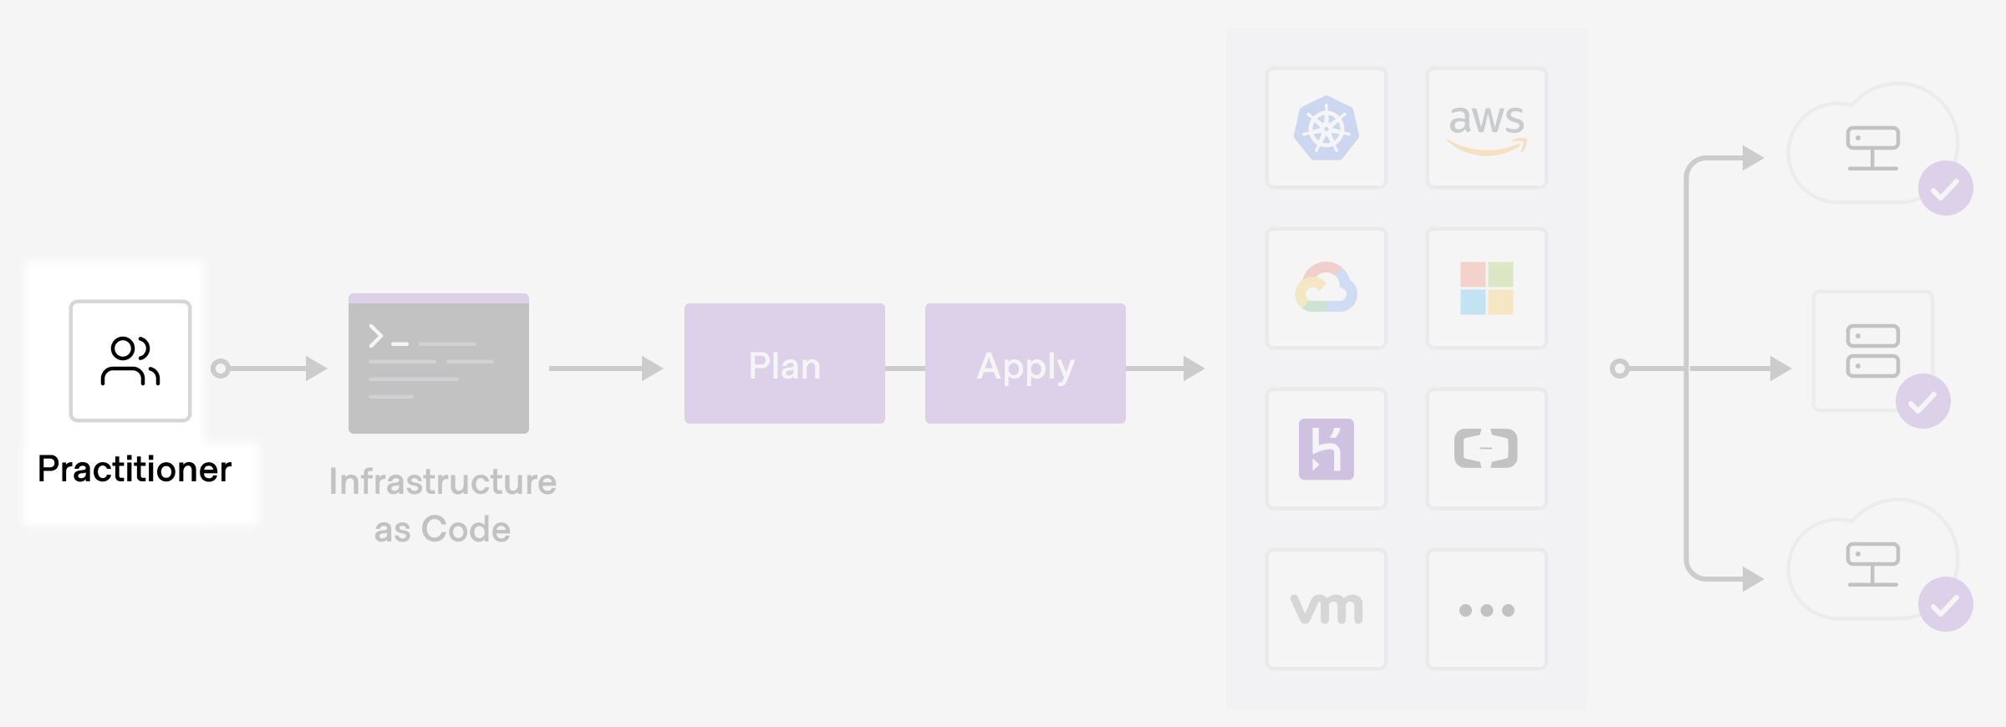
Terraform Architecture

Slide 9
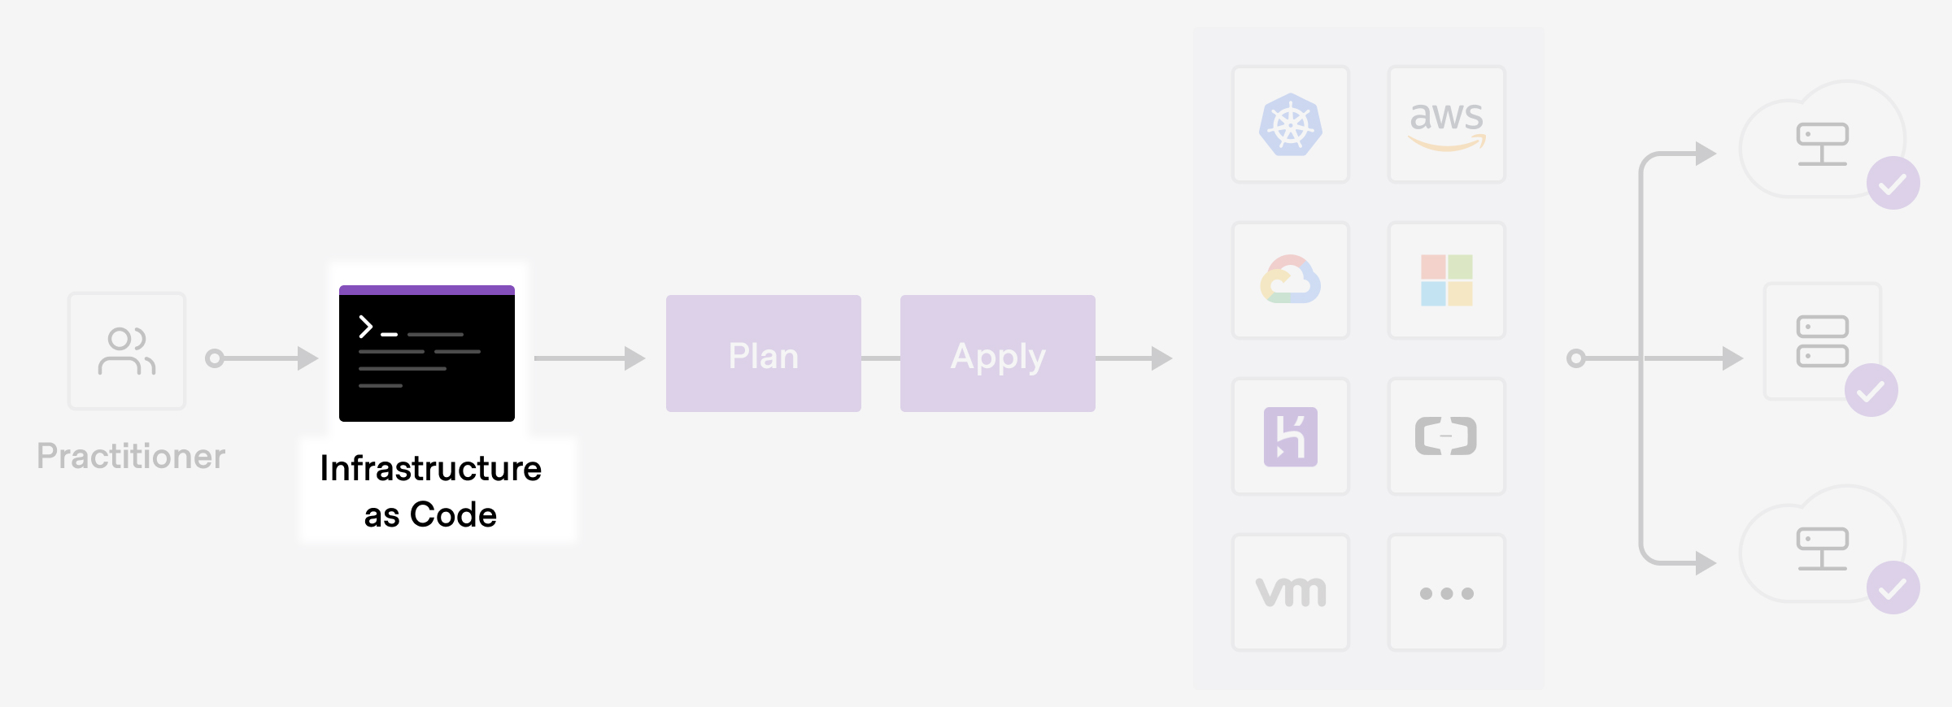
Terraform Architecture

Slide 10
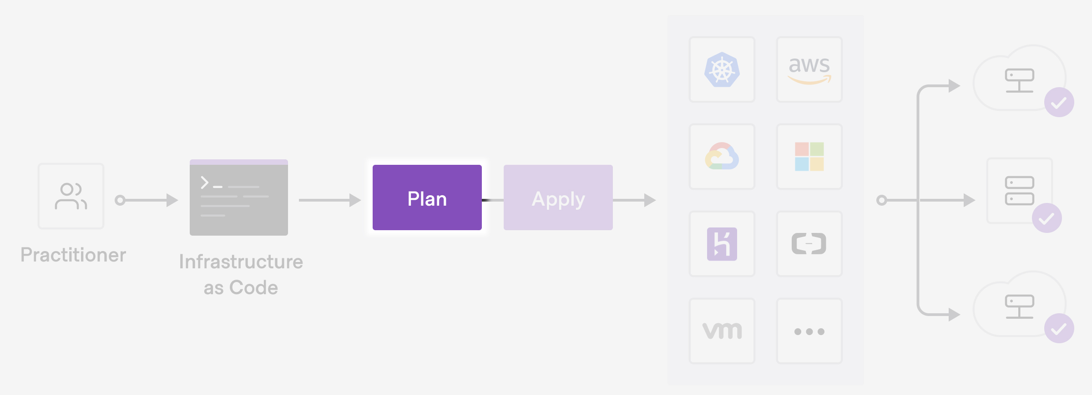
Terraform Architecture

Slide 11
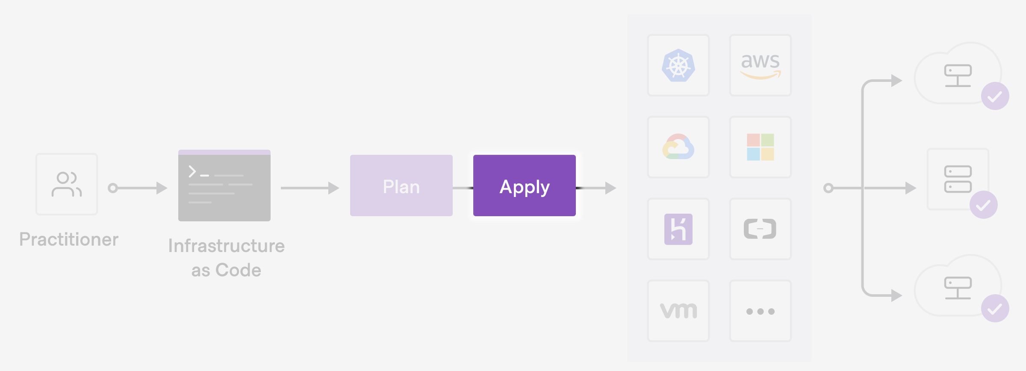
Terraform Architecture

Slide 12
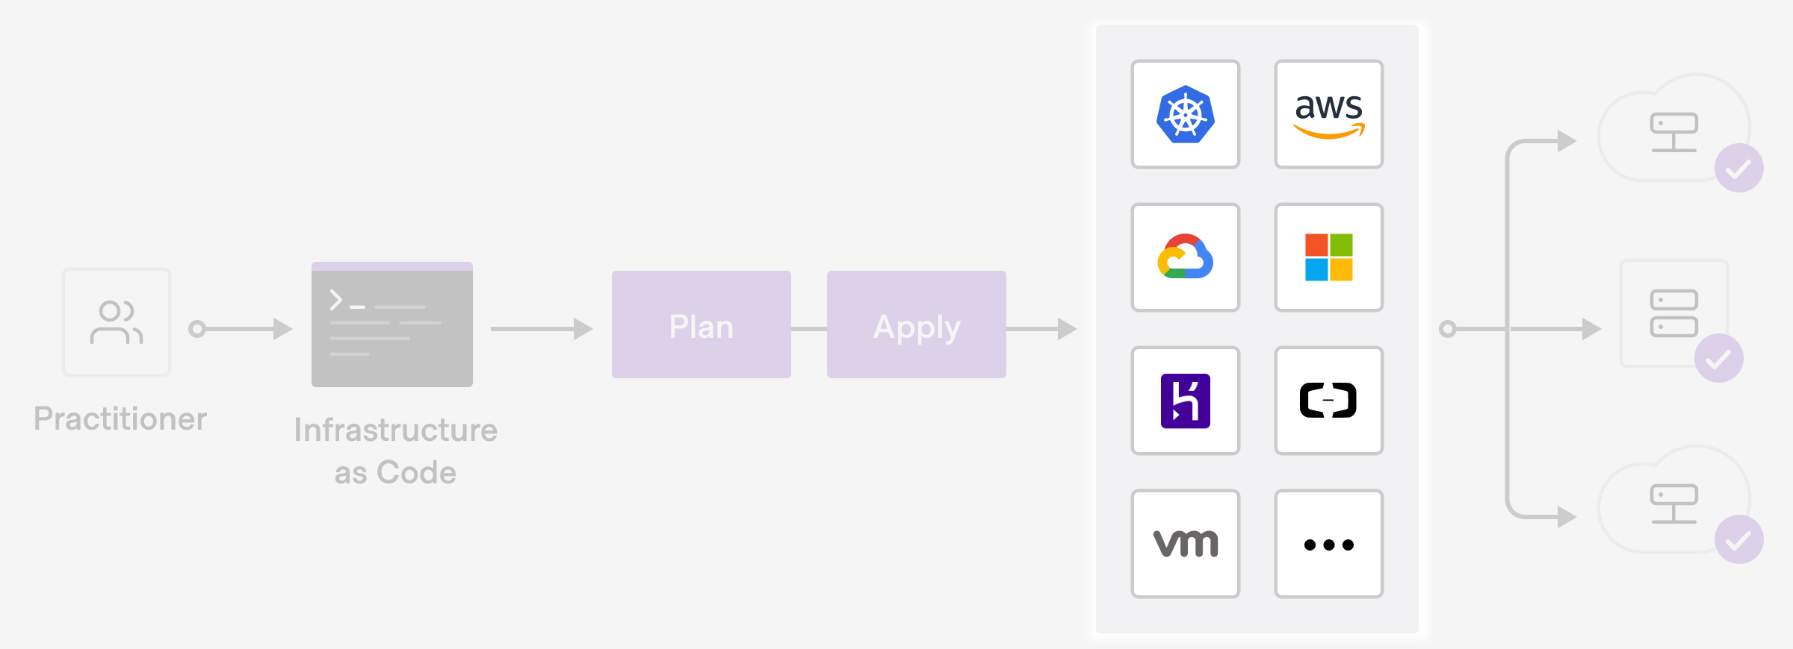
Terraform Architecture

Slide 13
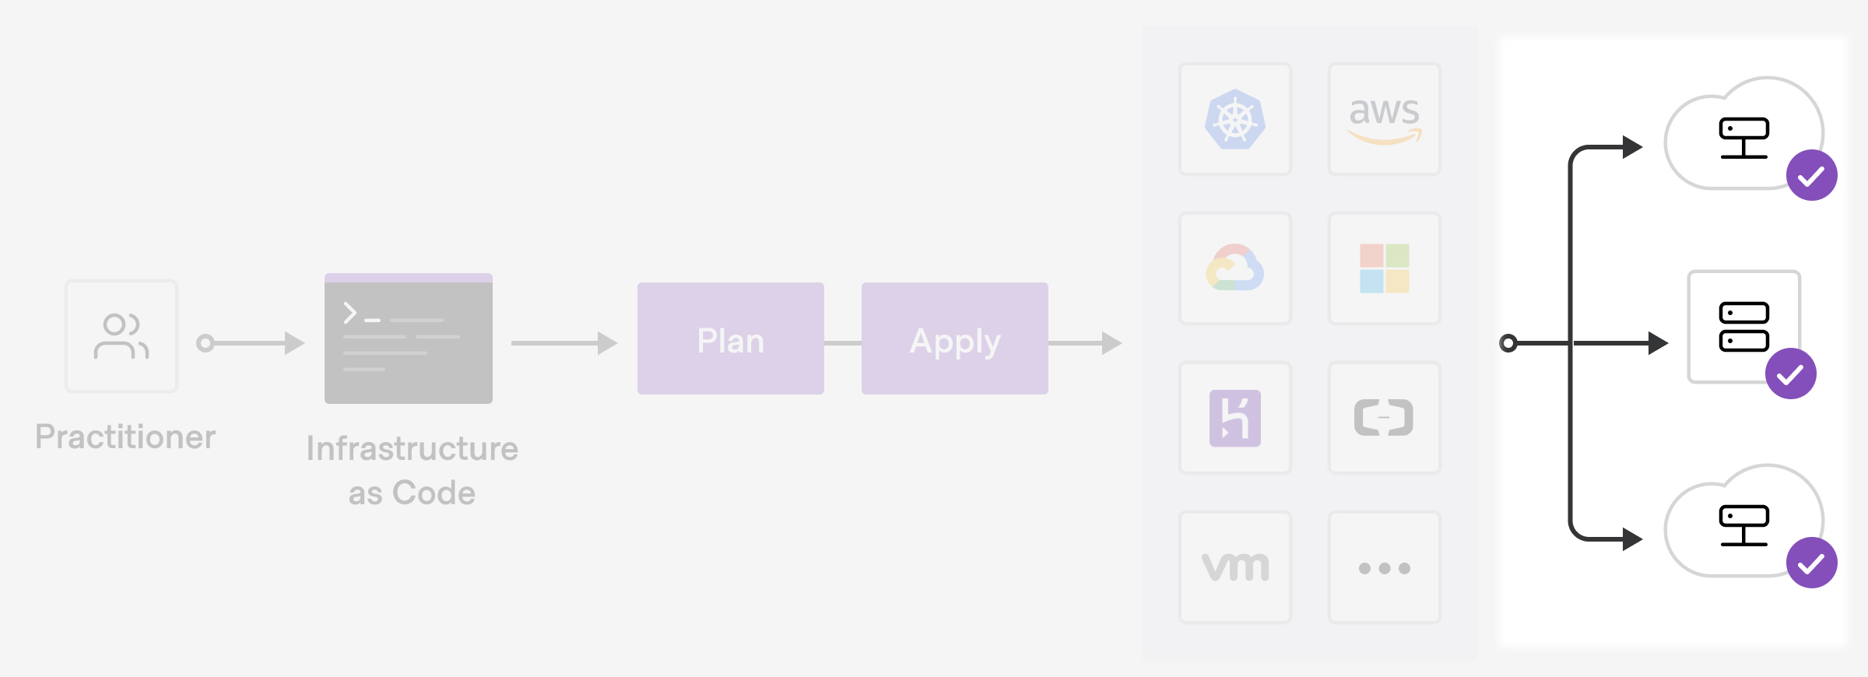
Terraform Architecture

Slide 14
How Terraform Works?

Slide 15






01
Continuous Management
Configuration File
Terraform continuously monitors the state of the infrastructure resources and updates them as necessary to maintain the desired state.
The configuration file specifies the provider to use, the resources to create, and their desired state.
06
02
Terraform
State Management
Initialization
works by providing a simple and efficient way to define, create, modify, and manage infrastructure resources in a scalable and consistent manner.
The state file is also used to track changes over time and to identify differences between the desired and actual state.
This is done using the "terraform init" command, which downloads the necessary provider plugins and modules.
Execution
05
03
Planning
Terraform manages the dependencies between resources and ensures that they are created in the correct order.
The plan includes the actions that will be taken, such as creating new resources, modifying existing resources, or destroying resources.
04

Slide 16
Terraform Basics
1
5
Configuration
State Management
2
6
Providers
Terraform
Basics
Command-line Interface
3
7
Resources
Plan
4
8
Modules
Apply

Slide 17





Terraform Config File extensions
.tf
.TF is the primary extension used in Terraform for configuration files.
.tfvars
These files contain variable definitions for your Terraform configuration.
.tfstate
These files store the current state of the infrastructure resources managed by Terraform.
.tfplan
They contain a summary of the changes that Terraform plans to make to your infrastructure resources.
.tfignore
These files are used to specify files or directories that should be ignored by Terraform

Slide 18
Terraform Commands
1
5
terraform init
terraform validate
2
6
terraform plan
Terraform
cmds
terraform state
3
7
terraform apply
terraform output
4
8
terraform destroy
terraform refresh

Slide 19
Terraform syntax

Slide 31
Links
Building TF: https://developer.hashicorp.com/terraform/tutorials/aws-get-started/aws-build

Slide 32
DEMO

Slide 33


