Slide 1
Devops
Presented by
Jitendra Singh Tomar
Notes:
Are your classroom colors different than what you see in this template? That’s OK! Click on Design -> Variants (the down arrow) -> Pick the color scheme that works for you!
Feel free to change any “You will…” and “I will…” statements to ensure they align with your classroom procedures and rules!

Slide 2
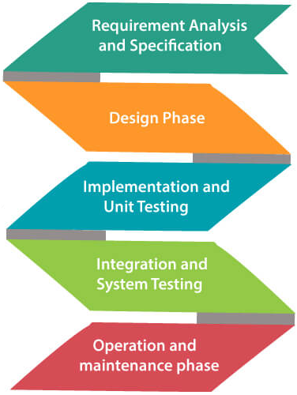
What we had before DevOps?
Traditionally, we had Waterfall Model.
In this model, next stage will only start when the earlier stage is completed.

Slide 3
Drawbacks on Waterfall Model:
Not suitable for complex projects.
No acceptance of changes during development.
It tough to revert back.
Testing done at a later stage, making it hard to identify the challenges and risks earlier.

Slide 4
Agile Methodology
The Agile methodology is a way to manage a project by breaking it up into several phases (iterations).
This methodology is one of the simplest and effective processes to turn a vision for a business need into software solutions.
Agile is a term used to describe software development approaches that employ continual planning, learning, improvement, team collaboration, evolutionary development, and early delivery.

Slide 5
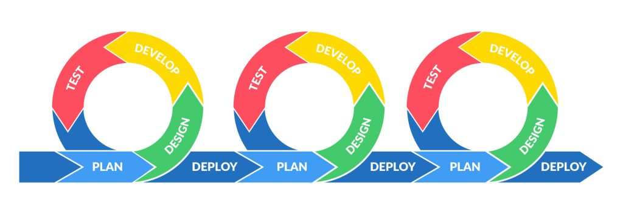
Agile Methodology

Slide 6
DevOps

Slide 7
What is DevOps?
DevOps is a combination of two words Development and Operations
The Development team is responsible for developing, designing, and building the application.
The Operation team deals with the deployment and testing of the application.
DevOps is a software development strategy which bridges the gap between Dev-side & Ops-side.

Slide 8
What is DevOps?
DevOps is not a technology.
In DevOps, teams participate together on entire software life cycle from design through the development to the production support.
Both teams (Dev & Ops) can work on rapidly changing systems, fix bugs, and help to deliver a good quality of software in time.

Slide 9
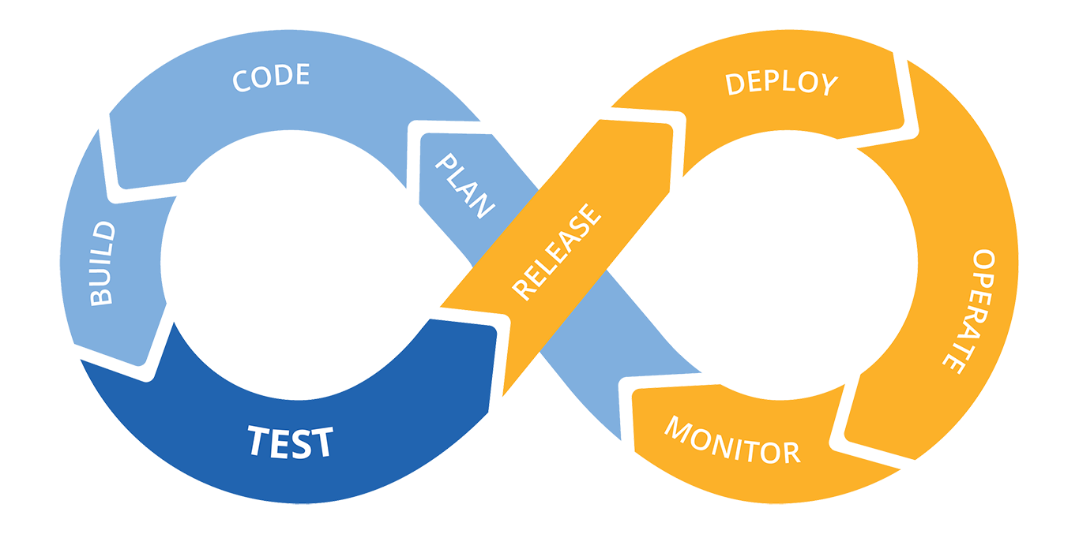
How DevOps work?

Slide 10
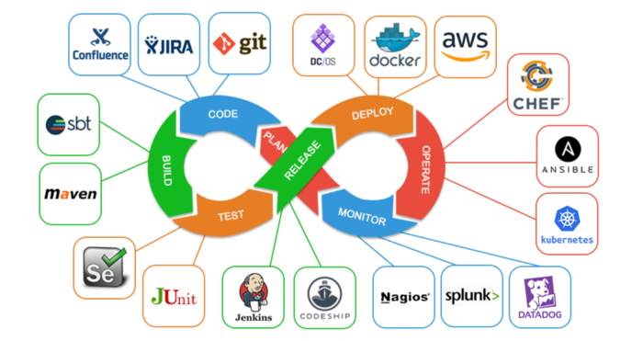
Tools under DevOps

Slide 11
DevOps Tools
Areas | Tools
Planning & Coding | Git, Jira
Building | Apache ants, Maven, Gradle, Jenkins
Integration | Selenium, Junit, Jenkins
Testing | Bamboo, Jenkins, Selenium
Deployment & Operations | Docker, Puppet, Chef, Ansible, Saltstack, Terraform
Monitoring | Stack, Splunk, Nagios

Slide 12
CI/CD
Jenkins
Travis CI
CircleCI
GitLab CI/CD
Azure DevOps (formerly known as Visual Studio Team Services)
TeamCity
Bamboo
GitHub Actions

Slide 13
Version Control:
Git
GitHub
GitLab
Bitbucket
Subversion (SVN)

Slide 14
Containerization and Orchestration:
Docker
Kubernetes
OpenShift
Amazon ECS
Google Kubernetes Engine (GKE)
Azure Kubernetes Service (AKS)

Slide 15
Configuration Management:
Ansible
Puppet
Chef
SaltStack
Terraform (for infrastructure as code)
PowerShell – DSC (Windows O.S)

Slide 16
Infrastructure as Code (IaC):
Terraform
AWS CloudFormation
Azure Resource Manager (ARM) Templates
Google Cloud Deployment Manager

Slide 17
Monitoring and Logging:
Prometheus
Grafana
ELK Stack (Elasticsearch, Logstash, Kibana)
Splunk
New Relic
Datadog
Nagios – XI (Paid), Core(Free)
Zabbix

Slide 18
Collaboration and Communication:
Slack
Microsoft Teams
Mattermost
HipChat
Jira
Confluence

Slide 19
Artifact Repository:
Nexus Repository
JFrog Artifactory
Docker Hub
AWS Elastic Container Registry (ECR)
Google Container Registry (GCR)

Slide 20
Continuous Testing:
Selenium
JUnit
TestNG
Postman
JMeter
Appium
Cucumber

Slide 21
Security:
SonarQube
OWASP ZAP (Zed Attack Proxy)
Nessus
Qualys
Vault (for secret management)

Slide 22
Deployment and Release Orchestration:
Spinnaker
Octopus Deploy
DeployHub

Slide 23
Continuous Monitoring and Performance Optimization:
APM (Application Performance Monitoring) tools like AppDynamics, Dynatrace
Performance testing tools like Apache JMeter
Load balancers and traffic management tools

Slide 24
Cloud Providers:
AWS (Amazon Web Services)
Azure (Microsoft Azure)
Google Cloud Platform (GCP)
IBM Cloud
Alibaba Cloud

Slide 25
Serverless Computing:
AWS Lambda
Azure Functions
Google Cloud Functions

Slide 26
Database and Data Management:
Database migration and schema management tools
Data backup and recovery tools
DataOps platforms

Slide 27
Code Quality and Code Review:
SonarQube
Crucible
Review Board

Slide 28
DevOps Stages
There are 4 stages under DevOps.
Stage 01 – Version Control
Stage 02 – Continuous Integration
Stage 03 – Continuous Delivery
Stage 04 – Continuous Deployment
Continuous Monitoring

Slide 29
Git

Slide 30
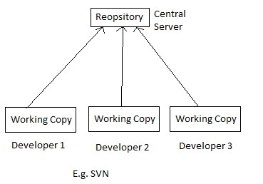
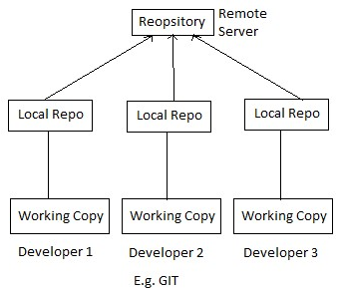
Version Control
Its the practice of tracking and managing changes to software code.
Version control has two approaches.
Centralized version control system | Distributed version control system

Slide 31
Version Control Tools
Git
Subversion
CVS
Mercurial
SVN

Slide 32
Git Operations & Basic commands
GIT init
Add origin
Creating Repo
State
Sync Repo
Making Changes
Add
Parse
GIT
Pull
Commit
Parallel Development
Merge
Branch
Release

Slide 33
Continuous Integration (CI)

Slide 34
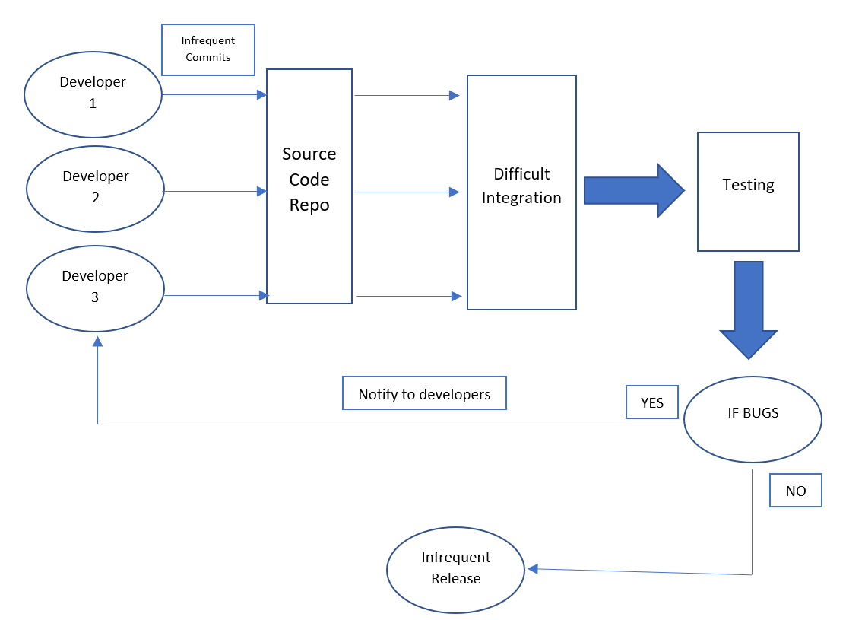
Without Continuous Integration

Slide 35
Continuous Integration
Continuous integration (CI) is the practice of automating the integration of code changes from multiple contributors into a single software project.
A source code version control system is the crux of the CI process.
In this, developers make changes/commits frequently.
Every commit is then “build”, which allows to detect problems/bugs within the code at early stage.

Slide 36
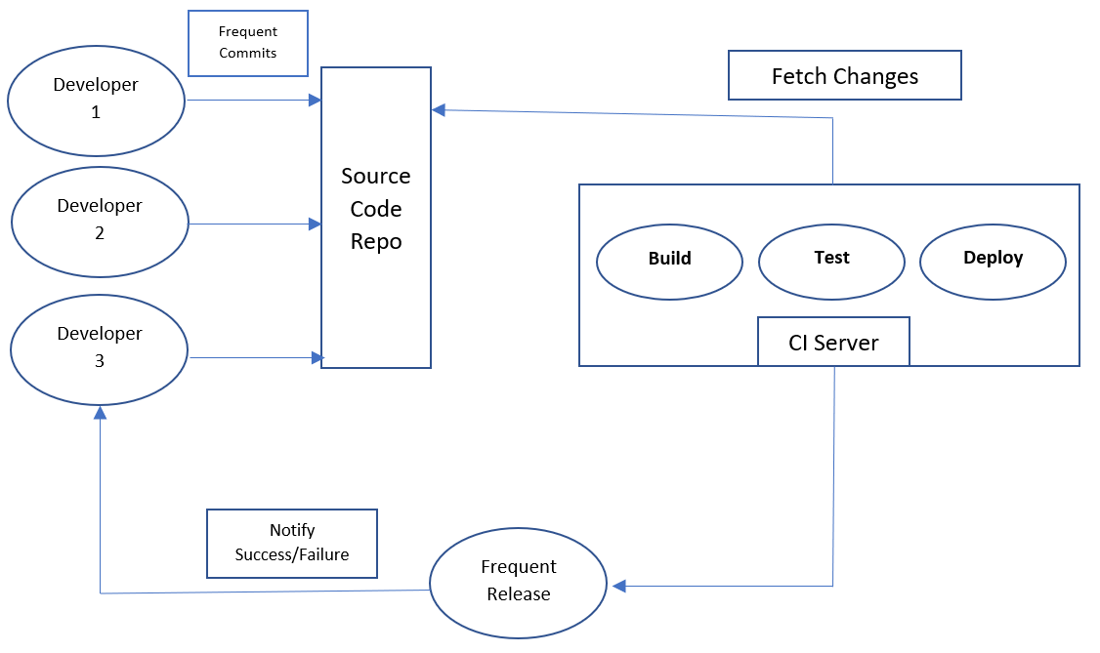
With Continuous Integration

Slide 37
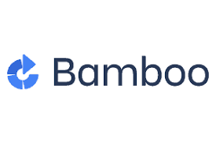


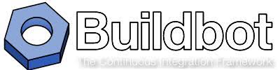
Continuous Integration Tools
Jenkins
Buildbot
Travis CI
Bamboo

Slide 38
Continuous Delivery (CD)

Slide 39
What is Continuous Delivery?
Continuous delivery is a software engineering approach in which teams produce software in short cycles.
This ensures that the software can be reliably released at any time.
It aims at building, testing, and releasing software with greater speed and frequency.
The approach helps reduce the cost & time.

Slide 40
Continuous Delivery
Continuous delivery (CD) has become a mandatory requirement for organizations.
A release pipeline can create multiple testing or staging environments to automate infrastructure creation and deploy new builds.
Successive environments support progressively longer-running integration, load, and user acceptance testing activities.

Slide 41
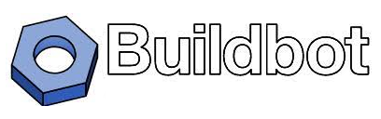
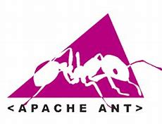
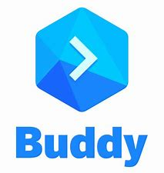
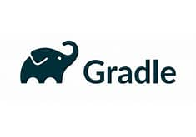
Continuous Delivery Tools
Gradle
Jenkins
BuildBot
Buddy
Ant

Slide 42
Deployment Pipeline
Continuous delivery is enabled through the deployment pipeline.
The purpose of the deployment pipeline has three components.
Visibility – All aspects of the delivery system including building, deploying, testing, and releasing are visible to every member of the team to promote collaboration.
Feedback – Team members learn of problems as soon as possible when they occur so that they are able to fix them as quickly as possible.
Continually deploy – Through a fully automated process, you can deploy and release any version of the software to any environment.

Slide 43
Configuration Management

Slide 44
What is Configuration Management?
Configuration management (CM) is a process for establishing and maintaining consistency of a product's performance, functional, and physical attributes with its requirements, design, and operational information throughout its life.
Software configuration management is a systems engineering process that tracks and monitors changes to a software systems configuration metadata.
In software development, configuration management is commonly used alongside version control and CI/CD infrastructure.

Slide 45
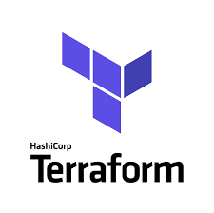
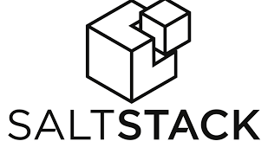

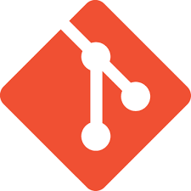
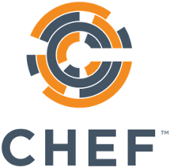
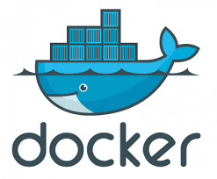
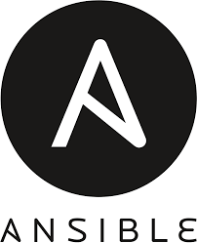
Configuration management tools
Terraform
Git
Chef
Ansible
Saltstack
Puppet
Docker

Slide 46
Outcomes of Properly Managed Configurations
Automation of the infrastructure environment provides standardization
Setups are free of human error
Collaboration is enhanced between operations and development
Keeps configurations from drifting
Makes infrastructure more flexible, ready to scale
Each step is consistent across all resources
Version control is a given

Slide 47
Containerization

Slide 48
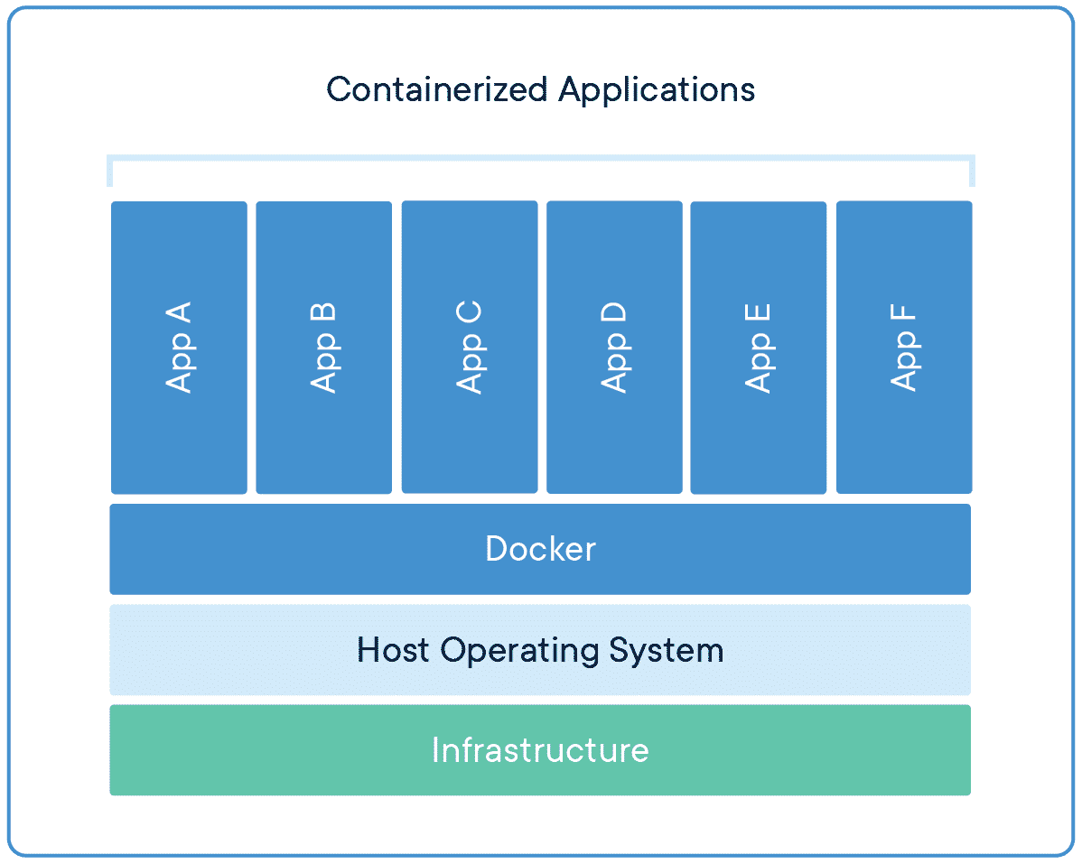
What is Containerization?
Containerization is a form of virtualization.
Containers are lightweight, portable, and highly conducive to automation.
Containers solve application conflicts between different environments.

Slide 49
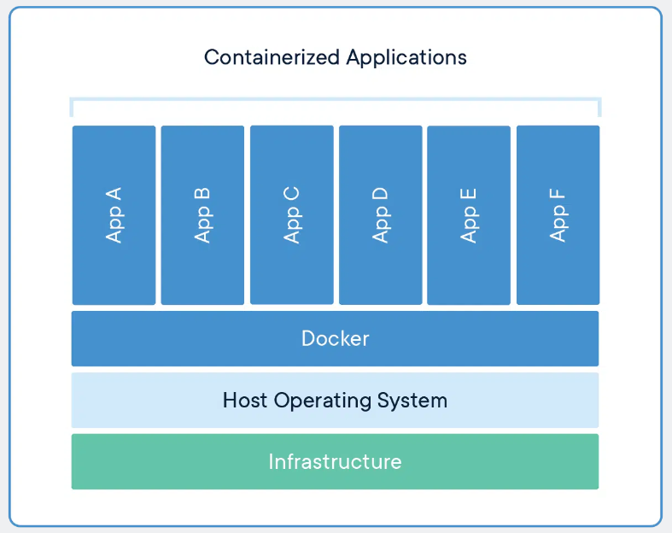
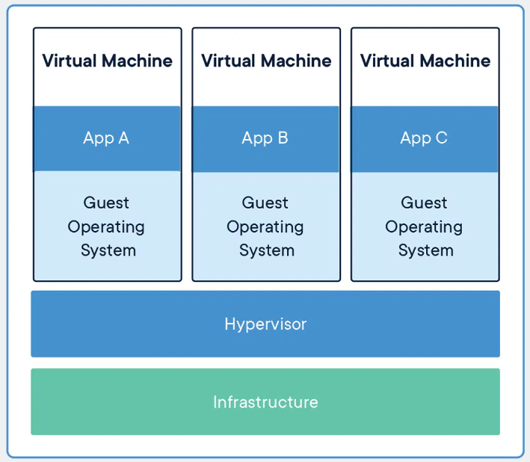
Containers vs Virtual Machines

Slide 50
Benefits of Containers
Greater consistency
Cost savings
Security
Agility

Slide 51
Continuous Monitoring (CM)

Slide 52
What is Continuous Monitoring?
Continuous monitoring is the process of identifying threats to the security and compliance rules of a software development cycle and architecture.
It is an automated procedure that can be extended to detect similar inconsistencies in IT infrastructures.
Continuous monitoring (CM) is a step towards the end of the DevOps process.

Slide 53
Types of Continuous Monitoring
Infrastructure Monitoring
IT infrastructures typically include components like storage, software and hardware units, data centers, servers, networks, and so on.
Application Monitoring
provides details about an application, everything from application uptime, security to performance and log-time.
Network Monitoring
This tool facilitates the evaluation of switches, servers, virtual machines, firewalls, and routers.

Slide 54
Tools for Continuous Monitoring

Slide 55
Docker

Slide 56
What is Docker?
Docker is a set of platforms as a service (PaaS) product that use the Operating system level visualization to deliver software in packages called containers.
Containers are isolated from one another and bundle their own software, libraries, and configuration files; they can communicate with each other through well-defined channels.
Docker is an open platform for developing, shipping, and running applications.

Slide 57
Benefits of using Docker
Fast, consistent delivery of your applications
Responsive deployment and scaling
Running more workloads on the same hardware

Slide 58
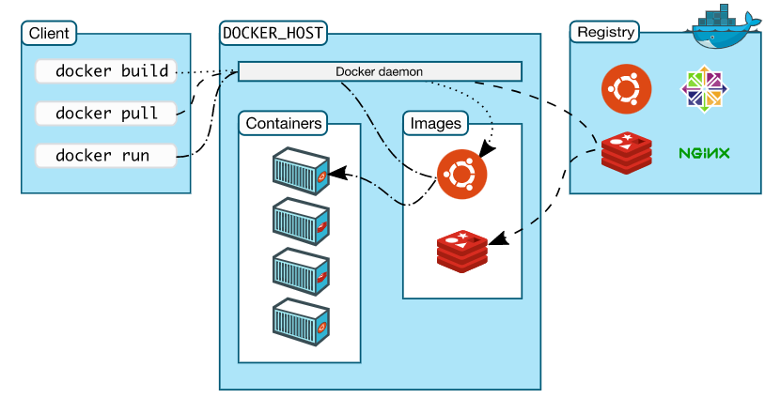
Docker architecture

Slide 59
Kubernetes

Slide 60
What is Kubernetes?
Kubernetes is an open-source container orchestration system for automating software deployment, scaling, and management.
Kubernetes automates operational tasks of container management
Deploying applications
Rolling out changes to your applications
Scaling your applications up and down.
Monitoring your applications.

Slide 61
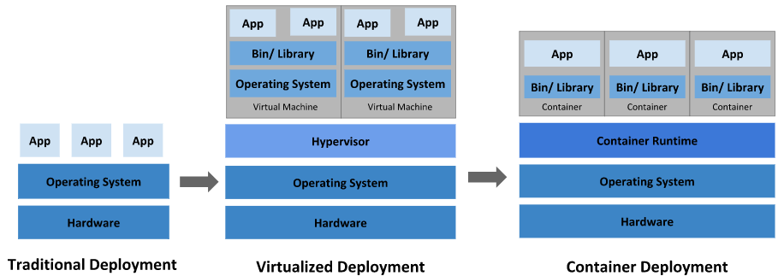
Why Kubernetes?

Slide 62
Benefits of Kubernetes
Automated day-to-day operations
Kubernetes handles complete compute, networking & storage workloads.
Monitors every time, every container.

Slide 63
IaC

Slide 64
What is IaC?
Infrastructure as Code (IaC) is an approach to managing data center server, storage, and networking infrastructure.
IaC is meant to significantly simplify large-scale configuration and management.
With IaC, infrastructure configuration information is housed in standardized files, which can be read by software that maintains the state of the infrastructure.
IaC can improve productivity and reliability by eliminating manual configuration steps.

Slide 65
IaC vs. Automation
Infrastructure as code is concerned with maintaining the configuration or state of the data center infrastructure in a known way.
Automation deals more with the process for automatically pushing that state into the infrastructure and maintaining it.

Slide 66
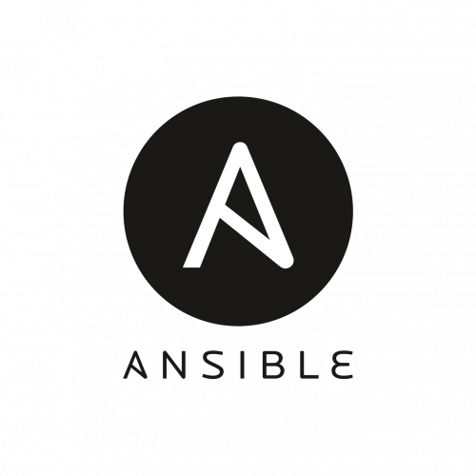
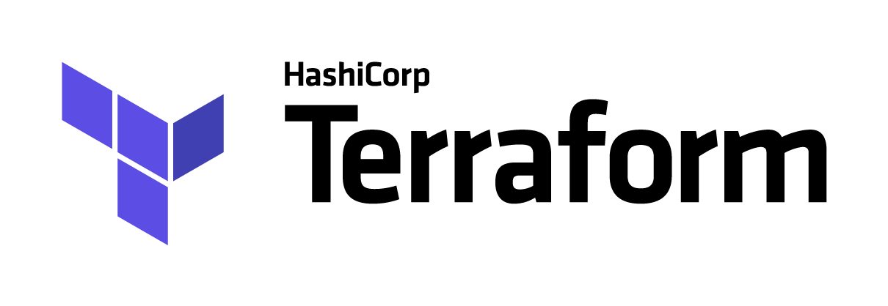
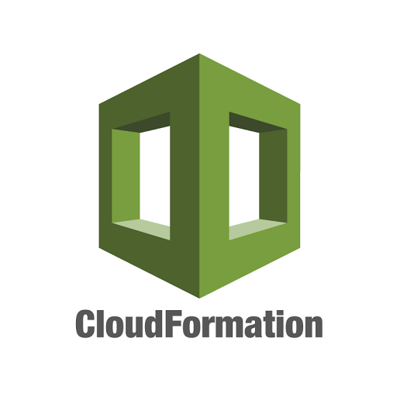
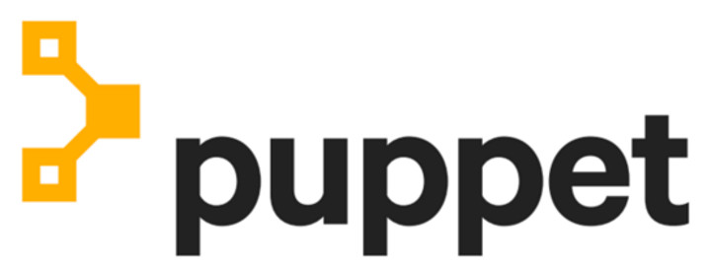
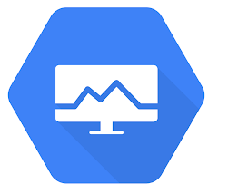
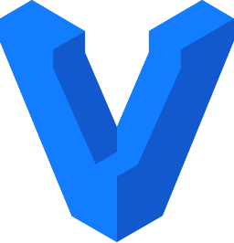
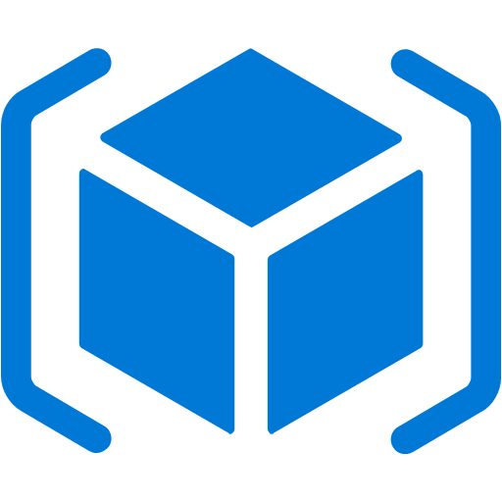
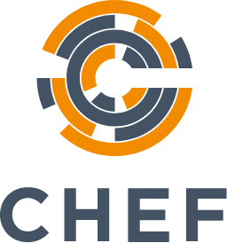
Tools for Infrastructure as Code

Slide 67
Tools for Infrastructure as Code
Terraform
AWS CloudFormation
Azure Resource Manager (Templates)
Google Cloud Deployment Manager
Ansible
Chef
Puppet
Vagrant

Slide 68
Ansible

Slide 69
What is Ansible?
Ansible is a radically simple IT automation system.
It handles configuration management, application deployment, cloud provisioning, ad-hoc task execution, network automation, and multi-node orchestration.
Ansible makes complex changes like zero-downtime rolling updates with load balancers easy.

Slide 70
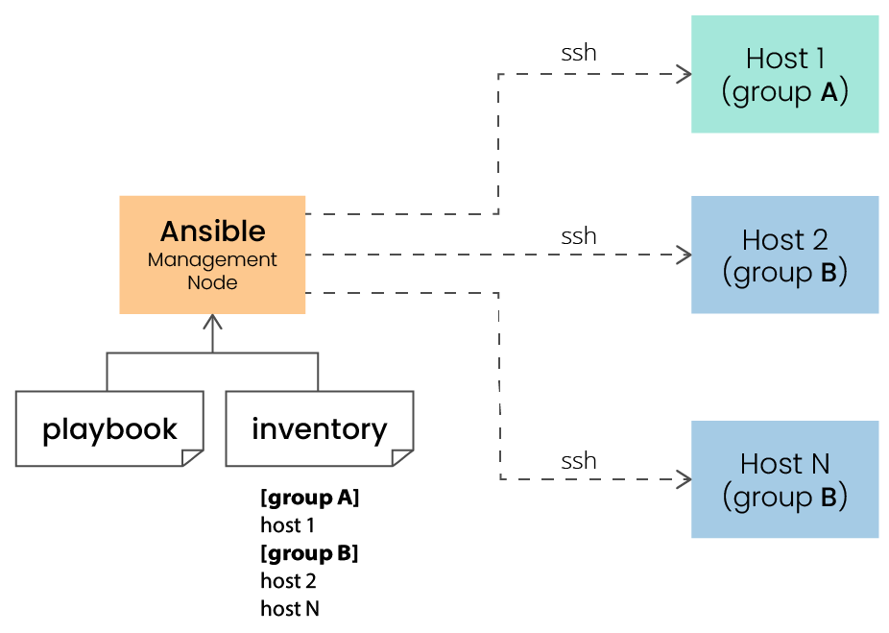
How ansible works?

Slide 71
Ansible playbooks
A playbook is a configuration file written in YAML that provides instructions for what needs to be done in order to bring a managed node into the desired state.
Playbooks are meant to be simple, human-readable, and self-documenting.
A playbook can be very simple or it can be very complex.
Example
Create a user with elevated permissions.
Patching servers, hosts etc.

Slide 72
Puppet

Slide 73
What is Puppet?
Puppet is a configuration management technology to manage the infrastructure on physical or virtual machines.
Puppet follows the client-server model.
Puppet has the capability to manage any system from scratch, starting from initial configuration till the end-of-life of any particular machine.

Slide 74
Puppet versions
Puppet comes in two versions:
Open Source Puppet
Puppet Enterprise

Slide 75
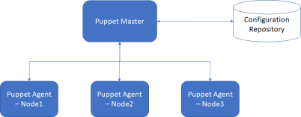
Puppet Architecture

Slide 76
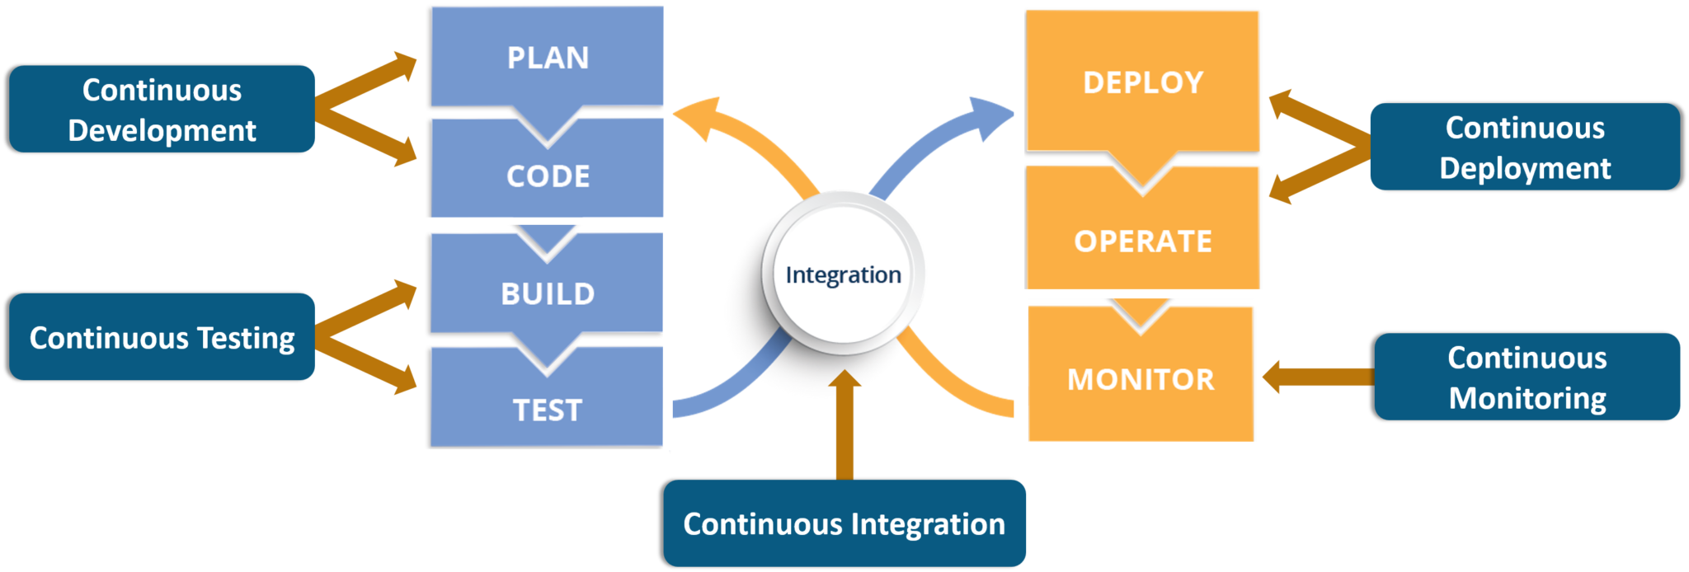
How everything fits together?

Slide 77


Slide 78
Any Question?

