Slide 1
Kubernetes
By
Jitendra Singh Tomar || Jeetu

Slide 2
Topics to discuss
Introduction to K8S.
K8S features
K8S benefits
K8S architecture
Pods
ReplicaSet
Namespaces
Deployment
ConfigMaps
Secrets
Self-Healing.
Persistent Volume & PVC
Monitoring
Logging

Slide 3
Introduction to K8S.
Kubernetes is an open-source container orchestration platform that helps
Automate the deployment,
Scaling and,
Management of containerized applications.
Kubernetes provides a powerful framework for
managing containerized workloads and services,
allowing organizations to build scalable and resilient application architectures.

Slide 4
K8S features
Container Orchestration
Scaling and Load Balancing
Service Discovery
Self-Healing
Rolling Updates and Rollbacks
Storage Orchestration
Secrets
ConfigMaps

Slide 5
Where K8s is useful?
Containerized Application Deployment
Scalability and High Availability
Microservices Architecture
Multi-Cloud and Hybrid Cloud Environments.
Development and Testing Environments
CI/CD Pipelines
Big Data and AI/ML Workloads
Internet of Things (IoT) Applications

Slide 6
Kubernetes Benefits
Scalability and Elasticity
High Availability and Fault Tolerance
Automated Deployments and Rollbacks
Container Orchestration and Management
Service Discovery and Load Balancing
Storage Orchestration
Infrastructure Flexibility
Ecosystem and Community Support
DevOps Enablement
Cost Efficiency

Slide 7
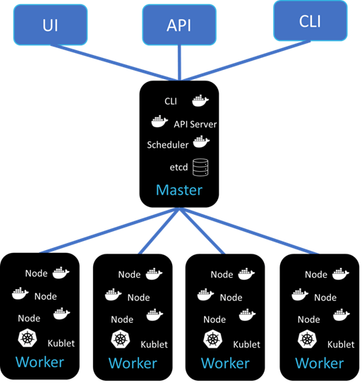
K8s Architecture
A high-level K8s architecture has 4 components:
Master node or Control plane
Worker node(s)
Pods
Containers

Slide 8
K8s Architecture – Master Node
Master Node: The master node is the control plane of the Kubernetes cluster. It coordinates and manages the cluster's operations.
The master node typically runs the following components:
API Server
Scheduler
Controller Manager
ETCD

Slide 9
K8s Architecture – Worker Node
Aka minion nodes, are the machines where containers are scheduled and run.
Worker nodes runs the pods and containers (inside the pods).
Each worker node typically runs the following components:
Kubelet
Container Runtime
kube-proxy

Slide 10
K8s Architecture – Networking
K8s requires a networking solution to enable communication between containers running on different nodes.
There are various K8s networking types:
Container Networking
POD Networking
ClusterIP
Ingress
Load Balancer
Kubernetes Egress
Kubernetes CNI
DNS

Slide 11
K8s Architecture – Add-ons
Kubernetes provides various add-ons and extensions that enhance its functionality.
These include:
Dashboard
Ingress Controller
DNS
Metrics Server

Slide 12
PODs
To keep it simple
Virtualization | Virtual Machines
Docker | Containers
Kubernetes | Pods

Slide 13
PODs
Pods are the workloads that runs on worker nodes.
A pod is the smallest and most fundamental unit of deployment. It represents a single instance of a running process in the cluster.
A pod encapsulates one or more containers, storage resources, and network resources, and it is the basic building block of an application in Kubernetes.
Pods play a vital role in Kubernetes, providing a logical unit for managing containers and enabling applications to be scheduled and deployed as a cohesive unit.
They enable efficient resource sharing, easy inter-container communication, and encapsulation of application components within a single entity.

Slide 14
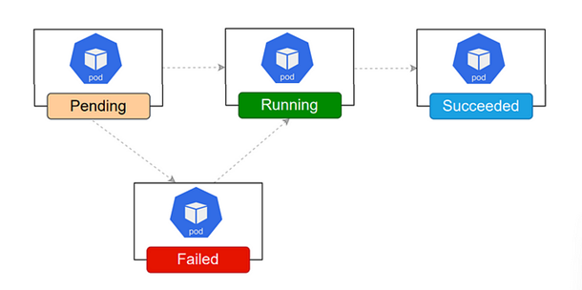
PODs life cycle

Slide 15
PODs life cycle
When a pod is created, it goes in PENDING state.
PENDING state means, your pod is accepted for the deployment but hasn’t scheduled onto any of the VMs (nodes).
Schedular check for resources like CPU & RAM requirements and puts it into a specific VM within cluster.
Now POD status changes from PENDING to CREATING.
In CREATING state, image is getting pulled from centralized repository (in our case Docker Hub). If the image is already present locally, this pulling will be skipped.

Slide 16
PODs life cycle
Once image is pulled, container status changes from CREATING to RUNNING state.
If it fails to pull the image due to any reason, it will change to FAILED state.
RUNNING state means, now the program/application is running properly.
Now in case, if a service within fails or crashes due to any reason, schedular will restart the pod.
But if it crashes frequently, the container state changes to “CRASH LOOP BACK OFF” state. Here the pod tries to heal itself. But if it fails to do so, you need to start looking into commands like “kubectl get pods” or “kubectl describe pod <pod-name>” or even need to check logs.

Slide 17
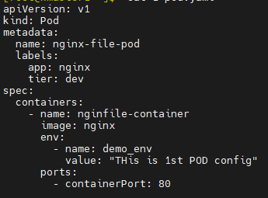
POD YAML Code

Slide 18
ReplicaSet
A replicaset is a resource object that is used to ensure a specific no. of pod replicas are running & maintained within a cluster.
It is one of the core controllers provided by K8s & is responsible for managing & scaling pods.
ReplicaSet always ensures that a specified no. of pods replica are always available & running.
If a pod fails or terminated, RS automatically replaces it with a new pod to maintain the desired count.
Similarly, if a count is increased, RS creates additional pods to maintain the desired count.

Slide 19
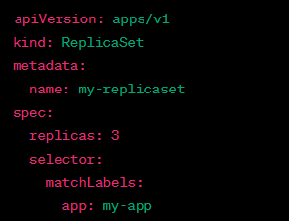
ReplicaSet - Example

Slide 20
Namespaces
It's a way of partitioning the entire K8s cluster into multiple virtual partitions.
You can partition your K8s cluster into:
Various teams
Applications
Environments
Or by any other custom requirement.
By default, k8s install 2 namespaces
Kube-system namespace
Default namespace

Slide 21
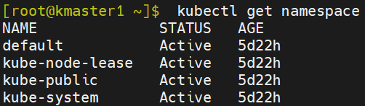
Namespaces

Slide 22
Deployment
A Kubernetes Deployment tells Kubernetes how to create or modify instances of the pods that hold a containerized application.
Deployments can help to efficiently scale the number of replica pods, enable the rollout of updated code in a controlled manner, or roll back to an earlier deployment version if necessary.

Slide 23
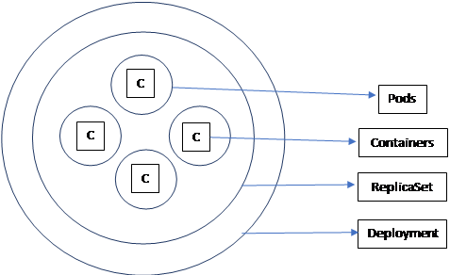
Deployment
Whenever an app is deployed, there are few things to consider.
Scaling of app.
Meaning, increasing & decreasing of instances as per configuration.
Rollout & Rollback of version.
'Deployment' will take care of rollout & rollback.

Slide 24
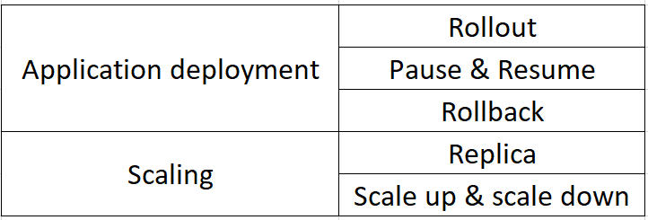
Deployment features
Deployment supports following features under 2 categories

Slide 25
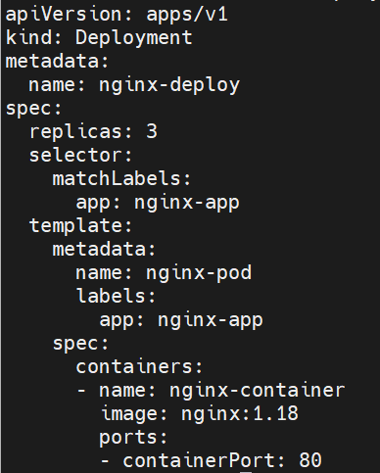
Deployment

Slide 26
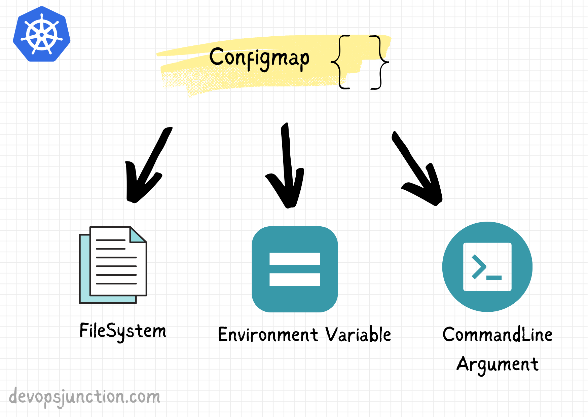
ConfigMaps
ConfigMaps are a Kubernetes mechanism that let you inject configuration data into application pods.
The ConfigMaps concept allow you to decouple configuration artifacts from image content to keep containerized applications portable.

Slide 27
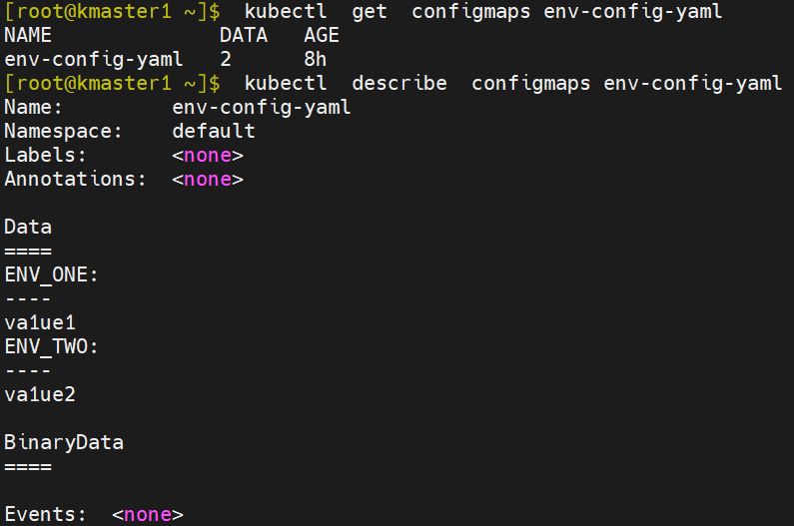
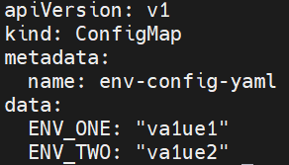
ConfigMaps

Slide 28
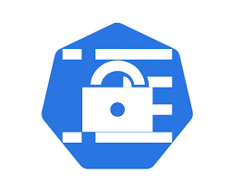
Secret
Kubernetes Secrets are placeholders for sensitive information like credentials, tokens, and certificates, a mechanism for abstracting them.
Kubernetes Secrets act as separate objects which can be queried by the application Pod to provide credentials to the application for access to external resources.

Slide 29
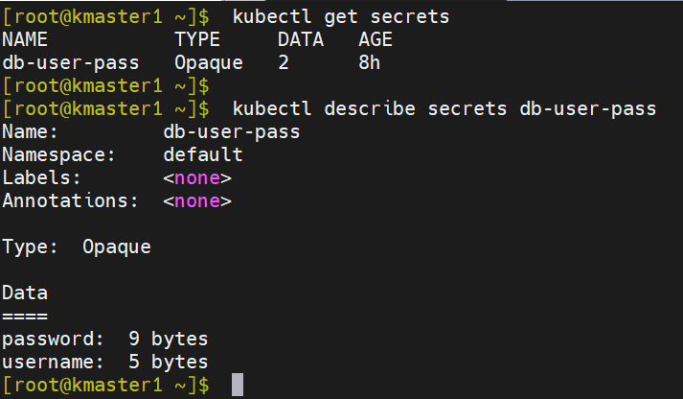
Secret

Slide 30
Self-Healing
A system that heals itself without any manual intervention even in an undesirable situation.
K8s is self-healing system.
K8s provides multiple solutions to heal itself. Like:
Replicaset
Deployment
Daemon set
Etc.

Slide 31
PersistentVolume (PV)
A PersistentVolume (PV) is a piece of storage in the cluster that has been provisioned by an administrator or dynamically provisioned using Storage Classes.
It is a resource in the cluster just like a node is a cluster resource. PVs are volume plugins like Volumes, but have a lifecycle independent of any individual Pod that uses the PV.
This API object captures the details of the implementation of the storage, be that NFS, iSCSI, or a cloud-provider-specific storage system.

Slide 32
PersistentVolumeClaim (PVC)
A PersistentVolumeClaim (PVC) is a request for storage by a user.
It is similar to a Pod.
Pods consume node resources and PVCs consume PV resources.
Pods can request specific levels of resources (CPU and Memory).
Claims can request specific size and access modes (e.g., they can be mounted ReadWriteOnce, ReadOnlyMany, ReadWriteMany, or ReadWriteOncePod).

Slide 33
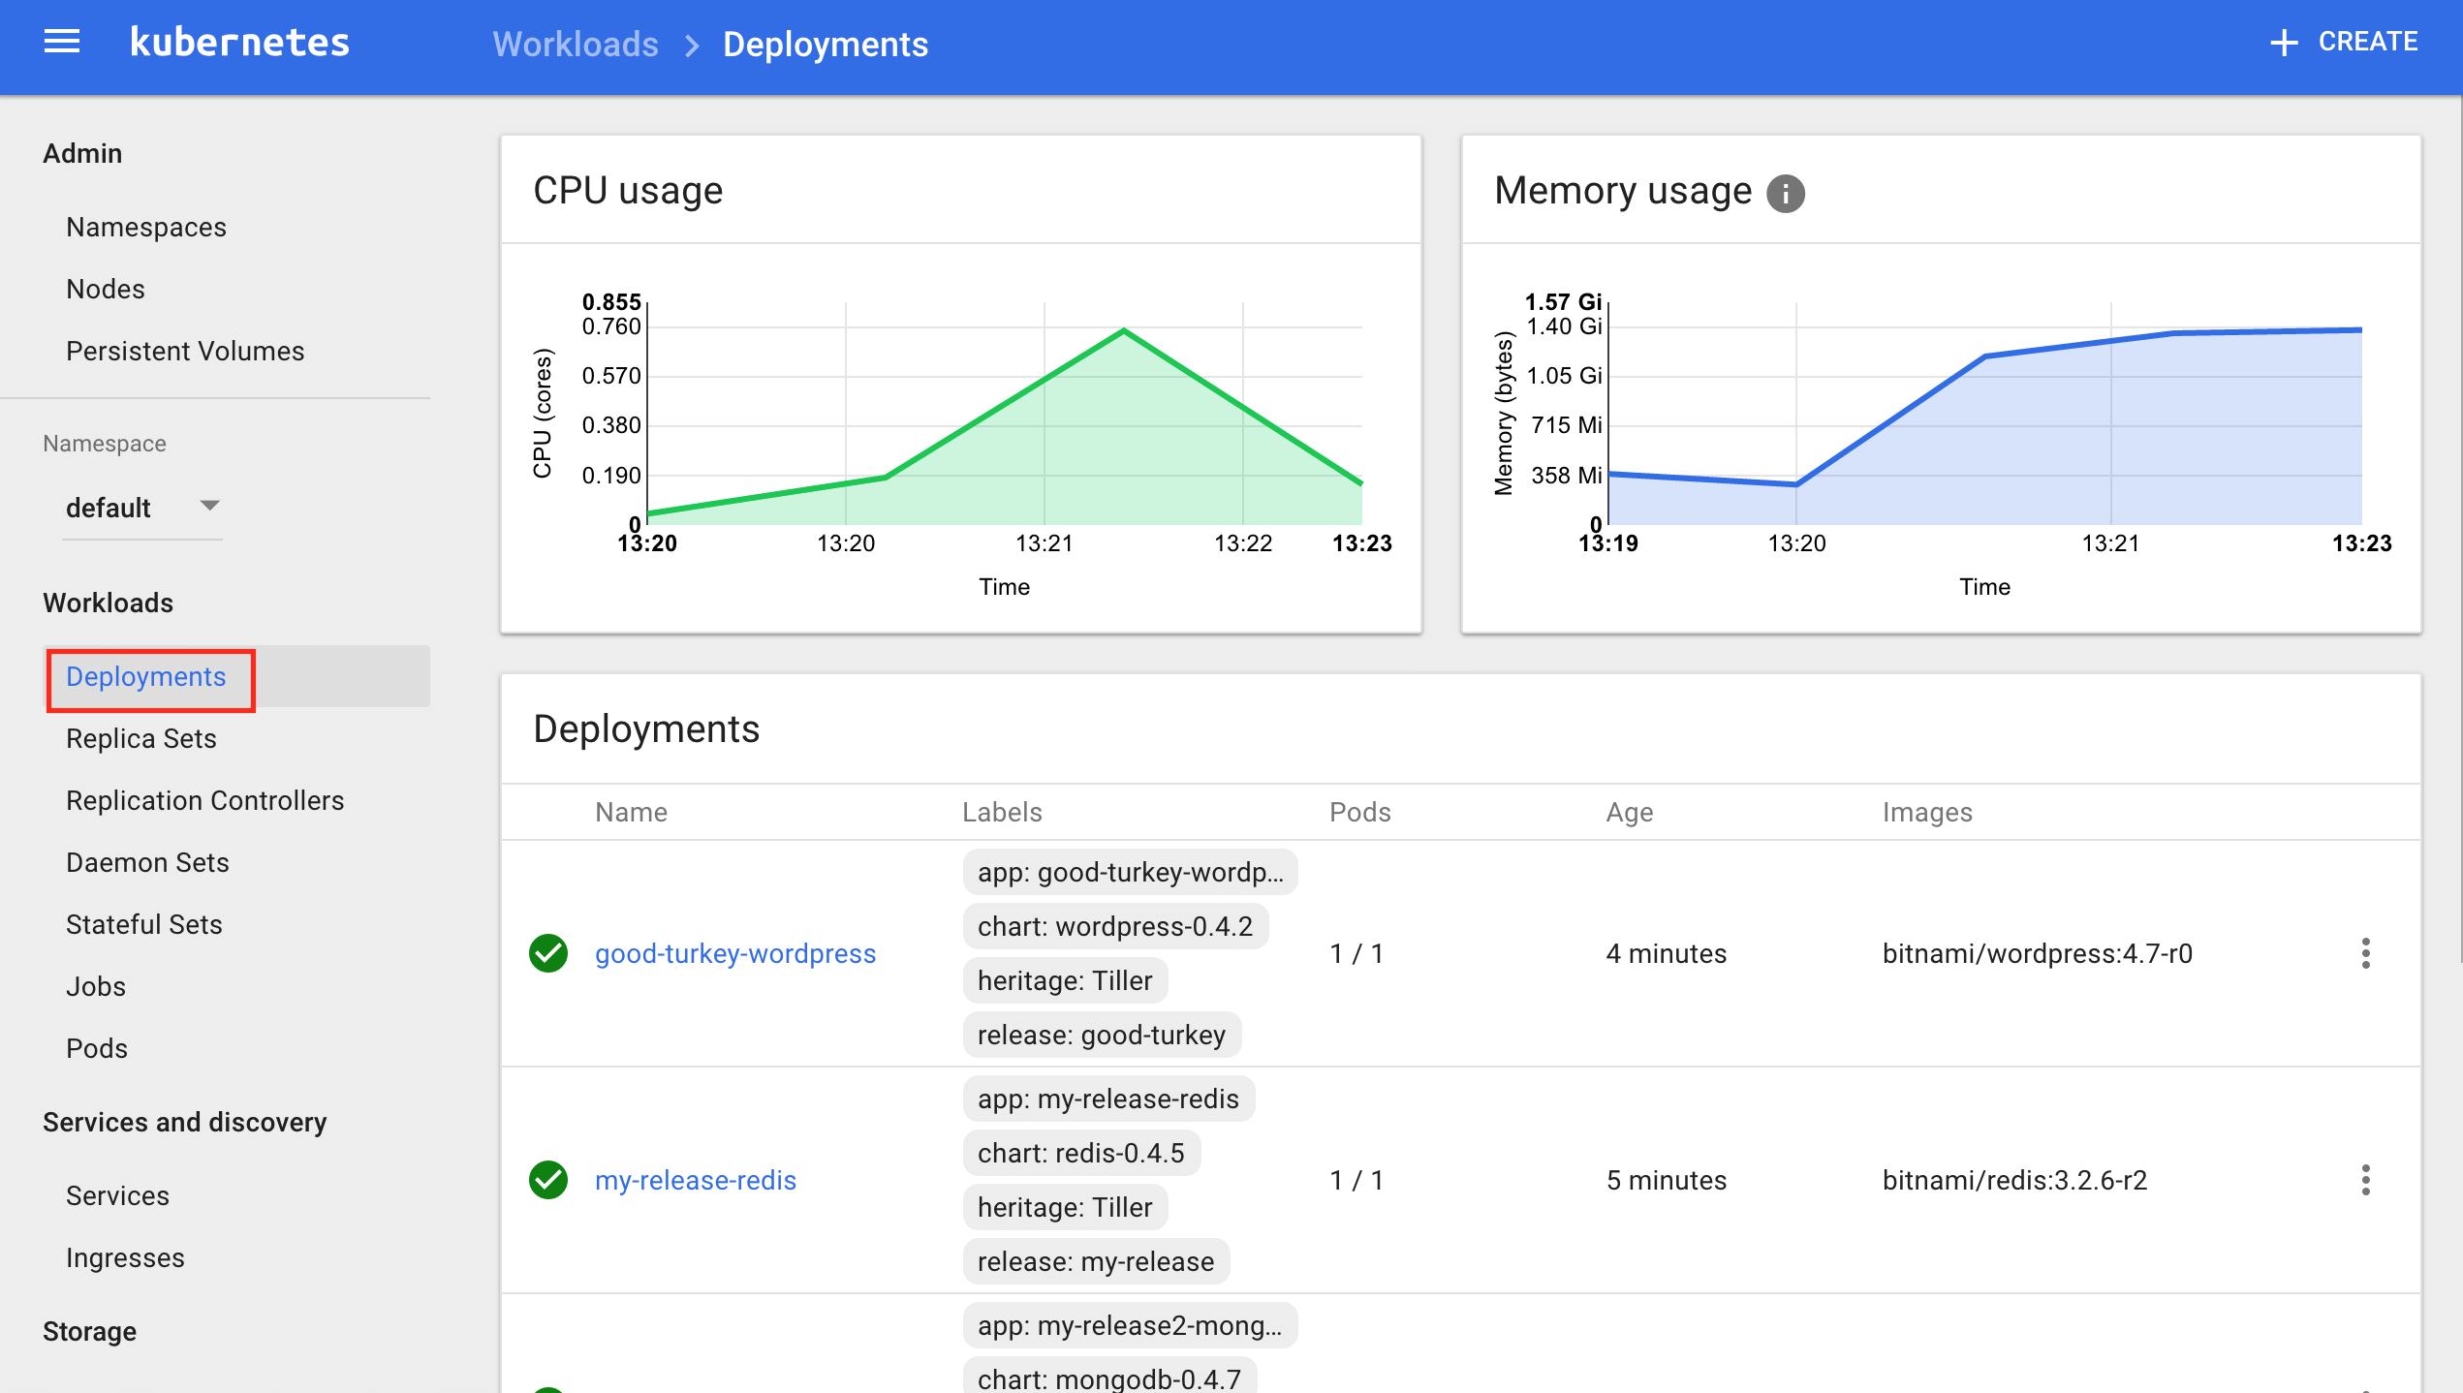
Kubernetes Monitoring

