Slide 1
Virtualization
By
Jitendra Singh Tomar || Jeetu

Slide 2
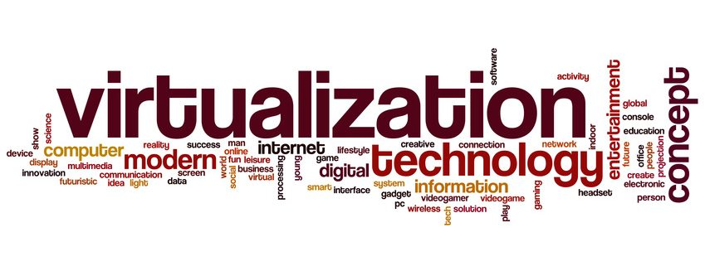
Agenda
Overview of Virtualization
Evolution of Virtualization and VMware history
Types of Virtualization
Advantages and Disadvantages of Virtualization
Hyperthreading and Memory virtualization overview
VMware products overview

Slide 3
Overview
Virtualization is technology that you can use to create virtual representations of servers, storage, networks, and other physical machines.
Virtualization refers to the process of creating virtual computers on top of a single physical computer.
These virtual computers are known as virtual machines. Virtual machines use the hardware of the physical computer, but they do have their own operating systems.
Each virtual machine functions as an independent computer.
Virtualization allows the organizations to utilize the hardware of a single computer to create multiple virtual computers and therefore increase productivity.

Slide 4
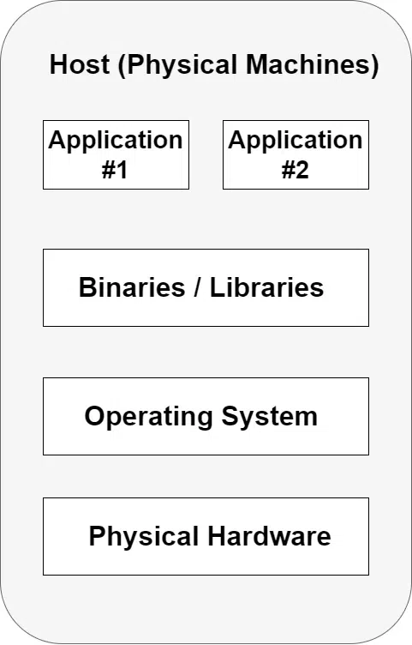
Evolution of Virtualization
Bare metal computing

Slide 5
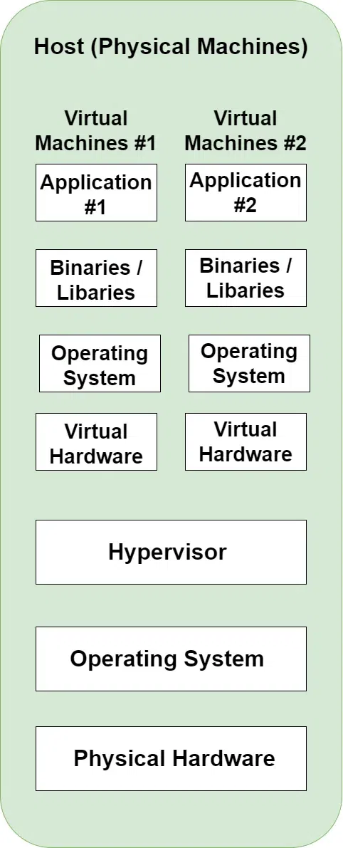
Evolution of Virtualization
Bare metal computing
Virtual Machines

Slide 6
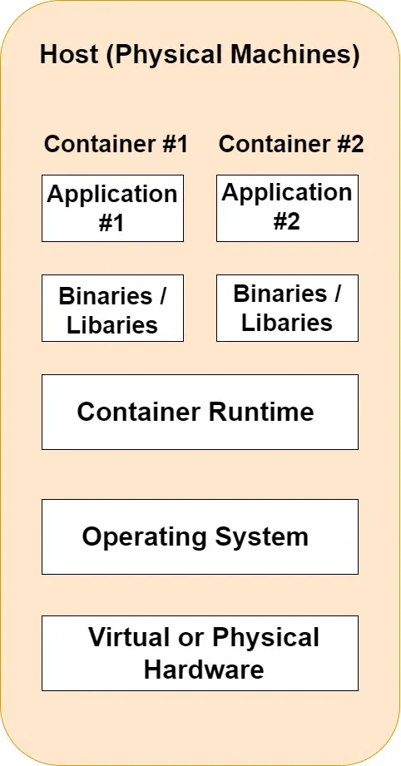
Evolution of Virtualization
Bare metal computing
Virtual Machines
Containers

Slide 7
Evolution of Virtualization
 | Bare Metal | Virtual Machine | Container
Dependency Management | Poor | Good | Good
Utilization | Poor | Fine | Good
Isolation | Good | Good | Fine
Start up Speed | Poor | Fine | Good
Dev/Prod Parity | Poor | Fine | Good
Control | Good | Fine | Fine
Operational Overhead | Poor | Fine | Good

Slide 8
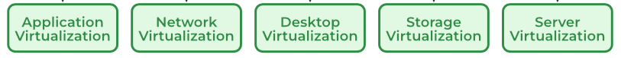
Types of Virtualization

Slide 9
Application Virtualization
Application virtualization is a technology that allows applications to run in an isolated environment on a host system.
This isolation provides several benefits, such as compatibility across different platforms, easier deployment, and enhanced security.
The application is separated from the underlying operating system and other applications.
The application and its dependencies (like specific versions of libraries) are packaged together into a single executable or container.
This allows the application to run without needing to install those dependencies on the host system.

Slide 10
Types of Application Virtualization
Remote Application Virtualization
The application runs on a remote server, and only the user interface is delivered to the client device.
Citrix Virtual Apps, Microsoft RemoteApp.
Streaming Application Virtualization
The application is streamed to the client device on demand.
Only the parts of the application that are needed are delivered initially, with other components streamed as needed.
Local Application Virtualization
The application is fully encapsulated and runs locally on the client device but within a virtualized environment.
This method is typically used for legacy applications or those requiring specific environments.

Slide 11
Network virtualization
It is a method of combining hardware and software network resources and functionalities into a single, software-based administrative entity, which allows for the efficient management and deployment of network resources.
It abstracts physical network components like switches, routers, and firewalls into virtual counterparts, enabling more flexible, scalable, and dynamic network configurations.
Types of Network Virtualization
External Network Virtualization
Internal Network Virtualization

Slide 12
Key Components of Network virtualization
Key Components:
Virtual Switches (vSwitches)
Virtual Routers
Virtual Firewalls
Software-Defined Networking (SDN)
Network Functions Virtualization (NFV)
Popular Network Virtualization Solutions
VMware NSX
Cisco ACI (Application Centric Infrastructure)
OpenStack Neutron
Microsoft Hyper-V Network Virtualization

Slide 13
Desktop virtualization
Desktop virtualization is a technology that separates the desktop environment and its applications from the physical client device that is used to access it.
This allows users to run their desktop from a central server, making it accessible from virtually any device.
Desktop virtualization provides numerous benefits in terms of flexibility, security, and manageability.
Desktop virtualization is a powerful technology for organizations seeking to provide secure, flexible, and manageable desktop environments for their users, particularly in remote work, education, and BYOD scenarios.

Slide 14
Desktop Virtualization
Types:
Virtual Desktop Infrastructure (VDI)
Remote Desktop Services (RDS)
Desktop as a Service (DaaS)
Local Desktop Virtualization
Popular Desktop Virtualization Solutions:
VMWare Horizon
Citrix Virtual Desktop
Microsoft Azure Virtual Desktop
Amazon Workspaces

Slide 15
Storage Virtualization
Storage virtualization is a technology that abstracts physical storage resources from multiple storage devices and consolidates them into a single, centralized, and manageable virtual storage pool.
This virtualization layer allows administrators to manage storage as a unified resource, irrespective of the underlying hardware, improving flexibility, efficiency, and scalability in storage management.
Storage virtualization allows:
Improved utilization
Simplified management
Scalability & flexibility
Cost efficiency

Slide 16
Types of Storage Virtualization
Block-Level Storage Virtualization
Virtualizes storage at the block level, which means it abstracts the physical storage blocks from multiple storage devices (like SANs) and presents them as a unified storage pool.
This type is commonly used in storage area networks (SANs) to improve storage utilization and simplify management.
Examples include IBM SAN Volume Controller (SVC) and EMC VPLEX.
File-Level Storage Virtualization:
Virtualizes storage at the file level, allowing files to be abstracted from the physical storage devices.
This type is used in network-attached storage (NAS) environments and can provide features like global namespace and transparent file migration across storage systems.
Examples include Microsoft DFS (Distributed File System) and NetApp's ONTAP.

Slide 17
Types of Storage Virtualization
Object-Level Storage Virtualization:
Abstracts storage into objects, which include data and metadata, and stores them in a flat address space.
It’s commonly used in cloud storage solutions, providing scalability and efficient management of large amounts of unstructured data.
Examples include Amazon S3 and OpenStack Swift.
Popular Storage Virtualization Solutions
VMware vSAN
IBM SAN Volume Controller (SVC)
EMC VPLEX
NetApp ONTAP
Hitachi Virtual Storage Platform (VSP)

Slide 18
Server Virtualization
Server virtualization is a technology that allows multiple virtual servers to run on a single physical server.
Server virtualization provides significant benefits in terms of resource optimization, cost savings, and flexibility.
Future Trends
Hybrid Cloud Integration
Hyper-Converged Infrastructure (HCI)
Automation and Orchestration

Slide 19
Types of Server Virtualization
Full Virtualization
The most common form, where the hypervisor provides a complete virtual environment that emulates the underlying hardware.
Para-Virtualization
The guest OS is aware that it is running in a virtualized environment and communicates directly with the hypervisor for certain operations.
OS-Level Virtualization (Containerization)
Containers share the same OS kernel but are isolated from each other, making them lightweight and highly efficient.

Slide 20
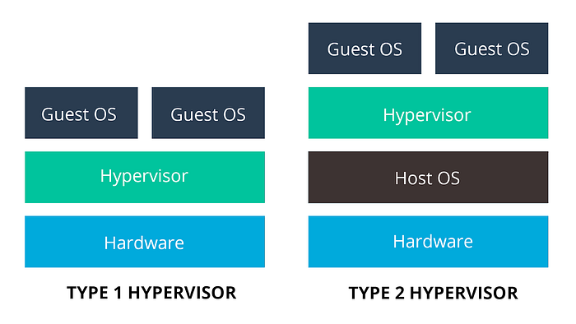
Components of Server Virtualization
Hypervisor
Type 1 (Bare-Metal Hypervisor)
Type 2 (Hosted Hypervisor)
Virtual Machines (VMs)
Management Tools

Slide 21
Types of Hypervisors
Type-1
Microsoft Hyper-V
VMWare ESXi
KVM
Xen
Oracle VM server
RedHat Virtualization
Citrix Hypervisor
OpenVZ
LXC (Linux Container)

Slide 22
Types of Hypervisors
Type-2
Oracle VirtualBox
QEMU (Quick Emulator)
KVM
Hyper-V Manager
Parallel Desktops
VMWare Workstation
VMWare Fusion
Bochs
PearPC

Slide 23
VMware products overview
Compute Virtualization
VMware vSphere: The core hypervisor that enables virtualization of servers.
VMware vCenter: A centralized management platform for vSphere environments.
VMware vCloud Suite: A comprehensive suite of products for building and managing private clouds.
Networking and Security
VMware NSX: A software-defined networking (SDN) platform for virtualizing network functions.
VMware vRealize Network Insight: A network visibility and analytics tool.
VMware vShield: A security platform for protecting virtualized environments.
Storage
VMware vSAN: A hyper-converged storage platform.
VMware Virtual Volumes: A storage abstraction layer that enables independent management of storage.

Slide 24
VMware products overview
Cloud Management
VMware vRealize Automation: An automation platform for IT infrastructure.
VMware vRealize Operations: A cloud management platform for monitoring and optimizing IT resources.
VMware Cloud Foundation: A pre-integrated platform for building and running hybrid clouds.
End-User Computing
VMware Horizon: A desktop virtualization platform.
VMware Workspace ONE: A unified endpoint management platform.
Other Products
VMware Tanzu: A platform for building and running modern applications.
VMware Aria: A cloud operations platform.
VMware vCloud Director: A multi-tenant cloud management platform.

Slide 25
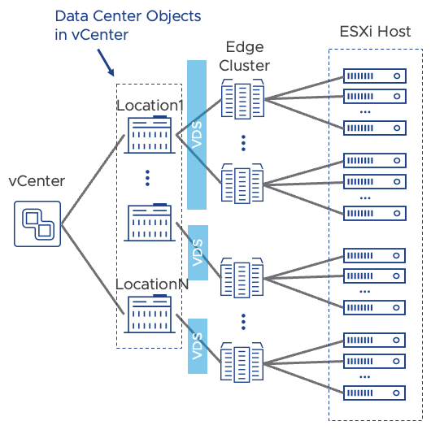
VMware Architecture

Slide 26
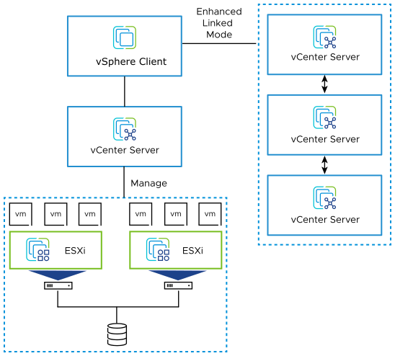
VMware vSphere

Slide 27
minimum requirements for VMware ESXi 6.7
CPU:
Minimum: 2 cores (4 logical processors)
Recommended: 4 cores (8 logical processors) or more
Memory:
Minimum: 8 GB
Recommended: 8 GB or more
Storage:
Minimum: 20 GB for the ESXi installation
Recommended: At least 100 GB for the operating system and virtual machines
Network Interface Card (NIC):
Minimum: 1 NIC
Recommended: 2 NICs or more for redundancy and improved performance

Slide 28
minimum requirements for VMware ESXi 6.7
Additional Considerations:
Virtual Machines (VMs): The amount of CPU, memory, and storage required will depend on the number and type of VMs you plan to run.
Workload: The specific workload (e.g., database, web server, virtual desktop) will also affect the hardware requirements.
High Availability: If you require high availability features like HA and DRS, you may need additional hardware resources.

Slide 29
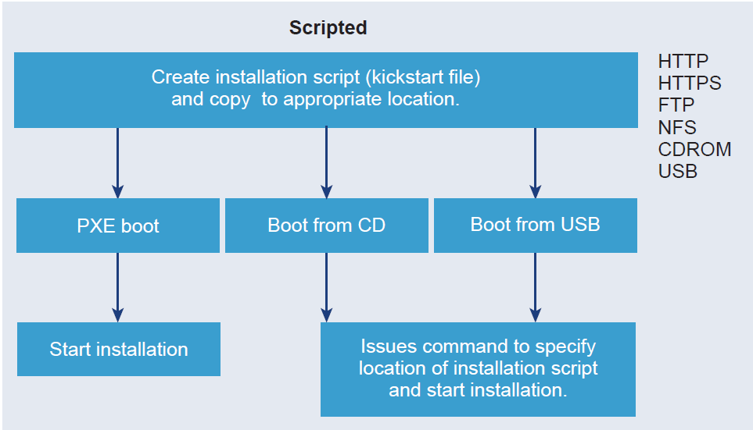
Options for Installing ESXi
Interactive ESXi Installation
You boot the installer from a CD or DVD, from a bootable USB device, or by PXE booting the installer from a location on the network.
Scripted ESXi Installation
Running a script is an efficient way to deploy multiple ESXi hosts with an unattended installation.

Slide 30
VMWare vSphere
The two core components of vSphere are ESXi and vCenter Server.
ESXi is the virtualization platform on which you can create and run virtual machines and virtual appliances.
vCenter Server is a service that acts as a central administrator for ESXi hosts connected in a network. vCenter Server lets you pool and manage the resources of multiple hosts.
You can install vCenter Server on a Windows virtual machine or physical server, or deploy the vCenter Server Appliance.
The vCenter Server Appliance is a preconfigured Linux-based virtual machine optimized for running vCenter Server and the vCenter Server components.
You can deploy the vCenter Server Appliance on ESXi hosts 6.0 or later, or on vCenter Server instances 6.0 or later.

Slide 31
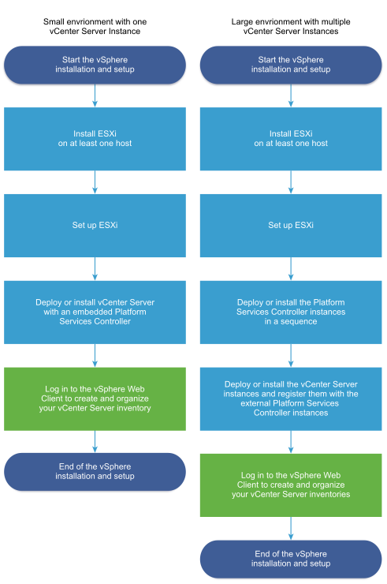
VMWare vSphere
Starting with vSphere 6.0, all prerequisite services for running vCenter Server and the vCenter Server components are bundled in the VMware Platform Services Controller™.
You can deploy vCenter Server with an embedded or external Platform Services Controller, but you must always install or deploy the Platform Services Controller before installing or deploying vCenter Server.

Slide 32
Hardware and System Resources of ESXi 6.7
At least two CPU cores.
It supports 64-bit x86 processors.
It requires the NX/XD bit to be enabled for the CPU in the BIOS.
ESXi 6.7 requires a minimum of 4 GB of physical RAM. It is recommended to provide at least 8 GB of RAM to run virtual machines in typical production environments.
To support 64-bit virtual machines, support for hardware virtualization (Intel VT-x or AMD RVI) must be enabled on x64 CPUs.
SCSI disk or a local, non-network, RAID LUN with unpartitioned space for the virtual machines.

Slide 33
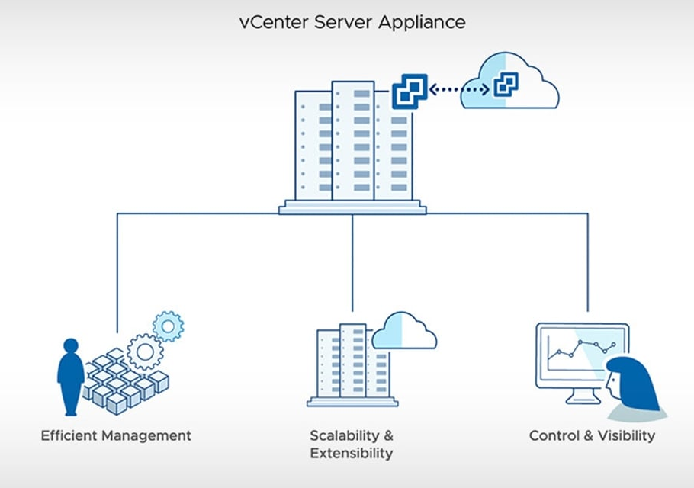
VMware vCenter
VMware vCenter is advanced server management software that provides a centralized platform for controlling your VMware vSphere environments, allowing you to automate and deliver a virtual infrastructure across the hybrid cloud with confidence.
VMware vCenter Features:
Simple Deployment
Extensibility and Scalability Across Hybrid Cloud
Centralized Control and Visibility

Slide 34
Authentication Services
vCenter Single Sign-On
External identity provider federation
vCenter Server built-in identity provider
vSphere License Service
The vSphere License service provides common license inventory and management capabilities to all vCenter Server systems within the Single Sign-On domain.
VMware Certificate Authority
VMCA provisions each ESXi host with a signed certificate that has VMCA as the root certificate authority.

Slide 35
Services Installed with vCenter Server
PostgreSQL
PostgreSQL database for vSphere and vCloud Hybrid Services.
vSphere Client
The HTML5-based user interface that lets you connect to vCenter Server instances by using a Web browser
vSphere ESXi Dump Collector
The vCenter Server support tool that collects such memory dumps over the network.
vSphere Auto Deploy
The vCenter Server support tool that can provision hundreds of physical hosts with ESXi software.
VMware vSphere Lifecycle Manager
It enables centralized, automated patch and version management for VMware vSphere

Slide 36
Platform Services Controller Services
With PSC, all VMware products within the same environment can share the authentication domain and other services. Services include certificate management, authentication, and licensing.
Some of the services are:
Appliance Management Service
License service
Component Manager
Identity Management Service
HTTP Reverse Proxy
Service Control Agent
Security Token Service
Common Logging Service
Syslog Health Service
Authentication Framework
Certificate Service
Directory Service

Slide 37
What is vCenter Server Appliance
The vCenter Server appliance is a preconfigured virtual machine that is optimized for running vCenter Server and the associated services.
The vCenter Server appliance package contains the following software:
Photon OS 3.0
The vSphere authentication services
PostgreSQL
VMware vSphere Lifecycle Manager Extension
VMware vCenter Lifecycle Manager
Version 8.0 of vCenter Server is deployed with virtual hardware version 10, which supports 64 virtual CPUs per virtual machine in ESXi.

Slide 38
vCenter Server appliance default user names
Root
Use this user name to log in to the appliance operating system and the vCenter Server Management Interface.
administrator@yourdomainname
Use this user name for vCenter Single Sign-On login.
You set the password while creating the vCenter Single Sign-On domain.
You create a vCenter Single Sign-On domain during the deployment of a vCenter Server appliance in a new vCenter Single Sign-On domain.

Slide 39
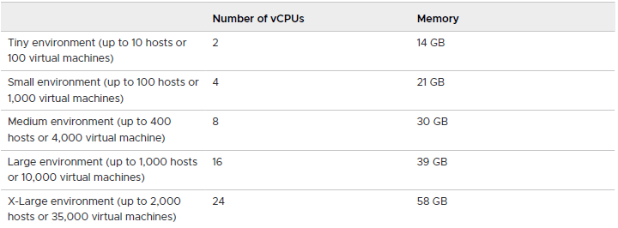
Hardware Requirements for the VCSA

Slide 40
GUI Deployment of VCSA
Stage 1 - OVA Deployment
Stage 2 - Appliance Setup

Slide 41
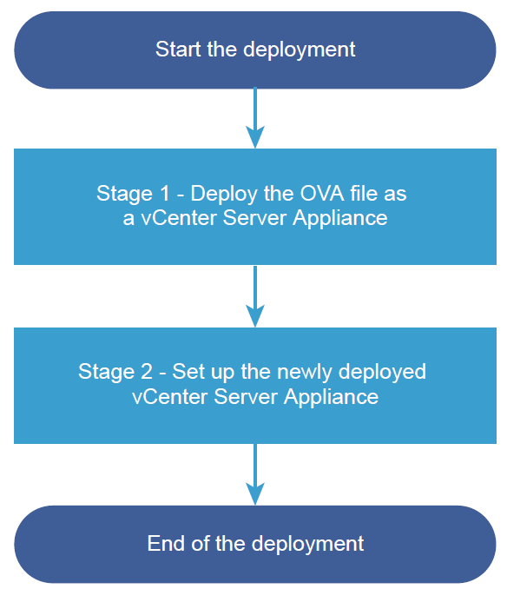
Deployment Workflow of a VCSA

Slide 42
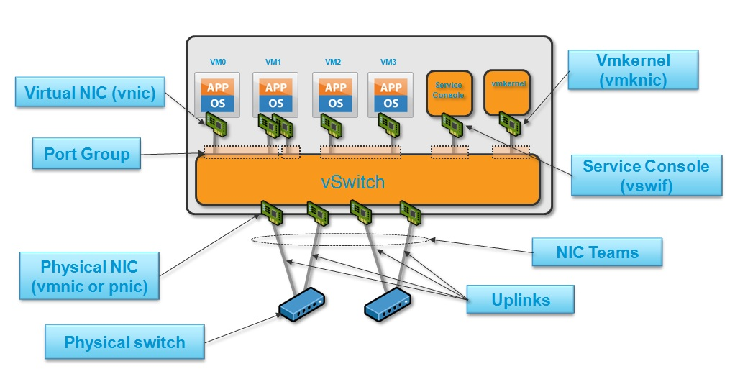
Virtual Networking in VMWARE

Slide 43
Types of traffic on virtual network
Virtual machine traffic
Traffic sourced & received from virtual machine(s)
Isolated from each other
vMotion traffic
Traffic sent when moving a VM from 1 ESXi to another.
Must be dedicated and isolated.
Management Traffic
Isolated from VM traffic
If HA is enabled, includes heartbeats
IP Storage Traffic
NFS traffic, iSCSI initiator.

Slide 44
Types of traffic on virtual network
FT Traffic
Heavy IOPS and low latency
VSAN Traffic
Generated data during Read/Write operations performed across vSAN nodes.
VXLAN Traffic
It get generates during VTEP (VXLAN tunnel endpoint) to VTEP communication in NSX
Provisioning Traffic
VM clone operations generated provisioning traffic

Slide 45
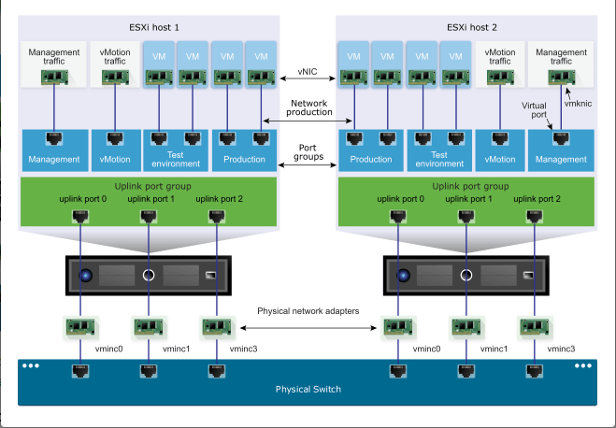
Standard virtual switch

Slide 46
Standard switch forwarding rules
Allowed rules
VM ←→ VM
VM ←→ Uplink
Unallowed rules
vSwitch ⬅➔ vSwitch
Uplink ⬅➔ Uplink
ESXi vSwitch till not create loops in the physical network.

