Slide 1
Switching
By
Jitendra Singh Tomar || Jeetu

Slide 2
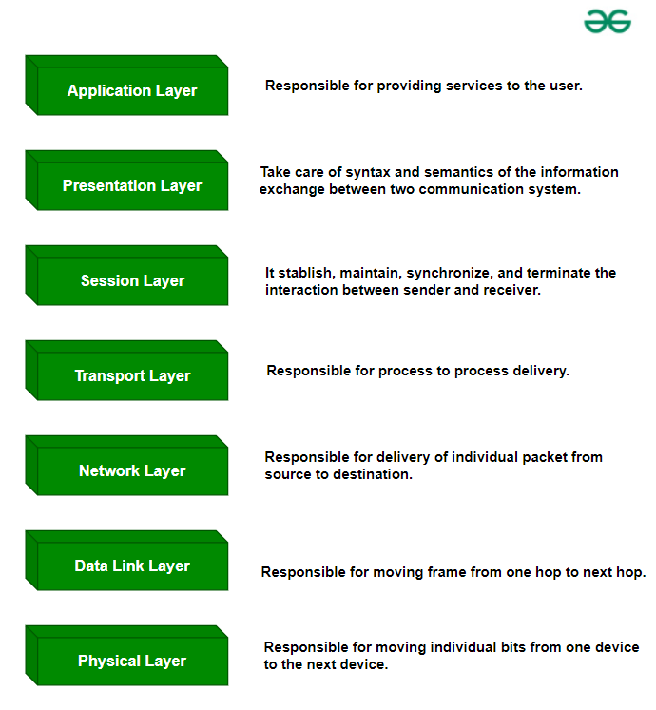
OSI Layers
Open System Interconnect (OSI) model.
OSI is used to define how data is sent from one computer to another through network.
Introduced by International Organization for Standardization (ISO) in 1984.
It contains 7 layers.

Slide 3
OSI Layers
Application Layer: Applications create the data.
Presentation Layer: Data is formatted and encrypted.
Session Layer: Connections are established and managed.
Transport Layer: Data is broken into segments for reliable delivery.
Network Layer: Segments are packaged into packets and routed.
Data Link Layer: Packets are framed and sent to the next device.
Physical Layer: Frames are converted into bits and transmitted physically.

Slide 4
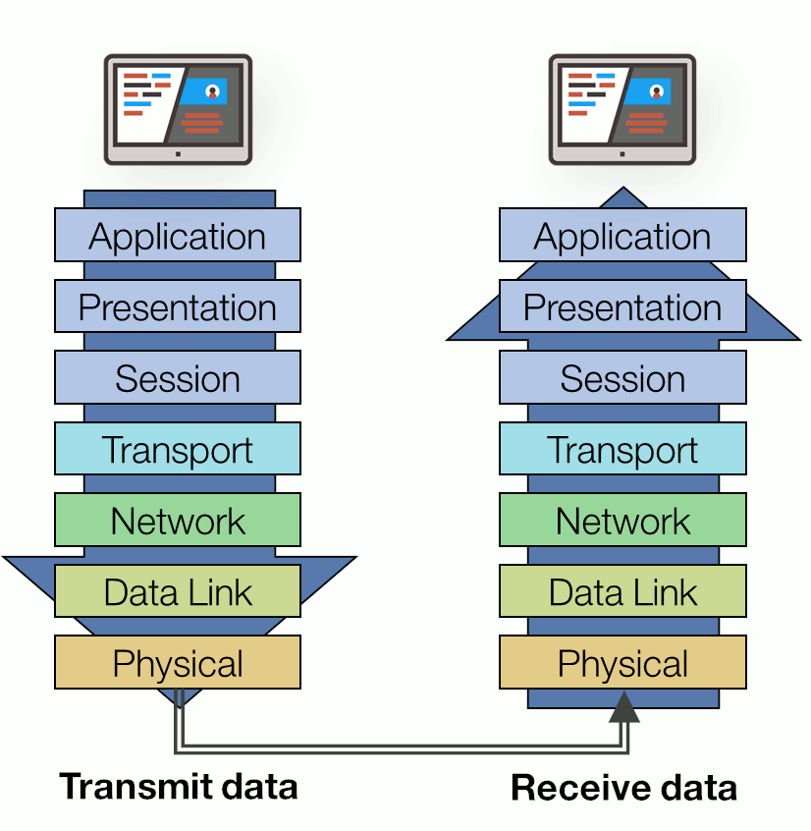
OSI Layers – Sender & receiver

Slide 5
Layer 7: Application layer
The Application layer is the highest layer of the OSI model.
It provides the interface between the network protocol and the software running on the computer.
This layer is used by “networking applications” like:
Google Chrome, Firefox, Skype, Teams, Etc.…
It facilitates data formatting and translation for application use.
It uses common protocols like:
HTTP, FTP, SMTP, DNS, Telnet, SSH, IMAP, POP, SNMP, etc.

Slide 6
Layer 6: presentation layer
This layer receives data from application layer in form of characters & numbers.
This layer converts these characters into binary format & is called “translation”.
Here, data is compressed which requires less size to transmit which could be useful in scenarios like video streaming.
It also encrypts the data by using SSL for secured transmission.
It supports protocols like: SSL/TLS, JPEG, MPEG, ASCII
It performs:
Data translation (into binary)
Data encryption/decryption (for security)
Data compression (for reduced size)

Slide 7
Layer 5: Session layer
The session layer manages sessions or connections between applications.
It establishes, manages, and terminates sessions, ensuring that the data exchange between systems is synchronized.
This layer is responsible for:
Authorization (who you are?)
Authentication (do you have permission?)
Placement of header information in a packet (where a message starts and where it ends)
It supports protocols like: NetBIOS, RPC, SOCKS, L2TP, SDP, H.245, NFS, etc.
Controls whether the data being exchanged in a session are transmitted as full or half duplex messages.

Slide 8
Layer 4: Transport layer
The Transport Layer ensures that messages are delivered error-free, in sequence and with no loss or duplication.
It controls reliability of communication through:
Segmentation (divides data into small data units called segments)
Flow control (controls amount of data flow)
Error control (Automatic repeat request in case of transmission lost)
This layer has:
Transmission Control Protocol (TCP) – Connection Oriented transmission
User Datagram Protocol (UDP) – Connection-less transmission

Slide 9
Tcp vs udp
UDP | TCP
- No feedback | - Send feedback
- Faster than TCP | - Slower in nature
- Example: | - Example:
- DNS | - World Wide Web
- Online games | - File Transfer Protocol (FTP)
- Online video streaming | - Emails
- Radio

Slide 10
Layer 3: network layer (internet layer)
Transport layer sends segments to this layer. Here, data units are called “Packets”.
This layer is primarily responsible for establishing the paths used for transfer of data packets between nodes on the network. This is the layer that routers operate on.
Path determination (finding best path of delivery).
This layer is responsible for:
Logical addressing (IP addresses)
Packet forwarding (routing through different routers)
Fragmentation and reassembly of packets
Handling traffic control (congestion management)

Slide 11
Layer 3: network layer (internet layer)
The network layer also takes care of mapping logical (IP) addresses to physical (MAC) addresses that are used in the Data Link layer.
Supported protocols:
IP (Internet Protocol) - IPv4 & IPv6
ICMP (Internet Control Message Protocol)
RIP (Routing Information Protocol)
OSPF (Open Shortest Path First)
BGP (Border Gateway Protocol)
MPLS (Multiprotocol Label Switching)

Slide 12
Layer 2: data link layer
At the Data Link layer, data packets are encoded into bits.
This layer is responsible for establishing, maintaining, and terminating a link between two directly connected nodes.
It ensures error-free transmission between devices on the same network and controls how data is placed on the physical medium.
MAC address of sender & receiver is assigned to packet to create a frame.
MAC address is a 12 digit, alpha-numeric number embedded on NIC by manufacturer.
Supported protocols: ARP, PPP, Token ring, L2TP, etc

Slide 13
Layer 1: physical layer
This layer converts data from data link layer into signals.
This layer is the lowest layer of the OSI model and consists of the functionality that interacts with the actual hardware and signaling mechanism.
This layer is responsible for:
Defines the physical characteristics of the network (cables, connectors, voltage levels).
Handles the transmission of binary data (0s and 1s) as electrical, optical, or radio signals.
Manages the data rate and synchronization of bit-level communication.
Supported protocols: Ethernet, USB, Bluetooth, Infrared,

Slide 14
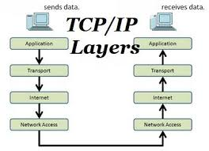
TCP/IP Model - Application Layer
The TCP/IP model is a fundamental framework for computer networking.
It consists of four layers: the Link Layer, the Internet Layer, the Transport Layer, and the Application Layer.
Each layer has specific functions that help manage different aspects of network communication, making it essential for understanding and working with modern networks.
The main work of TCP/IP is to transfer the data of a computer from one device to another.
The TCP/IP model is used in the context of the real-world internet, where a wide range of physical media and network technologies are in use.

Slide 15
TCP/IP Model - Application Layer
This model defines how data is transmitted over networks, ensuring reliable communication between devices.
This layer corresponds to the Application, Presentation, and Session layers of the OSI model.
This layer:
Provides protocols that allow software applications to send and receive data over the network.
Manages the formatting, encryption, and compression of data for use by applications.
Supports the establishment, maintenance, and termination of communication sessions between applications.

Slide 16
TCP/IP - Application Layer
This protocol supports:
HTTP/HTTPS (Hypertext Transfer Protocol/Secure) - Web browsing.
FTP (File Transfer Protocol) - File transfers.
SMTP (Simple Mail Transfer Protocol) - Email transmission.
DNS (Domain Name System) - Resolving domain names to IP addresses.
Telnet, SSH (Secure Shell) - Remote access to servers.
SNMP (Simple Network Management Protocol) - Network management.

Slide 17
TCP/IP - Transport Layer
The Transport Layer ensures reliable data transfer between devices.
It is responsible for maintaining the end-to-end communication, error-checking, and data flow control.
Functionalities of this layer:
Establishes, maintains, and terminates connections between devices.
Segments and reassembles data into a format that can be transmitted over the network.
Provides flow control to prevent network congestion and ensures that data is delivered in sequence.
Offers error-checking mechanisms to detect and recover from data transmission errors.

Slide 18
TCP/IP - Transport Layer
Standard protocols used here are:
TCP (Transmission Control Protocol) - Ensures reliable, connection-oriented communication.
UDP (User Datagram Protocol) - Supports fast, connectionless communication with no guarantee of delivery.

Slide 19
TCP/IP - Internet Layer
The Internet Layer is responsible for routing data across networks and ensuring that it reaches its destination.
It is equivalent to the Network Layer in the OSI model.
In this layer:
Logical addressing (IP addresses) to identify devices across different networks.
Routing of data packets from the source network to the destination network, possibly across multiple networks.
Fragmentation and reassembly of data packets if the data exceeds the size limit of a network.
This protocol supports: IP, ICMP, IGMP, IPSec

Slide 20
TCP/IP - Network Interface Layer (Link Layer)
The Network Interface Layer is responsible for the physical transmission of data over a network. It corresponds to the combination of the Physical and Data Link layers in the OSI model.
In this layer, it:
Defines how data is sent over the physical medium (cables, radio waves).
Handles hardware addressing (MAC addresses) and error detection within the local network.
Manages frame placement on the network and ensures data reaches its immediate destination within the same network.

Slide 21
TCP/IP - Network Interface Layer (Link Layer)
This layer supported protocols/standards:
Ethernet
Wi-Fi (IEEE 802.11)
ARP (Address Resolution Protocol)
PPP (Point-to-Point Protocol)

Slide 22
Introduction to Networks
Computer Network is a group of computers connected with each other through wires, optical fibers or optical links so that various devices can interact with each other through a network.
The aim of the computer network is the sharing of resources among various devices.
A computer network consists of various kinds of nodes. Servers, networking hardware, personal computers, and other specialized or general-purpose hosts can all be nodes in a computer network.

Slide 23
What is a Computer Network?
A computer network is a system that connects many independent computers to share information (data) and resources.
The integration of computers and other different devices allows users to communicate more easily.
A network connection can be established using either cable or wireless media.
Hardware and software are used to connect computers and tools in any network.

Slide 24
What Do Computer Networks Do?
Computer Networks help in providing better connectivity that helps nowadays. Modern computer networks have the following functionality:
Computer Networks help in operating virtually
Computer Networks integrate on a large scale
Computer Networks respond very quickly in case of conditions change
Computer Networks help in providing data security

Slide 25
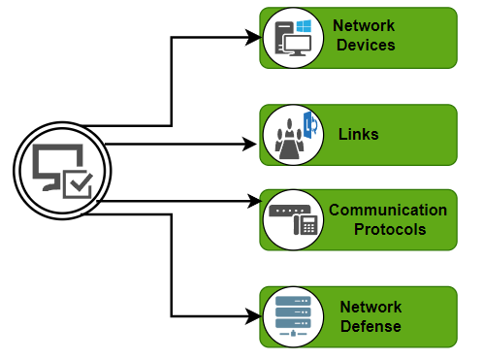
Key Components of a Computer Network
A computer network is made up of two main parts:
Devices (called nodes) &
Connections (called links)
The links connect the devices to each other.
The rules for how these connections send information are called communication protocols.
The starting and ending points of these communications are often called ports.

Slide 26
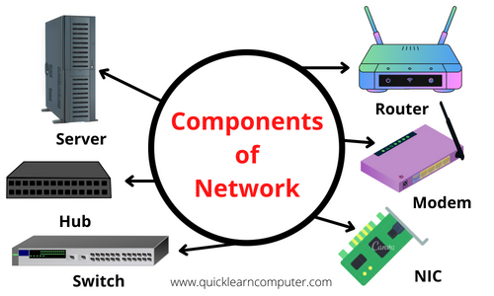
Components Of Computer Network

Slide 27
Network devices
Network Interface Card (NIC)
Repeater
Hub
Bridges
Switches
Routers
Gateways

Slide 28
Network Interface Card
NIC is a hardware component, typically a circuit board or chip on a computer.
A NIC provides a computer with a dedicated, full-time connection to a network.
It implements the physical layer circuitry necessary for communicating with a data link layer standard, such as Ethernet or Wi-Fi.
Each card represents a device and can prepare, transmit and control the flow of data on the network.
The NIC operates as a middleman between a computer and a data network.

Slide 29
Types of NICs
Types of NICs include the following:
Wireless. NICs that use an antenna to provide wireless reception through radio frequency waves. Wi-Fi connections use wireless NICs.
Wired. NICs that have input jacks made for cables. Ethernet is the most popular wired LAN technology.
USB. NICs that provide network connections through a device plugged into the USB port.
Fiber optics. NICs used as a high-speed support system for network traffic handling on server computers.

Slide 30
NIC components
Speed. All NICs have a speed rating in terms of megabits per second (Mbps) that determines the card's performance in a network. The average Ethernet NICs come in
10 Mbps,
100 Mbps,
1000 Mbps and
1 gigabits per second varieties.
Driver. The required software that passes data between the computer's operating system and the NIC.

Slide 31
NIC components
MAC address. Unique, unchangeable media access control addresses, also known as physical network addresses, are assigned to NICs. Router.
LED indicator. Most NICs have an LED indicator integrated into the connector to notify the user when the network connects and data transmission occurs.
Router. A router is sometimes needed to enable communication between a computer and other devices. In this case, the NIC connects to the router which is connected to the internet.

Slide 32
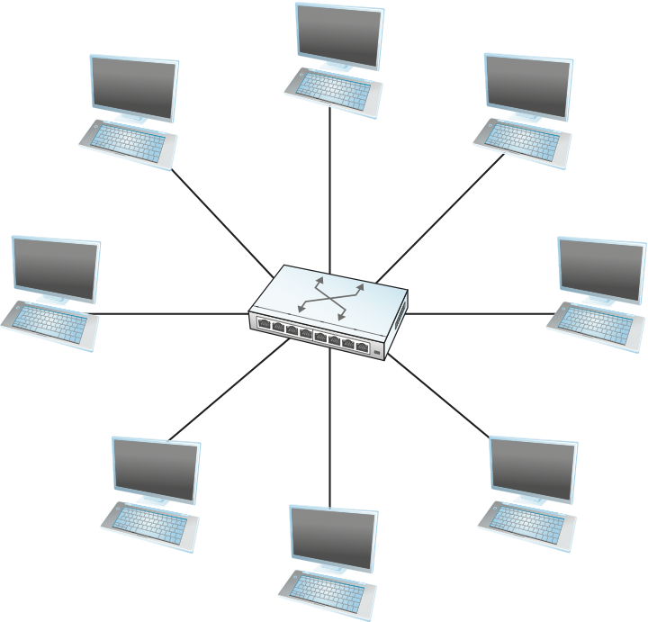
Basics of Switching
A switch is a mechanism that allows you to interconnect links to form a larger network.
A switch is a multi-input, multi-output device that transfers packets from an input to one or more outputs.
A switch’s primary job is to receive incoming packets on one of its links and to transmit them on some other link.
This function is sometimes referred to as either switching or forwarding, and in terms of the Open Systems Interconnection (OSI) architecture, it is considered a function of the network layer.

Slide 33
How Does a Network Switch Work?
A network switch can work in three ways:
Edge switches, also known as access switches: They handle traffic entering and departing the network. Edge switches link various devices, including personal computers and access points.
Aggregation switches: Switches for aggregation are located within an optional intermediary layer. These connect to edge switches, which may transmit traffic from one switch to another or up to the core switches.
Core switches: The network’s backbone is made up of these switches. Core switches link edge or aggregation switches, device or consumer edge networks to networks at data centers, and routers to organizational LANs.

Slide 34
MAC/CAM Table
Content Addressable Memory / Media Access Control
Ethernet switches store the MAC addresses of all connected devices in a table known as CAM or MAC address table and use it to make forwarding decisions.
The CAM table is also known as
MAC forward table,
MAC filter table,
MAC address table,
Switching table, or
Bridging table.

Slide 35
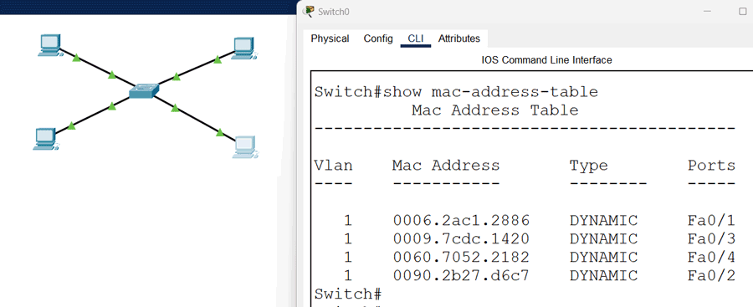
MAC/CAM Table
A CAM table uses entries to store information in two ways
Static & Dynamic.
In the static method, we manually add entries to the CAM table.
In the dynamic method, the switch automatically adds entries to the CAM table.

Slide 36
components of switch
Switching Fabric:
The switching fabric is the internal connection that allows data to be transferred between ports. It determines the switch's capacity to handle data traffic.
Ports:
These are the physical interfaces where network cables connect. Ports can support different speeds like 10/100/1000 Mbps (Ethernet) or even 10 Gbps.
MAC Address Table (Content Addressable Memory - CAM):
This table stores the MAC addresses of devices connected to the switch along with the corresponding port numbers. It allows the switch to forward frames to the correct destination.
Central Processing Unit (CPU):
The CPU controls the switch's operations, including processing management tasks, running the switch’s firmware, and managing data traffic.

Slide 37
components of switch
Memory (RAM and Flash):
RAM is used for running the switch’s operating system and for temporarily storing data during operations.
Flash memory stores the switch's operating system, configuration files, and other essential data.
Power Supply:
The power supply provides the necessary power to all the internal components of the switch.
Cooling System:
Switches often have fans or heat sinks to dissipate heat generated by the internal components.

Slide 38
components of switch
Application-Specific Integrated Circuits (ASICs):
These specialized chips are designed to handle the data forwarding process at high speeds, enabling the switch to perform at wire-speed without burdening the CPU.
Network Interface Cards (NICs):
These cards are responsible for managing the physical network connections and converting data from the switch to the appropriate network media (e.g., copper, fiber).
Management Interface:
includes both hardware and software components that allow network administrators to configure, monitor, and manage the switch, often through a web interface, CLI, or SNMP.

Slide 39
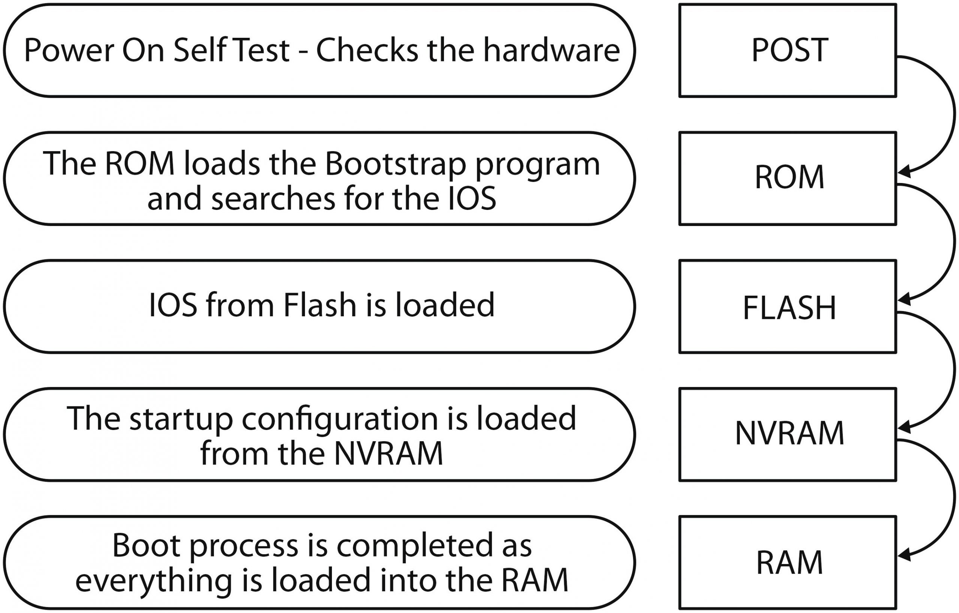
Booting process of switch

Slide 40
Booting process of switch

Slide 41
Booting process of switch
After a Cisco switch is powered on, it goes through the following boot sequence:
First, the switch loads a power-on self-test (POST) program stored in ROM.
POST checks the CPU subsystem.
It tests the CPU, DRAM, and the portion of the flash device that makes up the flash file system.
Next, the switch loads the boot loader software.
The boot loader is a small program stored in ROM and is run immediately after POST successfully completes.

Slide 42
Booting process of switch
The boot loader performs low-level CPU initialization.
It initializes the CPU registers, which control where physical memory is mapped, the quantity of memory, and its speed.
The boot loader initializes the flash file system on the system board.
Finally, the boot loader locates and loads a default IOS operating system software image into memory and hands control of the switch over to the IOS.

Slide 43
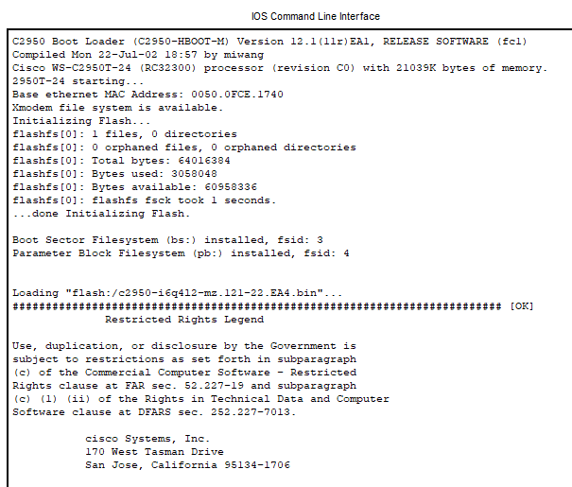
Booting process of switch

Slide 44
Types of Switches
Virtual Switches: Virtual Switches are the switches that are inside Virtual Machine hosting environments.
Routing Switches: These are the switches that are used to connect LANs. They also have the work of performing functions in the Network Layer of the OSI Model.
Unmanaged Switches: Unmanaged Switches are the devices that are used to enable Ethernet devices that help in automatic data passing. These are generally used for home networks and small businesses.

Slide 45
Types of Switches
Managed Switches: Managed Switches are switches having more complex networks. SNMP (Simple Network Management Protocol) can be used for configuring managed switches.
LAN Switches: LAN (Local Area Network) Switches are also called ethernet switches or data switches. LAN switches always try to avoid overlapping of data packets in the network just by allocating bandwidth in such a manner.
PoE Switches: Power over Ethernet(PoE) are the switches used in Gigabit Ethernets. PoE help in combining data and power transmission over the same cable so that it helps in receiving data and electricity over the same line.

Slide 46
Types of Switches
Smart Switches: Smart Switches are switches having some extra controls on data transmissions but also have extra limitations over managed Switches. They are also called partially managed switches.
Stackable Switches: Stackable switches are connected through a backplane to combine two logical switches into a single switch.
Modular Switches: These types of switches help in accommodating two or more cards. Modular switches help in providing better flexibility.

Slide 47
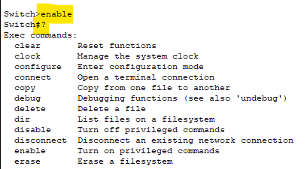
Basic Configuration(CLI)
Working with “User EXEC mode”:

Slide 48
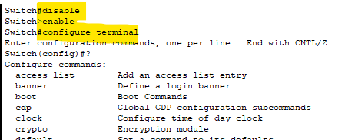
Basic Configuration(CLI)
Disabling “User EXEC mode” & then enabling configuration terminal:

Slide 49
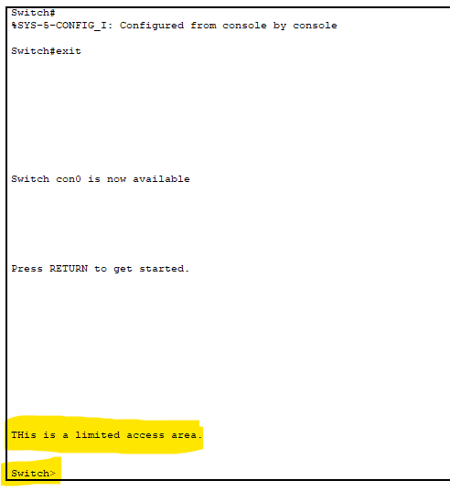

Basic Configuration(CLI)
Changing the banner on Cisco IOS:

Slide 50
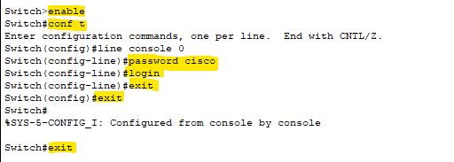
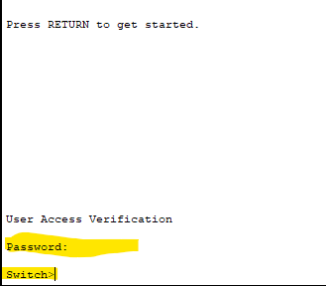
Configuring Password
On next login,

Slide 51
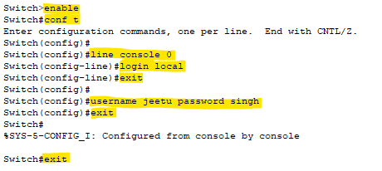
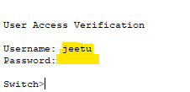
Configuring Username and Password
On next login,

Slide 52
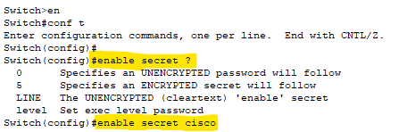
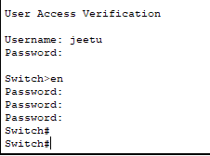
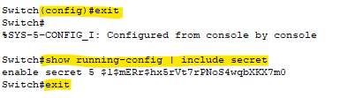
Configuring Secret
It’s the alternative of password in Cisco environment.

Slide 53
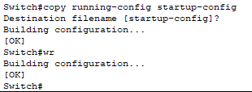
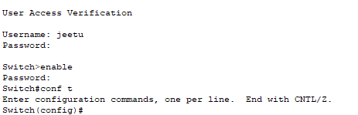
Configuring password permanently
On next login,
Username: Jeetu
Password: singh
Admin mode pwd: cisco

Slide 54
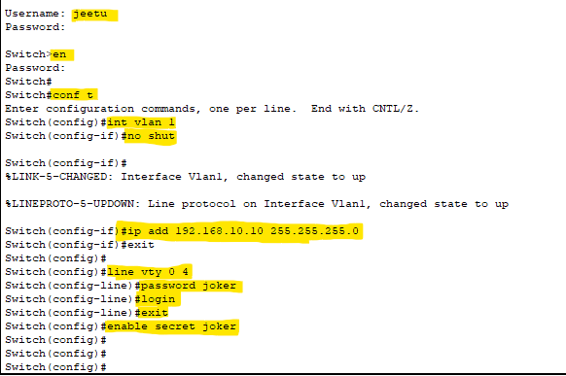
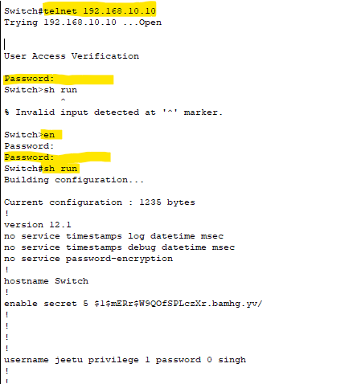
Configuring Telnet Access and Password

Slide 55
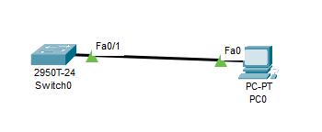
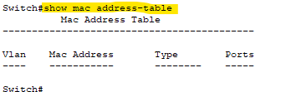
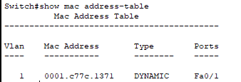
Showing mac address table
Before pinging switch & PC
After pinging switch & PC

Slide 56
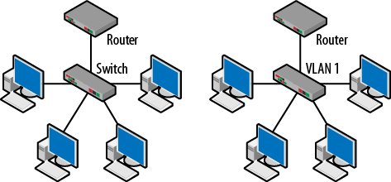
VLAN
A VLAN is a group of end stations in a switched network that is logically segmented by function or application, without regard to the physical locations of the users.
VLANs have the same attributes as physical LANs, but you can group end stations even if they are not physically located on the same LAN segment.
Under IEEE 802.1Q, the maximum number of VLANs on a given Ethernet network is 4,094.
VLANs provide a number of advantages including
ease of administration,
confinement of broadcast domains,
reduced network traffic, and
enforcement of security policies.

Slide 57
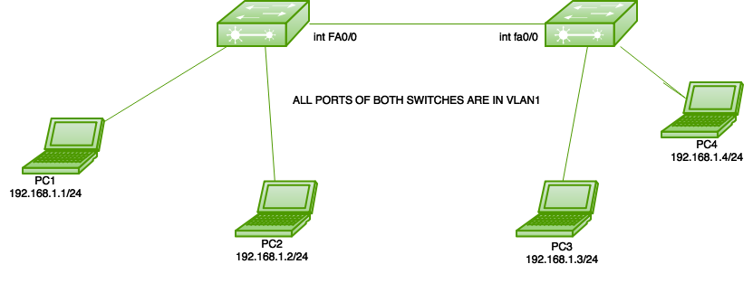
VLAN - Access Ports

Slide 58
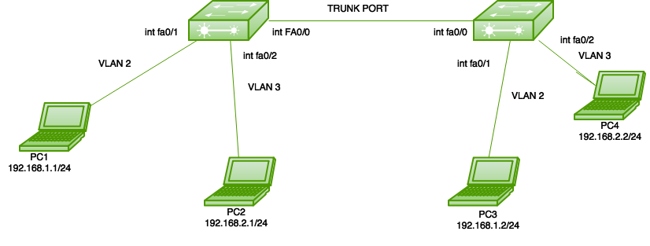
VLAN - Trunk Ports

Slide 59
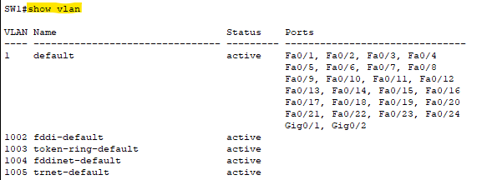
To show VLAN
Command:
# show vlan

Slide 60
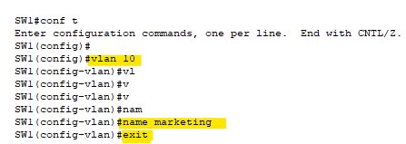
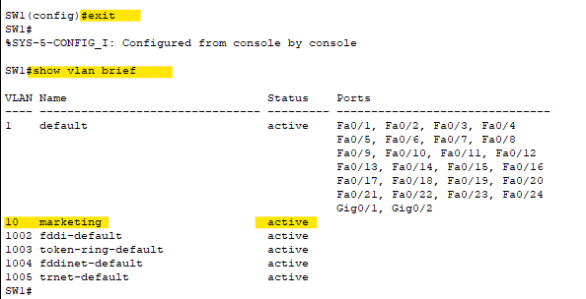
To create vlan

Slide 61
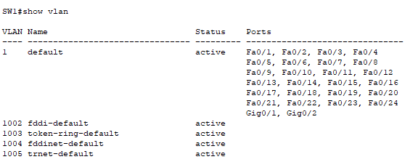
Deleting VLAN

Slide 62
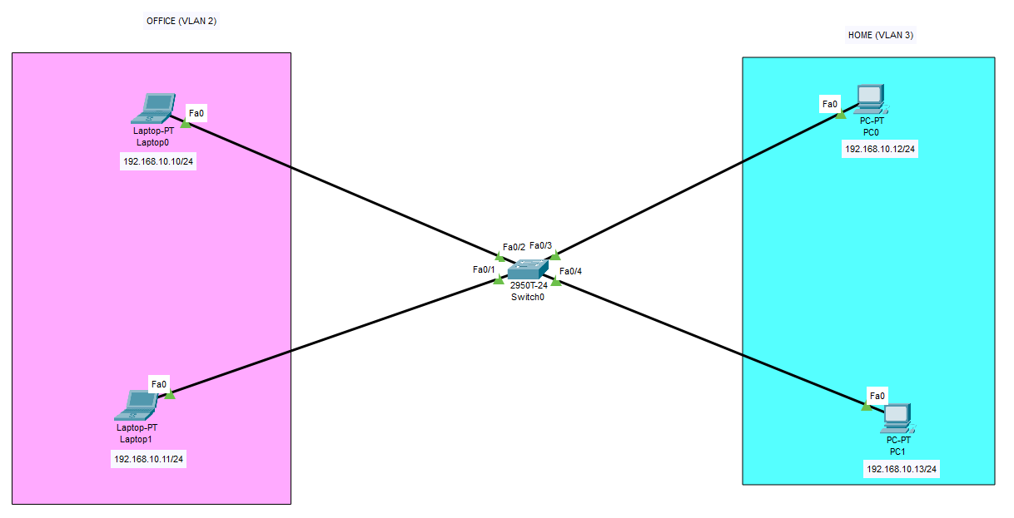
Home-office vlan

Slide 63
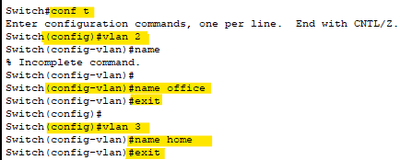
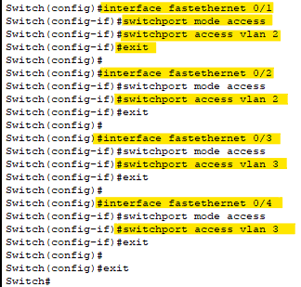
Home-office vlan - Commands

Slide 64
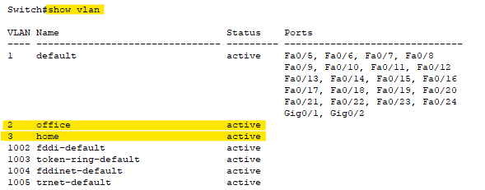
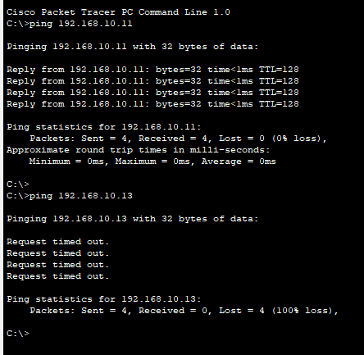

Home-office vlan - verify

Slide 65

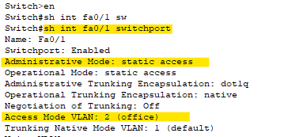
Dynamic Trunking protocol (DTP)
Manual commands (not recommended)
# switchport mode access
# switchport mode trunk
DTP configuration:
Switchport mode dynamic auto
Switchport mode dynamic desirable
Switchport nonegotiate

Slide 66
DTP
Switchport mode dynamic auto
It will form a trunk if the neighbor switch port is set to trunk or desirable.
Trunk will not be formed if both sides are set to auto.
Default on newer switches.
Switchport mode dynamic desirable
Will form a trunk if the neighbor switch port is set to trunk, desirable or auto.
Default on older switches.
Switchport nonegotiate
Disabled DTP

Slide 67
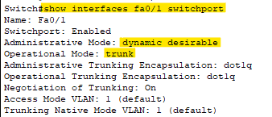
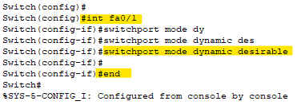
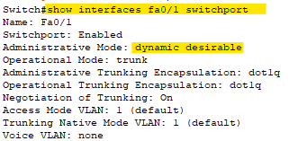
DTP
For new switch (default)
After changing
Verify:
For 2 switches connected together

Slide 68
VTP – VLAN Trunking protocol
VTP helps in reducing misconfiguration of VLAN on multiple switches (say 10, 15, 30 or more switches) while trying to replicate the configuration.
VTP helps you simplify the management of VLAN database across multiple switches.
If you create VLAN on a single switch, then it gets replicated on all the switches by using VTP.
Pre-requisites:
To make “trunk” on any 1 of the switch's interface, on another interface it will be created manually.

Slide 69
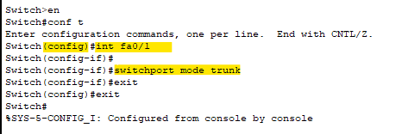
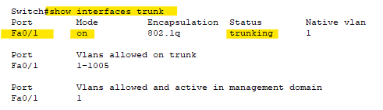
VTP – creation & verify

Slide 70
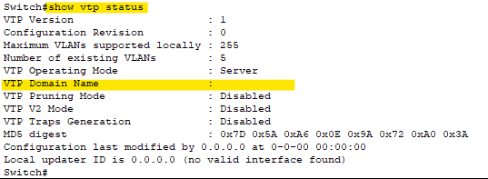
VTP status – by default

Slide 71
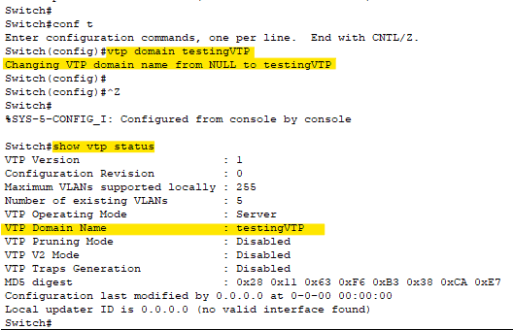
VTP status – changing on Switch 1

Slide 72
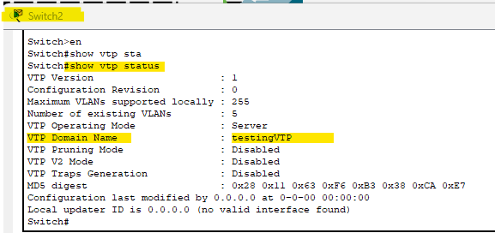
VTP status – changed on Switch 2

Slide 73

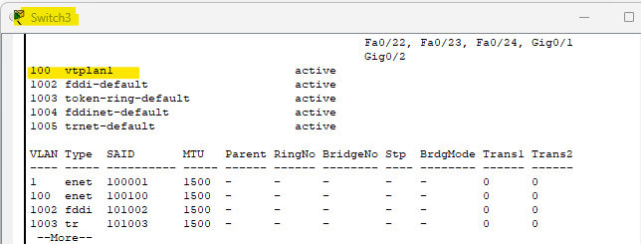
Creating VLAN using VTP – Switch 1
Checking on Switch 2

Slide 74
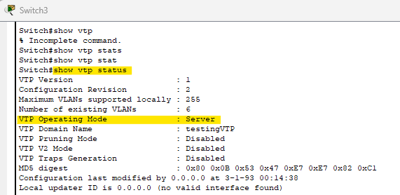
Modes of vtp
Client
Cannot create, change or delete VLANs.
Forwards advertisements to other switches.
Does not save VLAN configuration on NVRAM.
Server (by default)
Creates, modifies and deletes VLANs.
Sends & Forwards advertisements to other switches.
Saves VLAN configuration in NVRAM. (filename: vlan.dat(flash file)
Transparent
It forwards the advertisements to another switches but do not stores on that switches.

Slide 75
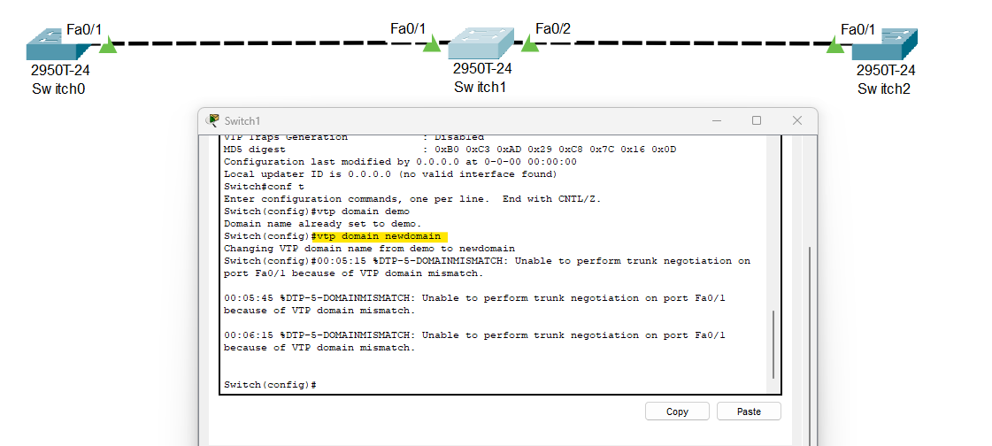
Configuring VTP
Notes:
Configure VTP domain on center switch so that it can replicate the domain name to all the switches.
Sometimes, if configured on 1st switch would not reflect the VTP domain name on 3rd switch (due to Cisco Packet Tracer issue/bugs).

Slide 76


VTP commands
# show vlan // list existing VLANs
Creating VTP:

Slide 77


Verify VTP – on 1st switch

Slide 78

VLAN replication to all switches

Slide 79

Spanning Tree Protocol (STP)
It is a Layer 2 protocol that runs on bridges and switches.
The main purpose of STP is to ensure that you do not create loops when you have redundant paths in your network.

Slide 80

Spanning Tree Protocol (STP)
When you have switches which keeps sending the broadcast messages, it creates a loop due to which the network could go down.
This creates a situation called “Broadcast storm”.
Extreme amounts of broadcast traffic constitute a broadcast storm.
Spanning Tree Protocol (STP) is useful in handling this situation.
STP prevents loop formation within the network.

Slide 81
STP
STP is known by IEEE 802.1D (original).
Switches send probe into the network periodically to discover loops.
The work of these probe messages is to detect the loops within network.
It’s detect the loops, when a switch receives the same broadcast message that was sent by itself earlier.
These probes are called BPDU (Bridge Protocol Data Unit), that contains the details of a sender switch. Once a switch receives the same BPDU, it understands that theirs a loop in network.
Switch multicasts this BPDU after every 2 seconds. And block if any redundant links.

Slide 82

STP – Root bridge
BPDU ID = Bridge Priority + MAC address.
The switch with the lowest BPDU ID is elected as “root bridge”.
The bridge with the lowest MAC address will be root bridge.

Slide 83

STP – link failure

Slide 84



STP – list root bridge

Slide 85


STP – Port rules
Root port (used to reach the root bridge)
Designated Port (forwarding port)
Blocking / Non-Designation Port (Loop)

Slide 86
Types of STP
STP / 802.1D (Original STP)
Per VLAN Spanning Tree (PVST) + Cisco improvement of STP
Rapid Spanning Tree Protocol (RSTP) / 802.1W (improved STP with fast convergence)
RAPID PVST (Cisco improvement of RSTP)

Slide 87
Port Security
To configure port security:
Maximum – allows max number of MAC addresses allows on that port.
MAC-Address – allows only specific MAC addresses on that port.
Static – statically assigning MAC address
Sticky – it learns the attached MAC address connected to that port.
If the port security breaks the rules, it falls under VIOLATION:
Protect – it will drop all packets until MAC address is connect with no violation notification
Restrict – same as ‘protect’ but will receive notifications & increase counter with every violation.
Shutdown – it shutdown all the interface together.

Slide 88

Port Security – Command - 1

Slide 89
Port Security – Command - 2

Slide 90


Port Security – validate
After adding a PC to the Switch

