Slide 1
ITIL
By
Jitendra Singh Tomar || Jeetu

Slide 2
Topics to discuss
Introduction to ITIL and ITSM
What is ITIL?
ITSM Introduction — ITSM
Why ITSM — ITSM
Basic concept of ITIL4 and RACI
What Is ITIL V4?
RACI Matrix
Difference between ITIL v3 and ITIL 4
Service Value System and Framework v0.1
ITIL v4 Service Value Chain Defined
Service Level Management and Change Control v0.1
SLM Example - Explained using Pizza Delivery

Slide 3
Topics to discuss
What is change Management
What Is Change Management Flow
Change Management- Example
Service Management Practice Overview v0.1
Event Management
Incident Management v0.1
Incident Management - Explained
Prioritization
Problem Management
Problem Management - Explained
Service Request Fulfillment

Slide 4
What is ITIL?
Full form – Information Technology Infrastructure Service
ITIL is a framework for IT service management (ITSM – Information Technology Service Management).
ITSM encompasses various processes, policies, and procedures aimed at designing, delivering, managing, and improving the way IT services are utilized within an organization.
For business, ITIL Provides best practice & technique for:
Selecting
Planning
Delivering
Maintaining,

Slide 5
What is ITIL?
ITIL is a set of best practices for IT service management (ITSM) that focuses on aligning IT services with the needs of the business.
Originally developed by the UK government's Central Computer and Telecommunications Agency (CCTA) in the 1980s, ITIL has evolved into a globally recognized framework used by organizations worldwide.

Slide 6
ITIL history timeline
ITIL V1 --> 1989
ITIL V2 --> 2001
ITIL V3 --> 2007
ITIL 4 --> 2019

Slide 7
Key Concepts of ITIL
Service Lifecycle
Processes
Functions
Roles and Responsibilities

Slide 8
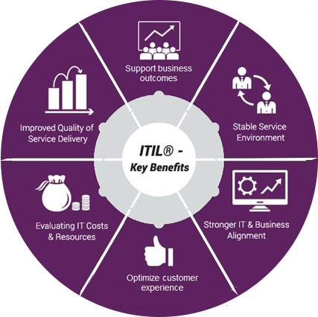
Benefits of ITIL
Lower cost
High-Quality of IT service.
Increased business productivity.
Improved Return on Investment (ROI).
Greater Satisfaction.
Improved resources utilization.

Slide 9
What is ITSM?
It focuses on meeting the needs of customers and aligning IT services with business objectives.
ITIL is a specific framework for ITSM, providing detailed guidance on processes, functions, roles, and best practices, while ITSM is a broader concept encompassing the overall management and delivery of IT services within an organization.
Both ITIL and ITSM aim to improve the quality, efficiency, and alignment of IT services with business objectives.

Slide 10
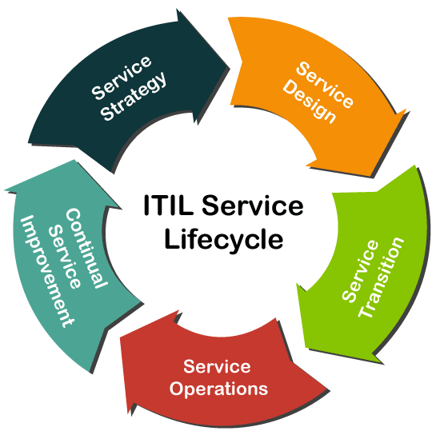
Key Components of ITSM
Service Strategy
Service Design
Service Transition
Service Operation
Continual Service Improvement (CSI)

Slide 11
Benefits of ITSM
Improved Service Quality
Increased Efficiency
Enhanced Customer Satisfaction
Better Decision-Making
Cost Optimization

Slide 12
Why ITSM???
Improved Service Quality
Enhanced Customer Satisfaction
Efficient Resource Utilization
Better Decision-Making
Alignment with Business Goals
Risk Reduction
Cost Optimization

Slide 13
Basic concept of ITIL4
Service Value System (SVS)
Service Value Chain (SVC)
Guiding Principles
Four Dimensions of Service Management
Service Value System (SVS) Components
ITIL Practices
Continual Improvement

Slide 14
RACI
R
Responsible
A
Accountable
C
Consulted
I
Informed

Slide 15
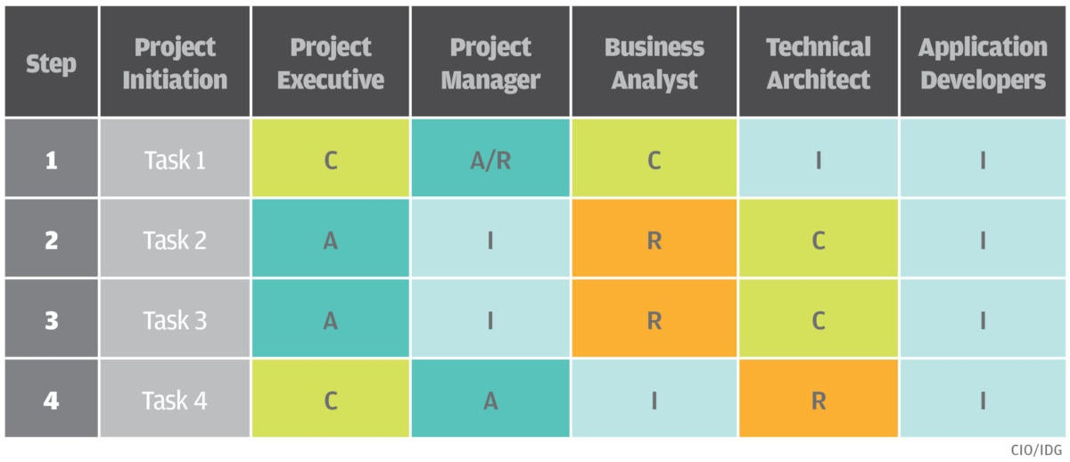
RACI matrix – task VS people

Slide 16
Why RACI?
Facilitates communication
Helps to avoid people overload
Helps to avoid work overload
Helps to eliminate confusion.

Slide 17
How to create RACI matrix?
Identity the roles of the project.
Identify tasks & deliverables of the project.
Assign tasks to each role.
Share with your team.
Share with the major stakeholders.

Slide 18
Rules of a RACI matrix creation
Every row must contain at an “R” – responsible.
There should be single “A” – accountable for a task.
No too many “C” – consulted for a task.

Slide 19
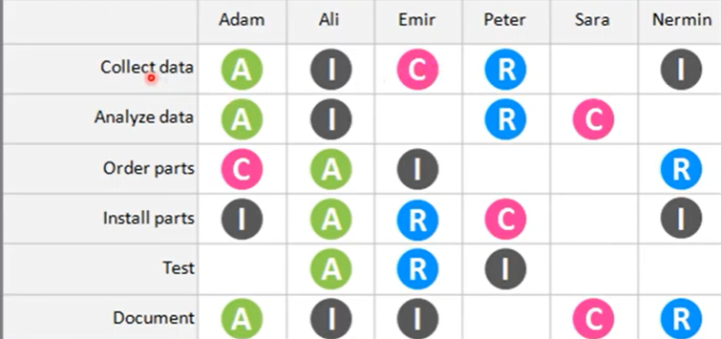
Assigning person to a project

Slide 20
Disadvantages of RACI
It can add confusion through a lack of understanding of differences between the terms.
It can be time-consuming to create.
It’s often ignored after approval.
It can add unnecessary complexity to a project.
It does not account for the approval process on tasks or deliverables.

Slide 21
RACI alternatives
DACI | RASCI

Slide 22
Difference between ITIL v3 and ITIL 4
 | ITIL v3 | ITIL v4
Service value system (SVS) | Focuses on service lifecycle. | Introduces the service value system (SVS)
Service Value Chain (SVC) | Does not include the concept of a Service Value Chain | ITIL 4 introduces the Service Value Chain
Guiding Principles | v3 does not explicitly define a set of Guiding Principles | ITIL 4 introduces seven Guiding Principles.
Four Dimensions of Service Management | v3 does not explicitly define four dimensions of service management. | ITIL 4 expands the focus beyond traditional processes and functions
Flexibility and Integration | provides a structured approach to IT service management | ITIL 4 emphasizes flexibility and integration

Slide 23
Framework v0.1
ITIL 4 introduces the concept of the "ITIL 4 Framework," which is an evolution from the previous version of ITIL.
The ITIL 4 Framework encompasses various components and concepts aimed at modernizing IT service management and aligning it with evolving business practices.
Here are some key aspects of the ITIL 4 Framework v0.1:
Service Value System (SVS)
Service Value Chain (SVC)
Guiding Principles
Continual Improvement
Practices

Slide 24
ITIL v4 Service Value Chain Defined
Plan
Improve
Engage
Design and Transition
Obtain/Build
Deliver and support.

Slide 25
Service Level Management & Change Control v0.1
Service Level Management (SLM) and Change Control are two key components of service management aimed at ensuring that IT services meet agreed-upon service levels and that changes to IT infrastructure are managed effectively.
While these concepts are not explicitly defined as separate components in the ITIL 4 Framework v0.1, they are integral parts of the broader framework and are addressed within the context of service management practices and processes.

Slide 26
Service Level Management (SLM)
SLM focuses on defining, negotiating, documenting, and managing service level agreements (SLAs) with customers and stakeholders.
The primary objective of SLM is to ensure that IT services meet agreed-upon service levels and performance targets.
SLM involves activities such as identifying service requirements, defining SLAs, monitoring service performance, and reporting on service level achievements.
By establishing clear SLAs and continuously monitoring service performance, organizations can ensure that IT services align with business needs and customer expectations.

Slide 27
Change Control
Change Control is the process of managing changes to IT infrastructure, systems, applications, and services in a controlled and systematic manner.
The goal of Change Control is to minimize the risk of disruptions and negative impacts on service quality and stability.
Change Control involves activities such as assessing proposed changes, prioritizing changes based on impact and urgency, reviewing change requests, approving changes, implementing changes, and evaluating their effectiveness.
By implementing effective Change Control processes, organizations can ensure that changes are implemented smoothly and that service disruptions are minimized.

Slide 28
Service Level Management (SLM) - Pizza Delivery
Defining Service Level Agreements (SLAs)
Monitoring Service Performance
Responding to Service Issues
Continual Improvement
Reporting and Review

Slide 29
What is change Management?
Change Management in ITIL is a structured approach to managing changes to
IT services,
systems,
processes, and
infrastructure in a controlled and systematic manner.
The primary objective of Change Management is to minimize the risk of disruptions and negative impacts on service quality and stability while facilitating beneficial changes that support business objectives.

Slide 30
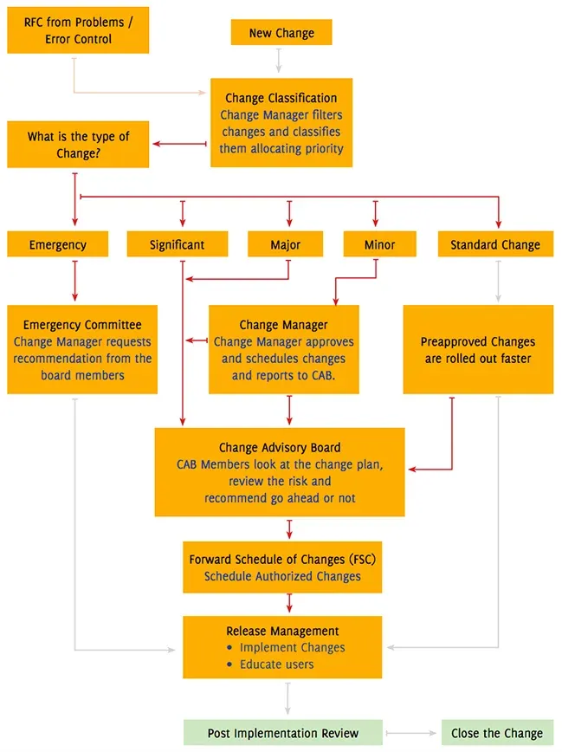
Key aspects of Change Management in ITIL
Change Control Process
Change Types
Change Advisory Board (CAB)
Change Models and Templates
Change Authorization and Approval
Change Implementation and Review
Post-Implementation Review (PIR)

Slide 31
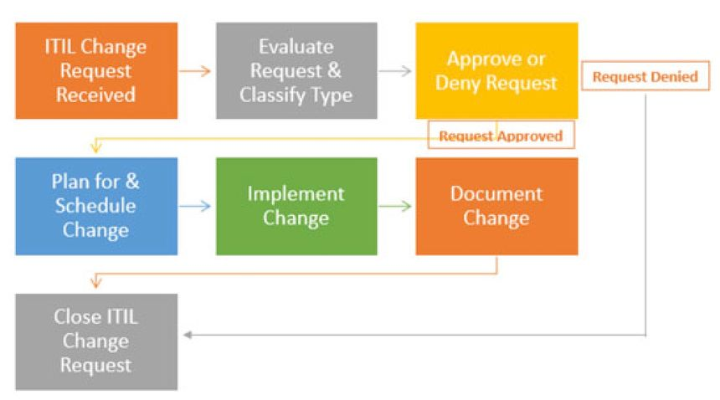
Change Management Flow/Process
Request for Change (RFC)
Initial Assessment
Change Evaluation
Change Approval
Change Planning
Change Implementation
Change Review and Closure
Change Communication and Documentation

Slide 32
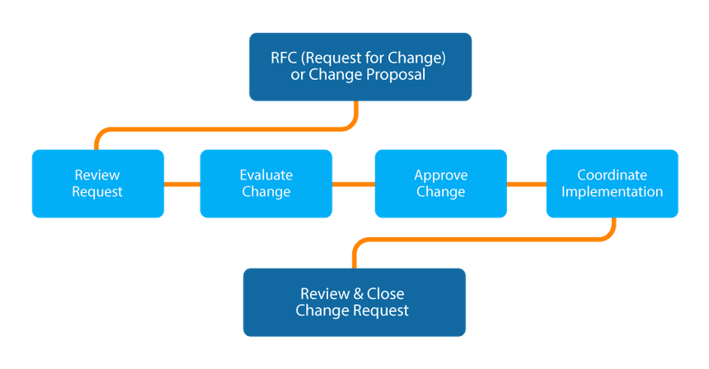
Key aspects of Change Management in ITIL
Change Control Process
Change Types
Change Advisory Board (CAB)
Change Models and Templates
Change Authorization and Approval
Change Implementation and Review
Post-Implementation Review (PIR)

Slide 33
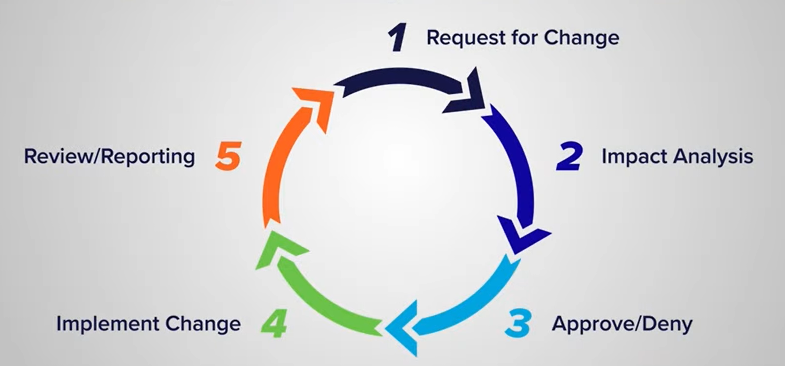
Change Management

Slide 34
Service Management
It refers to the set of practices, processes and capabilities used to design, deliver, manage and improve IT services to meet the needs of customers and support business objectives effectively.
It encompasses the entire lifecycle of IT services from initial planning and design to ongoing operations, support and optimization.
Key aspects of Service management includes:
Service strategy
Service design
Service transition
Service Operation
Continual Service Improvements (CSI)

Slide 35
Service Management – Service Strategy
Service Strategy in ITIL is the phase where an organization defines its approach to delivering value to its customers and stakeholders through IT services.
It's about aligning IT service management with business objectives and ensuring that IT resources are utilized effectively to support business goals.
Examples:
Defining service offerings
Assessing Market Demands
Establishing Service Portfolios
Defining Service Level Agreements (SLAs)
Identifying Strategic Assets
Financial Management for IT Services

Slide 36
Service Management – Service Design
Service Design in ITIL is the phase where organizations translate their strategic objectives and customer requirements into actionable plans for delivering IT services.
It focuses on designing new or modified services that meet business needs, are cost-effective, and align with service strategy.
Examples:
Service Catalog Management
Service Level Management
Capacity Management
Availability Management
IT Service Continuity Management
Information Security Management

Slide 37
Service Management – Service transition
Service Transition in ITIL is the phase where organizations plan and manage the transition of new or modified IT services into operation while ensuring that changes are implemented effectively and efficiently.
It focuses on minimizing the risk of disruptions to IT services and maximizing the value delivered to customers and stakeholders.
Examples:
Change Management
Release and Deployment Management
Service Validation and Testing
Knowledge Management
Configuration Management
Transition Planning and Support

Slide 38
Service Management – Service Operation
Service Operation in ITIL is the phase where organizations ensure that IT services are delivered and supported effectively to meet business needs and customer expectations.
It focuses on executing day-to-day operational activities, handling service requests and incidents, and maintaining service quality and availability.
Example:
Incident Management
Request Fulfillment
Problem Management
Access Management
Event Management
Continuous Monitoring and Reporting

Slide 39
Service Management – Continual Service Improvements
CSI in ITIL is a phase focused on systematically identifying and implementing improvements to IT services, processes, and capabilities to enhance service quality, efficiency, and alignment with business objectives.
CSI emphasizes the importance of ongoing evaluation, feedback, and learning to drive continuous improvement across the IT organization.
Example:
Define CSI Approach
Identify Opportunities for Improvement
Assess Current State
Define Improvement Initiatives
Implement Improvements
Measure and Monitor Progress
Review and Learn

Slide 40
Event Management
Event Management in ITIL is a process focused on monitoring and managing events that occur within an IT infrastructure or service environment.
An event is defined as any detectable occurrence that has significance for the management of IT services or infrastructure.
Examples:
Detection of Events
Categorization and Prioritization
Event Filtering and Correlation
Notification and Escalation
Incident Identification and Resolution
Proactive Management and Root Cause Analysis
Reporting and Analysis

Slide 41
Incident Management
Incident Management in ITIL is a process focused on restoring normal service operation as quickly as possible following an unplanned interruption or reduction in the quality of IT services.
The primary goal of Incident Management is to minimize the impact of incidents on business operations and service delivery by ensuring that incidents are promptly reported, categorized, prioritized, diagnosed, and resolved

Slide 42
Incident Management
Incident Identification and Reporting
Incident Logging and Categorization
Initial Assessment and Prioritization
Incident Diagnosis and Escalation
Incident Resolution and Workaround
Incident Closure and Documentation
Continuous Improvement

Slide 43
Incident Management - Examples
Imagine you're driving a car, and suddenly it starts making a strange noise and slows down. That's an incident – something unexpected that affects your journey (like an IT service being disrupted).
Reporting the Incident:
You notice the problem and tell someone – maybe a mechanic (like reporting to IT support).
Noting Down the Details:
The mechanic logs the issue and figures out what's wrong (like IT support categorizing and understanding the problem).
Deciding How Urgent It Is:
They decide if it's a quick fix or if it needs immediate attention (like determining the severity of an IT issue).

Slide 44
Incident Management - Examples
Fixing the Problem:
The mechanic repairs the car or provides a temporary solution so you can keep driving (like IT support resolving the IT issue).
Keeping Track:
They make a note of what happened and what they did to fix it (like documenting the incident and resolution in a system).
Learning and Improving:
Afterwards, they might look at why it happened and how to prevent it in the future (like analyzing incidents to improve IT services).

Slide 45
Prioritization
Incident Prioritization
Change Prioritization
Service Request Prioritization
Problem Prioritization
Task Prioritization
Resource Allocation

Slide 46
Problem Management
Problem Management is a process focused on
identifying,
analyzing, and
resolving the root causes of recurring incidents or problems within the IT infrastructure.
While Incident Management focuses on restoring service operation as quickly as possible, Problem Management aims to prevent incidents from recurring by addressing their underlying causes.

Slide 47
Problem Management
Identification of Problems
Logging and Categorization
Investigation and Diagnosis
Workarounds and Temporary Fixes
Resolution and Closure
Knowledge Sharing and Documentation
Continuous Improvement

Slide 48
Service Request
Service Request refers to a formal request from a user or a customer for access to an IT service or for some specific action to be taken by the IT service provider.
Unlike incidents, which represent unplanned disruptions to IT services, service requests are typically routine, pre-approved, and do not require troubleshooting or resolution.
Breakdown of Service Requests in ITIL:
Definition
Examples
Characteristics
Fulfilment Process
Service Level Agreements (SLAs)

