Slide 1
Database
By
Jitendra Singh Tomar || Jeetu

Slide 2
Topics to discuss
Understanding Databases
Overview of Relational Databases
Getting Started with SQL
Types of databases & their usage
Database Design and Modeling
Normalization
Practical Database Design
Advanced SQL and Database Administration Basics
Database Administration Basics
Data Integrity and Transactions

Slide 3
What is DATA?
Data is raw fact or figures or entity.
When activities in the organization takes place, the effect of these activities need to be recorded which is known as Data.

Slide 4
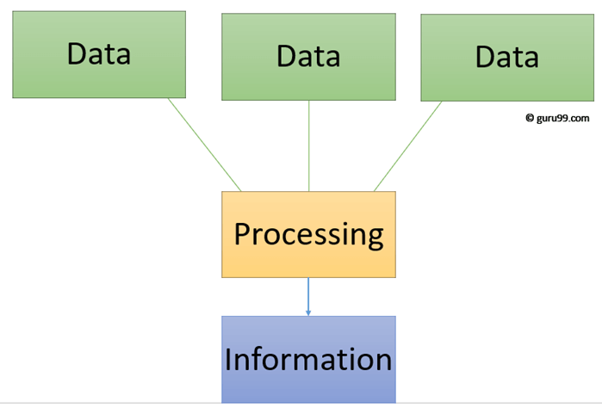
What is INFORMATION?
Processed data is called information.
The purpose of data processing is to generate the information required for carrying out the business activities.

Slide 5
Introduction to Databases
A database is a structured collection of data that is organized and stored in a way that allows for efficient retrieval, management, and update of information.
Databases are fundamental to modern computing and play a crucial role in storing and managing vast amounts of data for various applications and industries.

Slide 6
Database
Database may be defined in simple terms as a collection of data
A database is a collection of related data.
The database can be of any size and of varying complexity.
A database may be generated and maintained manually or it may be computerized.

Slide 7
Database Management System
Database Management Systems (DBMS) are software systems used to store, retrieve, and run queries on data.
A DBMS serves as an interface between an end-user and a database, allowing users to create, read, update, and delete data in the database.
A DBMS is a collection of program that enables user to create and maintain a database.

Slide 8
Characteristics of DBMS
Data Definition and Schema Management
Data Manipulation
Transaction Management
Query Optimization
Security and Access Control
Security and Access Control
Data Recovery and Backup
Scalability
Data Independence
Query Language Support
Backup and Recovery

Slide 9
DBMS Utilities
A data loading utility:
Which allows easy loading of data from the external format without writing programs.
A backup utility:
Which allows to make copies of the database periodically to help in cases of crashes and disasters.
Recovery utility:
Which allows to reconstruct the correct state of database from the backup and history of transactions.

Slide 10
DBMS Utilities
Monitoring tools:
Which monitors the performance so that internal schema can be changed and database access can be optimized.
File organization:
Which allows restructuring the data from one type to another?

Slide 11
File system VS Database
File System | DBMS
File system is a collection of data. Any management with the file system, user has to write the procedures. | DBMS is a collection of data and user is not required to write the procedures for managing the database.
File system gives the details of the data representation and Storage of data. | DBMS provides an abstract view of data that hides the details.
In File system storing and retrieving of data cannot be done efficiently. | DBMS is efficient to use since there are wide varieties of sophisticated techniques to store and retrieve the data.
Concurrent access to the data in the file system has many problems. | DBMS takes care of Concurrent access using some form of locking.
File system doesn’t provide crash recovery mechanism. | DBMS has crash recovery mechanism, DBMS protects user from the effects of system failures.
Protecting a file under file system is very difficult. | DBMS has a good protection mechanism.

Slide 12
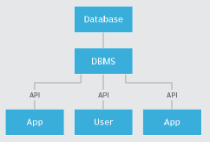
Advantages of DBMS
Data independency
Efficient data access
Data integrity and security
Data Administration
Concurrent access and Crash recovery
Reduced application development time

Slide 13
Types of DBMS
Relational database
Object oriented database
Hierarchical database
Network database

Slide 14
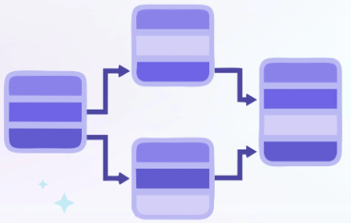
Relation Database
It is based on SQL.
A relational database management system.
This is one of the most popular data models which is used in industries.
Every table in a database has a key field which uniquely identifies each record.
RDBMS is a system where data is organized in two-dimensional tables using rows and columns.

Slide 15
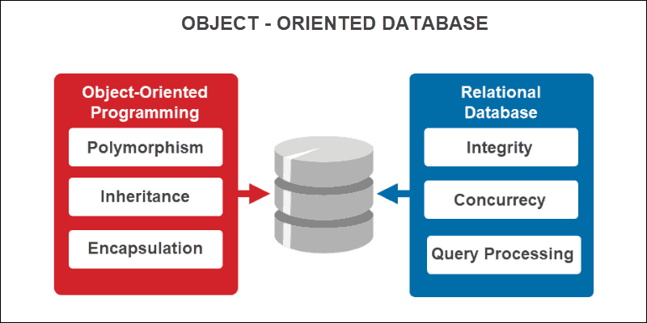
Object Oriented Database
It is a combination of relational database concepts and object-oriented principles.
OOPs principles are data encapsulation, inheritance, and polymorphism.
It requires less code and is easy to maintain.
For example − Object DB software.

Slide 16
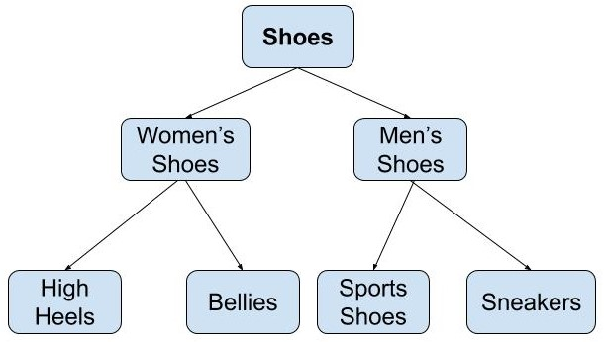
Hierarchical Database
It is used in industry on mainframe platforms.
The hierarchy starts from the root node, connecting all the child nodes to the parent node.
For example
IMS (IBM)
Windows registry (Microsoft).

Slide 17
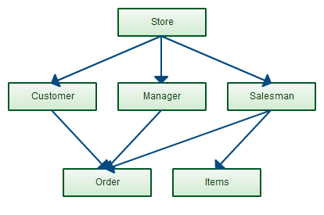
Network database
A Network database management system.
This maintain one to one relationship (1: 1) or many to many relationship (N: N).
It is based on a network data model, which allows each record to be related to multiple primary records and multiple secondary records.

Slide 18
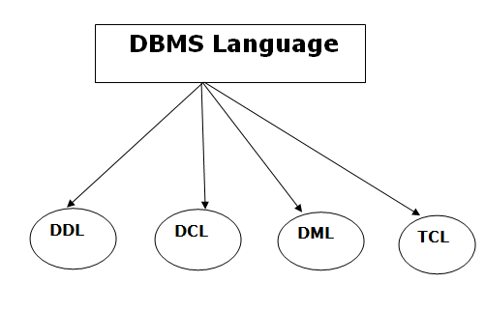
DBMS Language

Slide 19
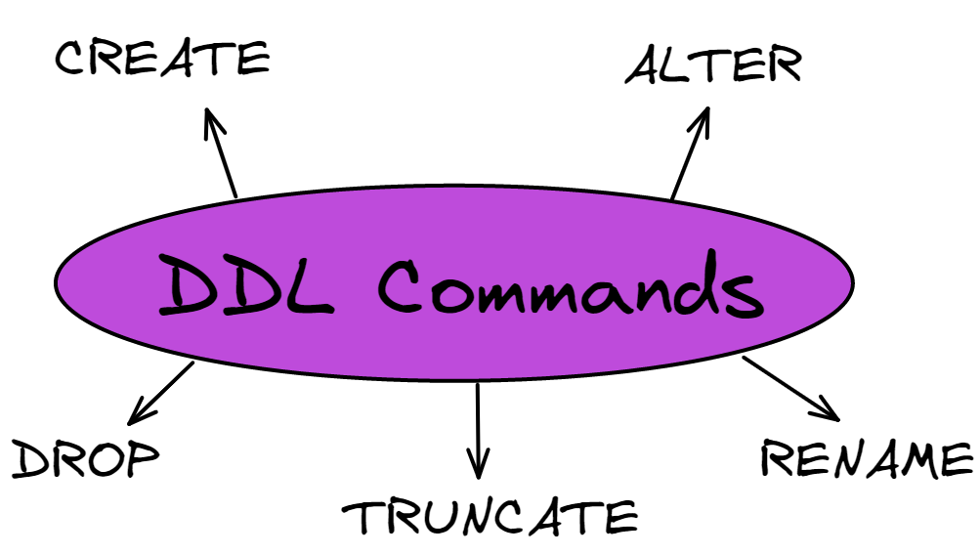
Data Definition Language (DDL)
It is used to define database structure or pattern.
It is used to create schema, tables, indexes, constraints, etc. in the database.
Using the DDL statements, you can create the skeleton of the database.

Slide 20
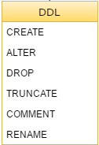
Data Definition Language (DDL)
Create: It is used to create objects in the database.
Alter: It is used to alter the structure of the database.
Drop: It is used to delete objects from the database.
Truncate: It is used to remove all records from a table.
Rename: It is used to rename an object.
Comment: It is used to comment on the data dictionary.

Slide 21
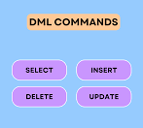
Data Manipulation Language (DML)
It is used for accessing and manipulating data in a database.
Here are some tasks that come under DML:
Select: It is used to retrieve data from a database.
Insert: It is used to insert data into a table.
Update: It is used to update existing data within a table.
Delete: It is used to delete all records from a table.
Merge: It performs UPSERT operation, i.e., insert or update operations.

Slide 22
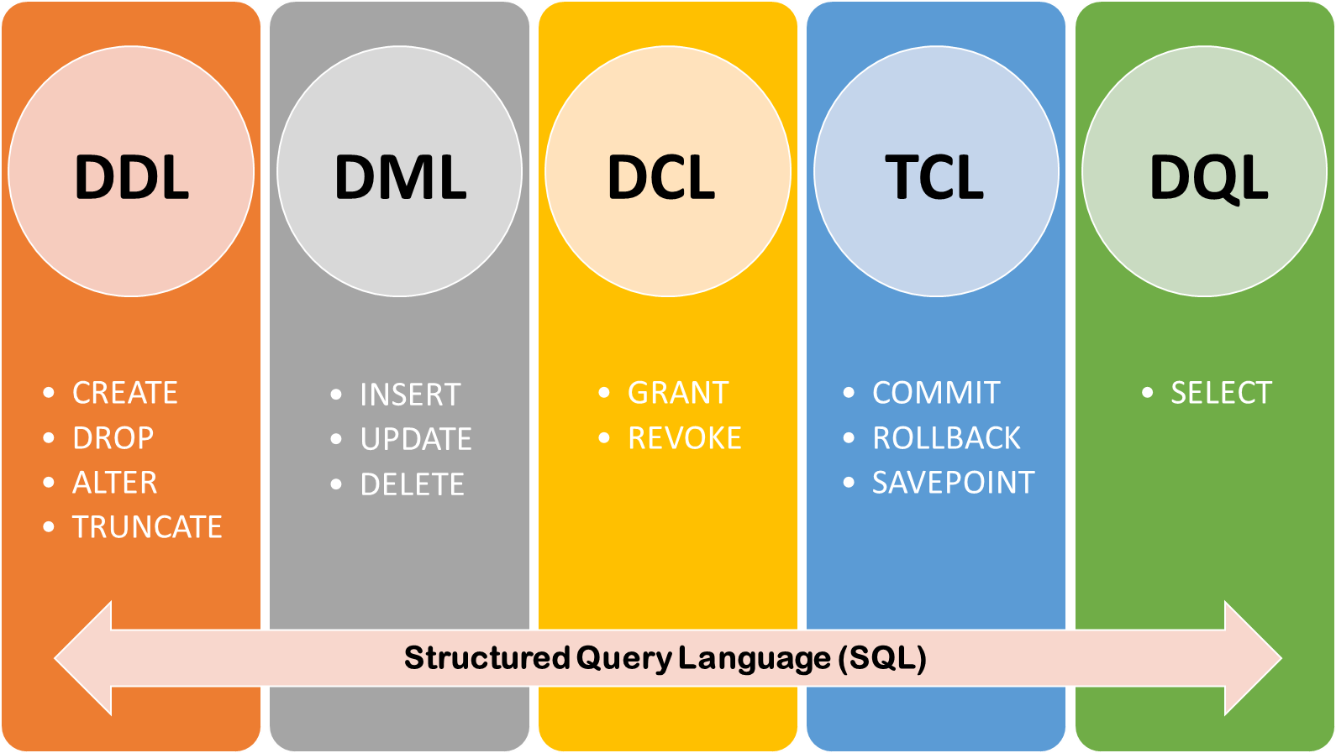
Data Control Language (DCL)
DCL stands for Data Control Language.
It is used to retrieve the stored or saved data.
The DCL execution is transactional.
It also has rollback parameters.
Here are some tasks that come under DCL:
Grant: It is used to give user access privileges to a database.
Revoke: It is used to take back permissions from the user.

Slide 23
Transaction Control Language (TCL)
TCL is used to run the changes made by the DML statement.
TCL can be grouped into a logical transaction.
Here are some tasks that come under TCL:
Commit: It is used to save the transaction on the database.
Rollback: It is used to restore the database to original since the last Commit.

Slide 24
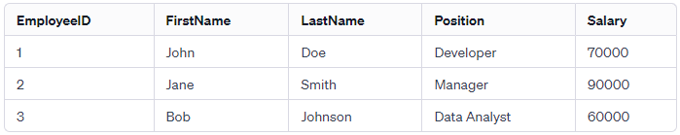
Key Concepts
These are fundamental components that help organize and structure data
Tables
Rows
Columns

Slide 25
Key Concepts - Tables
A table is a structured representation of data in a relational database.
It is often compared to a spreadsheet, where data is organized into rows and columns.
Tables are used to store information about a specific entity or concept, such as customers, products, or orders.

Slide 26
Key Concepts - Rows
Also known as records or tuples, rows represent individual entries in a table.
Each row contains data related to a specific instance of the entity represented by the table.

Slide 27
Key Concepts - Columns
Columns, also referred to as fields or attributes, represent the different properties or attributes of the data stored in a table.
Each column in a table has a specific data type (such as text, number, date) and holds a particular kind of information.

Slide 28
Terminologies used in DBMS
Primary key
Foreign key
Index
Query
Normalization
Transaction
ACID Property
Schema
View

Slide 29
Introduction to Structured Query Language (SQL)
SQL is a specialized programming language designed for managing and manipulating relational databases.
It serves as the standard language for interacting with relational database management systems (RDBMS), allowing users to create, modify, and query databases.
SQL provides a set of powerful and flexible commands for handling data, maintaining database integrity, and retrieving information efficiently.

Slide 30
Key aspects of SQL
Data Definition Language (DDL)
Data Manipulation Language (DML)
Data Query Language (DQL)
Data Control Language (DCL)
Data Integrity
Transactions
Views

Slide 31
Data Definition Language (DDL)
DDL defines & manage the structure of the database.
DDL commands include:
CREATE: Used to create database objects such as tables, indexes, or views.
ALTER: Modifies the structure of existing database objects.
DROP: Deletes database objects like tables or indexes.

Slide 32
Data Manipulation Language (DML)
DML statements are used to manipulate the data stored in the database.
SELECT: Retrieves data from one or more tables.
INSERT: Adds new records to a table.
UPDATE: Modifies existing records in a table.
DELETE: Removes records from a table.

Slide 33
Data Query Language (DQL)
DQL is a subset of SQL used exclusively for querying and retrieving data from the database.
The primary DQL command is SELECT.

Slide 34
Data Control Language (DCL)
DCL statements are used to control access to data within the database.
GRANT: Provides specific privileges to database users.
REVOKE: Removes specific privileges from database users.

Slide 35
Data Integrity
SQL allows the definition of constraints to maintain data integrity.
PRIMARY KEY: Ensures the uniqueness of a column's values in a table.
FOREIGN KEY: Establishes a link between two tables based on a column.
CHECK: Defines conditions that must be satisfied for data to be entered into a table.
UNIQUE: Ensures that all values in a column are unique.

Slide 36
Transactions
SQL supports transaction management to ensure the consistency and reliability of database operations.
The ACID properties (Atomicity, Consistency, Isolation, Durability) define the characteristics of a transaction.

Slide 37
Views
SQL allows the creation of virtual tables known as views.
Views are based on the result of a SELECT query and provide a way to simplify complex queries or restrict access to certain columns.

Slide 38
ACID Properties
Atomicity
Either successfully completed or none.
Consistency
Consistent state before & after the transaction.
Isolation
Transactions are isolation
Durability
Durability ensures the permanency of something.

Slide 39
SQL
It’s a language.
Used for interacting with Relational DBMS (RDBMS).
Performs C.R.U.D operation.
C = Create
R = Read/Retrieve
U = Update
D = Delete
Also performs admin tasks:
Security
User management
Import/Export data
Backup

Slide 40

Create Database
Syntax to create a DB:
CREATE DATABASE <DB-NAME>;

Slide 41

Selecting DB
In simple terms, the use statement selects a specific database and then performs operations on it using the inbuilt commands of SQL.
Syntax:
USE DATABASE;

Slide 42
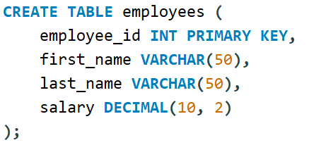
Creating Table

Slide 43


Viewing table
Output:

Slide 44
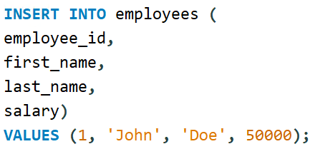
Inserting 1st row in table

Slide 45

Verifying:
Output:

Slide 46
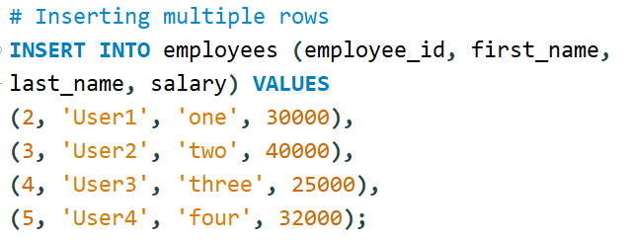
Inserting multiple values

Slide 47
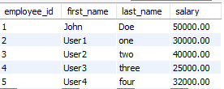
Verifying:
Output:

Slide 48



Dropping
Table
Database

Slide 49
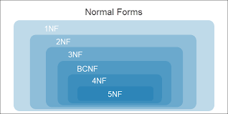
Normalization
Normalization is the process of minimizing redundancy from a relation or set of relations.
Redundancy in relation may cause insertion, deletion, and update anomalies. So, it helps to minimize the redundancy in relations.
Normal forms are used to eliminate or reduce redundancy in database tables.

Slide 50
Normalization
First Normal Form (1NF)
Second Normal Form (2NF)
Third Normal Form (3NF)
Boyce-Codd Normal Form (BCNF)
Fourth Normal Form (4NF)
Fifth Normal Form (5NF)

Slide 51
Normalization of DBMS – 1NF
This is the most basic level of normalization.
In 1NF, each table cell should contain only a single value, and each column should have a unique name.
The first normal form helps to eliminate duplicate data and simplify queries.

Slide 52
Normalization of DBMS – 2NF
2NF eliminates redundant data by requiring that each non-key attribute be dependent on the primary key.
This means that each column should be directly related to the primary key, and not to other columns.

Slide 53
Normalization of DBMS – 3NF
3NF builds on 2NF by requiring that all non-key attributes are independent of each other.
This means that each column should be directly related to the primary key, and not to any other columns in the same table.

Slide 54
Boyce-Codd Normal Form (BCNF):
BCNF is a stricter form of 3NF that ensures that each determinant in a table is a candidate key.
In other words, BCNF ensures that each non-key attribute is dependent only on the candidate key.

Slide 55
SQL JOIN
SQL Join statement is used to combine data or rows from two or more tables based on a common field between them.
Here are the different types of the JOINs in SQL:
(INNER) JOIN: Returns records that have matching values in both tables
LEFT (OUTER) JOIN: Returns all records from the left table, and the matched records from the right table
RIGHT (OUTER) JOIN: Returns all records from the right table, and the matched records from the left table
FULL (OUTER) JOIN: Returns all records when there is a match in either left or right table

Slide 56
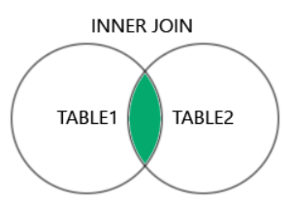
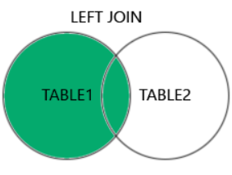
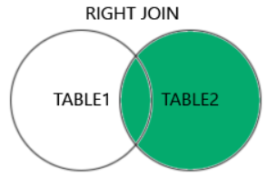
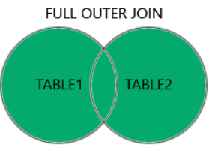
SQL JOIN

Slide 57
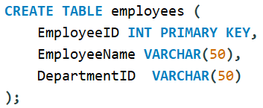
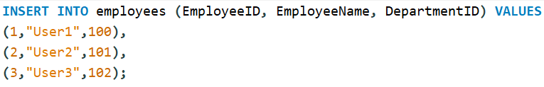

Inner Joins
Table 1:

Slide 58
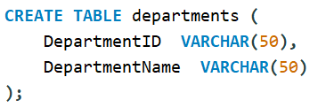
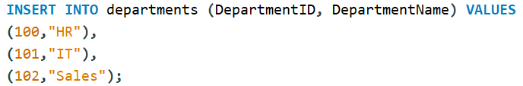

Inner Joins
Table 2:

Slide 59


Inner Joins

