Slide 1
Webservices
By
Jitendra Singh Tomar || Jeetu

Slide 2
Topics to discuss
What are Web Services?
Types of Web Services
Introduction to APIs
Understanding RESTful Web Services
Getting Started with REST APIs
Using APIs in Real Life
Introduction to JSON
Building a Simple Web Service
Testing and Exploring APIs
Web servers

Slide 3
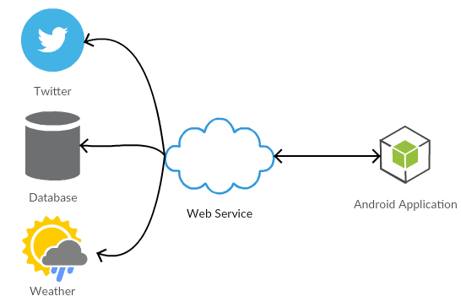
What are Web Services?
Web services are a standardized way of integrating web-based applications using open standards over an internet protocol.
Protocols like:
They allow different systems to communicate with each other, regardless of the platforms or languages they are built on, by exchanging data in a predefined format.
HTTP
SOAP
REST
XML
JSON
WSDL
Swagger / OpenAPI
GraphQL

Slide 4
Basic concepts
Concept | Meaning
Service | A unit of functionality exposed over the network
Request and Response | The fundamental interaction in web services where a client sends a request to a service, and the service sends back a response.
Protocol | The set of rules defining how messages are formatted and transmitted between clients and services. Common protocols include HTTP, SOAP, and REST.
Endpoint | The specific URL or network address where a web service can be accessed.
Message Format | The structure in which data is exchanged between clients and services. Common formats include XML, JSON, and sometimes even plain text or binary.
WSDL | A standardized XML format used to describe the functionality offered by a web service.

Slide 5
Basic concepts
Concept | Meaning
SOAP | A protocol that relies on XML & for exchanging structured information in the implementation of web services.
REST | An architectural style for designing networked applications. RESTful services use standard HTTP methods (GET, POST, PUT, DELETE) to perform CRUD operations on resources identified by URLs.
API | The interface provided by a web service that defines how clients can interact with it.
Security | Techniques and protocols used to ensure the confidentiality, integrity, and authenticity of data exchanged between clients and services. Common security mechanisms include HTTPS, OAuth, JWT, etc.
Versioning | The practice of managing changes to a web service's interface over time to ensure backward compatibility and smooth upgrades for clients.
Documentation | Comprehensive and accurate documentation is essential for understanding how to use a web service effectively.

Slide 6
Examples of Everyday Web Services
Weather API
Social Media APIs
Payment Gateways
Mapping and Geolocation APIs
E-commerce Platforms
Messaging and Communication APIs
File Storage and Sharing APIs
Travel and Booking APIs
Health and Fitness APIs
News and Content APIs

Slide 7
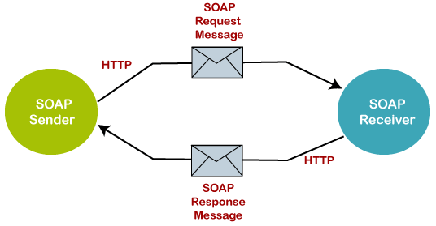
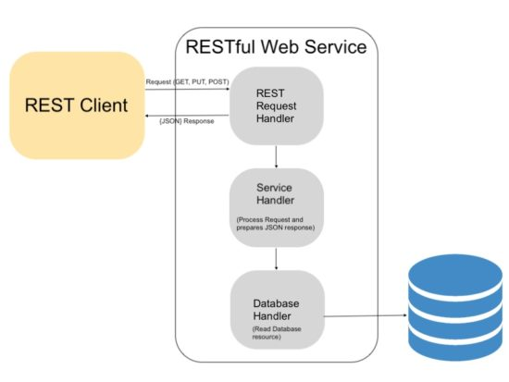
Types of Web Services
SOAP Web Services
RESTful Web Services
JSON-RPC and XML-RPC
GraphQL
WebSocket Services

Slide 8
Overview of SOAP
Stands for “Simple Object Access Protocol”.
SOAP is a protocol for exchanging structured information in the implementation of web services.
SOAP is a message protocol that enables the distributed elements of an application to communicate.
SOAP can be carried over a variety of standard protocols, including the web-related Hypertext Transfer Protocol (HTTP).
SOAP is a lightweight protocol used to create web APIs, usually with Extensible Markup Language (XML).
It supports a wide range of communication protocols across the internet, HTTP, SMTP, TCP.

Slide 9
Key characteristics of SOAP
Protocol
XML-Based
Transport Agnostic
WSDL (Web Services Description Language)
Strong Typing
Error Handling
Complexity

Slide 10
Breaking down SOAP
Communication Protocol
Structured Messages
Transport Options
Describing Services
Error Handling

Slide 11
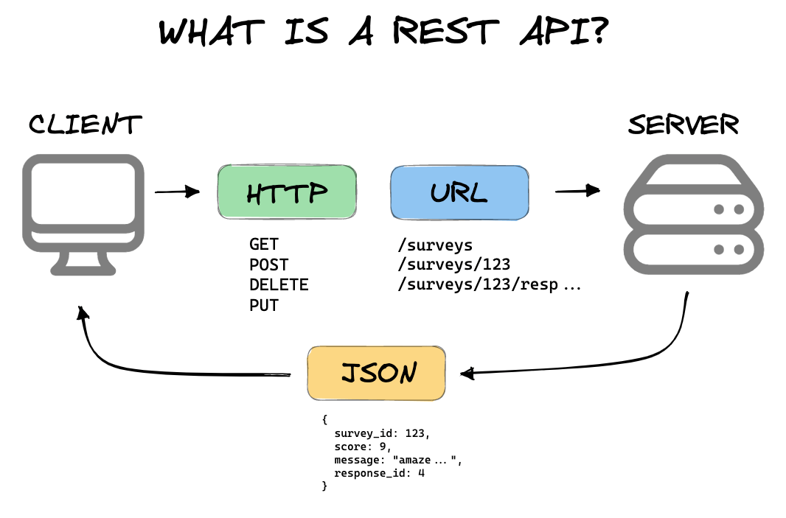
Overview of REST
REST means Representational State Transfer.
Key characteristics of REST are:
Architecture Style
HTTP-Based
Resource-Oriented
Representations
Statelessness
Hypermedia
Simplicity

Slide 12
Breaking down REST
Architecture Style
Resource-Based
HTTP Methods
Statelessness
Representation
Uniform Interface
State Transfer
HATEOAS (Hypermedia as the Engine of Application State)

Slide 13
SOAP vs REST
Feature | SOAP | REST
Type | Protocol | Architectural Style
Data format | XML only | XML, JSON, Plain Text, etc.
Performance | Slower due to larger messages | Faster due to smaller messages
Scalability | More complex to scale due to statefulness | Easier to scale due to statelessness
Security | Requires additional security layers | Inherits security from underlying protocol (HTTPS)

Slide 14
Comparison with Real-life Analogies
Sending Mail:
SOAP is like sending a registered letter through the postal service.
It's formal, with a predefined structure and clear instructions.
Each letter contains detailed information, including the sender, recipient, and contents, and follows a specific delivery protocol.
REST is like sending a postcard.
It's lightweight and flexible, with less strict formatting requirements.
You write down the essential information (e.g., recipient's address) and drop it in the mailbox.
The postcard's format is simpler, and there's no need for formalities like registration or signatures.

Slide 15
Introduction to APIs
APIs, or Application Programming Interfaces, serve as the bridge between different software applications, allowing them to communicate and interact with each other.
An API is a set of rules and protocols that define how different software components should interact with each other. It specifies the methods, parameters, and data formats that applications can use to communicate.
APIs enable developers to build upon existing software components without needing to understand their internal workings.

Slide 16
APIs
Types of APIs:
Web APIs
Library APIs
Operating System APIs
Hardware APIs
Key Concepts:
Endpoints
Requests and Responses
Authentication and Authorization
Rate Limiting

Slide 17
Communication Between Different Systems
Standardized Interface
Abstraction of Complexity
Encapsulation of Functionality
Interoperability
Data Exchange
Integration
Service Composition
Scalability and Flexibility

Slide 18
Popular APIs
Social Media APIs
Mapping and Geolocation APIs
Payment Processing APIs
E-commerce APIs
Messaging and Communication APIs
Cloud Services APIs
Weather APIs
News and Content APIs

Slide 19
RESTful Web Services
Resource-Oriented
HTTP Methods
Statelessness
Uniform Interface
Data Formats
State Transfer

Slide 20
Basic Components of a RESTful API
Resources
Uniform Resource Identifiers (URIs)
HTTP Methods
Representations
Headers
Status Codes
Hypermedia Controls (HATEOAS
Authentication and Authorization

Slide 21
What is JSON ?
JSON (JavaScript Object Notation) is a lightweight data interchange format that is easy for humans to read and write, and easy for machines to parse and generate.
It is based on a subset of the JavaScript programming language, although it is language-independent, meaning it can be used with any programming language.
JSON is commonly used for transmitting data between a server and a web application, as well as for storing configuration data and transmitting structured data over the internet. It is often used as an alternative to XML due to its simplicity and ease of use.

Slide 22
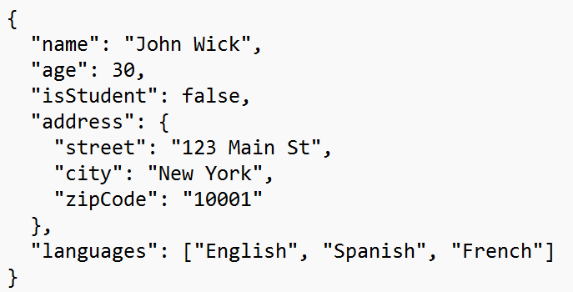
JSON
JSON is represented in Key-Value pair.
Example:

