Slide 1
Exceptions & Hardware support
Reading Reference: Textbook 1 Chapter 2
TANZIR AHMED CSCE 313 Summer 2020

Slide 2
Today’s Discussion: Control Flow
Computers do only one thing
From startup to shutdown, a CPU simply reads and executes (interprets) a sequence of instructions, one at a time
This sequence is the system’s physical control flow (or flow of control)
Physical control flow
<startup>
inst₁
inst₂
inst₃
…
inst_{n}
<shutdown>
Time

Slide 3
Altering the Control Flow
Program-assisted mechanisms for changing control flow:
Jumps and branches—react to changes in program state
Function call and return using stack discipline—react to program state
Insufficient for a useful system
The user application is the central thing – how to let OS into the CPU unless the app gives up control?
Thus, difficult for the CPU to react to other changes in system state
Data arrives from a network adapter
Instruction divides by zero
User hits control-C at the keyboard
System needs mechanisms for “exception control flow”

Slide 4
Exception Control Flow
An exception is a transfer of control to the OS in response to some event (i.e., change in processor state)
User Process
OS
event
current
exception
next
exception processing
by exception handler
exception
return (optional)

Slide 5
Asynchronous Exceptions (Interrupts)
Caused by events external to processor (i.e., outside the current program)
Indicated by setting the processor’s interrupt pin(s)
Handler returns to “next” instruction after servicing
Examples:
I/O interrupts
Key pressed on the keyboard
Arrival of packet from network, or disk
Hard-reset interrupt
Hitting reset button
Soft-reset interrupt
Hitting control-alt-delete to initiate restart on a PC

Slide 6
Interrupt Vectors
Exception
numbers
Each type of event has a unique exception number k
Index into jump table (a.k.a., interrupt vector)
Jump table entry k points to a function (exception handler).
Handler k is called each time exception k occurs.
code for
exception handler 0
interrupt
vector
code for
exception handler 1
0
1
code for
exception handler 2
2
...
n-1
...
code for
exception handler n-1

Slide 7
Synchronous Exceptions: Traps, Faults, Aborts
Caused by events that occur as result of executing an instruction (i.e., from the currently running process):
3 types:
Traps
Faults
Aborts

Slide 8
Traps
User Process
OS
exception
int
Attributes
Intentional
Returns control to “next” instruction
Examples: all system calls (e.g., printf, cout), breakpoint traps, special instructions
Example: Opening a File
User calls open(filename, options)
Function open executes system-call instruction: int $0x80
OS must find or create file, get it ready for reading or writing
Returns integer file descriptor
pop
return
Open file

Slide 9
Flow of Control in System Calls
User Program
foo(){ open(“test”,“rw”);
}
(1)
(4)
User Stub⁺
Kernel Opens the file
open(arg1,arg2){ push SYSOPEN trap return
}
(2)
File_open_handler_function(){ 1. open the file for reading
2. Return the file descriptor
}
(3)
⁺the stub is to make system calls appear like regular functions.
Dashed lines mean context switch

Slide 10
Faults
Attributes
Unintentional but possibly recoverable
Examples: Page Faults
Either re-executes faulting (“current”) instruction or aborts
User Process
OS
event
Fault happened
Fault handled
Return to same instruction

Slide 11
Fault Example #1
int a[1000];
main ()
{
a[500] = 13;
}
Memory Reference
User writes to memory location
That portion (page) of user’s memory is not mapped yet (because memory pages are mapped only when necessary)
Page handler must load page into physical memory
Returns to faulting instruction
Successful on second try
User Process
OS
event
page fault
Allocate page and its mapping in page table
return

Slide 12
Fault Example #2
Illegal Memory Reference
User writes to memory location
Address is not valid
Page handler detects invalid address
Sends SIGSEGV signal to user process
User process exits with “segmentation fault”
int a[1000];
main ()
{
a[5000] = 13;
}
User Process
OS
event
page fault
Detect invalid address
Signal process

Slide 13
Aborts
Attributes
Unintentional and unrecoverable
Examples: parity error, machine check, divide by zero
Aborts current program or entire OS
A way for the OS to put essential error checking

Slide 14
Example: Web Server
syscall
syscall
syscall
RTU
RTU
wait
wait
interrupt
interrupt

Slide 15
Summarizing Control Flow Exceptions
User programs are not in charge of (and therefore not burdened with) handling every exception
Not every program will check for divide- by-0 error
Mechanism is used by OS to do things beyond error handling
E.g., page faults are used to enable “lazy” physical memory allocation
Are Synchronous/Internal (Traps, Faults, Aborts) OR Asynchronous/External (I/O Interrupts, Hard or Soft Reset etc.)

Slide 16
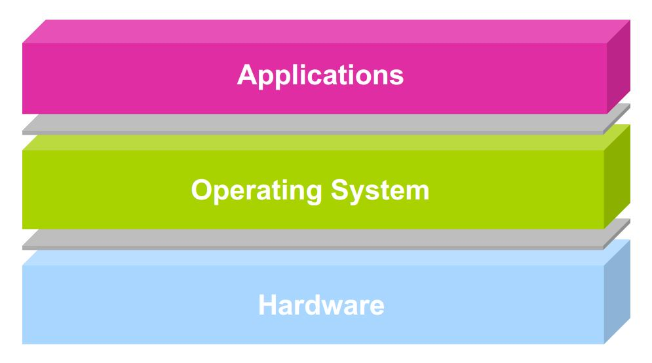
Architectural Support for OS
Operating systems mediate between applications and the physical hardware of the computer
However, a modern with all its features cannot run on a hardware that does not support it
The hardware must be modified to accommodate OS

Slide 17
Architectural Features
Protection Modes
Protection Ring / 2 modes: User/kernel
Privileged Instructions
Interrupts and Exceptions
System Calls
Timers (clock)
Memory Protection Mechanisms
I/O Control and Operation
Synchronization Primitives (e.g., atomic instructions)

Slide 18
Dual-mode Execution
Every CPU has at least 2 modes of execution (the CPU alternates between the modes)
Kernel-mode: Execution with the full privileges of the hardware
User-mode: Execution with Limited privileges
Only those granted by the operating system kernel
In USER mode?
Execute (i.e., can do anything w/o checks)
no
Allowed in both modes
Only allowed in Kernel mode
yes
Perform necessary checks before executing
Full Instruction Set
Any violation?
Execute
no
Terminate program
yes

Slide 19
Privileged Instructions - Examples
Only the OS should be able to
Directly access I/O devices (disks, printers..)
Allows OS to enforce security and fairness
User programs cannot possibly be fair to each other
Manipulate memory management state
E.g., page tables (Virtual-> Physical), protection bits, TLB entries, etc.
Processes use them, but cannot modify – that would defeat the protection
Adjust protected control registers
User ← → Kernel modes or Raise/Lower interrupt level
Execute CLF instruction
A small cache for page tables

Slide 20
A Simple CPU Model – Needs Some Change
branch/jump address
… 100: ADD $rs, $rt, $rd
104: JEQ $r1, $r2, -100 …
+4
Program Counter (PC)
CPU Instruction Fetch & Exec
Select PC
Opcode (if branch/jump)

Slide 21
A CPU with Dual-Mode Operation
branch/jump address
+4
Program Counter (PC)
CPU Instruction Fetch & Exec
New PC
Select PC
Exception/ Interrupt Handler PC
New Mode
jump/branch?
Exception?
None?
Select Mode
Mode
Kernel
If trap?
RTU?
None?
User
Opcode

Slide 22
What are “Necessary” Checks?
In USER mode?
no
Execute
yes
One example: Kernel Memory Protection
Note that because of Virtual Memory, no process can harm another
Then, why bother about memory protection?
However, the kernel is mapped into lower part of each process’s address space like in the picture:
Why is Kernel also included?
To load and run the process in the first place
Handle Interrupts, exceptions, and system calls
Therefore, kernel must be protected from a faulty or malicious user program
Perform necessary checks before executing
Terminate program
yes
Any violation?
no
Execute
Private address space
Process
Kernel

Slide 23
Memory Protection
Could we just make Kernel memory read-only?
No. Because kernel contain sensitive data that should not even be read
Example: page tables
A primitive but effective solution in hardware:
A Base and a Bound register for each process
Cannot access (read or write) anything below base
This check is done only in User mode
Kernel mode has unlimited access
bound
Private address space
Process
base
Kernel

Slide 24
Hardware Timer
Operating system timer is a critical building block
Many resources are time-shared; e.g., CPU
Allows OS to prevent infinite loops
Fallback mechanism by which OS regains control
When timer expires, generates an interrupt
Handled by kernel, which controls resumption context
Basis for OS scheduler; more later…
Setting (and clearing) a timer is a privileged instruction

Slide 25
Mode Switch
Mode separation does NOT mean that a user program cannot request a Kernel-mode operation
User mode to kernel mode switch is very common
How do we switch from one mode to the other?
Such that the protection is not compromised

Slide 26
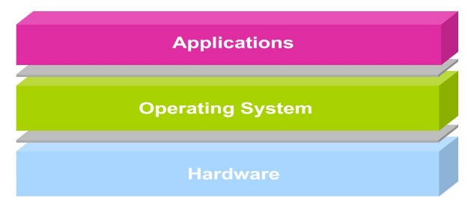
User → Kernel Mode Switch
From user-mode to kernel-mode
Interrupts
(Synchronous) Exceptions (Faults and Aborts)
System calls (traps) (aka protected procedure call)

Slide 27
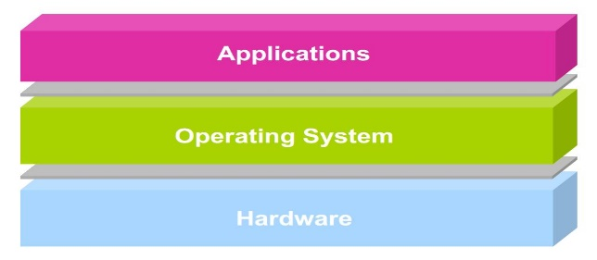
Kernel → User Mode Switch
From kernel-mode to user-mode
New process/new thread start
Jump to first instruction in program/thread
Return from interrupt, exception, system call
Resume suspended execution
Process/thread context switch
Resume some other process

Slide 28
Safe Mode Transfer – Interrupt Handling
First, User->Kernel. The main idea is rather simple
Store the state of the running process (so that it can be resumed later)
Execute the handler
Return to the interrupted process by restoring the saved state
But the actual implementation is a bit more complicated
We first need to know which process info must be stored
Basically, the Process Control Block (PCB)

Slide 29
Saving Process State: Difficulty
User-level Process
CPU
Kernel
foo (){ 5000: x=x+1; 5004: y=y-2;
… }
foo (){ x = x + 1; y = y - 2; }
PC=5000 SP EFLAGS Other Regs
Handler (){ 100: save PC
104: … … }
User Stack

Slide 30
Saving Process State: Difficulty
User-level Process
CPU
Kernel
foo (){ 5000: x=x+1; 5004: y=y-2;
… }
foo (){ x = x + 1; y = y - 2; }
PC=100 SP EFLAGS Other Regs
Handler (){ 100: save PC
104: … … }
User Stack
Kernel Stack
This will only save 100, the PC of the handler. The original PC=5000 of user app is lost forever!!

Slide 31
To Summarize
The processor has only 1 set of SP, PC, EFLAGS etc.
Any piece of code (e.g. handler code as well) will require its own PC (and also SP and others) first loaded into the CPU
Switching from User code to Handler code means overwriting PC, SP etc. with the handler PC, SP etc.
But ALAS!!! We just lost the PC, SP for the user code
How can we ever recover those??
Quoting the Anderson book: “This is akin to rebuilding the car’s transmission while it barrels down the road 60mph”
Solution: Take hardware help
Clearly, any other code will also need PC, SP,..
Hardware does not need to use SP, PC to implement a logic

Slide 32
Plan of Action: Before Interrupt
User-level Process
CPU
Kernel
foo (){ 5000:x=x+1; 5004:y=y-2; }
Registers
handler (){ pushad
… }
PC=5000 SP EFLAGS Other Regs
User Stack
Interrupts Enabled
Kernel Interrupt Stack

Slide 33
Plan of Action: Hardware Action
User-level Process
CPU
Kernel
foo (){ 5000:x=x+1; 5004:y=y-2; }
Registers
handler (){ pushad
… }
PC SP EFLAGS Other Regs
User Stack
Interrupts Disabled
EFLAGS
PC(5000)
SP
Kernel Interrupt Stack

Slide 34
Plan of Action: As Handler Starts
User-level Process
CPU
Kernel
foo (){ 5000:x=x+1; 5004:y=y-2; }
Registers
handler (){ pushad
… }
PC SP EFLAGS Other Regs
User Stack
Interrupts Disabled
Other Regs
EFLAGS
PC(5000)
SP
Kernel Interrupt Stack

Slide 35
User to Interrupt Handler – Mechanism on x86
Hardware does the following:
Mask further interrupts
they are stored, not thrown away
Getting interrupted within handling an interrupt is problematic but possible
Change mode to Kernel
Copy PC, SP, EFLAGS to the Kernel Interrupt Stack (KIS)
Change SP: to the KIS (above the stored PC, SP, EFLAGS)
Change PC: Invoke the interrupt handler by vectoring through the Interrupt Vector Table (i.e., overwrite PC with the handler PC)
Software (i.e., the handler code) does the following:
Stores the rest of the general purpose registers being used by the interrupted process
Does the rest of interrupt handling operation

Slide 36
When Handler Ends
Software does the following:
Handler code restores the saved general registers
Hardware does the following:
Restores PC, SP, EFLAGS from Kernel Stack
Reenable Interrupts
Switch to user mode

Slide 37
Sequential vs Nested Interrupt Handling
In x86, other interrupts are disabled to avoid confusion
This keeps things simple, however, no levels of priority among interrupts
Therefore, many systems support nested interrupt handler
Another interrupt handler will run if that is higher priority
Can be implemented with a little bit of more complexity

Slide 38
User-to-Kernel Mode Switch in System Calls
Locate arguments
In registers or on user stack
Copy arguments
From user memory into kernel memory
Protect kernel from malicious code evading checks
Validate arguments
Protect kernel from errors in user provided arguments
Copy results back into user memory so that user can use them
Note, Kernel Stack is not accessible by user

Slide 39
System Calls
User Program
Kernel
foo(){ open(“test”,“rw”);
}
open_handler(arg1,arg2){ //do operation
}
(1)
(6)
(3)
(4)
User Stub
Kernel Stub
open(arg1,arg2){ push SYSOPEN trap return
}
(2)
open_handler_stub(){ //copy args from user memory //check args open_handler(arg1,arg2) //copy return value to user mem. return
}
(5)

Slide 40
System Calls
Kernel
read_initial_handler(args){ Initiate the DMA
Yield()
}
(4)
(3)
User Program
Kernel Stub
foo(){ read(args);
}
read_handler_stub(){
Put PCB in queue in “blocked” state //copy args from user memory //check args read_initial_handler(args) }
(1)
(6)
(2)
User Stub
read(args){ push SYSREAD trap return
}
//DMA interrupt generated after read //operation. This triggers the following //function to store the data
read_final_handler(PCB, data){
Puts data into PCB user mem changes the state from blocked to ready }
(5)

Slide 41
Summary: User/Kernel (Privileged) Mode
User Mode
interrupt
FP exception
syscall
rtn
FP Exception error
rfi
Kernel Mode
exit
exec
Limited HW access
Full HW access
Notes:
Processor routinely checks for interrupts and if one is logged, it goes back to save the state of the process it is executing and enters the kernel to service the interrupt. The service is done by entering a interrupt vector table which contains the address of the specific interrupt service routine. Once the routine is serviced the kernel gives control back to the user process.
In multiprocessor systems, only one processor has to service the interrupt from an external device.
What happens when you move a mouse pointer? Each move or point or click registers as an interrupt which is noticed by the processor which moves the control back to the Kernel to service the interrupt routine and that shows up as an action to its associated process (e.g. move of mouse pointer in the active window, or highlight of a word selected, etc.)
An alternative to Interrupt would be “polling” where the Kernel would go in a round-robin fashion to check the status of each device to see if they have an interrupt.

