Slide 1
Process Programming Interface
Reading Reference:
Textbook 1 Chapter 3
Molay Reference Text: Chapter 8
Tanzir Ahmed CSCE 313 Summer 2020

Slide 2
Theme of Today’s Lecture
Talk a bit about Unix Shell
Introduce some key process control concepts
Executing a program from within another program
Creating a new process
Introducing Wait dependencies between parent and child processes

Slide 3
What is a Shell?
Shell is a program which
Runs programs
Manages inputs and outputs
Can be programmed
How about Windows Explorer in Windows or Ubuntu?
Effectively provides similar environments (i.e., can double click to launch a program)
Less programmable to some extent
Are these user apps or part of kernel?
User apps, because you can shut them down
Can crash, but the OS is OK

Slide 4
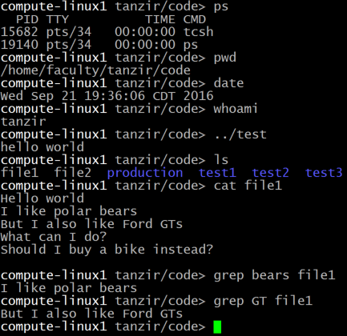
Shell – Running Programs
The commands ps, ls, grep, date, etc. are regular programs
The shell is just another user app (not kernel)
loads these programs into memory and runs them, with the help of System Calls

Slide 5
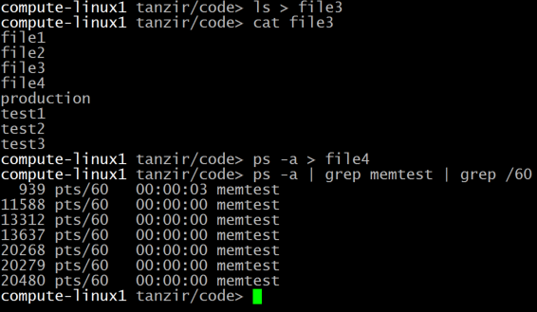
Shell – Managing I/O
Using ‘>’ (output redirect), ‘<’ (input redirect), ‘|’ (pipeline) etc. the output/input can be sent/recvd to/from a file , or to another process or even shell variables.
the default is standard output

Slide 6
If I ask you to write a Shell!!
I will do that for Programming Assignment 2
First thing to know:
How to run 1 program from another

Slide 7

Running Another Program from a C/C++ program
process
Say, the other program’s name is name
The current program makes a system call exec(“name”, arglist)
Kernel loads the “name” executable program from disk into the process
Kernel copies arglist into the process
Kernel calls main(arglist) of the name program
1
3
array of strings
2
program to run

Slide 8
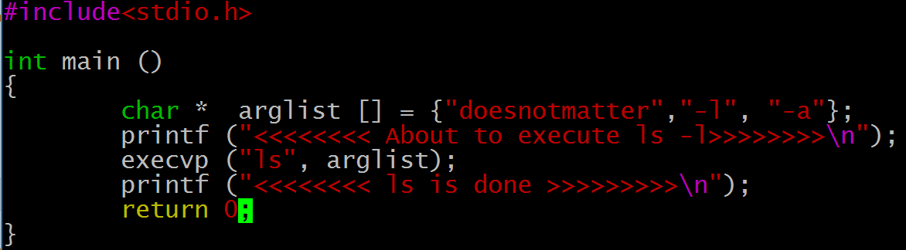
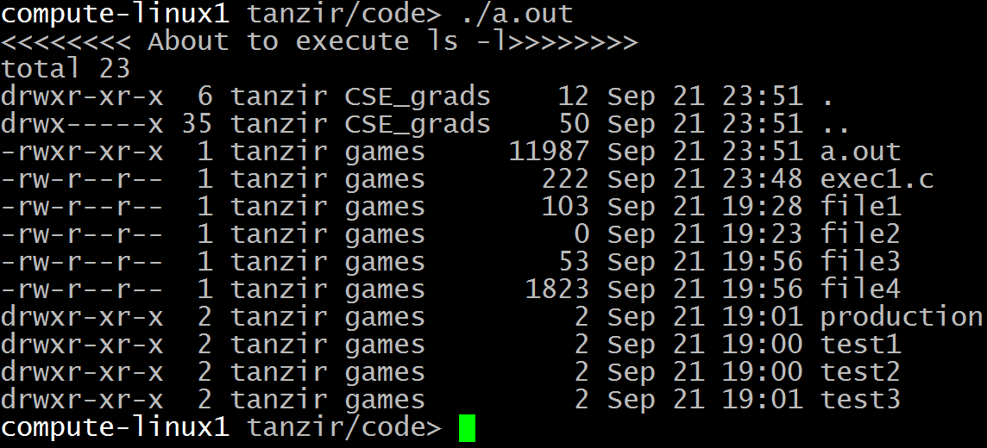
Example: One Program Running Another

Slide 9
What happens in exec()
Initial state of memory before hitting line: exec(“ls”)
Main memory
Process for a.out
Disk
a.out
Executable images in disk
ls
ps

Slide 10
What happens in exec() contd
Initial state of memory before after line: exec(“ls”)
Main memory
Process running ls
The same process container is overwritten with ls’s image
Disk
a.out
Executable images in disk
ls
ps

Slide 11
Example: contd.
Where is the second message?
The exec system call clears out the machine language code of the current program from the current process and then in the now empty process puts the code of the program named in the exec call and then runs the new program
execvp does not return if it succeeds
exec is like a brain transplant
Notes:
Reference: http://linux.about.com/library/cmd/blcmdl3_execvp.htm
Linux / Unix Command: execvp Command LibraryNAME
execl, execlp, execle, execv, execvp - execute a file SYNOPSIS
#include <unistd.h>extern char **environ;
int execl(const char *path, const char *arg, ...); int execlp(const char *file, const char *arg, ...); int execle(const char *path, const char *arg , ..., char * const envp[]); int execv(const char *path, char *const argv[]); int execvp(const char *file, char *const argv[]);
DESCRIPTION
The exec family of functions replaces the current process image with a new process image. The functions described in this manual page are front-ends for the function execve(2). (See the manual page for execve for detailed information about the replacement of the current process.)The initial argument for these functions is the pathname of a file which is to be executed.
The const char *arg and subsequent ellipses in the execl, execlp, and execle functions can be thought of as arg0, arg1, ..., argn. Together they describe a list of one or more pointers to null-terminated strings that represent the argument list available to the executed program. The first argument, by convention, should point to the file name associated with the file being executed. The list of arguments must be terminated by a NULL pointer.
The execv and execvp functions provide an array of pointers to null-terminated strings that represent the argument list available to the new program. The first argument, by convention, should point to the file name associated with the file being executed. The array of pointers mustbe terminated by a NULL pointer.
The execle function also specifies the environment of the executed process by following theNULL pointer that terminates the list of arguments in the parameter list or the pointer to the argv array with an additional parameter. This additional parameter is an array of pointers to null-terminated strings and must be terminated by a NULL pointer. The other functions take the environment for the new process image from the external variable environ in the current process.
Some of these functions have special semantics.
The functions execlp and execvp will duplicate the actions of the shell in searching for an executable file if the specified file name does not contain a slash (/) character. The search path is the path specified in the environment by the PATH variable. If this variable isn't specified, the default path ``:/bin:/usr/bin'' is used. In addition, certain errors are treated specially.
If permission is denied for a file (the attempted execve returned EACCES), these functions will continue searching the rest of the search path. If no other file is found, however, they will return with the global variable errno set to EACCES.
If the header of a file isn't recognized (the attempted execve returned ENOEXEC), these functions will execute the shell with the path of the file as its first argument. (If this attempt fails, no further searching is done.)
RETURN VALUE
If any of the exec functions returns, an error will have occurred. The return value is -1, and the global variable errno will be set to indicate the error.

Slide 12
To Avoid Image Overwrite
First, if we are running shell, we need to continue having the shell image intact
Otherwise it is out after exec()ing the first process
We need another function to create a separate Process container first using another function fork(), and then call exec(“ls”)
fork()
Main memory
Process for a.out
Process running ls
A new Process
exec(“ls”)
Executable images in disk
a.out
ls
ps

Slide 13
Creating a New Process
Calling fork() function
Parent process
Child process
Before
fork()
After
Before
fork()
After
Before
fork()
After
fork
fork
Before Fork
After Fork
After a process invokes fork(), control passes to the Kernel, which does the following:
Allocates address space and data structures
Copies the original process into the new process (everything including PC)
Adds the new process to the set of ready-to-run processes
Returns control back to both processes

Slide 14
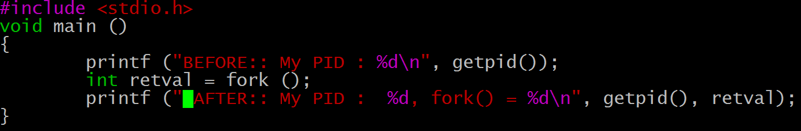
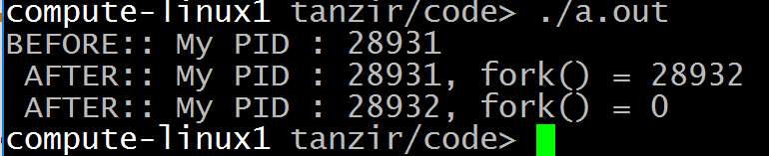
Example: Fork
Fork() returns the child’s ID to the parent side
BEFORE printed once, AFTER printed 2 times
Fork() returns different things (0 on one side, nonzero on the other)
Parent process
Child process
BEFORE
fork()
AFTER
BEFORE
fork()
AFTER
BEFORE
fork()
AFTER
Before Fork
kernel
After Fork
kernel

Slide 15

Fork() function
What this function returns depends on to which process
To the parent it returns the child PID
To the child, it returns 0
Can we use this fact to make the child behave differently from the parent? Of course.
#include <stdio.h>
int main (){
int ret = fork();
if (ret){
printf ("Hello from Parent\n");
printf ("My ID: %d, My Child ID: %d\n", getpid(), ret);
}else{
printf ("Hello from the Child\n");
printf ("My ID: %d, I do not have a child\n", getpid());
}
}

Slide 16
wait: Synchronizing with Children
int wait(int *child_status)
Notice that the argument is not an input argument, rather a place for wait() function to put return value
If you set the child_status != NULL (i.e., a valid address), then integer it points to will be set to indicate why child terminated (-1 usually means error, 0 success)
You will see this when a C-style function wants to return >1 values
Suspends current process until one of its children terminates
Return value is pid of child process that terminated
Of course, you call the argument a return value too that tells you the exit status

Slide 17
wait: Synchronizing With Children
#include <stdio.h>
#include <sys/types.h>
#include <unistd.h>
void wait_demo() {
int child_status;
if (fork() == 0) {
printf("HC: hello from child\n");
}
else {
printf("HP: hello from parent\n");
wait(&child_status);
printf("CT: child has terminated\n");
}
printf("Bye\n");
}
HC
Bye
HP
CT
Bye

Slide 18
Fork() Example 1
How many lines will be printed?
First, we have to unroll the loop:
#include <stdio.h>
int main (){
printf ("PID: %d\n", getpid());
for (int i=0; i<3; i++){
fork();
}
printf ("Done");
}
int main (){
printf ("PID: %d\n", getpid());
fork();
fork();
fork();
printf ("Done");
}

Slide 19
Fork Example 1
#include <stdio.h>
int main (){
printf("PID:%d\n",getpid());//print1:P1
fork();
fork();
fork();
printf ("Done"); //print2:P2
}
Let’s redraw the process for convenience:
Then, let’s draw the other child processes:
P1
fork()
fork()
fork()
P2
P1
Child 1
fork()
fork()
P2
Child 2
Child 3
fork()
P2
fork()
P2
P2
P2
P2
P2
P2
P2
P2
P2
P2
P2
P2
P2

Slide 20
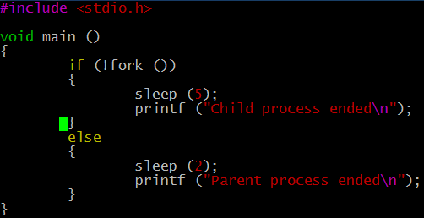

Example. 2
Command prompt shows up
Shell does not wait for “grand children”

Slide 21
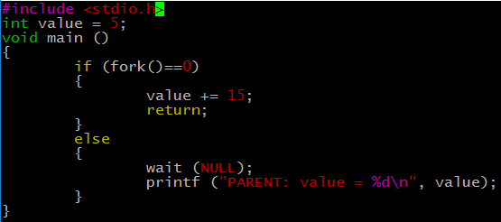
Example 3
PARENT: value = 5
Notes:
Reference: http://www.makelinux.net/books/lkd2/ch03lev1sec2
Process Creation
Process creation in Unix is unique. Most operating systems implement a spawn mechanism to create a new process in a new address space, read in an executable, and begin executing it. Unix takes the unusual approach of separating these steps into two distinct functions: fork() and exec()^{[8]}. The first, fork(), creates a child process that is a copy of the current task. It differs from the parent only in its PID (which is unique), its PPID (parent's PID, which is set to the original process), and certain resources and statistics, such as pending signals, which are not inherited. The second function, exec(), loads a new executable into the address space and begins executing it. The combination of fork()followed by exec() is similar to the single function most operating systems provide.
^{[8]} By exec() I mean any member of the exec() family of functions. The kernel implements the execve() system call on top of which execlp(),execle(),execv() , and execvp() are implemented.
Copy-on-Write
Traditionally, upon fork() all resources owned by the parent are duplicated and the copy is given to the child. This approach is significantly naïve and inefficient in that it copies much data that might otherwise be shared. Worse still, if the new process were to immediately execute a new image, all that copying would go to waste. In Linux, fork() is implemented through the use of copy-on-write pages. Copy-on-write (or COW) is a technique to delay or altogether prevent copying of the data. Rather than duplicate the process address space, the parent and the child can share a single copy. The data, however, is marked in such a way that if it is written to, a duplicate is made and each process receives a unique copy. Consequently, the duplication of resources occurs only when they are written; until then, they are shared read-only. This technique delays the copying of each page in the address space until it is actually written to. In the case that the pages are never writtenfor example, if exec() is called immediately after fork()they never need to be copied. The only overhead incurred by fork() is the duplication of the parent's page tables and the creation of a unique process descriptor for the child. In the common case that a process executes a new executable image immediately after forking, this optimization prevents the wasted copying of large amounts of data (with the address space, easily tens of megabytes). This is an important optimization because the Unix philosophy encourages quick process execution.
fork()
Linux implements fork() via the clone() system call. This call takes a series of flags that specify which resources, if any, the parent and child process should share (see the section on "The Linux Implementation of Threads" later in this chapter for more about the flags). The fork(), vfork(), and __clone() library calls all invoke the clone() system call with the requisite flags. The clone() system call, in turn, calls do_fork().
The bulk of the work in forking is handled by do_fork(), which is defined in kernel/fork.c. This function calls copy_process(), and then starts the process running. The interesting work is done by copy_process():
It calls dup_task_struct(), which creates a new kernel stack, thread_info structure, and task_struct for the new process. The new values are identical to those of the current task. At this point, the child and parent process descriptors are identical.
It then checks that the new child will not exceed the resource limits on the number of processes for the current user.
Now the child needs to differentiate itself from its parent. Various members of the process descriptor are cleared or set to initial values. Members of the process descriptor that are not inherited are primarily statistically information. The bulk of the data in the process descriptor is shared.
Next, the child's state is set to TASK_UNINTERRUPTIBLE, to ensure that it does not yet run.
Now, copy_process() calls copy_flags() to update the flags member of the task_struct. The PF_SUPERPRIV flag, which denotes whether a task used super-user privileges, is cleared. The PF_FORKNOEXEC flag, which denotes a process that has not called exec(), is set.
Next, it calls get_pid() to assign an available PID to the new task.
Depending on the flags passed to clone(), copy_process() then either duplicates or shares open files, filesystem information, signal handlers, process address space, and namespace. These resources are typically shared between threads in a given process; otherwise they are unique and thus copied here.
Next, the remaining timeslice between the parent and its child is split between the two (this is discussed in Chapter 4).
Finally, copy_process() cleans up and returns to the caller a pointer to the new child.
Back in do_fork(), if copy_process() returns successfully, the new child is woken up and run. Deliberately, the kernel runs the child process first^{[9]}. In the common case of the child simply calling exec() immediately, this eliminates any copy-on-write overhead that would occur if the parent ran first and began writing to the address space.

Slide 22
Key Learnings Today
Shell Basics
Replacing Program Executed by Process
Call execv (or variant)
One call, (normally) no return
Spawning Processes
Call to fork
One call, two returns
Reaping Processes
Call wait

