Slide 1
Computer Networks
Tanzir Ahmed CSCE 313 Summer 2020

Slide 2
Acknowledgments
TAMU CSCE 313 Lecture Notes in Networking
Acknowledgment: Profs Gu, Bettati, Tyagi
RICE COMP 221 Lecture Notes in Networking
Acknowledgment: Prof. Cox
U-Illinois CS241 Lecture Notes in Networking
Acknowledgment: Prof. Angrave
Beej’s Guide to Network Programming, Ver. 3.0.15
Socket Programming 101
Acknowledgment: Vivek Ramachandran
U-Wisconsin CS-354 Lecture Notes in Networking
Acknowledgment: Prof. Arpaci-Dusseau

Slide 3
Bottom-Line…..
Internet is a ubiquitous presence in our lives
Issues such as Security Lapses present themselves as opportunities for making our ways of communication more robust
Let’s now trace back the history from the early days of telephony in the next few slides

Slide 4
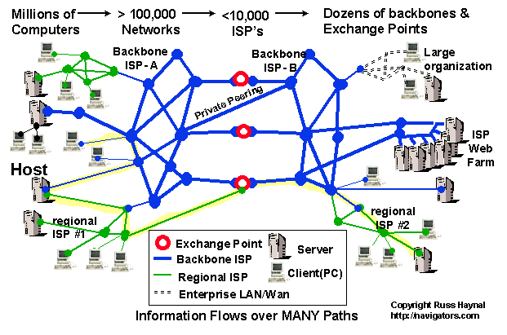
Current Internet Architecture - Conceptual
Cox
Networking
4

Slide 5
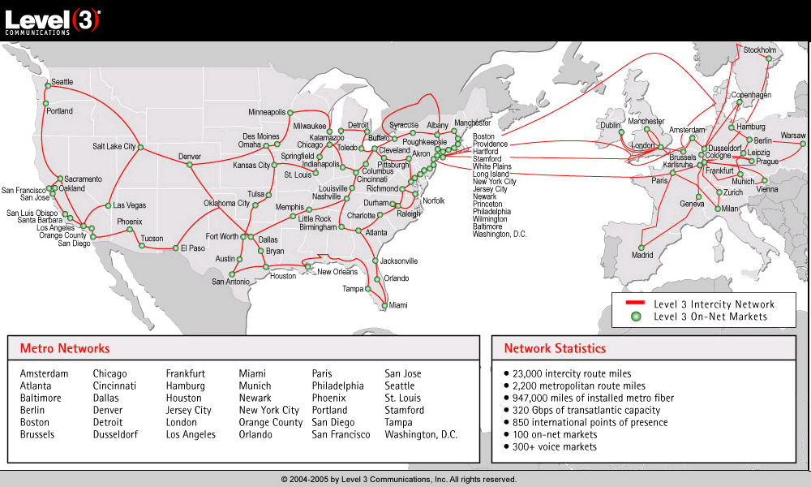
Level 3 Backbone
Cox
Networking
5

Slide 6
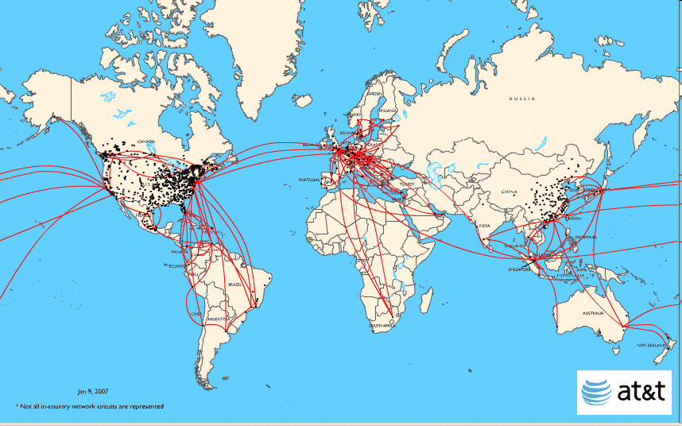
AT&T Backbone
Cox
Networking
6

Slide 7
A Client-Server Transaction
Most network applications are based on the client-server model:
A server process and one or more client processes
Server manages some resource
Server provides service by manipulating resource for clients
1. Client sends request
Client
process
Server
process
Resource
4. Client
handles
response
3. Server sends response
2. Server
handles
request
Note: clients and servers are processes running on hosts
(can be the same or different hosts)
Cox
Networking
7

Slide 8
Types of Networks
A network is a hierarchical system of boxes and wires organized by geographical proximity
LAN (local area network) spans a building or campus
WAN (wide-area network) spans very long distance
host
host
...
host
host
host
...
host
host
host
...
host
LAN 1
router
router
router
LAN 2
WAN
WAN
Cox
Networking
8

Slide 9
A more complicated Network
Multiple incompatible LANs can be physically connected by specialized computers called Routers
The connected networks are called an internet
An internetwork (internet) is an interconnected set of networks
The Global IP Internet (uppercase “I”) is the most famous example of an internet (lowercase “i”)
host
host
...
host
host
host
...
host
LAN 1
LAN 2
router
router
router
WAN
WAN
Cox
Networking
9

Slide 10
The Notion of an Internet Protocol
How is it possible to send bits across incompatible LANs and WANs?
Solution: Protocol software running on each host and router smoothens out the differences between the different networks
Implements an internet protocol (i.e., set of rules) that governs how hosts and routers should cooperate when they transfer data from network to network
TCP/IP is the protocol for the global IP Internet
Cox
Networking
10

Slide 11
What Does an Internet Protocol Do?
1. Provides a naming scheme
An internet protocol defines a uniform format for host addresses
Each host (and router) is assigned at least one of these internet addresses that uniquely identifies it
2. Provides a delivery mechanism
An internet protocol defines a standard transfer unit (packet)
Packet consists of header and payload
Header: contains info such as packet size, source and destination addresses
Payload: contains data bits sent from source host
Cox
Networking
11

Slide 12
Transferring Data Over an internet
Host A
Host B
client
server
(1)
data
(8)
data
protocol
software
protocol
software
internet packet
(2)
data
PH
(7)
data
PH
LAN1
adapter
LAN2
adapter
Router
(3)
data
PH
FH1
(6)
LAN1 frame
LAN1
adapter
LAN2
adapter
data
PH
FH2
LAN1
LAN2 frame
LAN2
(4)
data
PH
FH1
(5)
data
PH
FH2
protocol
software
Cox
Networking
12

Slide 13
Other Issues
We are glossing over a number of important questions:
What if different networks have different maximum frame sizes? (segmentation)
How do routers know where to forward frames?
How are routers informed when the network topology changes?
What if packets get lost?
We’ll leave the discussion of these question to computer networking classes
→ CSCE 463
Networking
13

Slide 14
Global IP Internet
Some games
HTTP
FTP
PA6
Based on the TCP/IP protocol family
IP (Internet protocol) :
Provides basic naming scheme and unreliable delivery capability of packets (datagrams) from host-to-host
UDP (User Datagram Protocol)
Uses IP to provide unreliable datagram delivery from process-to-process
TCP (Transmission Control Protocol)
Uses IP to provide reliable byte streams from process-to-process over connections
Accessed via a mix of Unix file I/O and functions from the sockets interface
TCP
UDP
IP
Cox
Networking
14

Slide 15
A Programmer’s View of the Internet
Hosts are mapped to (a set of) 32-bit IP addresses
e.g. 128.194.255.88 (4 * 8 bits)
linux2.cs.tamu.edu is mapped to 128.194.138.88
Dotted Decimal Notation:
Each byte of the IP ->its decimal value and separated by a period
IP address 0x8002C2F2 = 128.2.194.242
inet_ntop and inet_pton functions convert IP <->dotted decimal, respectively
15

Slide 16
IP Address Structure
IP (V4) Address space divided into classes:
Special Addresses for routers and gateways (all 0/1’s)
Loop-back address: 127.0.0.1
Un-routed (private) IP addresses:
10.0.0.0/8, 172.16.0.0/12, 192.168.0.0/16
Dynamic IP addresses (DHCP)
0 1 2 3 8 16 24 31
Class A
0
Net ID
Host ID
Class B
1
0
Net ID
Host ID
Class C
1
1
0
Net ID
Host ID
Class D
1
1
1
0
Multicast address
Class E
1
1
1
1
Reserved for experiments
Cox
Networking
16

Slide 17
Domain Naming System (DNS)
For even further convenience of naming Internet hosts, one or more “name” is used to represent one or more IP addresses
linux2.cs.tamu.edu is mapped to 128.194.138.88
DNS is a huge worldwide distributed database of these mappings
C++ functions for retrieving host entries from DNS:
getaddrinfo: query DNS using domain name or IP
Cox
Networking
17

Slide 18
Querying DNS
Domain Information Groper (dig) provides a scriptable command line interface to DNS
Shows just IP
Reverse lookup
unix> dig +short linux2.cse.tamu.edu
128.194.138.88
unix> dig +short -x 128.194.138.85
chevron.cs.tamu.edu.
unix> dig +short www.google.com
216.58.194.36
unix> dig +short www.google.com
172.217.12.68
unix> dig +short build.tamu.edu
compute.cse.tamu.edu.
128.194.138.139
Same server, different IPs
Shows aliases
18

Slide 19
Internet Connections
Clients and servers communicate by sending streams of bytes over connections:
Point-to-point, full-duplex (2-way communication), and reliable
A socket is an endpoint of a connection
Socket address is an IP address and port pair
A port is a 16-bit integer that identifies a process:
Ephemeral port: Assigned automatically on client when client makes a connection request
Well-known port: Associated with some service provided by a server (e.g., port 80 is associated with Web servers)
A connection is uniquely identified by the socket addresses of its endpoints (socket pair)
(cliaddr:cliport, servaddr:servport)
Cox
Networking
19

Slide 20
Putting it all Together: Anatomy of an Internet Connection
Client socket address
128.2.194.242:51213
Server socket address
208.216.181.15:80
Client
Server
(port 80)
Connection socket pair
(128.2.194.242:51213, 208.216.181.15:80)
Client host address
128.2.194.242
Server host address
208.216.181.15
Cox
Networking
20

Slide 21
Prerequisites for an Internet Connection
There must be a network path between the Client and the Server
For instance, there is a path between your cell phone and your computer residing in the same WiFi network
A path between your desktop and google.com
Firewalls could artificially block network paths
Path between off-campus computer and build.tamu.edu is blocked by system admins

Slide 22
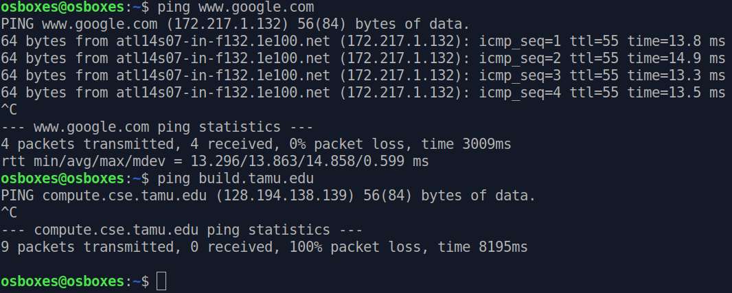
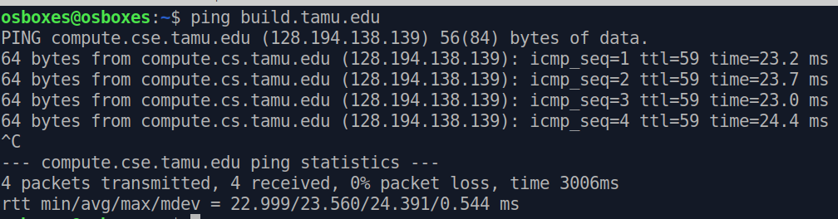
Testing for Network Paths
ping command
Tests if you can reach another host
Example 1: From off-campus (w/o VPN)
Example 2: Now with VPN connected

Slide 23
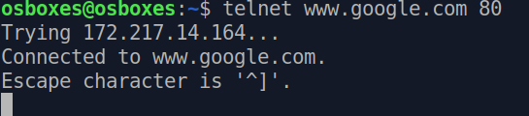
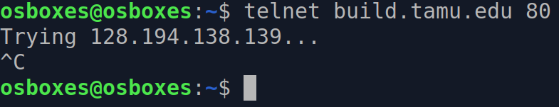
TCP Connectivity in the Path
telent command
A built in TCP client, used to check server existence or connection ability
Tests if you can make a TCP connection to a server port
Example 1: Connecting to port 80 (HTTP server) of google
Example 2: Connecting to port 80 of build.tamu
Connection not possible because:
No service at port 80
Even if it had, firewall does not allow

Slide 24
Clients
Examples of client programs
Web browsers, ftp, telnet, ssh
How does a client find the server?
The IP address in the server socket address identifies the host (more precisely, an adapter on the host)
The (well-known) port in the server socket address identifies the service, and thus implicitly identifies the server process that performs that service
Cox
Networking
24

Slide 25
Servers
Servers are long-running processes (daemons)
Created at boot-time (typically) by the init process (process 1)
Run continuously until the machine is turned off
Each server waits for requests to arrive on a well-known port associated with a particular service
Port 23: telnet server
Port 25: mail server
Port 80: HTTP server
A machine that runs a server process is also often referred to as a “server”
Cox
Networking
25

Slide 26
Server Examples
See /etc/services for a comprehensive list of the services available on a UNIX machine
Web server (port 80)
HTML files/content/other data through HTTP protocol
FTP server (20, 21)
Service: stores and retrieve files
Telnet server (23)
Resource: terminal
Service: proxies a terminal on the server machine
Mail server (25)
Resource: email “spool” file
Service: stores mail messages in spool file
Cox
Networking
26

Slide 27
A Server-Client Interaction in TCP – POSIX Functions
Server
socket()
Many clients can connect
bind()
listen()
Client
Blocks until connection attempt received
socket()
accept()
connect()
Establish connection
Can happen repeatedly
Data(request)
Recv()
send()
Data(reply)
send()
recv()
close()
close()

Slide 28
A Closer Look into POSIX Functions
getaddrinfo()
socket()
bind()
listen()
accept()
connect()
write(), send(), sendto()
read(), recv(), recvfrom()
close()

Slide 29
Data Structures

Slide 30
getaddrinfo() – Looking Up IP address from name
The first step to locate a server by the client
Converts easy-to-remember DNS names (e.g., linux.cs.tamu.edu) into machine-usable IP address
Queries DNS servers (a collection of mappings)
int getaddrinfo(char* name, char* port, struct addrinfo* hints, struct addrinfo** result);
name = name of the host
port = the port where the service (e.g., http, your data server in MP6) is running
hints = provides some initial hint (IPv4/IPv6, TCP/UDP etc.)
result = linked list of looked up addresses
Example:
getaddrinfo("www.example.com", "3490", &hints, &res);

Slide 31
socket() – A Connection End Point
Creates a communication end-point for a network connection
int socket (int domain, int type, int protocol)
domain = PF_INET (IPv4) / PF_INET6 (IPv6)
type = SOCK_STREAM (TCP) / SOCK_DGRAM (UDP)
protocol = 0
Example:
s = socket (AF_INET, SOCK_STREAM, 0)
will create a TCP socket
The above call returns >0 on success and -1 on failure

Slide 32
connect() – Client Attempting Server Connection
This is called by the client to attempt a connection with the server
Blocks until the server accepts it
int connect(int sockfd, struct sockaddr* server, socketlen_t server_len)
Sockfd: socket variable prepared beforehand
server = address of the server (returned by getaddrinfo)
Example:
getaddrinfo("www.example.com", "3490", &hints, &res); // lookup
// make a socket:
sockfd = socket(res->ai_family, res->ai_socktype, res->ai_protocol);
// connect to server. Once successful, the socket becomes ready as the endpoint
connect(sockfd, res->ai_addr, res->ai_addrlen);

Slide 33
close() – Close a Session
Called by both the client and the server
Signals end of a communication
Internally, frees resources associated with a connection
Important for busy servers, also for PA7 int close(int sock)
Example:
close (sock)

Slide 34
bind() – Server Attaching to a Port
A server process calls this to associate its socket to a given port
Port number is used by the kernel to forward an incoming packet to a certain process (its socket)
int bind(int sockfd, struct sockaddr* addr, socketlen_t addrlen)
Example:

Slide 35
listen() – Setting up Server
This is a prerequisite before a connection is accepted
Incoming connections wait in a queue before accepted, listen () sets the size of that queue
int listen(int sockfd, int backlog)
Example:

Slide 36
accept() – Server Accepting Client Connection
This is called by the server to accept a new client connection
int accept(int sockfd, struct sockaddr* client, socketlen_t client_len)
sockfd = socket
client = will hold the client address details
client_len = address length
Example:

Slide 37
send()/recv() – Finally Data
Called by both client and server to exchange data
Blocks until the server accepts it
int send(int sock, void* msg, size_t len, int flags)
int recv(int sock, void* msg, size_t len, int flags)
Msg = buffer pointer to send/receive data from/to
Len = sender: length of the message, receiver: buffer capacity (to avoid overflow)
Example:
char *send_msg = "a sample message";
int sent_bytes = send (sockfd, send_msg, strlen (send_msg)+1, 0);
char recv_buffer [1024];
int recv_len = recv (sockfd, recv_buffer, 1024, 0);

