Slide 1
Inter-Process Communication
Tanzir Ahmed CSCE 313 Summer 2020

Slide 2
Inter-Process Communication
IPC Methos
Pipes and FIFO
Message Passing
Shared Memory
Semaphore Sets
Signals
References:
Beej’s guide to Inter Process Communication for the code examples (https://beej.us/guide/bgipc/)
Understanding Unix/Linux Programming, Bruce Molay, Chapters 10, 15
Advanced Linux Programming Ch 5
Some material also directly taken or adapted with changes from Illinois course in System Programming (Prof. Angrave), UCSD (Prof. Snoeren), and USNA (Prof. Brown)

Slide 3
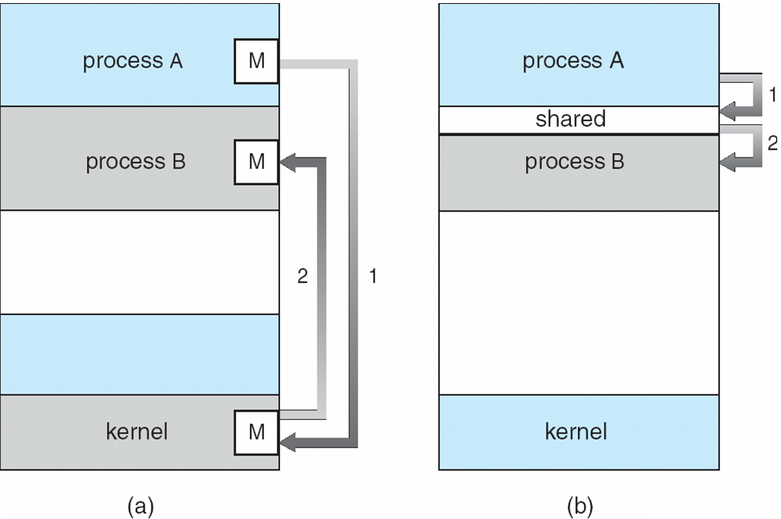
IPC Fundamental Communication Models
Example: pipe, fifo, message, signal
Example: shared memory, memory mapped file

Slide 4


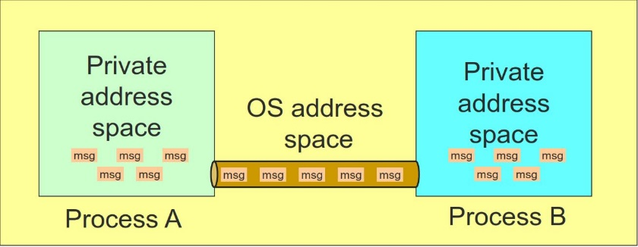
Unnamed Pipes
int pipe(int fildes[2])
Returns a pair of file descriptors
fildes[0] is the read end
fildes[1] is the write end
Create a message pipe
Data is received in the order it was sent
OS enforces mutual exclusion: only one process at a time
Processes sharing the pipe must have same parent in common
BEFORE
AFTER

Slide 5
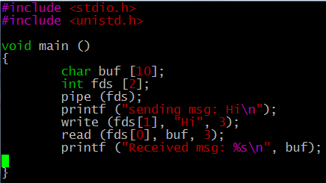

IPC Pipe - Method
Is this of any use at all ???
Connects the two fds as pipe

Slide 6
Unnamed Pipe Between Two Processes
int main ()
{
int fds [2];
pipe (fds); // connect the pipe
if (!fork()){ // on the child side
sleep (3);
char * msg = "a test message";
printf ("CHILD: Sent %s\n", msg);
write (fds [1], msg, strlen(msg)+1);
}else{
char buf [100];
read (fds [0], buf, 100);
printf ("PRNT: Recvd %s\n", buf);
}
return 0;
}
child
parent

Slide 7
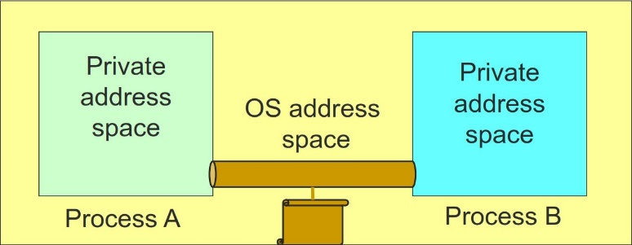
Named Pipes (FIFO)
FIFOs are a mechanism that allow for IPC that's like using regular files,
Data is never actually written to disk (instead it is stored in buffers in memory) so the overhead of disk I/O (which is huge!) is avoided
Filename is only for system-wide visibility/scope
Unlike unnamed pipes that exist only while the processes exist, FIFOs are persistent, just like regular files
They do not even go away after system reboot
You must clean them up yourself (reminding of PA3 experience)
Still directional in nature
Need 2 pipes for bidirectional communication
Still a bounded buffer

Slide 8
FIFO - Problems
We still need to agree on a name ahead of time – how to communicate that??
FIFORequestChannel rc (“control”, ..){ … mkfifo (“control”, PERMS); // create
}
Not concurrency safe within a process
Like a file used by multiple processes/threads
Multiple threads writing can cause race condition

Slide 9
Using FIFO’s
mkfifo (name): create a FIFO
How do I remove a FIFO: rm fifoname or unlink(fifoname)
How do I listen at a FIFO for a connection
open (fifoname, O_RDONLY)
How do I open a FIFO in write mode?
open(fifoname, O_WRONLY)
Can someone open in both read and write mode?
No. That makes it directional, but efficient

Slide 10
FIFO DEMO
Writer
Reader
#define FIFO_NAME "test.txt"
int main(void)
{
char s[300];
int num, fd;
mkfifo(FIFO_NAME, 0666); // create
printf("Waiting for readers...\n");
fd = open(FIFO_NAME, O_WRONLY); //open
if (fd < 0)
return 0;
printf("Got a reader--type some stuff\n");
while (gets(s)) {
if (!strcmp (s, "quit")) break;
if ((num = write(fd, s, strlen(s))) == -1)
perror("write");
else
printf("SENDER: wrote %d bytes\n", num);
}
//unlink (FIFO_NAME);
return 0;
}
int main(void)
{
char s[300];
int num, fd;
printf("waiting for writers...\n");
fd = open(FIFO_NAME, O_RDONLY);
printf("got a writer\n");
do{
if ((num = read(fd, s, 300)) == -1)
perror("read");
else {
s[num] = '\0';
printf("RECV: read %d bytes: \"%s\"\n", num, s);
}
} while (num > 0);
return 0;
}

Slide 11
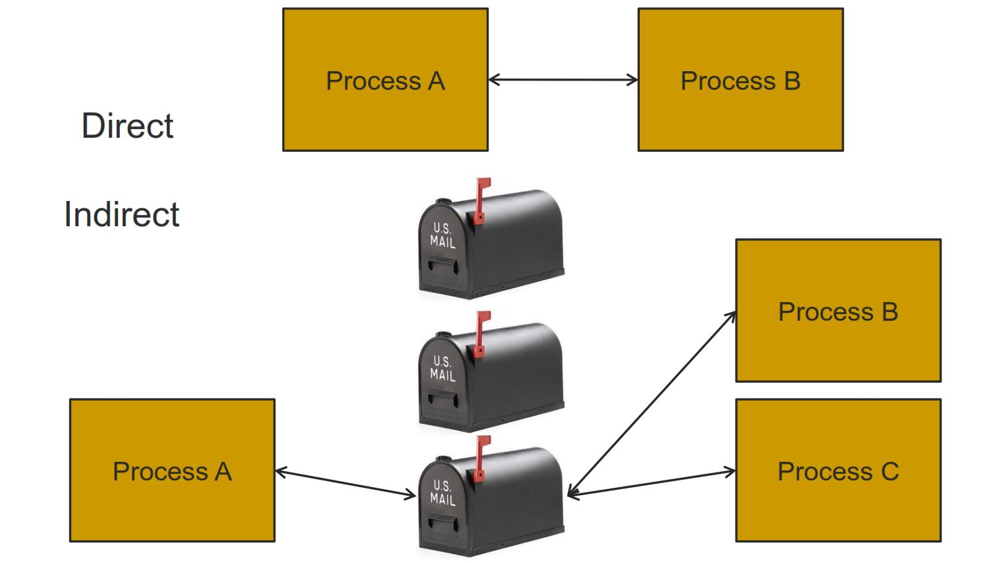
Message Queues

Slide 12
(Indirect) Message Queues
Messages are directed to and received from mailboxes (also referred to as ports)
Mailbox can be owned by a process or by the OS
Each mailbox has a unique id
Processes can communicate only if they share a mailbox
Properties of communication link
Link established only if processes share a common mailbox
A link may be associated with many processes
Each pair of processes may share several communication links
Process P2
Process P1
Mailbox A
Process P3

Slide 13
Operations on Message Queues
mqd_t mq_open(const char *name, int oflag, mode_t mode, struct mq_attr *attr);
int mq_send(mqd_t mqdes, const char *msg_ptr, size_t msg_len, unsigned int msg_prio);
ssize_t mq_receive(mqd_t mqdes, char *msg_ptr, size_t msg_len, unsigned int *msg_prio)
int mq_close(mqd_t mqdes)
Notes:
msgtyp in receive can be used for message selection.

Slide 14
Message Queue – Example
send(){
mqd_t mq = mq_open("/testqueue", O_RDWR|O_CREAT, 0664, 0);
if (mq_send(mq, av[1], strlen (av[1]) + 1, 0)<0){
perror ("MQ Send failure");
exit (0);
}
printf ("MQ Put: %s\n", av [1]);
return 0;
}
recieve(){
mqd_t mq = mq_open("/testqueue",O_RDWR|O_CREAT, 0664,0);
struct mq_attr attr;
mq_getattr (mq, &attr); // get attribute
char *buf = (char*)malloc (attr.mq_msgsize);
mq_receive(mq, buf, attr.mq_msgsize, NULL);
printf ("MQ Receive Got: %s\n", buf);
//clean-up
mq_close(mq);
//mq_unlink("/testqueue"); // remove from Kernel
return 0;
}

Slide 15
Shared Memory
Process A
Process B
OS Address Space
Processes request the segment
OS maintains the segment – it persists w/o any processes connected
Processes can map/unmap the segment
Synchronization is now up to the processes
No send/receive functions, must use “Kernel Semaphores”

Slide 16
Shared Memory – POSIX functions
shm_open: creates a shared memory segment
ftruncate: sets the size of a shared memory segment
mmap: maps the shared memory object to the process’s address space
munmap: unmaps from process’s address space
shm_unlink: removes the shared memory segment from the kernel
close: closes the file descriptor associated with the shared memory segrment

Slide 17
Shared Memory Example
char* my_shm_connect(char* name, int len){
int fd = shm_open(name, O_RDWR|O_CREAT, 0644 );
ftruncate(fd, len); //set the length to 1024, the default is 0, so this is a necessary step
char *ptr = (char *) mmap(NULL, len, PROT_READ|PROT_WRITE, MAP_SHARED, fd, 0);// map
if (fd < 0){
perror ("Cannot create shared memory\n");
exit (0);
}
return ptr;
}
void send(char* message){
char *name = "/testing";
int len = 1024;
char* ptr = my_shm_connect (name, len);
strcpy(ptr, message); // putting data by just copying
printf ("Put message: %s\n", message);
close(fd); // close desc, does not remove the segment
munmap (ptr, len); // this is a bit redundant,
}

Slide 18
Shared Memory Example- contd
void receive(){
char *name = "/testing";
int len = 1024;
char* ptr = my_shm_connect (name, len)
printf ("Got message: %s\n", ptr);
shm_unlink (name); //this removes the segment from Kernel, this is a necessary clean up
exit(0);
}

Slide 19
Kernel Semaphores
We have learned how to synchronize threads using Semaphores and Locks
But how do we synchronize processes?
We will again need semaphores, but this time Kernel Semaphores
They are visible to separate processes who do not share address space

Slide 20
Kernel Semaphore Operations
sem_open(name, …) to create or connect to a semaphore
The name argument must start with a “/”
sem_close () closes a semaphore
It does not destroy it from Kernel
sem_unlink() removes from Kernel
Must be put in the destructor for PA5
sem_wait() is equivalent to Semaphore::P() operation
semd_post() is equivalent to Semaphore::V() operation
Find out more from sem_overview(7) in man pages

