Slide 1
Introduction to Computer Systems
Tanzir Ahmed CSCE 313 Fall 2020

Slide 2
Lecture Outline
Part1
Course Objectives and Outcome
Logistics
Part2
Course Context
Intro to OS

Slide 3
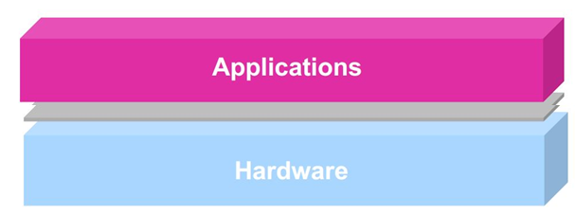
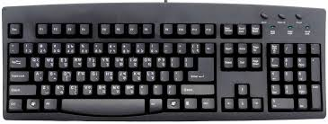
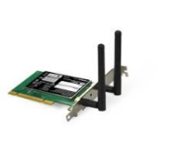
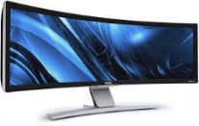

Essence of the Course
To learn the software interface to the Operating Systems
Why interface with OS? Or Why cannot the application software do everything by itself?
What is an OS anyways?
The following shows one program running in isolation (i.e., no other programs running) that uses CPU, memory, and other devices as it wishes
This is what we have been taught so far
Processor
Memory
INT
INT
Packet I/O
Character O/P
Block I/O
storage

Slide 4
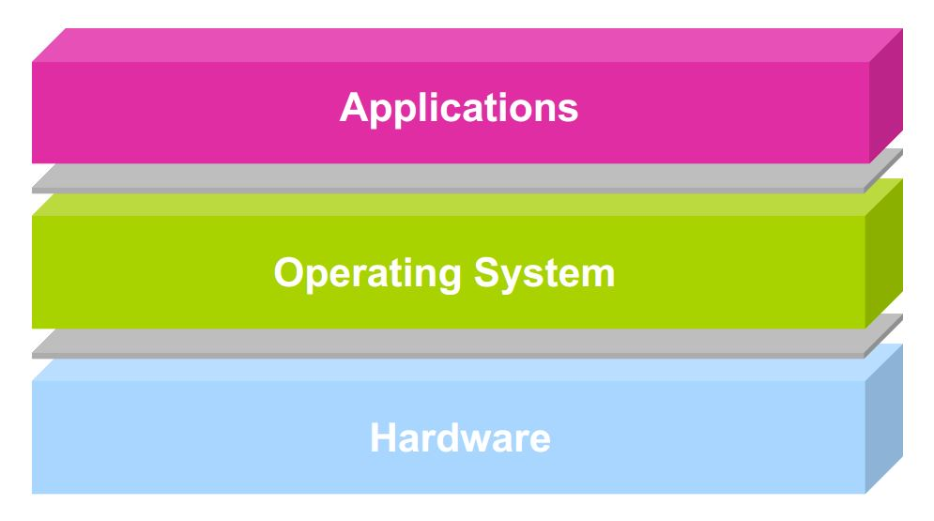


Essence of the Course
However, the reality is more complicated because of many application programs running at the same time:
There must be an agent that controls sharing of resources and makes peace between
App 1
App 2
App 3
App 4
Our discussions focus
Processor
Memory
INT
INT
Character O/P
Block I/O
Packet I/O
storage

Slide 5
Essence of the Course
This is NOT an Operating System (OS) course
Can take CSCE 410: Operating Systems
However, the content will discuss OS quite a bit from a programmer’s perspective, because:
We want to harness OS basics to write high-performance, inter-dependent, and hardware and OS-aware applications
We can also borrow techniques used in OS as a huge software and apply those to everyday software development practices
For instance, the concept of timers in OS is crucial for Asynchronous programming required in real-time systems

Slide 6
Learning Outcome
In this course, you will learn how to use different OS services and features from our application programs:
What is an operating system; its components; how it works
Execution of a program; function calls; interrupts; system calls; process control
File system
Concurrency and Synchronization
Inter-Process Communication (IPC)
Network/socket programming
Network Threats/Security Basics

Slide 7
CSCE 313 Instruction Team
Instructor: Dr. Sarker Tanzir Ahmed
Instructional Assistant Professor
Background: PhD from TAMU CSE in High Performance Computing, Big Data, Web Crawling
Teaching Assistants:
Wenxuan Wu ww6726@tamu.edu
Vicram Rajagopalan vicram@tamu.edu
Feras Khemakhem foufou1560@tamu.edu
See Class Website->Logistics page for detailed contacts, office hours and Zoom meeting links

Slide 8
Textbook, Reference Books
Text:
T1: Operating Systems: Principles and Practice, Second Edition, Thomas Anderson and Michael Dahlin, Recursive Books, 2014.
T2: Operating Systems: Three Easy Pieces, Remzi H. Arpaci-Dusseau and Andrea C. Arpaci-Dusseau, available online at: http://pages.cs.wisc.edu/~remzi/OSTEP/
Reference:
R1 (Main): Operating Systems – Internals and Design Principles, William Stallings, Ninth Edition
Secondary: Understanding Unix/Linux Programming A Guide to Theory and Practice, Bruce Molay, Pearson Education Inc., 2003
Other Interesting Readings
Computer Systems: A Programmer's Perspective, Randal E. Bryant and David R. O'Hallaron, Prentice Hall, 2011

Slide 9
How Success will be Measured
4-5 Quizzes (15%)
Mixture of analytic and small programming problems
2 Exams (35%): Midterm (15%) and Final (20%), both take-home, open-note
Midterm will be given a day or two
Final exam will be through ecampus test system on the register-scheduled day and time for a duration of 2 hours
6 to 7 Programming Assignments worth 50 points
The first one PA0 is tiny one, worth just 2%.
Rest 48% is equally divided in PA1-PAx
You will get Rubric and Grading instructions for each PA
Unless otherwise specified, each PA needs to be accompanied by a report and a demonstration video
Late penalty for Quizzes and PA’s is 12%/day or 0.5%/hour
100% penalty for exams (i.e., late exams not accepted)

Slide 10
Method of Teaching
Lectures and labs will happen synchronously during the howdy-schedule via Zoom
See class website->Logistics for the Zoom links
However, there will be an asynchronous component to the lectures only
Slide sets and recorded video lectures will be made available prior to the lecture meetings
Because of this, the lecture meetings will be like flipped classes
You must prepare before attending the class
Labs are synchronous only
You must physically or virtually attend the labs
Sessions may not be recorded, i.e., only the materials (e.g., slide sets, discussed code) will be available
Attendance in the meetings is critical for success in this course
However, we will not record attendance

Slide 11
Lecture Outline
Part1
Course Objectives and Outcome
Logistics
Part2
Introduction to Computer Systems
Background – What we know already
What we are going to learn
OS Intro

Slide 12
Background – From 312
Program counter / Instruction pointer
CPU
Arithmetic Logic Unit
PC/IP
Registers
ALU
Stack Pointer (points to data)
SP
I/O bridge
Main Memory
BUS Interface
I/O BUS
….
Keyboard, mouse
Display
Network
Disk
Simplified hardware organization of a typical system

Slide 13



Program Execution
Processor
Memory
INT
Character O/P
A program is a collection of instructions
Simple Instruction execution model:
CPU supports a small set of instructions
Aka. Instruction set
To run a single program, all we need is to load a program at addr=0 in the memory, and then unleash the above model
We must promote this model with ability to run multiple programs
Let us start with a little bit history first
Block I/O
INT
Packet I/O
storage
NO
Fetch Instruction @ PC (from memory)
End of program
YES
Start
Execute Instruction @ PC
Increment PC
Stop Execution

Slide 14
A Short Historical Tour
First Generation Computer Systems (1949-1956): Single user: writes program, operates computer through console or card reader / printer
Absolute machine language
No concept of an Operating Systems
Hardware was simple, but not the programs written on it
Compilation in head and loading by hand (later separate card readers were used for loading)
repeat
Fetch Instruction @ PC (from memory)
End of program
Start (PC=0)
Execute Instruction @ PC
Increment PC
Stop Execution

Slide 15
Second-Generation Computers (1956-1963)
Automation of Load/Translate/Load/Execute
Aka, Batch systems
Monitor programs
Problem: Resource management and I/O still under control of programmer. Issues??
Memory protection, security etc.
What if one program crashes?
Addr = 0
Addr = x
Monitor/OS
user program area
device drivers
control card interpreter
job sequencer / loader
No
No
Start (PC=0, load monitor)
Fetch @ PC and execute, increment PC
Jump to Loader, load the next program at addr=x, set PC=x
End of program
End of all programs
Yes
Yes
Stop Execution

Slide 16
Third-Generation Computer Systems (1964-1975)
Problem with batching: one-job-at-a-time
Solution: Multiprogramming
Job pools: have several programs ready to execute
Keep several programs in memory
New issues:
Job scheduling,
Memory management
Protection
sequential:
CPU
I/O
Job1
CPU
Job2
better:
Job3
I/O
Monitor
Job1
Job2
JobN
*Prerequisite for multiprogramming is Direct Memory Access (DMA): a sub-component of CPU that can drive I/O operations w/o involving CPU

Slide 17
Time Sharing (mid 1960s on)
Remote interactive access to computer: “Computing as Utility”
OS interleaves execution of multiple user programs with time quantum
CTSS (1961): time quantum 0.2 sec
User returns to own the machine
New aspects and issues:
On-line file systems
resource protection
virtual memory
sophisticated process scheduling
Advent of systematic techniques for designing and analyzing OSs.

Slide 18
Multiprogramming(MP)/Time Sharing (TS) – Implementation?
Some changes are needed in the following model to support MP and TS:
How do extend this to support either MP or TS
Clearly, we need a mechanism to “kick” a program out at some point from the CPU
And “bring it back” later into the CPU
In summary, we need “Asynchrony” in programs
repeat
No
Fetch Instruction @ PC (from memory)
End of program
Start
Execute Instruction @ PC
Increment PC
Yes
HLT

Slide 19
When to Kick-out a Program
For time sharing
Conceptually, what we need is this:
Here come “Interrupts”
For multiprogramming
Source: W. Stallings book

Slide 20
The Computing Model Changes
Computing Model to Support Interrupts
Source: W. Stallings book

Slide 21


A Modern Computer System
user2
user3
user1
user2
user3
user4
user1
user4
Application Programs/Processes
Compilers
Linker
Loader
return
System calls,
Exceptions
Memory Manager
Device Manager
Privileged
Operations
Processor
Memory
INT
INT
Character O/P
Block I/O
Packet I/O
storage
Notes:
This picture shows a broader generalized view of hardware and software stack in a modern computer system. Users write application programs. When many programs are running on a concurrent system, a system software known as the operating system is needed to play the role of a referee, illusionist, and glue. We will learn the specifics in coming lectures. But for now, it suffices to say that a modern computer system with multiple interacting hardware devices and software needs a controlling system software to keep things running efficiently and correctly.

Slide 22
What is an operating system?
Special layer of software that provides application software access to hardware resources
Convenient abstraction of complex hardware devices
Protected access to shared resources
Security and authentication
Communication amongst logical entities
appln
appln
appln
OS
Hardware

Slide 23
What is an OS? – Virtualization View
Many programs share the computer simultaneously
How to make this sharing easy?
Or not a nightmare to the app programmers?
Let us consider the following example code
#include <iostream>
using namespace std;
int main (int ac, char** av){
for (int i = 0; i < 10; i++){
cout<<"hello from "<<av[1]<< endl;
sleep (1);
}
}

Slide 24
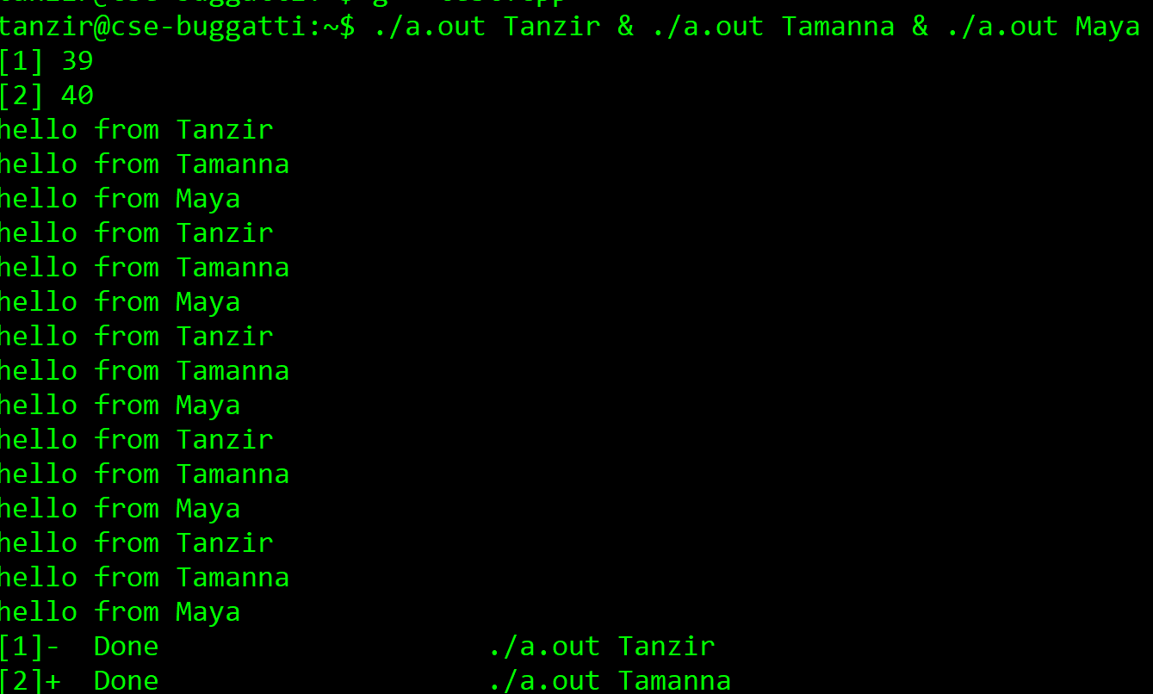
CPU Virtualization
When 3 instances are run together, the following happens:

Slide 25
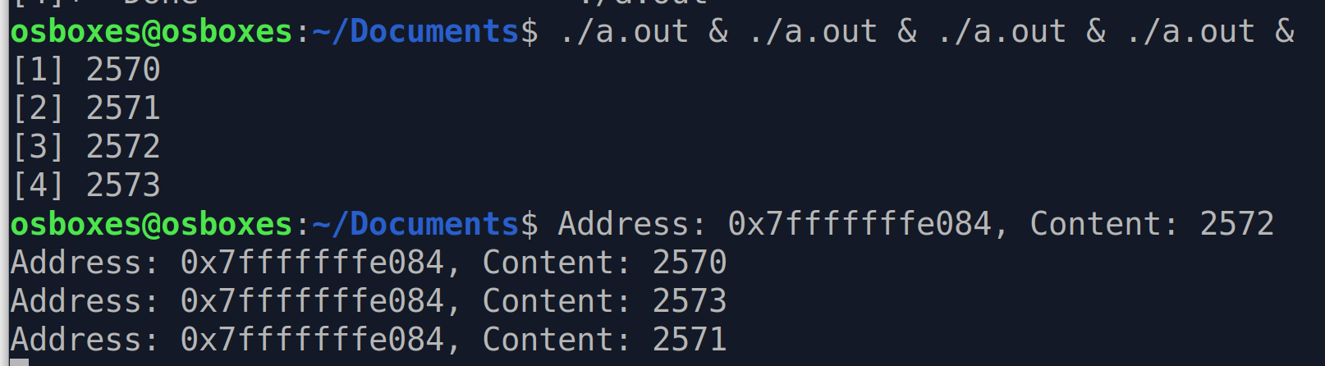
Memory Virtualization
Every program gets its own ID, even the same program running multiple times
#include <stdio.h>
#include <unistd.h>
#include <stdlib.h>
int main (){
int p = getpid();
sleep (1);
printf ("Address: %p, Content: %d\n" , &p, p);
}
Sleeps for a sec
These are coming from the shell, showing process IDs
Same address, different content

Slide 26
What’s the OS’s Role?
In a single word: Virtualization
The OS is hiding the physical machine and giving each program a virtual machine to play with
Each program can be agnostic of what else is going on in the System
If apps wanted to know and manage all that, their job would be a lot more difficult
appln
appln
appln
OS
Virtual Hardware Interface
Hardware

Slide 27
Goals of an Operating System?
The OS controls and coordinates the use of system resources.
Primary goal: Provide a convenient environment for a user to access the available resources (CPU, memory, I/O)
Provide appropriate abstractions (files, processes, ...)
“virtual machine”
Secondary goal: Efficient operation of the computer system
Make sure that the OS does not kill performance too much
Efficient Resource Management
Multiplexing: Create illusion of multiple resources from a single resource
Scheduling: “Who gets the resource when?”

