Slide 1
Signals
Tanzir Ahmed CSCE 313 Fall 2020

Slide 2
Signal: User-Mode Exceptional Flow
So far exceptional control flow features have been usable only by the operating system
Recall handling interrupts and exceptions
All exception handlers run in protected (Kernel) mode
Would like similar capabilities for user mode code
Inter-Process communication to facilitate ‘exceptional control flow’ is subject of today’s discussion
We will discuss them through “Signals” mechanism
……but also in a broader context beyond just IPC
A Signal is a one-word message with
Each has a numerical code
For instance, when we press CTRL-C key we ask the Kernel to send the interrupt signal to the currently running process

Slide 3
Major Purposes of Signals
Obviously, Inter Process Communication
A human interacting with a program using the terminal. For instance,
Ctrl+C sends a interrupt signal SIGINT
Ctrl+D sends EOF signal
Ctrl+Z suspends the process by sending SIGSTP
Most importantly, it is the Kernel’s mechanism for making processes behave according to specifications
SIGSEGV is sent on memory exceptions
SIGILL sent on seeing illegal instructions
SIGPIPE when on attempts to use a broken pipe

Slide 4
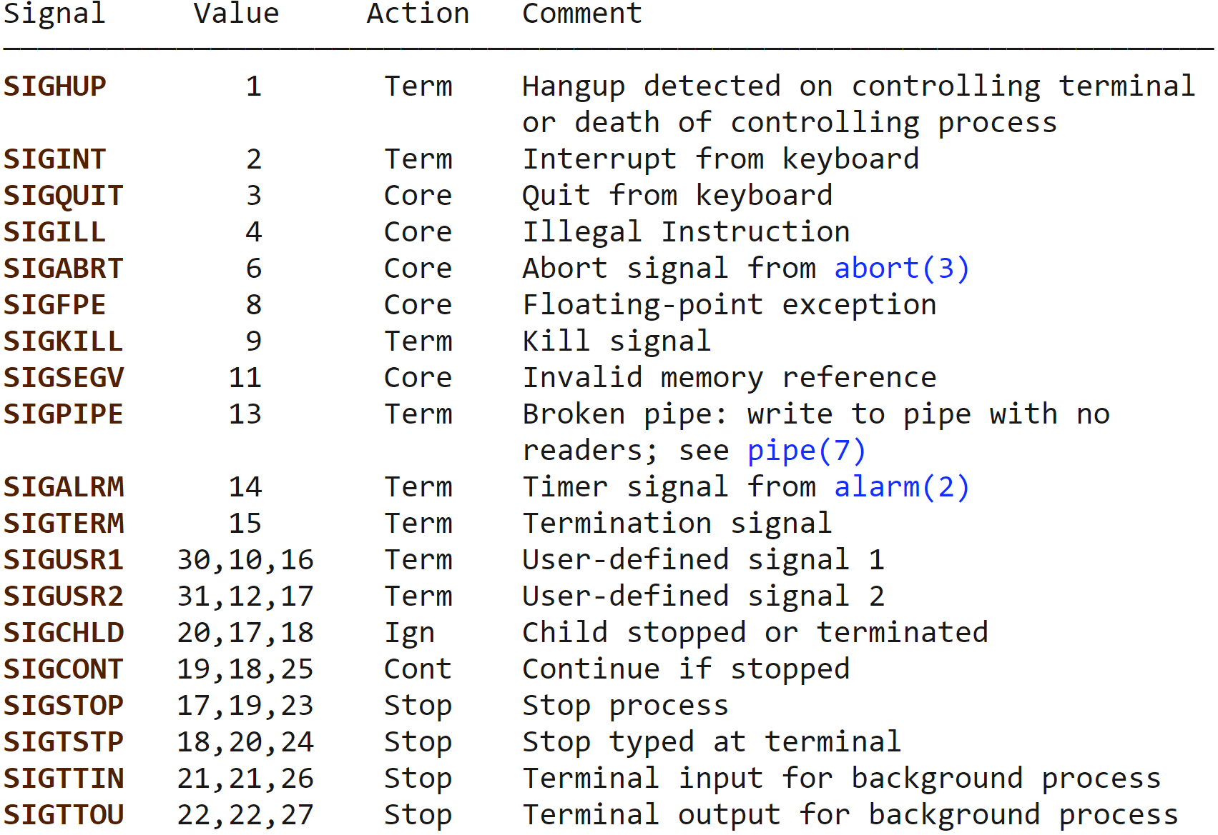
List of Signals
Terminate and also dump core (for further investigation)
Will be ignored by default, unless you override
Process scheduler??
Source of table: http://man7.org/linux/man-pages/man7/signal.7.html
Multiple values mean that they are different based on architecture

Slide 5
What can a Process do about a Signal?
Tell the Kernel what to do with a signal:
Accept Default action. All signals have a default action signal (SIGINT, SIG_DFL)
Ignore the signal. Works for most signals
signal (SIGINT, SIG_IGN)
cannot ignore SIGKILL and SIGSTOP; also unwise to ignore hardware exception signals
Catch the signal (call a function). Tell the Kernel to invoke a given function (signal handler) whenever signal occurs. signal (SIGINT, foo)

Slide 6
Signals – Some Points
The “Action” in the previous page in many cases indicate the “Default Action”
You are allowed to “override” the action for some signals (e.g., SIGINT, SIGUSRx, SIGTERM, SIGSTP), while for others (SIGKILL, SIGILL, SIGFPE, SIGSEGV, SIGSTOP) you cannot override
This is also called “signal handling”, or “catching”
SIGCHLD is the only signal so far that is Ignored by default
Most others will kill the process except SIGCONT and SIGSTP
Does that mean you can kill any process by sending any signal??
NO. You can only signal processes that you created
SIGSTP (suspends a process) and SIGCONT (conitues/unsuspends a process) are very useful for “job control”
How to control a process group tied by a shell session?
All processes that you run make a group of processes that need special controlling
You may suspend a process, run it in the background, move to foreground
What happens to standard input/output of a background process?

Slide 7
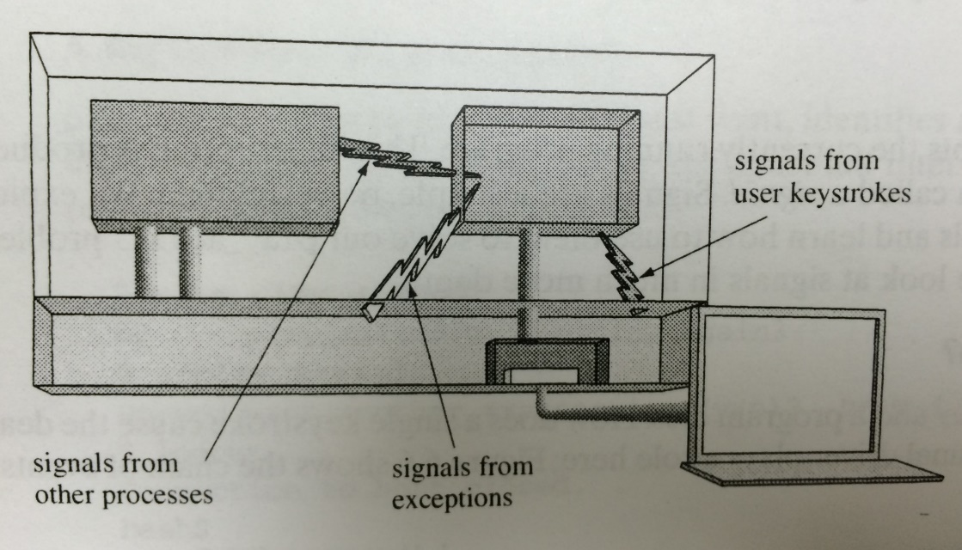
Where do Signals come from?
Today we’ll look at Signals in a broader context
IPC is one of the contexts (one process sending to another)
Others are facilitated by Users and Kernel
[Users] Signals generated by external Input devices
[Kernel] Exceptions
Taken from: Chapter 6 of “Understanding Unix/Linux Programming” by Bruce Molay
Notes:
This is a fairly accurate description of relationship between exceptions and signals as stated in WIKIPEDIA or any other commonly available references:
A process's execution may result in the generation of a hardware exception, for instance, if the process attempts to divide by zero or incurs a TLB miss.
In Unix-like operating systems, this event automatically changes the processor context to start executing a Kernel exception handler. In case of some exceptions, such as a page fault, the Kernel has sufficient information to fully handle the event itself and resume the process's execution.
Other exceptions, however, the Kernel cannot process intelligently and it must instead defer the exception handling operation to the faulting process. This deferral is achieved via the signal mechanism, wherein the Kernel sends to the process a signal corresponding to the current exception. For example, if a process attempted integer divide by zero on an x86 CPU, a divide error exception would be generated and cause the Kernel to send the SIGFPE signal to the process.
Similarly, if the process attempted to access a memory address outside of its virtual address space, the Kernel would notify the process of this violation via a SIGSEGVsignal. The exact mapping between signal names and exceptions is obviously dependent upon the CPU, since exception types differ between architectures.

Slide 8
Where do Signals come from?
(USER) Terminal-generated signals: triggered when user presses certain key on terminal. (e.g. ^C)
kill(2) function: Sends any signal to another process.
kill(1) command: The command-line interface to kill(2)
raise(3): Sends a signal to itself
A user can send signals to only his owned processes
(Kernel) Exception-generated signals: CPU execution detects condition and notifies Kernel. (e.g. SIGFPE divide by 0, SIGSEGV invalid memory reference, SIGILL when an instruction with illegal opcode is found)
(PROCESSES) Software-condition generated signals: Triggered by software event (e.g. SIGURG by out-of-band data on network connection, SIGPIPE by broken pipe, SIGALRM by timer)

Slide 9
Generating Signals: kill(2) and raise(3)
#include <signal.h>
int kill(pid_t pid, int sig);
/* send signal ‘sig’ to process ‘pid’ */
/* example: send signal SIGUSR1 to process 1234 */
if (kill(1234, SIGUSR1) == -1)
perror(“Failed to send SIGUSR1 signal”);
/* example: kill parent process */
if (kill(getppid(), SIGTERM) == -1)
perror(“Failed to kill parent”);
#include <signal.h>
int raise(int sig);
/* Sends signal ‘sig’ to itself.
Part of ANSI C library! */
Raise sends a signal to the executing process
Kill sends a signal to the specified process
Notes:
“raise” is defined by ANSI C, not POSIX.1. Since ANSI C does not deal with multiple processes it could not define a function such as “kill” that requires a process ID argument.

Slide 10
Signals and the Kernel
Many of the signals are generated by the Kernel in response to events and exceptions received
SIGFPE – FP exception
SIGILL – Illegal instruction
SIGSEGV – Segment Violation
All others are routed through the Kernel, if not originating from the Kernel itself
E.g. SIGHUP (terminal hang), SIGINT (CTRL-C keyboard), SIGTSTP (CTRL-Z), SIGKILL (KILL)

Slide 11
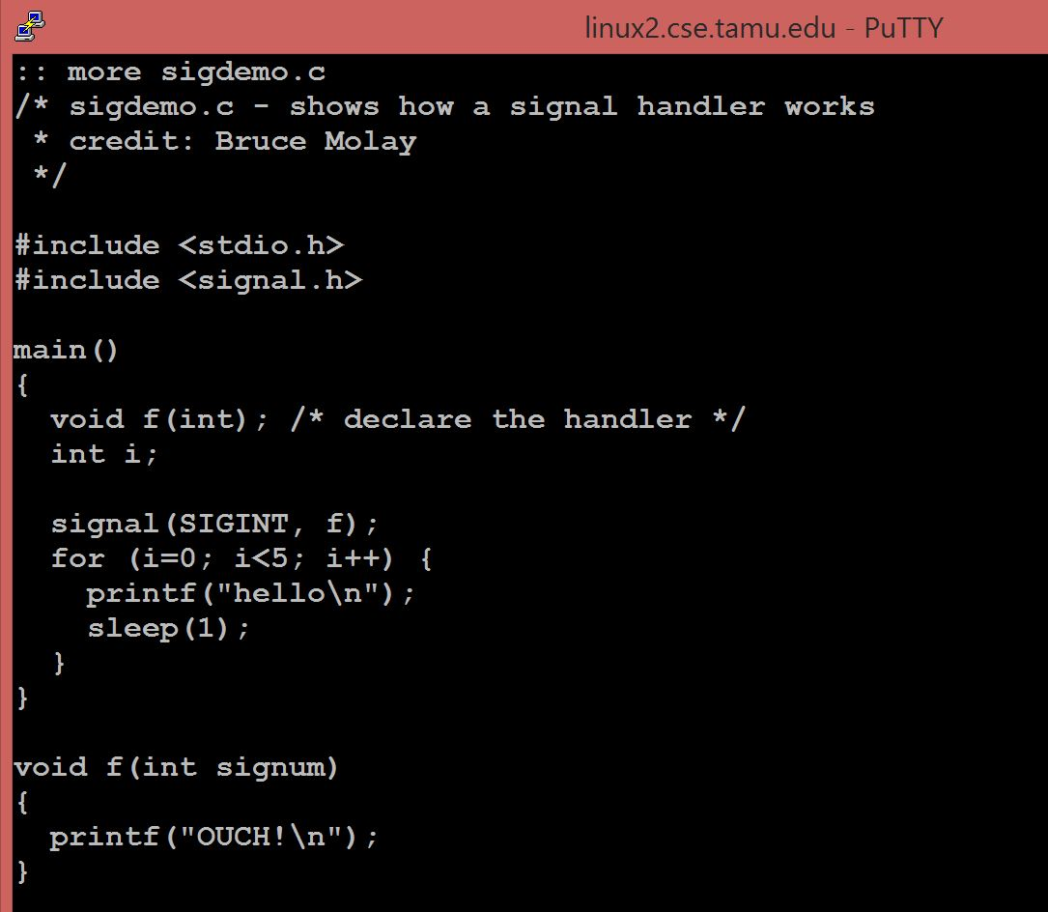
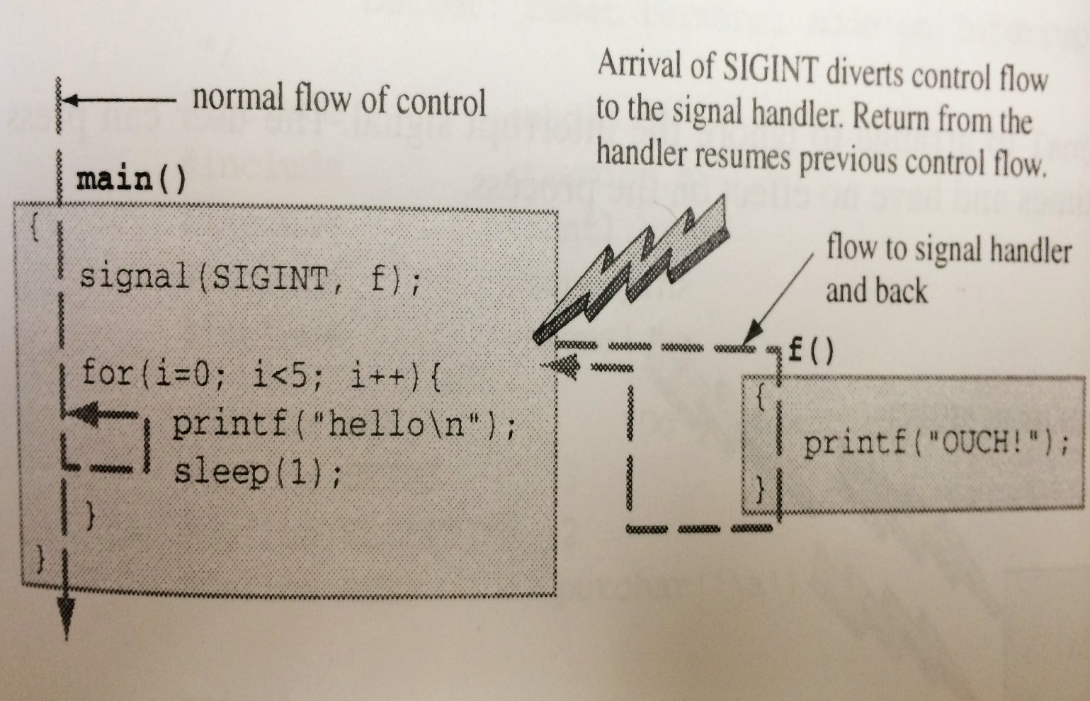
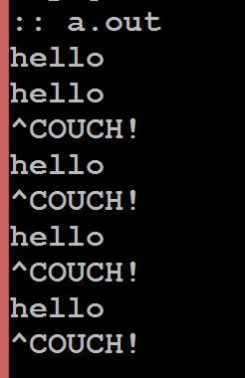
Simple Signal Handling: Example
Taken from: Chapter 6 of “Understanding Unix/Linux Programming” by Bruce Molay

Slide 12
Example – One Handler for Multiple Signals
static void sig_usr(int); /* one handler for two signals */
int main (void) {
if (signal(SIGUSR1, sig_usr) == SIG_ERR)
perror(“cannot catch signal SIGUSR1”);
if (signal(SIGUSR2, sig_usr) == SIG_ERR)
perror(“cannot catch signal SIGUSR2”);
for(;;) pause();
}
static void sig_usr(int signo) { /*argument is signal number*/
if (signo == SIGUSR1) printf(“received SIGUSR1\n”);
else if (signo == SIGUSR2) printf(“received SIGUSR2\n”);
else error_dump(“received signal %d\n”, signo);
return;
}

Slide 13
Reaping Child Processes
A child process being terminated generates SIGCHLD for the parent process
The parent can handle this signal by reaping children
This is asynchronous, i.e., the parent process can do other things instead of continually waiting
void my_handler (int sig){
wait (0);
}
int main (){
// install handler
signal (SIGCHLD, my_handler);
// create 5 child procs,
// i-th proc sleeps i sec and then dies
for (int i=1; i<=5; i++){
int pid = fork ();
if (pid == 0){
sleep (i);
return 0;
}
}
// parent in an infinite loop
// busy doing something else
while (true){
cout << "Relaxing" << endl;
sleep (1);
}
}

Slide 14
Signal Blocking
A process has the option of manually blocking the delivery of a signal.
Signal remains blocked until process either (a) unblocks the signal, or (b) changes the action to ignore the signal.
Blocking is automatic for a signal type when the same signal is being handled
First, SIGINT received causes the SIGINT handler (if any) to be called
Also causes SIGINT to be blocked for the process - If another SIGINT occurs during Handler execution, it is recorded in the pending bit vector, but not delivered
When handler returns, signals of that type can start to be delivered again
The following function is used to block a signal:
sigprocmask (manipulate the set of blocked signals for the process)

Slide 15
Properly Reaping Child Processes Under Simultaneous Termination
A child process being terminated generates SIGCHLD for the parent process
The parent can handle this signal by reaping children
This is asynchronous, i.e., the parent process can do other things instead of continually waiting
void my_handler (int sig){
while (waitpid (-1, 0, 0) != -1)
;
}
int main (){
// install handler
signal (SIGCHLD, my_handler);
// create 5 child procs,
// i-th proc sleeps i sec and then dies
for (int i=1; i<=5; i++){
int pid = fork ();
if (pid == 0){
sleep (5);//all die simult. return 0;
}
}
// parent in an infinite loop
// busy doing something else
while (true){
cout << "Relaxing" << endl;
sleep (1);
}
}

