Slide 1
Unix Process Scheduling
Reading Reference:
Textbook: Chapter 7
Tanzir Ahmed CSCE 313 Fall 2020

Slide 2
Process Scheduling
Today we will ask how does a Kernel juggle the (often) competing requirements of Performance, Fairness, Utilization, etc. in dealing with concurrency
Proc 1
Proc 2
Proc n
Kernel

Slide 3
Process Scheduling – More Specifically
Which one to dispatch???
P₁
P₂
…
P_{n}
preempt
Create
(new)
ready
running
Exit
(terminated)
dispatch
I/O or
Event complete
blocked
I/O or event wait

Slide 4
Overall Idea
If there were no other processes, a process’s life would look like the following:
However, since there are other processes, each process is slowed down by waits in Ready and Blocked queues:
Think of CPU and I/O devices as servers in the bank, where people must wait in line to get service
Now, the scheduler’s goal is to minimize these Wait times in some aggregate sense, especially in the Ready queue
Our focus is CPU scheduler
There are other schedulers (e.g., I/O schedulers) are not our focus
start
…
terminate
CPU burst
I/O Operation
CPU burst
I/O Operation
start
terminate
Wait in Ready queue
Wait in Device queue
Wait in Ready queue
…
CPU burst
I/O Operation
CPU burst

Slide 5
Some Thoughts – Why the Reality has Hope
Based on which queue a process spends most of its time, we can classify processes to 2 types:
I/O-bound Processes
Spend most time in blocked state as the I/O device performs I/O
Example: A web-server reading requests from network (I/O), reading files from disk (I/O), writing response back to network (I/O), and some request parsing (CPU)
CPU-bound Processes
Spend most time in ready queue or as running
Example: A program computing large prime numbers – a lot of computations involving CPU, but no/less I/O

Slide 6
Scheduling Metrics
Task/Job
User request: e.g., mouse click, web request, shell command, …
Latency/Response Time
How long does a task take to complete?
Throughput
How many tasks can be done per unit of time?
Overhead
How much extra work is done by the scheduler?
Fairness
How equal is the performance received by different users?
Predictability
How consistent is the performance over time?
Notes:
1. Minimize response time: elapsed time to do an operation (or job)
Response time is what the user sees: elapsed time to
echo a keystroke in editor
compile a program
run a large scientific problem
2. Maximize throughput: operations (or jobs) per second
Throughput is related to response time, but they're not identical -- for example, I’ll show that minimizing response time will lead you to do more context switching than you would if you were only concerned with throughput.
Two parts to maximizing throughput
a. Minimize overhead (for example, context switching)
b. Efficient use of system resources (not only CPU, but disk, memory, etc.)
What does CPU scheduling have to do with efficient use of the disk? A lot! Have to have CPU to make a disk request.
3. Fair: share CPU among users in some equitable way
Tradeoff: will argue you can get better average response time by making system less fair.
What does fairness mean?
Minimize # of angry phone calls? Minimize my response time?
Minimize average response time? We will argue fairness is a tradeoff against average response time; can get better average response time by making system less fair. Sort of like capitalism.
Anecdote: Response time has a lot to do with perceived effectiveness.
IBM keystroke experiment -- consistency is better than speed.
Might believe that since have PC's, CPU scheduling is less important -- usually, only one thing running at a time, for a single user. But! Face similar problems in networks -- how do you allocate scarce resources among users? Do you optimize for response time, throughput, fairness? In networks, fairness is often suboptimal.

Slide 7
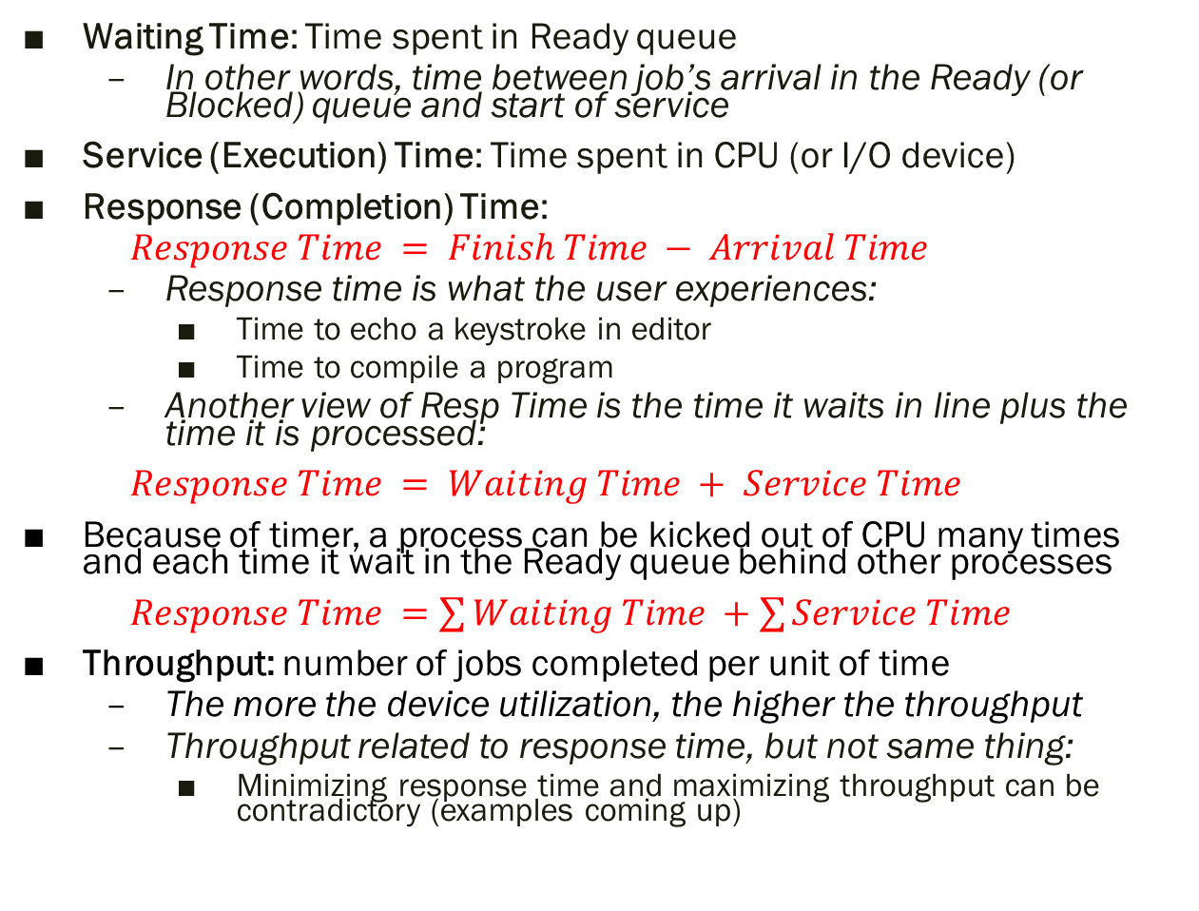
How to Measure?
Waiting Time: Time spent in Ready queue
In other words, time between job’s arrival in the Ready (or Blocked) queue and start of service
Service (Execution) Time: Time spent in CPU (or I/O device)
Response (Completion) Time:
$Response Time = Finish Time − Arrival Time$
Response time is what the user experiences:
Time to echo a keystroke in editor
Time to compile a program
Another view of Resp Time is the time it waits in line plus the time it is processed:
$Response Time = Waiting Time + Service Time$
Because of timer, a process can be kicked out of CPU many times and each time it wait in the Ready queue behind other processes
$Response Time =\sum{Waiting Time} +\sum{Service Time}$
Throughput: number of jobs completed per unit of time
The more the device utilization, the higher the throughput
Throughput related to response time, but not same thing:
Minimizing response time and maximizing throughput can be contradictory (examples coming up)
Notes:
What does CPU scheduling have to do with efficient use of the disk?
A lot! Have to have the CPU to make a disk request
Fairness: Minimize # of angry phone calls? Minimize my response time?

Slide 8
Scheduling Metrics and Goals
Scheduling metrics are important for both individual processes and the system as a whole
Customer-Centric: Response Time
System-Centric: Throughput , Average Response Time, Fairness
Scheduling Goals
Minimize Average Response Time (ART)
Measure from the response time of several jobs
Also applies to 1 job as – i.e., we want to minimize the response time for processing a mouse click, a file copy, to compile a program etc.
Maximize Throughput
By keeping CPU and I/O devices as utilized as possible
Ensure Fairness
Share CPU in some equitable way
This policy can contradict with others (we will see examples)
Notes:
What does CPU scheduling have to do with efficient use of the disk?
A lot! Have to have the CPU to make a disk request
Fairness: Minimize # of angry phone calls? Minimize my response time?

Slide 9
Scheduling: Decision Points
There can be 3 points in time when the scheduler runs:
The current process voluntarily gives up (by requesting I/o) CPU
Timer expired - the current process is kicked out
Arrival of a new process (new!!)
A scheduler can be preemptive or not (related to the above):
Preemptive: scheduler runs as soon as new arrival
Non-preemptive: scheduler waits until timer expires, or the current process yields CPU
Some scheduling algorithms can run in both preemptive and non-preemptive mode
SRTF can be run in both preemptive or non-preemptive manner. FIFO would be the same with or w/o preemption
Round Robin is non-preemptive by definition

Slide 10
P1: First In First Out (FIFO) or FCFS (First Come First Served)
Schedule tasks in the order they arrive
Continue running them until they complete or give up the processor
Uses:
Read/write requests to a disk file
Network packets in a NIC
An Example:
Job | Arrival Time (sec) | Service Time (sec)
P1 | T | 10
P2 | T+2 | 1
P3 | T+2 | 1
P4 | T+2 | 1
P5 | T+2 | 1
t=T
t=T+2
t=T+10
t=T+14
In CPU:
P1
P2
P3
P4
P5
Arrivals:
P1
P2, P3, P4, P5
ART = ((10 - 0) + (11–2) + (12-2) + (13–2) + (14–2))/5 = 10.4 sec
10/2/2020

Slide 11
P2: Shortest Remaining Time First (SRTF)
Always do the task that has the shortest remaining amount of work to do
Aka. Shortest Job First (SJF)
Note: Remaining time of a job changes every time it gets service in CPU
Example:
Job | Arrival Time (sec) | Service Time (sec)
P1 | T | 10
P2 | T+2 | 1
P3 | T+2 | 1
P4 | T+2 | 1
P5 | T+2 | 1
P1(8), P2-P5(1)
P1(8), P4-P5(1)
P1(10)
P1(8), P3-P5(1)
P1(8), P5(1)
P1(8)
t=T
t=T+2
t=T+6
t=T+14
In CPU:
P1
P2
P3
P4
P5
P1
Arrivals:
P1
P2, P3, P4, P5
ART = ((14 - 0) + (3 – 2) + (4 - 2) + (5 – 2) + (6 – 2))/5 = 4.8 sec

Slide 12
Some Thoughts
Claim: SRTF is optimal for ART
SRTF always picks the shortest job; if it did not, then, by definition, it would result in higher average response time. <<see notes for details>>
When is FIFO optimal?
When all jobs are equal in length
SRTF gives the same schedule, but incurs many context switches
Does SRTF have any downsides?
Starvation: longer jobs would suffer. Imagine a supermarket that implements SRTF in checkout lines! Longer lines will keep waiting
Implementation: No exact algorithm to implement SRTF (how would you know how much is remaining???)
Notes:
Consider a hypothetical alternative policy that is not SJF, but that we think might be optimal. Because the alternative is not SJF, at some point it will choose to run a task that is longer than something else in the queue. If we now switch the order of tasks, keeping everything the same, but doing the shorter task first, we will reduce the average response time.
Downsides: starvation, and variance in response time. Some task might take forever?
Imagine a supermarket that used SJF – would it work?
Clever person would go through with one item at a time…
Rich get richer, and poor get poorer = short jobs get through the system faster, long jobs take even longer

Slide 13
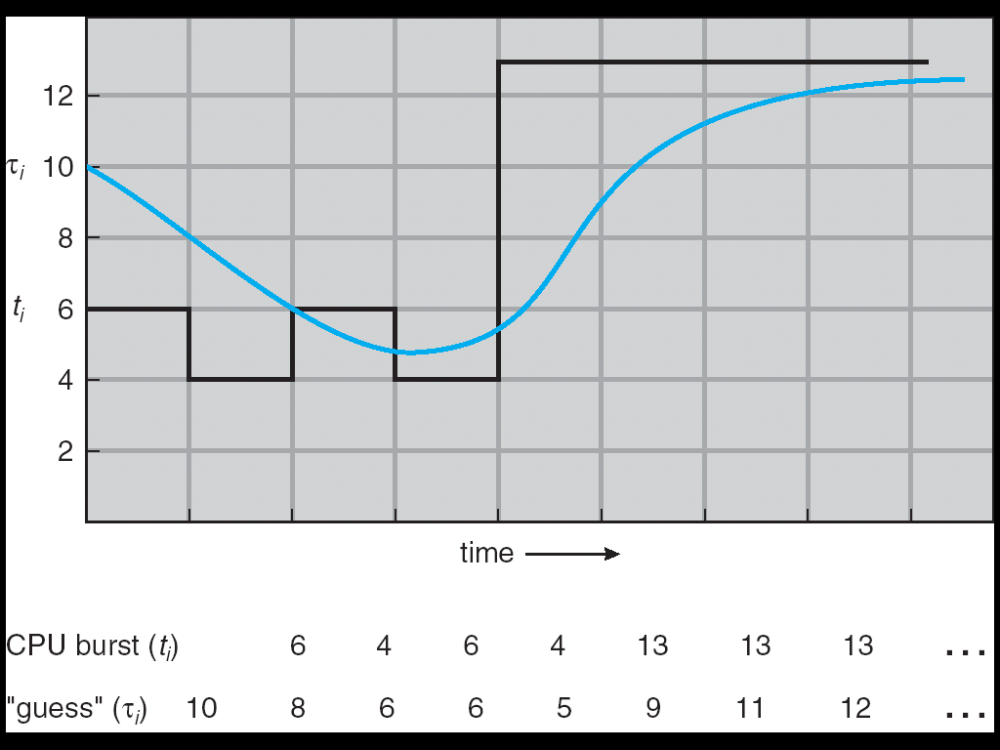
Practical Implementation of SRTF
Issue: How do we know the remaining time?
User provides job runtime
System kills job if takes too long (i.e., to stop cheating)
But even for non-malicious users, it is hard to predict runtime accurately
Adaptive Algorithm without user input: Predict the next CPU burst (not the whole task length) based on the recent past
Works because programs have predictable behavior
If program was I/O bound in past, probably it will be in future
Example: SRTF with estimated burst length
Use an estimator function on previous bursts: Let t_{n-1}, t_{n-2}, t_{n-3}, etc. be previous CPU burst lengths. Estimate next burst τ_{n} = f(t_{n-1}, t_{n-2}, t_{n-3}, …)
Function f could be one of many different time series estimation schemes (Kalman filters, etc.)

Slide 14
P3: Round Robin
Each task gets resource for a fixed time quantum
If task doesn’t complete, it goes back in line
If it finishes the CPU burst because of I/O, it gets out before the quantum expires
Now, we need a timer, right???
So far, we have been operating w/o a timer
But, how to we choose a good time quantum???
Too long (i.e., Infinite)?
Then it will be equivalent to FIFO (as if there is no timer and no preemption)
Too short (i.e. one instruction)?
Too much overhead of swapping processes
But tasks finish approximately in the order of their length (approximating SRTF)
Thus, RR is sort of a compromise between FIFO and SRTF
Notes:
Can we combine best of both worlds? Optimal like SJF, but without starvation?

Slide 15
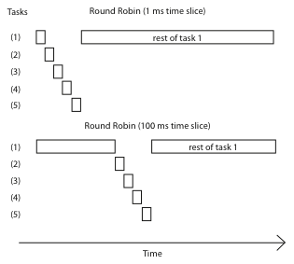
Round Robin – Varying Time Slice

Slide 16
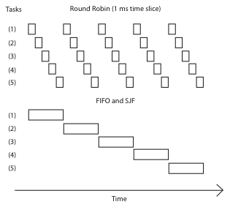
Round Robin vs. FIFO
Average Response Time
= (21+22+23+24+25)/5
= 23
Average Response Time
= (5+10+15+20+25)/5
= 15
Notes:
Everything is fair, but average response time in this case is awful – everyone finishes very late! In fact, this case is exactly when FIFO is optimal, RR is poor.
On the other hand, if we’re running streaming video, RR is great – everything happens in turn. SJF maximizes variance. But RR minimizes it.

Slide 17
Round Robin vs. FIFO
Assuming zero-cost context-switch, is Round Robin always better than FIFO?
No. Round robin is better when there is a mix of short and long jobs. However, it is poor for jobs that are the same length
Of course, context switches are not zero-cost, adding more overhead to RR
What’s the worst case for RR?
All jobs are of same length
All tasks run a factor slower than the best case
CPU devoted to Context Switch Overhead is without any benefit
Is Round Robin always fair?
Yes. Round robin ensures nobody starves, and gives everyone a turn
But lets short tasks complete before longer ones
Notes:
Not really. Suppose we have 10 jobs, each takes 100 seconds of CPU time, and the time slice for the round robin is 1 second. Let us look at job completion times.
Job Completion Times
Job # FIFO Round robin
1 100 991
2 200 992
…
…
…
9 900 999
10 1000 1000
Although both round robin and FIFO finish at the same time, the average turnaround time is much worse under round robin than under FIFO. Therefore, round robin is better for short jobs, but it is poor for jobs that are the same length.
What’s the worst case for RR?

Slide 18
Assuming 0.5 sec overhead per context switch (i.e., time between 2 user processes) in a 1-CPU-1-core system, schedule the following workload and compute Average Response Time (ART) under: a. Shortest Remaining Time First (SRTF) (preemptive) b. Round-Robin (RR) with time quantum=2sec
Process | Arrival Time | Service Time
P1 | 1 | 4
P2 | 2 | 3
P3 | 2 | 2
P4 | 3 | 1
SRTF
ART = ((10-1) + (13.5 – 2) + (6.5 – 2) + (4.5-3))/4 = 26.5/4
1
2
2.5
3
3.5
4.5
5
6.5
10
13.5
P1
CS
P3
CS
P4
CS
P3
CS
P1
CS
P2
P1(3) P2(3)
P3(2)
P1(3) P2(3) P3(1.5)
P4(1)
P1(3) P2(3) P3(1.5)
P1(3) P2(3)
P2(3)

Slide 19
Assuming 0.5 sec overhead per context switch (i.e., time between 2 user processes) in a 1-CPU-1-core system, schedule the following workload and compute Average Response Time (ART) under: a. Shortest Remaining Time First (SRTF) (preemptive) b. Round-Robin (RR) with time quantum=2sec
Process | Arrival Time | Service Time
P1 | 1 | 4
P2 | 2 | 3
P3 | 2 | 2
P4 | 3 | 1
RR
ART = ((12-1) + (13.5 – 2) + (8 – 2) + (9.5-3))/4 = 35/4
1
3
4.5
5.5
8
9.5
12
13.5
P1
CS
P2
CS
P3
CS
P4
CS
P1
CS
P2
8

Slide 20
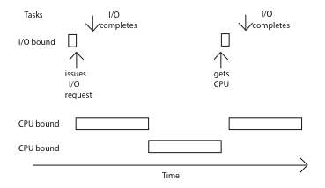
Another Downside of RR – Mixed Workload
I/O task (e.g., keystroke) must wait for its turn for the CPU
Gets a tiny fraction of the performance it could get
We could shorten the RR quantum - would help, but it would increase overhead
What would this do under SRTF?
Every time the task is ready, it is scheduled immediately!
Notes:
I/O task has to wait its turn for the CPU, and the result is that it gets a tiny fraction of the performance it could get.
We could shorten the RR quantum, and that would help, but it would increase overhead.
what would this do under SJF? Every time the task returns to the CPU, it would get scheduled immediately!

Slide 21
Max-Min Fairness
RR is fair when the tasks are CPU bound
Each job is getting the same CPU share
However, RR cannot stay fair when a process does not use the full time-quantum
In the previous example: if the I/O bound task take 1ms in CPU and the quantum is 50ms, then the I/O bound job is getting 1% CPU attention while the CPU bound jobs are getting ~50%
One approach to solve this: maximize the minimum allocation given to a task
This is called Max-min fairness
Anytime a job gets higher attention (i.e., a CPU job), find the smallest job and try to give that a little more attention
Notes:
On previous slide, what would happen if we used max-min fairness? Then I/O task would be scheduled immediately – its always the one

Slide 22
Example - Benefits of SRTF
A or B
C
C’s
I/O
C’s
I/O
C’s
I/O
Three jobs:
A,B: CPU bound, each run for 100ms C: I/O bound, loop 1ms CPU, 9ms disk I/O
If only one at a time, C uses 90% of the disk, A or B use 100% of the CPU
With FIFO:
Once A or B get in, keep CPU for 100ms
What about RR or SRTF?
Easier to see with a timeline

Slide 23
RR vs. SRTF
Disk Utilization:
9/201 ~ 4.5%
A
B
C
RR 100ms time slice
C’s
I/O
C’s
I/O
Disk Utilization:
~90% but lots of context switches
CABAB…
C
RR 1ms time slice
C’s
I/O
C’s
I/O
Disk Utilization:
90% w/o so many context switches
C
A
A
A
SRTF
C’s
I/O
C’s
I/O

Slide 24
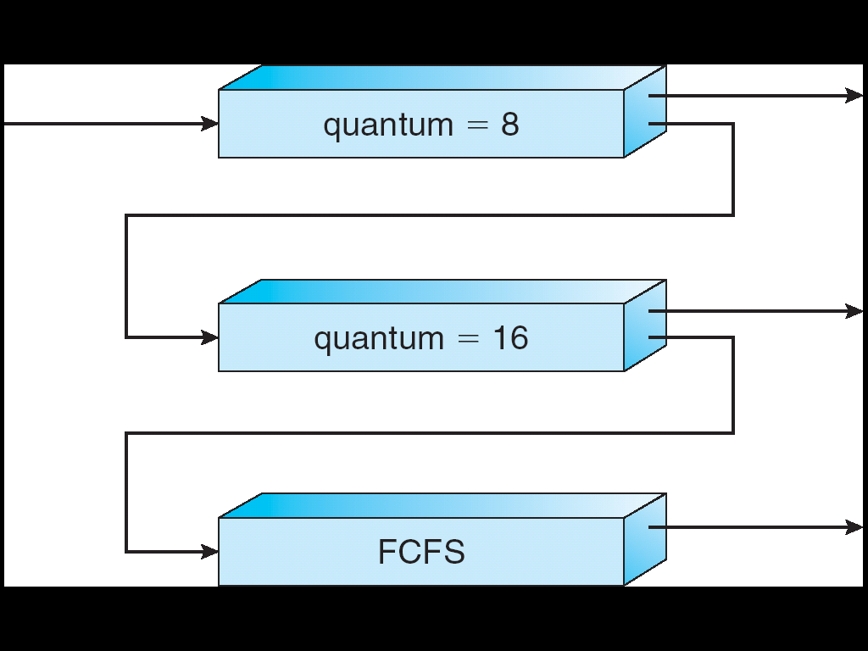
Multi-Level Feedback Scheduling
Long-Running
Compute tasks
demoted to low priority
Another method for exploiting past behavior
First used in Cambridge Time Sharing System (CTSS)
Multiple queues, each with different priority
Higher priority queues often considered “foreground” tasks
Each queue has its own scheduling algorithm
e.g., foreground – RR, background – FCFS
Sometimes multiple RR priorities with quantum increasing exponentially (highest:1ms, next:2ms, next: 4ms, etc.)
Adjust each job’s priority as follows (details vary)
Job starts in highest priority queue
If timeout expires, drop one level

Slide 25
Countermeasure
Countermeasure: User action that can foil intent of the OS designer
Put in a bunch of meaningless I/O to keep job’s priority high
Of course, if everyone did this, wouldn’t work!
Example: MIT Othello game project (simpler version of Go game)
Computer playing against competitor’s computer, so key was to do computing at higher priority than the competitors.
Cheater (or Winner!!!) put in carefully crafted cout statements, stayed high up in priority

Slide 26


MLFQ Scheduling Details
Result approximates SRTF:
CPU bound jobs drop like a rock
Short-running I/O bound jobs stay near top
Scheduling must be done between the queues
Fixed priority scheduling:
Serve all from highest priority, then next priority, etc.
But this tends to be unfair
Example: In Multics, people found a 10-year old job while shutting down
Time slice:
Each queue gets a certain amount of CPU time
e.g., 70% to highest, 20% next, 10% lowest
More fair compared to fixed priority, so this one used in practice

Slide 27
Summary
FCFS is simple and minimizes overhead.
If tasks are variable in size, then FCFS can have very poor ART
If tasks are equal in size, FCFS is optimal in terms of ART
SRTF becomes equivalent to FCFS
RR would do increase ART significantly
SRTF is optimal in terms of ART
The only way to implement is for Kalman filter-like approximations for the individual CPU bursts
But NOT fair
We also do not have preemption – longer jobs can have very long waiting times, making them unresponsive

Slide 28
Summary (contd.)
If tasks are equal in size, RR will have poor ART
RR works poorly on a mix of CPU and I/O bound tasks
SJF is hugely beneficial in this case
RR avoids starvation and is fair
To avoid the downsides of RR and SRTF, we want something in the middle
That would combine the good sides of both
MFQ scheduler is the most practical – answer to our prayer
Approximates SJF while running just RR for each queue, no need to run any adaptive algorithm got the CPU bursts
Achieves a balance between responsiveness, low overhead, and fairness
Good for mixed workloads (user typing and long CPU computations running simultaneously)

