Slide 1
File Systems
Tanzir Ahmed CSCE 313 Fall 2020

Slide 2
The UNIX File System
File Systems and Directories
UNIX inodes
File protection/access control

Slide 3
Why Study File Systems?
The main subject is non-volatile storage, e.g.,
Magnetic disk
Tape drives
Flash disks
SSDs
These retain data between shutdown and reboots
Important for keeping the OS, programs, and user data
But these devices have unique characteristics and limitations not found in main memory
First, they do not allow random accesses to individual bytes – only allow block level access (512 bytes or multiple)
Second, accesses are much slower (10ms compared to 0.1ms of memory)

Slide 4
Why Study File Systems?
The physical characteristics drive the following keys features of file systems:
Named data: Human-readable names (e.g. file names) given to data
Performance: By grouping, ordering, scheduling disk operations so that high latency is hidden/amortized
Reliability: Unexpected power-cycles do not corrupt the data
Controlled sharing: Determine who can read/write/execute certain files sequentially/simultaneously w/o corrupting

Slide 5
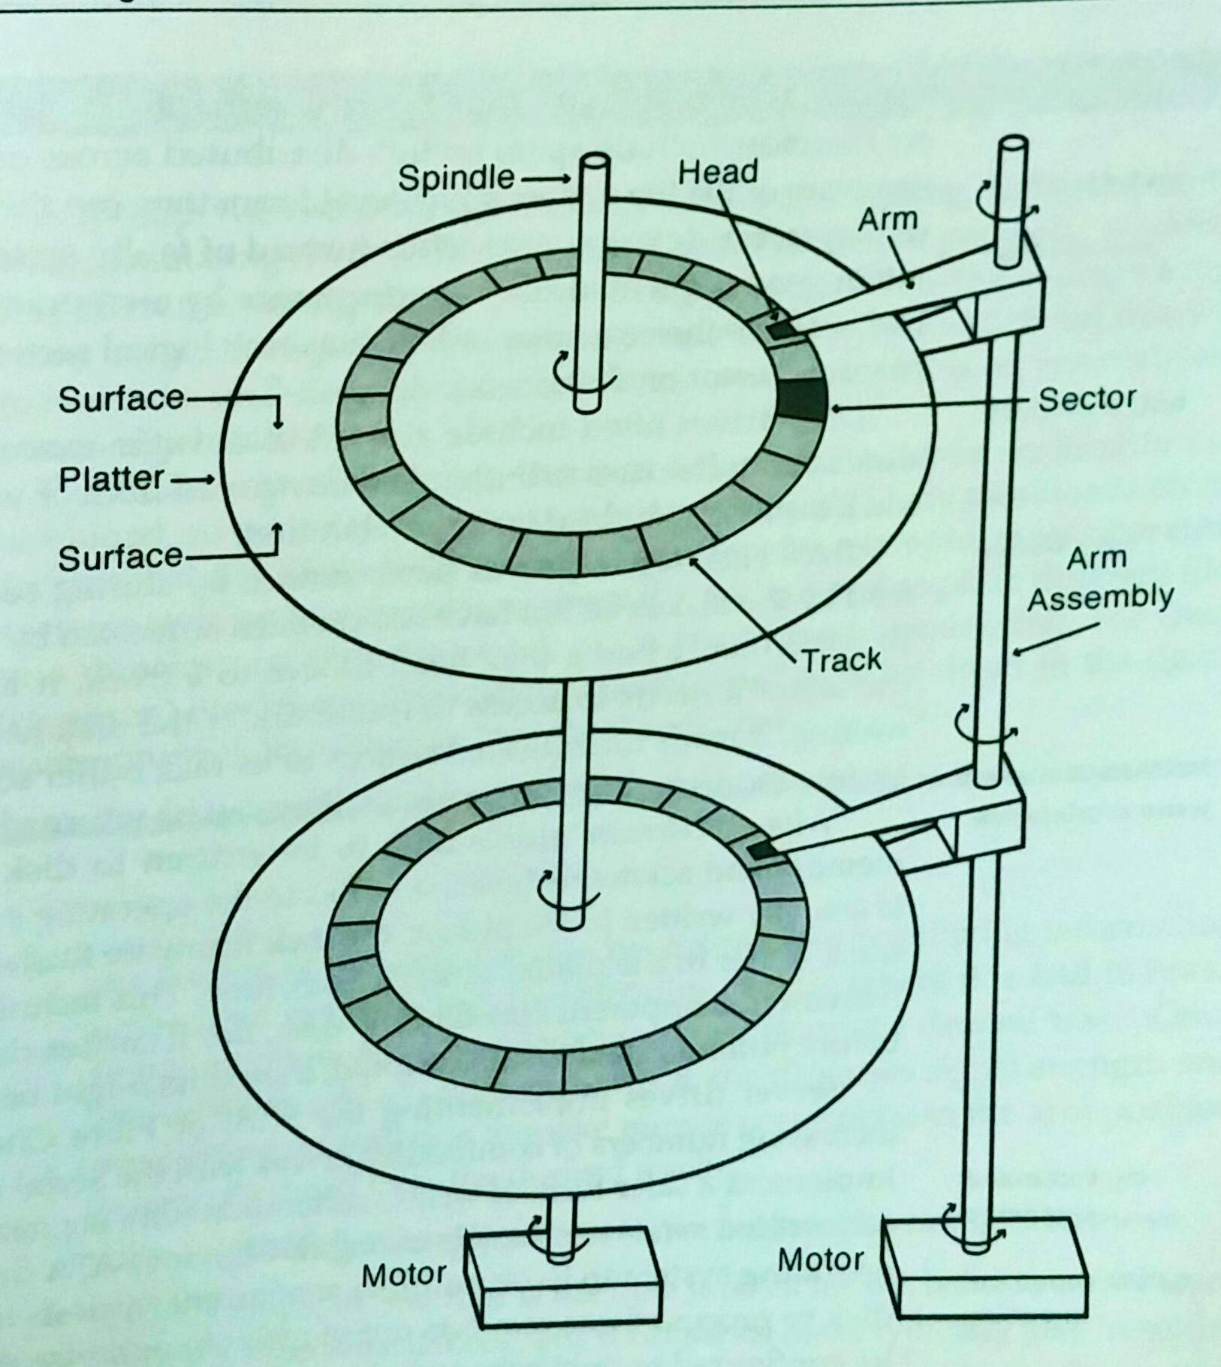
Now, Why Are Disks Slow?
Consider a typical magnetic disk
Platters are rotating at a constant speed
Each surface has data in the form of several tracks
Each track is separated in sectors/blocks
To read from disk
Arm moves the disk head to place that on the right track. This is called “seek”
Extremely slow (> 10 ms)
Then, the head waits for the correct sector to come below
Relatively faster because of constant motion (<10 ms), determined by disk RPM
Read the sector and send to the CPU
Much faster (at SATA rate: ~500MB/s)

Slide 6
Disk Access Time
disk access time = seek time + rotation time + transfer time
The mechanical movement of the disk arm makes the seek time often the bottleneck
Sequentially read => less disk seeking
It takes less time to move between adjacent tracks
If data is read randomly, the disk arm must seek randomly, leading to very slow operation
Even then, it applies algorithms similar to the ones in elevators to service requests

Slide 7
How About SSDs?
Are they “true random access” – meaning do they take same time as sequential even when accessed randomly?
The answer is NO
Because accesses are still at sector or page level
Accessing just 1 byte experiences the full sector latency
Anticipatory prefetching an adjacent page is a common practice, which hides latency for sequential, but not for random
Overall, random access is faster than magnetic, but not as fast as sequential
From that same logic, even the main memory, which is called Random Access Memory (RAM) not truly random access
You will always have some leverage accessing sequentially
However, the RAM is much better in random access than any type of disk

Slide 8
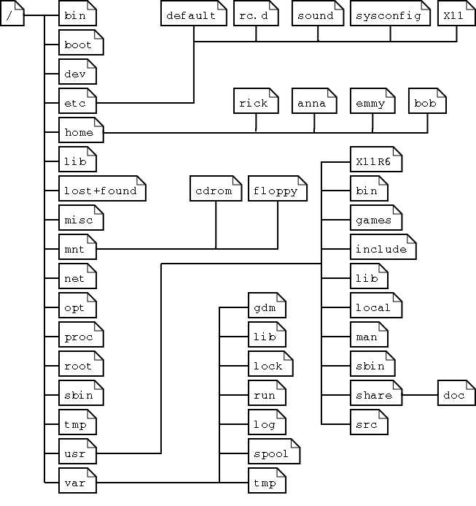
File System Abstraction
Definition: “File system is an OS abstraction that provides persistent and named data”
Key components:
Files: contain metadata and actual data
Directories: Special files that contain names and pointers to actual files
Because of directories and sub-directories, the File System looks like a tree

Slide 9
File Systems Terms
path: a string identifying a file (e.g., /home/tanzir/Work/hw1.cpp)
root directory: think of the directory as a tree whose root is the root directory
Often denoted by the “/”
absolute path: a path starting with “/”
relative path: a path relative to the current working directory. Does not start with a “/”

Slide 10
File System “Tree”
hard link: The mapping between the name and the underlying file
There can be multiple hard links to the same file (e.g., short cuts)
Means that the directory tree is not always a tree
/
home
tanzir
urgent
classes
csce313
lectures
L15.pptx
csce315

Slide 11
UNIX Directory API: Current Directory
#include <unistd.h>
char * getcwd(char * buf, size_t size);
/* get current working directory */
Example:
void main(void) {
char mycwd[PATH_MAX];
if (getcwd(mycwd, PATH_MAX) == NULL) {
perror (“Failed to get current working directory”);
return 1;
}
printf(“Current working directory: %s\n”, mycwd);
return 0;
}

Slide 12
UNIX Directory API – Open, Read, Close
Read is stateful with a cursor
Reading the same directory again gives back the next file in the directory
In the next quiz, you will be asked to implement “ls –l”
That will require many more fields from the dirent struct
#include <dirent.h>
int main(int argc, char * argv[]) {
struct dirent * direntp;
DIR * dirp = opendir(argv[1]);
while ((direntp = readdir(dirp)) != NULL)
printf(%s\n”, direntp->d_name);
closedir(dirp);
return 0;
}

Slide 13
UNIX Directory API – Traversal
Read is stateful with a cursor
Reading the same directory again gives back the next file in the directory
You can even do “seek” to the beginning using rewindir()
#include <dirent.h>
DIR* opendir(const char * dirname);
/* returns pointer to directory object */
struct dirent * readdir(DIR * dirp);
/* read successive entries in directory ‘dirp’ */
int closedir(DIR *dirp);
/* close directory stream */
void rewinddir(DIR * dirp);
/* reposition pointer to beginning of directory */

Slide 14
File System Organization
First, each sector/block is numbered from 0, 1, ….
The larger the disk, the more the sectors
Then, the file system contains the following components:
Component | Purpose
Superblock | Contains metadata about the file system. Size is OS dependent
Inode table | An array of inode structs, where each struct contains info of a file (e.g., size, owner id, last modification). Each inode has an identification number, which is also the index into the inode table
Data Area | Contains file content. Each file can be >= 1 block
Super block
Inode table
Data Area

Slide 15
Creating a New File
Let us create a file called “newfile” that is 12KB in size, and a disk block is 4KB.
First, we need a free inode to put the file metadata, then find 3 free disk blocks to put the actual data
SB
47
Data Area
2
20
100
Free data blocks: 2, 20, 100
1) make inode
2) Copy data into the blocks 2, 20, 100 in that order
Metadata (perms, mod date etc.)
Inode # | File
123 | Foo.zip
2 | Bar.txt
47 | newfile
List of data blocks: 2, 20, 100,
3) Make a directory entry

Slide 16
Steps in Creating a File
1) Store Properties: Kernel looks for a free inode and stores the metadata (e.g., permissions, size, creation date) in that
2) Store Data and Record Allocations: Kernel then looks for free disk blocks (and enough of those) and copies content there. Kernel updates the inode with which blocks contain data for that file
3) Add file name to directory: Kernel stored the (inode#, filename) pair in the directory entry

Slide 17
Reading a File
1) Search the directory for the file name and extract its inode
2) Locate and read the inode, find the data block number from there
3) Read each data block in sequence and output that
This is how out “$cat newfile” command will work
Output will go to standard output

Slide 18
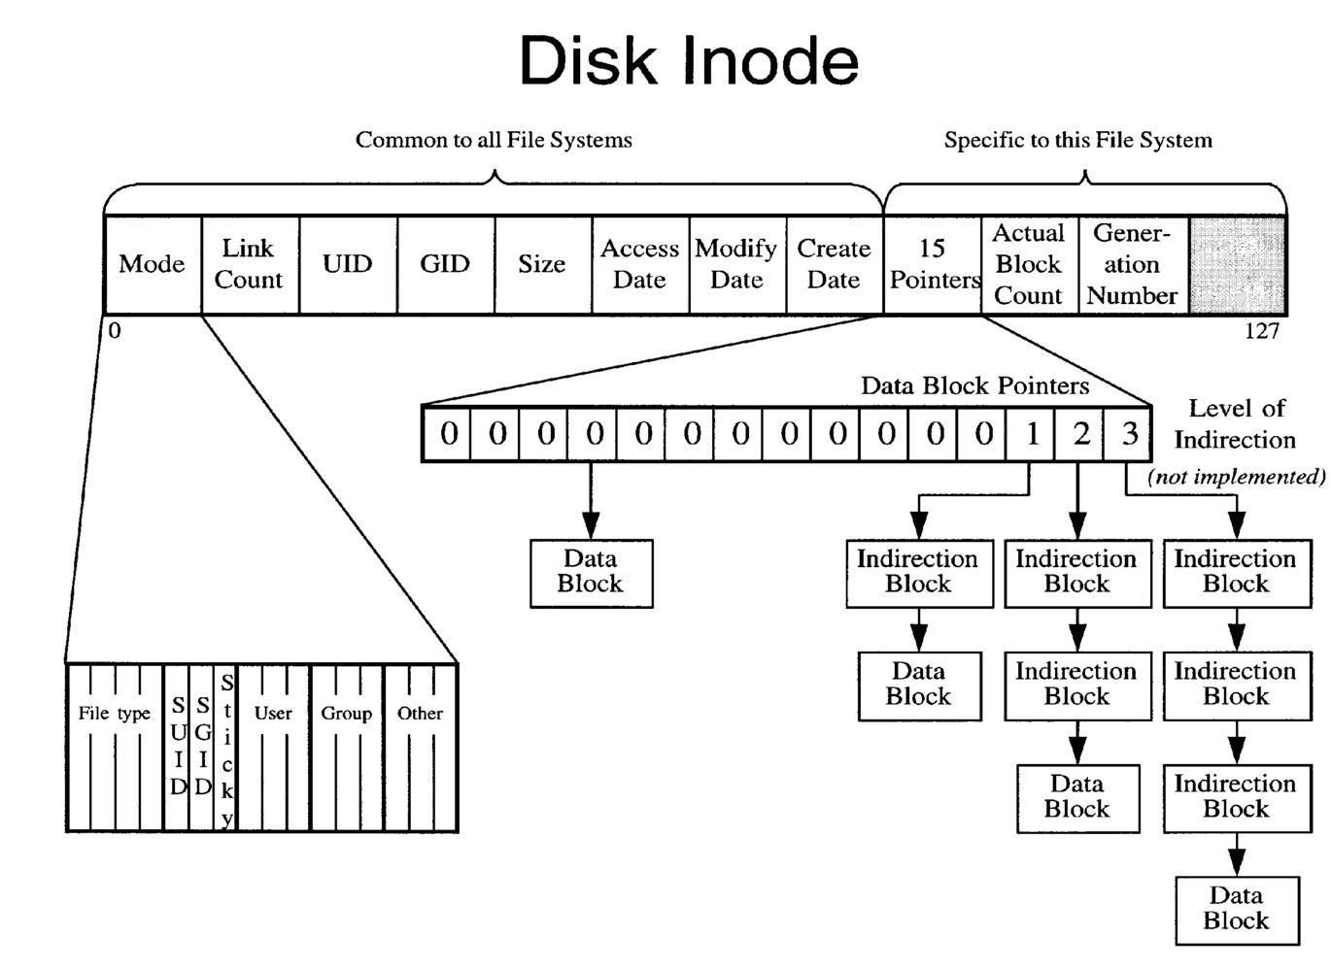
What goes inside a inode??
See the following for more details: http://man7.org/linux/man-pages/man7/inode.7.html
Ref: UCLA, cs111 sp 14 lec 12b

Slide 19
Inode’s Features: Protection
File owner/creator should be able to control:
what can be done
by whom
Types of access
Read
Write
Execute
Append
Delete
List

Slide 20
Access Lists and Groups
Mode of access: read, write, execute
Three classes of users
RWX
a) owner access 7 ⇒ 1 1 1 RWX
b) group access 6 ⇒ 1 1 0
RWX
c) public access 1 ⇒ 0 0 1
Ask manager to create a group (unique name), say G, and add some users to the group.
For a particular file (say game) or subdirectory, define an appropriate access.
owner
group
public
chmod
761
game
Attach a group to a file: chgrp G game

Slide 21
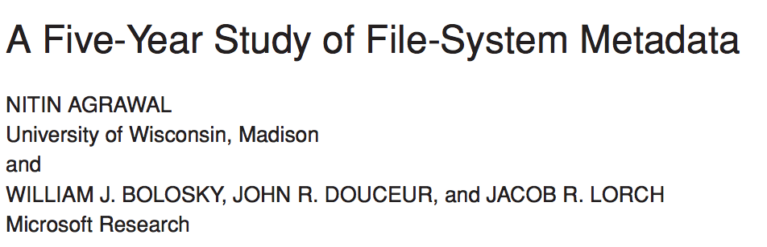
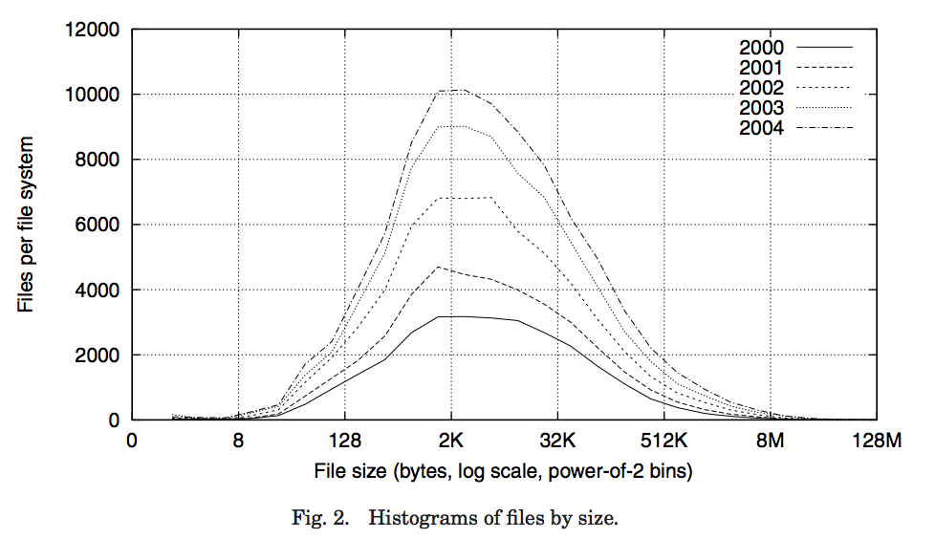
Characteristics of Files
Observations:
Most files are small
Most of the space is occupied by the rare big ones

Slide 22
Does this help deciding the inode structure?
file_number

Slide 23
FFS: Data Storage
Small files: 12 pointers direct to data blocks
Direct pointers
With 4kB blocks, sufficient
For files up to 48KB

Slide 24
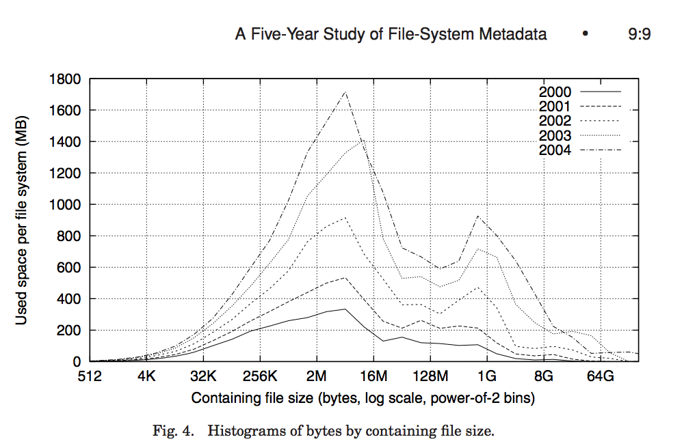
FFS: Data Storage
Large files: 1,2,3 level indirect pointers
Indirect pointers
- point to a disk block
containing only pointers
- eg. 4 kB blocks => 1024 pointers
=> 4 MB @ level 2
=> 4 GB @ level 3
=> 4 TB @ level 4
48 KB
+4 MB
+4 GB
+4 TB

Slide 25
Device Files and inodes
How to handle device files (e.g., terminal input, output, printer)?
Inode # | Filename
123 | Foo.zip
2 | Bar.txt
47 | newfile
… | …
100 | tty
Disk
data
data
code
data
code
data
Inode’s for device files and regular files are different:
They both point to disk blocks
However, device files’ inodes point to device driver code instead of regular data blocks

Slide 26
Links
Hard link
Directory entry contains the inode number
Creates another name (path) for the file
Each is “first class”
Soft link or Symbolic Link
Directory entry contains the name of the file
Map one name to another name

Slide 27
Hard Links
directory entry in /dirA
inode
name
directory entry in /dirB
12345
name1
inode
name
12345
name2
inode 12345
block 23567
…
“some text in the file…”
1
…
2
23567
…
shell command
ln /dirA/name1 /dirB/name2
is typically implemented using the link system call:
#include <stdio.h>
#include<unistd.h>
if (link(“/dirA/name1”, “/dirB/name2”) == -1)
perror(“failed to make new link in /dirB”);
Notes:
Create an entry called “name2” in “dirB” containing a pointer to the same inode as “/dirA/name1”

Slide 28
Hard Links: unlink
directory entry in /dirA
directory entry in /dirB
inode
name
inode
name
12345
name1
12345
name2
inode 12345
block 23567
…
“some text in the file…”
0
1
2
…
23567
#include <stdio.h>
#include<unistd.h>
if (unlink(“/dirA/name1”) == -1)
perror(“failed to delete link in /dirA”);
…
if (unlink(“/dirB/name2”) == -1)
perror(“failed to delete link in /dirB”);

Slide 29
Symbolic (Soft) Links
directory entry in /dirA
directory entry in /dirB
inode
name
inode
name
12345
name1
13579
name2
Only count
hard links!
inode 12345
inode 13579
block 23567
block 3546
…
“some text in the file…”
…
“/dirA/name1”
1
1
…
…
23567
3546
…
…
shell command
ln -s /dirA/name1 /dirB/name2
is typically implemented using the link system call:
#include <stdio.h>
#include<unistd.h>
if (symlink(“/dirA/name1”, “/dirB/name2”) == -1)
perror(“failed to create symbolic link in /dirB”);
Notes:
“symbolic link” is basically a file containing the name of another file.

Slide 30
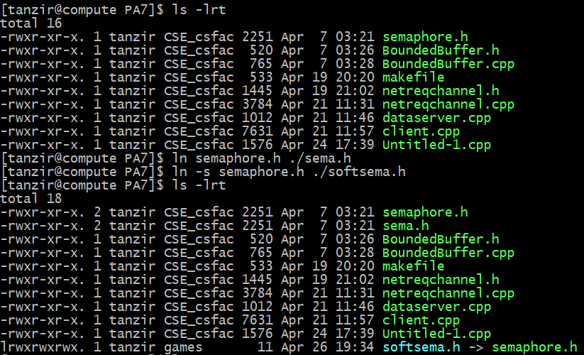
Links: Example

Slide 31
Files: Big Picture
User Space
Kernel Space
Physical Drive
Desc Table
File Table
V-node Table
Process PID: 1412
inode
data
data
data
Mode Offset vNod ptr Refcount
Type Access Size Refcnt
Inode
1520
read
reg
0
0
1
Process PID: 1520
2
3
1
2
Mode Offset vNod ptr Refcount
1412
write
10
0
1
2
1
3

