Slide 1
Computer Networks
Tanzir Ahmed CSCE 313 Fall 2020

Slide 2
Acknowledgments
TAMU CSCE 313 Lecture Notes in Networking
Acknowledgment: Profs Gu, Bettati, Tyagi
RICE COMP 221 Lecture Notes in Networking
Acknowledgment: Prof. Cox
U-Illinois CS241 Lecture Notes in Networking
Acknowledgment: Prof. Angrave
Beej’s Guide to Network Programming, Ver. 3.0.15
Socket Programming 101
Acknowledgment: Vivek Ramachandran
U-Wisconsin CS-354 Lecture Notes in Networking
Acknowledgment: Prof. Arpaci-Dusseau

Slide 3
Objectives
Exposure to the basic underpinnings of the Internet
Use network socket interfaces effectively

Slide 4
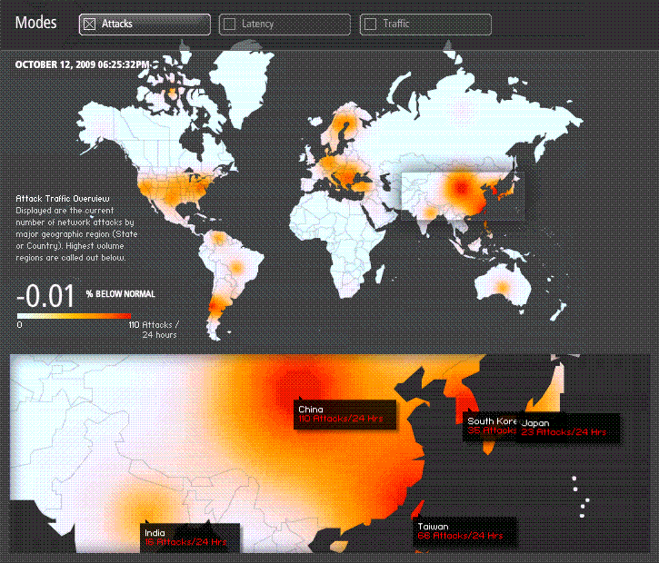
Network Security is a Massive Issue...
Daily, e.g. 110 attacks from China; 26 attacks from USA
2/2016 Hackers dumped the records of nearly 30,000 FBI and Department of Homeland Security workers.
1/2017 Hacking/Surveillance company Cellebrite lost 900GB of user data to a hacker
9/2018 Facebook security breach exposes personal data of 50M users
Source: Akamai Technologies, Inc.
4

Slide 5
Bottom-Line…..
Internet is a ubiquitous presence in our lives
Issues such as Security Lapses present themselves as opportunities for making our ways of communication more robust
Let’s now trace back the history from the early days of telephony in the next few slides

Slide 6
Telephony
Interactive telecommunication between people
Analog voice
Transmitter/Receiver continuously in contact with electronic circuit
Electric current varies with acoustic pressure
Analog/Continuous Signal
Cox
Networking
6

Slide 7
Telephony Milestones
1876: Alexander Bell invented telephone
1878: Public switches installed at New Haven and San Francisco, public switched telephone network is born
People can talk without being on the same wire!
Without Switch
With Switch
Cox
Networking
7

Slide 8
Telephony Milestones
1937: Multiplexing introduced for inter-city calls
One link carries multiple conversations
With Multiplexing
Without Multiplexing
Cox
Networking
8

Slide 9
Data or Computer Networks
Networks designed for computers to computers or devices
vs. communication between human beings
Digital information
vs. analog voice
Not a continuous stream of bits, rather, discrete “packets” with lots of silence in between
Dedicated circuit hugely inefficient
Digital/Discrete Signal
Cox
Networking
9

Slide 10
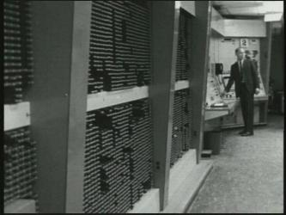
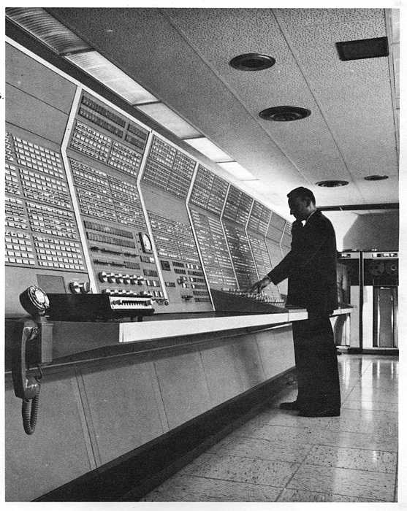
Major Internet Milestones
1960-1964 Basic concept of “packet switching” was independently developed by Baran (RAND), Kleinrock (MIT)
1965 First time two computers talked to each other using packets (Roberts, MIT; Marill, SDC)
dial-up
MIT TX-2
SDC Q32
Cox
Networking
10

Slide 11
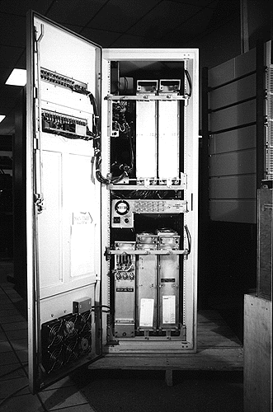
Major Internet Milestones
1968 BBN group proposed to use Honeywell 516 mini-computers for the Interface Message Processors (i.e. packet switches)
1969 The first ARPANET message transmitted
between UCLA (Kleinrock) and SRI (Engelbart)
We sent an “L”, did you get the “L”? Yep!
We sent an “O”, did you get the “O”? Yep!
We sent a “G”, did you get the “G”?
An hour later, the first message “login” was successfully transmitted
Crash!
Cox
Networking
11

Slide 12
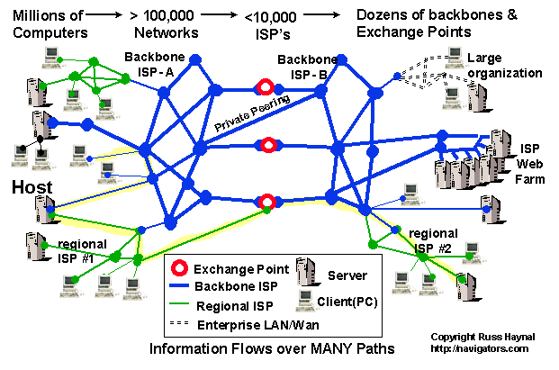
Current Internet Architecture - Conceptual
Cox
Networking
12

Slide 13
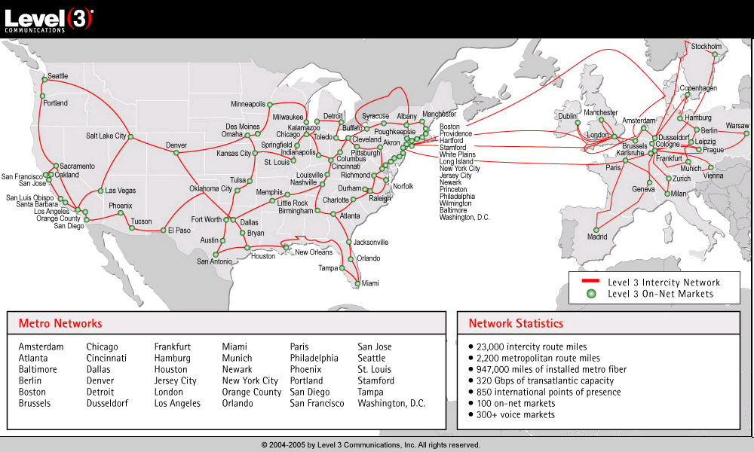
Level 3 Backbone
Cox
Networking
13

Slide 14
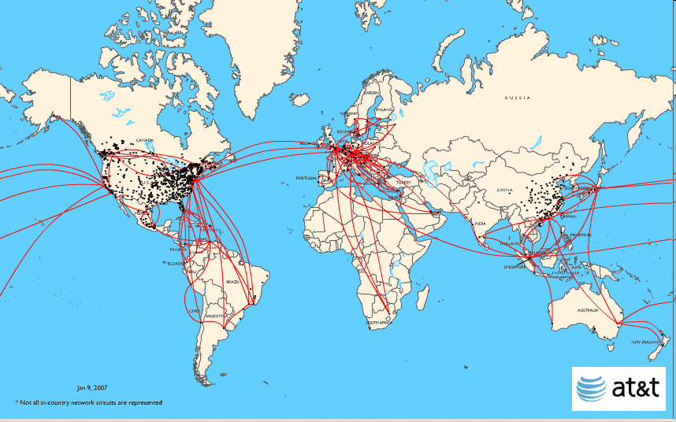
AT&T Backbone
Cox
Networking
14

Slide 15
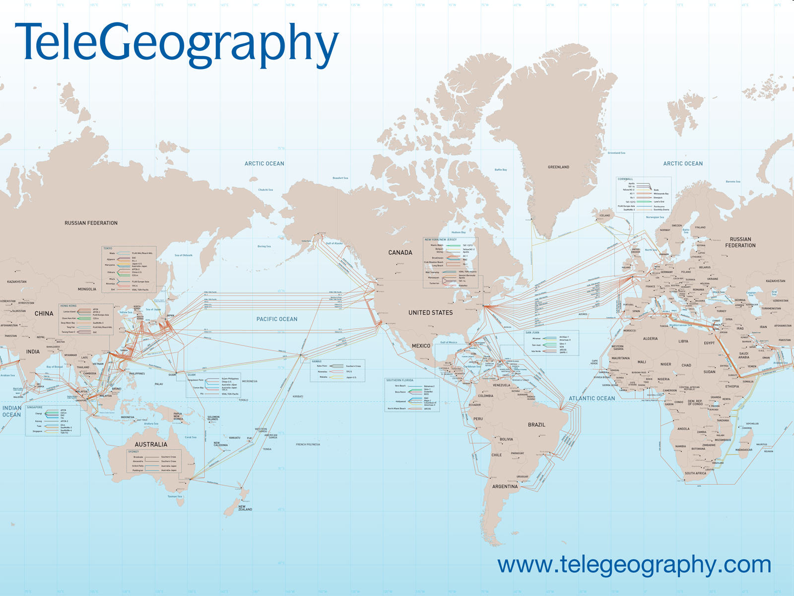
Submarine Cabling
Cox
Networking
15

Slide 16
A Client-Server Transaction
Most network applications are based on the client-server model:
A server process and one or more client processes
Server manages some resource
Server provides service by manipulating resource for clients
1. Client sends request
Client
process
Server
process
Resource
4. Client
handles
response
3. Server sends response
2. Server
handles
request
Note: clients and servers are processes running on hosts
(can be the same or different hosts)
Cox
Networking
16

Slide 17
Computer Networks
A network is a hierarchical system of boxes and wires organized by geographical proximity
Cluster network spans cluster or machine room
Switched Ethernet, Infiniband, …
LAN (local area network) spans a building or campus
Ethernet is most prominent example
WAN (wide-area network) spans very long distance
A high-speed point-to-point link
Leased line or SONET/SDH circuit, or MPLS/ATM circuit
An internetwork (internet) is an interconnected set of networks
The Global IP Internet (uppercase “I”) is the most famous example of an internet (lowercase “i”)
Cox
Networking
17

Slide 18
Lowest Level of Connectivity: Ethernet Segment
Ethernet segment consists of a collection of hosts connected by wires (twisted pairs) to a hub
Operation
Each Ethernet adapter has a unique 48-bit address
Hosts send bits to any other host in chunks called frames
Hub copies each bit from each port to every other port
Every host sees every bit
Note: Hubs are largely obsolete
Bridges (switches, routers) became cheap enough to replace them (don’t broadcast all traffic)
host
host
host
100 Mb/s
100 Mb/s
hub
ports
Cox
Networking
18

Slide 19
Next Level: Bridged Ethernet Segment
Bridges cleverly learn which hosts are reachable from which ports.
After that, any incoming packet is stored temporarily in incoming port buffer and then selectively copied into outgoing port (store-and-forward paradigm)
host
host
host
host
host
hub
bridge
hub
100 Mb/s
100 Mb/s
1-10 Gb/s
host
host
host
1 Gb/s
bridge
1 Gb/s
bridge
host
1 Gb/s
host
host
host
Cox
Networking
19

Slide 20
Conceptual View of LANs
For simplicity, hubs, bridges, and wires are often shown as a collection of hosts attached to a single wire:
host
host
...
host
Cox
Networking
20

Slide 21
Next Level: internets
Multiple incompatible LANs can be physically connected by specialized computers called routers
The connected networks are called an internet
host
host
...
host
host
host
...
host
LAN 1
LAN 2
router
router
router
WAN
WAN
LAN 1 and LAN 2 might be completely different, totally incompatible LANs (e.g., Ethernet and WiFi, 802.11*, T1-links, DSL, …)
Cox
Networking
21

Slide 22
The Notion of an Internet Protocol
How is it possible to send bits across incompatible LANs and WANs?
Solution: protocol software running on each host and router smoothens out the differences between the different networks
Implements an internet protocol (i.e., set of rules) that governs how hosts and routers should cooperate when they transfer data from network to network
TCP/IP is the protocol for the global IP Internet
Cox
Networking
22

Slide 23
What Does an Internet Protocol Do?
1. Provides a naming scheme
An internet protocol defines a uniform format for host addresses
Each host (and router) is assigned at least one of these internet addresses that uniquely identifies it
2. Provides a delivery mechanism
An internet protocol defines a standard transfer unit (packet)
Packet consists of header and payload
Header: contains info such as packet size, source and destination addresses
Payload: contains data bits sent from source host
Cox
Networking
23

Slide 24
Transferring Data Over an internet
Host A
Host B
client
server
(1)
data
(8)
data
protocol
software
protocol
software
internet packet
(2)
data
PH
FH1
(7)
data
PH
FH2
LAN1 frame
LAN1
adapter
LAN2
adapter
Router
(3)
data
PH
FH1
(6)
data
PH
FH2
LAN1
adapter
LAN2
adapter
LAN1
LAN2 frame
LAN2
(4)
data
PH
FH1
(5)
data
PH
FH2
protocol
software
Cox
Networking
24

Slide 25
Other Issues
We are glossing over a number of important questions:
What if different networks have different maximum frame sizes? (segmentation)
How do routers know where to forward frames?
How are routers informed when the network topology changes?
What if packets get lost?
We’ll leave the discussion of these question to computer networking classes
→ CSCE 463
Networking
25

Slide 26
Some games
HTTP
FTP
PA6
Global IP Internet
TCP
UDP
Based on the TCP/IP protocol family
IP (Internet protocol) :
Provides basic naming scheme and unreliable delivery capability of packets (datagrams) from host-to-host
UDP (User Datagram Protocol)
Uses IP to provide unreliable datagram delivery from process-to-process
TCP (Transmission Control Protocol)
Uses IP to provide reliable byte streams from process-to-process over connections
Accessed via a mix of Unix file I/O and functions from the sockets interface
IP
Cox
Networking
26

Slide 27
Organization of an Internet Application
Internet client
Internet server
Client
User code
Server
Sockets interface
(system calls)
TCP/IP
Kernel code
TCP/IP
Hardware interface
(interrupts)
Network
adapter
Hardware
and firmware
Network
adapter
Global IP Internet
Cox
Networking
27

Slide 28
A Programmer’s View of the Internet
Hosts are mapped to a set of 32-bit IP addresses
e.g. 128.194.255.88 (4 * 8 bits)
A set of identifiers called Internet domain names are mapped to the set of IP addresses for convenience (Domain Name Server aka DNS)
linux2.cs.tamu.edu is mapped to 128.194.138.88
A process on one Internet host can communicate with a process on another Internet host over a connection
28

Slide 29
IP Addresses
32-bit IP addresses are stored in an IP address struct
IP addresses are always stored in memory in network byte order (big-endian byte order)
True in general for any integer transferred in a packet header from one machine to another
E.g., the port number used to identify an Internet connection
/* Internet address structure */
struct in_addr {
unsigned int s_addr; /* network byte order (big-endian) */
};
Handy network byte-order conversion functions:
htonl: convert long int from host to network byte order
htons: convert short int from host to network byte order
ntohl: convert long int from network to host byte order
ntohs: convert short int from network to host byte order
Cox
29

Slide 30
Dotted Decimal Notation
By convention, each byte in a 32-bit IP address is represented by its decimal value and separated by a period
IP address 0x8002C2F2 = 128.2.194.242
Functions for converting between binary IP addresses and dotted decimal strings:
inet_pton: converts a dotted decimal string to an IP address in network byte order
inet_ntop: converts an IP address in network by order to its corresponding dotted decimal string
“n” denotes network representation, “p” denotes presentation representation
Cox
Networking
30

Slide 31
IP Address Structure
IP (V4) Address space divided into classes:
Special Addresses for routers and gateways (all 0/1’s)
Loop-back address: 127.0.0.1
Unrouted (private) IP addresses:
10.0.0.0/8, 172.16.0.0/12, 192.168.0.0/16
Dynamic IP addresses (DHCP)
0 1 2 3 8 16 24 31
Class A
0
Net ID
Host ID
Class B
1
0
Net ID
Host ID
Class C
1
1
0
Net ID
Host ID
Class D
1
1
1
0
Multicast address
Class E
1
1
1
1
Reserved for experiments
Cox
Networking
31

Slide 32
Internet Domain Names
unnamed root
.net
.edu
.gov
.com
First-level domain names
mit
tamu
berkeley
amazon
Second-level domain names
cse
build
128.194.4.169
www
72.21.210.11
Third-level domain names
linux2
128.194.138.88
compute
128.194.138.138
Cox
Networking
32

Slide 33
Domain Naming System (DNS)
The Internet maintains a mapping between IP addresses and domain names in a huge worldwide distributed database called DNS
Conceptually, programmers can view the DNS database as a collection of millions of addrinfo structures:
Functions for retrieving host entries from DNS:
getaddrinfo: query DNS using domain name or IP
getnameinfo: query DNS using sockaddr struct
struct addrinfo {
int ai_flags; /* flags for getaddrinfo */
int ai_family; /* address type (AF_INET or AF_INET6) */
int ai_socktype; /* the socket type */
int ai_protocol; /* the type of protocol */
size_t ai_addrlen; /* length of ai_addr */
struct sockaddr *ai_addr; /* pointer to a sockaddr struct */
char *ai_canonname;/* the canonical name */
struct addrinfo *ai_next; /* pointer to the next addrinfo struct */
};
Cox
Networking
33

Slide 34
Properties of DNS Host Entries
Each host entry is an equivalence class of domain names and IP addresses
Each host has a locally defined domain name localhost which always maps to the loopback address 127.0.0.1
Different kinds of mappings are possible:
Simple case: 1 domain name maps to one IP address
Multiple domain names mapped to the same IP address
Multiple domain names mapped to multiple IP addresses
Some valid domain names don’t map to any IP address
Cox
Networking
34

Slide 35
Querying DNS
Domain Information Groper (dig) provides a scriptable command line interface to DNS
Lots of web interfaces (google “domain information groper”)
unix> dig +short linux2.cse.tamu.edu
128.194.138.88
unix> dig +short -x 128.194.138.85
chevron.cs.tamu.edu.
unix> dig +short google.com
74.125.227.174
74.125.227.169
74.125.227.160
35

Slide 36
Internet Connections
Clients and servers communicate by sending streams of bytes over connections:
Point-to-point, full-duplex (2-way communication), and reliable
A socket is an endpoint of a connection
Socket address is an IP address and port pair
A port is a 16-bit integer that identifies a process:
Ephemeral port: Assigned automatically on client when client makes a connection request
Well-known port: Associated with some service provided by a server (e.g., port 80 is associated with Web servers)
A connection is uniquely identified by the socket addresses of its endpoints (socket pair)
(cliaddr:cliport, servaddr:servport)
Cox
Networking
36

Slide 37
Putting it all Together: Anatomy of an Internet Connection
Client socket address
128.2.194.242:51213
Server socket address
208.216.181.15:80
Client
Server
(port 80)
Connection socket pair
(128.2.194.242:51213, 208.216.181.15:80)
Client host address
128.2.194.242
Server host address
208.216.181.15
Cox
Networking
37

Slide 38
Prerequisites for an Internet Connection
There must be a network path between the Client and the Server
For instance, there is a path between your cell phone and your computer residing in the same WiFi network
A path between your desktop and google.com
Firewalls could artificially block network paths
Path between off-campus computer and build.tamu.edu is blocked by system admins

Slide 39
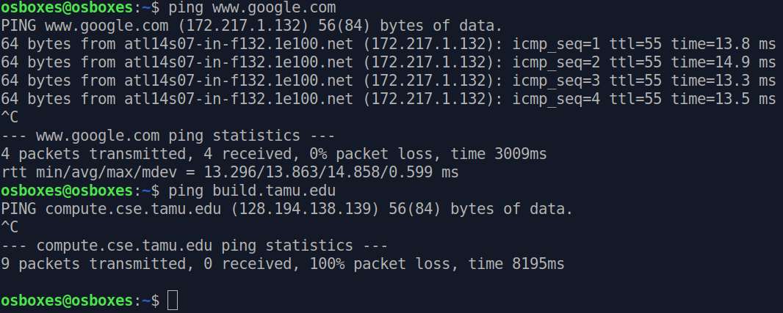
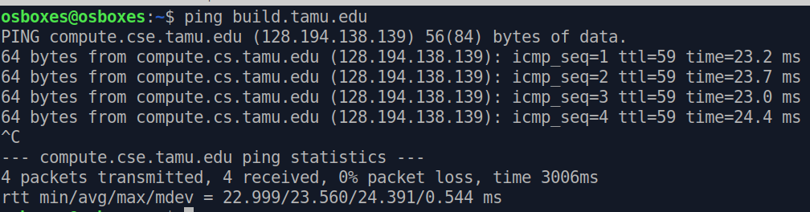
Testing for Network Paths
ping command
Tests if you can reach another host
Example 1: From off-campus (w/o VPN)
Example 2: Now with VPN connected

Slide 40
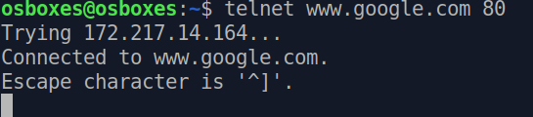
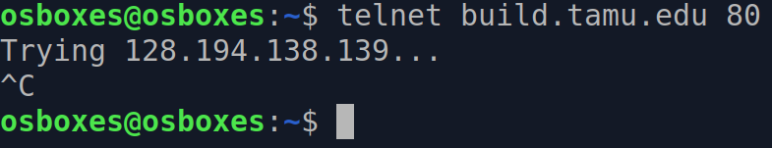
TCP Connectivity in the Path
telent command
A built in TCP client, used to check server existence or connection ability
Tests if you can make a TCP connection to a server port
Example 1: Connecting to port 80 (HTTP server) of google
Example 2: Connecting to port 80 of build.tamu
Connection not possible because:
No service at port 80
Even if it had, firewall does not allow

Slide 41
Clients
Examples of client programs
Web browsers, ftp, telnet, ssh
How does a client find the server?
The IP address in the server socket address identifies the host (more precisely, an adapter on the host)
The (well-known) port in the server socket address identifies the service, and thus implicitly identifies the server process that performs that service
Cox
Networking
41

Slide 42
Servers
Servers are long-running processes (daemons)
Created at boot-time (typically) by the init process (process 1)
Run continuously until the machine is turned off
Each server waits for requests to arrive on a well-known port associated with a particular service
Port 23: telnet server
Port 25: mail server
Port 80: HTTP server
A machine that runs a server process is also often referred to as a “server”
Cox
Networking
42

Slide 43
Server Examples
Web server (port 80)
Resource: files/compute cycles (CGI programs)
Service: retrieves files and runs CGI programs on behalf of the client
FTP server (20, 21)
Resource: files
Service: stores and retrieve files
Telnet server (23)
Resource: terminal
Service: proxies a terminal on the server machine
Mail server (25)
Resource: email “spool” file
Service: stores mail messages in spool file
See /etc/services for a comprehensive list of the services available on a UNIX machine
Cox
Networking
43

Slide 44
Organization of an Internet Application
Internet client
Internet server
Client
User code
Server
Sockets interface
(system calls)
TCP/IP
Kernel code
TCP/IP
Hardware interface
(interrupts)
Network
adapter
Hardware
and firmware
Network
adapter
Global IP Internet
Cox
Networking
44

Slide 45
OSI Model (Layers)
Client
Server
Application
Application
Transport
Router
Transport
Network
Network
Network
Data Link
Data Link
Data Link
Physical
Physical
Physical
Intra/Internet

Slide 46
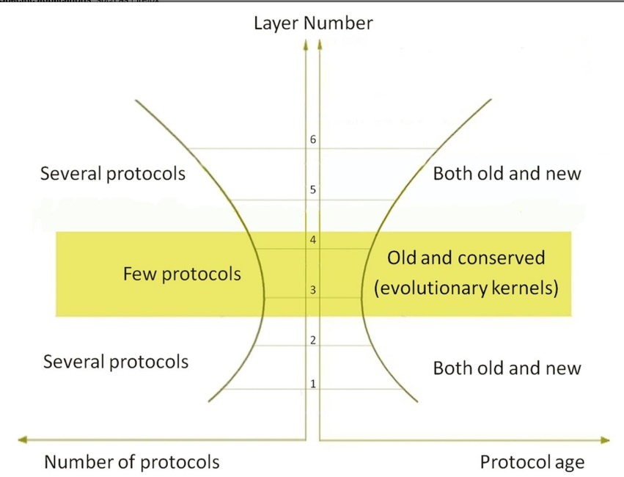

Internet Hourglass Architecture
Email, Web, ssh,...
TCP, UDP, …
Source: GATECH Internet Hourglass Architecture
IP
From top to bottom, the Internet architecture consists of six layers:
Specific applications, such as Firefox;
Application protocols, such as Hypertext Transfer Protocol (HTTP);
Transport protocols, such as Transmission Control Protocol (TCP);
Network protocols, such as Internet Protocol (IP);
Data-link protocols, such as Ethernet; and
Physical layer protocols, such as DSL.
Layers near the top and bottom contain many items, called protocols.
The central transport layer contains two protocols
and the network layer contains only one, creating an hourglass architecture.
Ethernet, WiFi,
3G, bluetooth,...
46

Slide 47
A Server-Client Interaction in TCP – POSIX Functions
Server
socket()
bind()
listen()
Client
Blocks until connection attempt received
socket()
accept()
connect()
Establish connection
Data(request)
Recv()
send()
Data(reply)
send()
recv()
close()
close()

Slide 48
A Closer Look into POSIX Functions
getaddrinfo()
socket()
bind()
listen()
accept()
connect()
write(), send(), sendto()
read(), recv(), recvfrom()
close()

Slide 49
Data Structures

Slide 50
getaddrinfo() – Looking Up IP address from name
The first step to locate a server by the client
Converts easy-to-remember DNS names (e.g., linux.cs.tamu.edu) into machine-usable IP address
Queries DNS servers (a collection of mappings)
int getaddrinfo(char* name, char* port, struct addrinfo* hints, struct addrinfo** result);
name = name of the host
port = the port where the service (e.g., http, your data server in MP6) is running
hints = provides some initial hint (IPv4/IPv6, TCP/UDP etc.)
result = linked list of looked up addresses
Example:
getaddrinfo("www.example.com", "3490", &hints, &res);

Slide 51
getaddrinfo() - Detailed

Slide 52
socket() – A Connection End Point
Creates a communication end-point for a network connection
int socket (int domain, int type, int protocol)
domain = PF_INET (IPv4) / PF_INET6 (IPv6)
type = SOCK_STREAM (TCP) / SOCK_DGRAM (UDP)
protocol = 0
Example:
s = socket (PF_INET, SOCK_STREAM, 0)
will create a TCP socket
The above call returns -1 on failure

Slide 53
connect() – Client Attempting Server Connection
This is called by the client to attempt a connection with the server
Blocks until the server accepts it
int connect(int sockfd, struct sockaddr* server, socketlen_t server_len)
Sockfd: socket variable prepared beforehand
server = address of the server (returned by getaddrinfo)
Example:
getaddrinfo("www.example.com", "3490", &hints, &res); // lookup
// make a socket:
sockfd = socket(res->ai_family, res->ai_socktype, res->ai_protocol);
// connect to server. Once successful, the socket becomes ready as the endpoint
connect(sockfd, res->ai_addr, res->ai_addrlen);

Slide 54
close() – Close a Session
Called by both the client and the server
Signals end of a communication
Internally, frees resources associated with a connection
Important for busy servers, also for PA6 int close(int sock)
Example:
close (sock)

Slide 55
bind() – Server Attaching to a Port
A server process calls this to associate its socket to a given port
Port number is used by the kernel to forward an incoming packet to a certain process (its socket)
int bind(int sockfd, struct sockaddr* addr, socketlen_t addrlen)
Example:

Slide 56
listen() – Setting up Server
This is a prerequisite before a connection is accepted
Incoming connections wait in a queue before accepted, listen () sets the size of that queue
int listen(int sockfd, int backlog)
Example:

Slide 57
accept() – Server Accepting Client Connection
This is called by the server to accept a new client connection
int accept(int sockfd, struct sockaddr* client, socketlen_t client_len)
sockfd = socket
client = will hold the client address details
client_len = address length
Example:

Slide 58
send()/recv() – Finally Data
Called by both client and server to exchange data
Blocks until the server accepts it
int send(int sock, void* msg, size_t len, int flags)
int recv(int sock, void* msg, size_t len, int flags)
Msg = buffer pointer to send/receive data from/to
Len = sender: length of the message, receiver: buffer capacity (to avoid overflow)
Example:
char *send_msg = "a sample message";
int sent_bytes = send (sockfd, send_msg, strlen (send_msg)+1, 0);
char recv_buffer [1024];
int recv_len = recv (sockfd, recv_buffer, 1024, 0);

Slide 59
