Slide 1
Security
CSCE 313 Fall 2020
Tanzir Ahmed

Slide 2
Outline
Overview
Security Goals
The Attack Space
Security Mechanisms
Introduction to Cryptography
Authentication
Authorization
Confidentiality
Case Studies

Slide 3

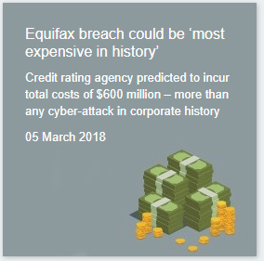

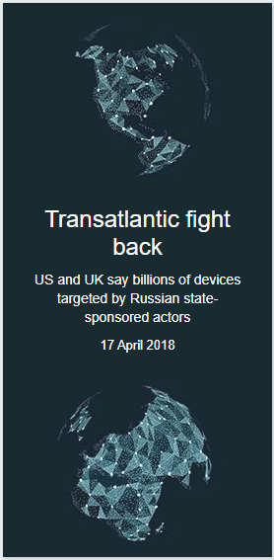
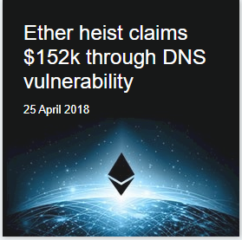
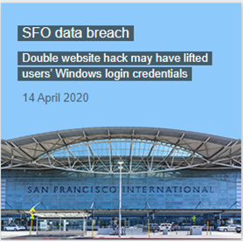
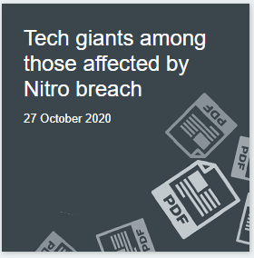
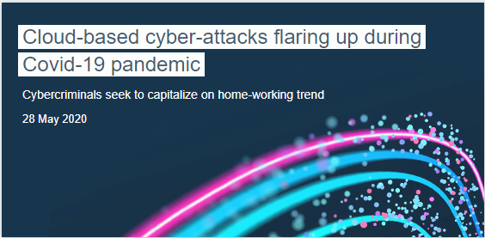
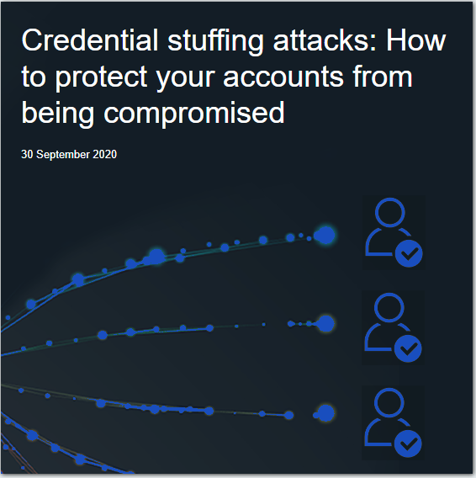
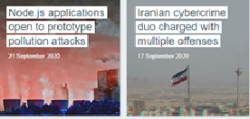
Security Today…
Source: https://portswigger.net/daily-swig/cyber-attacks

Slide 4
Typical Attacks: Penetration Attempts
Two basic forms:
completely bypass authentication mechanism
obtain information or alter the system so as to enter system as authorized user
Attempts:
Wire tapping (active vs. passive)
Trial and error
Browsing
Search storage (in particular, previously allocated, but now available) for unauthorized information.
Trap doors
Unspecified and undocumented features of the system that may be exploited to perform unauthorized actions.
Trojan horse

Slide 5
Wire-Tapping: Passive
Eavesdropping or monitoring communication between legitimate users
This is damaging because it may lead to:
Release of information
Traffic analysis to determine location, identity or communication pattern for further attacks
Difficult to detect
However, easily prevented through encryption

Slide 6
Active Attacks
Also known as Man-In-The-Middle attacks
Involves some modification of the communication
Can be divided into 4 categories:
Masquerading
Replaying
Altering message
Denial of service
Active attacks pose opposite challenges compared to passive ones:
Easy to detect, harder to prevent
The goal is more towards damage control and recovering quickly from such attacks

Slide 7
Active Attacks
Masquerading – impersonating to be someone else by replaying captured messages
Replaying – for instance, transferring 10$, 1000 times instead of just once
Altering message – changing a 10$ transfer request to a 10M$ request
Denial of service
Kill all communication directed to the audit service
Pretend to be legitimate customers from many different locations and thus, disrupt or slowdown services provided to actual users

Slide 8
Active Attack: Example I
Active wire tapping
Modify data being transmitted
Example:
user
intruder
server
X
Intruder
takes over
identity of user
(masquerading)
logoff!
fine!

Slide 9
Active Attack: Example II
Active wire tapping
Modify data being transmitted
Example:
user
intruder
malicious server
server
Authenticate Server
X
logoff!
Intruder redirects traffic to malicious server

Slide 10
Security Threats
Information Disclosure:
unauthorized dissemination of information
result of theft or illegal action of who has access to information
Information Destruction:
loss of internal data structures
loss of stored information
information may be destroyed without being disclosed
Unauthorized Use of Service:
bypass system accounting policies
unauthorized use of some proprietary services
Denial of Service:
prevent an authorized user from utilizing the system’s services in a timely manner

Slide 11

Security Goals
“Bob”
“Alice”
“Eve”
“Lucifer”
Authentication: Assurance that communicating entity’s identity is the same as he claims it to be
Authorization/Access Control: Determining who has access to what set of resources
Confidentiality Keeping the content of a request secret
Accountability Non-repudiation and preventing content modification
Availability: Immunity to DoS attacks

Slide 12
Security: Systems Overview
Functionality | Authentication | Authorization | Confidentiality
Primitives | sign() verify() | Access control lists Capabilities “magic cookies” | encrypt() decrypt()
Cryptography | cyphers and hashes

Slide 13
Cryptography
Functionality | Authentication | Authorization | Confidentiality
Primitives | sign() verify() | Access control lists Capabilities “magic cookies” | encrypt() decrypt()
Cryptography | cyphers and hashes
Cryptography:
Closed-Design vs. Open-Design Cryptography
Symmetric Encryption
Asymmetric (“Public-Key”) Encryption

Slide 14
Closed-Design Cryptography
The set of transformations (e.g., hash functions), their order, and any keys used are all kept secret
This sometimes could give a false sense of confidence, because often these can be either leaked or broken by brute-force
“Alice”
“crypto box”
(closed)
“de-crypto box”
(closed)
“Bob”

Slide 15
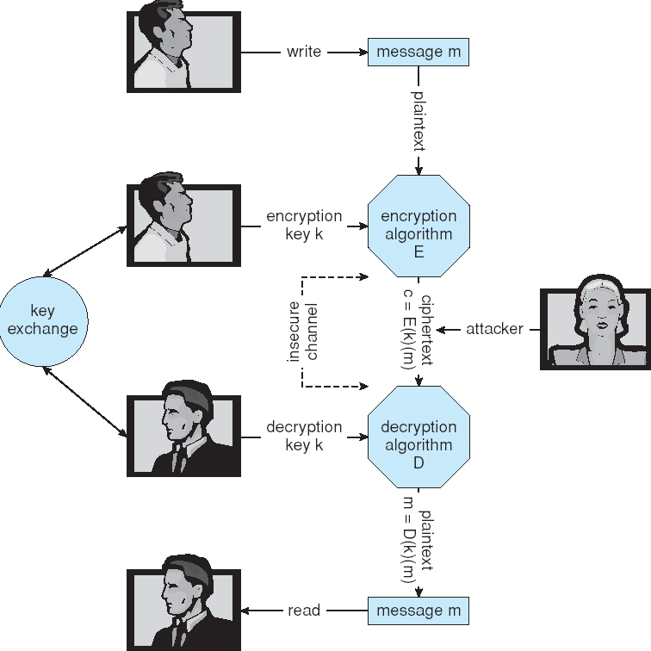
Open-Design Cryptography

Slide 16

Encryption
Encryption algorithm consists of
Set of K keys
Set of M Messages
Set of C ciphertexts (encrypted messages)
A function E : K → (M→C). That is, for each k ∈ K, E(k) is a function for generating ciphertexts from messages.
E(k) for any k should be efficiently computable functions.
A function D : K → (C → M). That is, for each k ∈ K, D(k) is a function for generating messages from ciphertexts.
D(k) for any k should be efficiently computable functions.
An encryption algorithm must provide this essential property:
Given a ciphertext c ∈ C, a computer can compute m such that E(k)(m) = c only if it possesses D(k).
Thus, a computer holding D(k) can decrypt ciphertexts to the plaintexts used to produce them, but a computer not holding D(k) cannot decrypt ciphertexts.
Since ciphertexts are generally exposed (for example, sent on the network), it is important that it be infeasible to derive D(k) from the ciphertexts

Slide 17
Symmetric Encryption
Same key used to encrypt and decrypt
E(k) can be derived from D(k), and vice versa
Examples:
Data Encryption Standard (DES)
Triple-DES
Advanced Encryption Standard (AES)

Slide 18
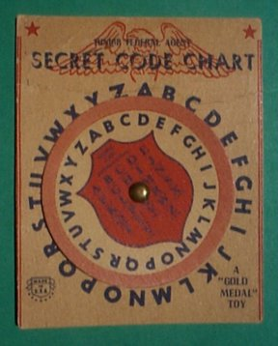
Symmetric Encryption: Caesar Cipher
MERRY CHRISTMAS
3
PHUUB FKULVWPDV

Slide 19
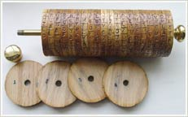
Symmetric Encryption: Jefferson’s Wheel Cipher
Sender:
assemble wheels in some (secret) order.
Align message on one line.
Choose any of the other lines as ciphertext.
Receive:
Assemble wheels in same secret order.
Align cipertext on one line.
Look for meaningful message on other lines.
Monticello Web Site: www.monticello.org/reports/interests/wheel_cipher.html

Slide 20
Symmetric Encryption: XOR
m
m ⊕ k
m ⊕ k
m ⊕ k ⊕ k = m
⊕
⊕
“Alice”
“Bob”
k
k
⊕ | 0 | 1
0 | 0 | 1
1 | 1 | 0

Slide 21
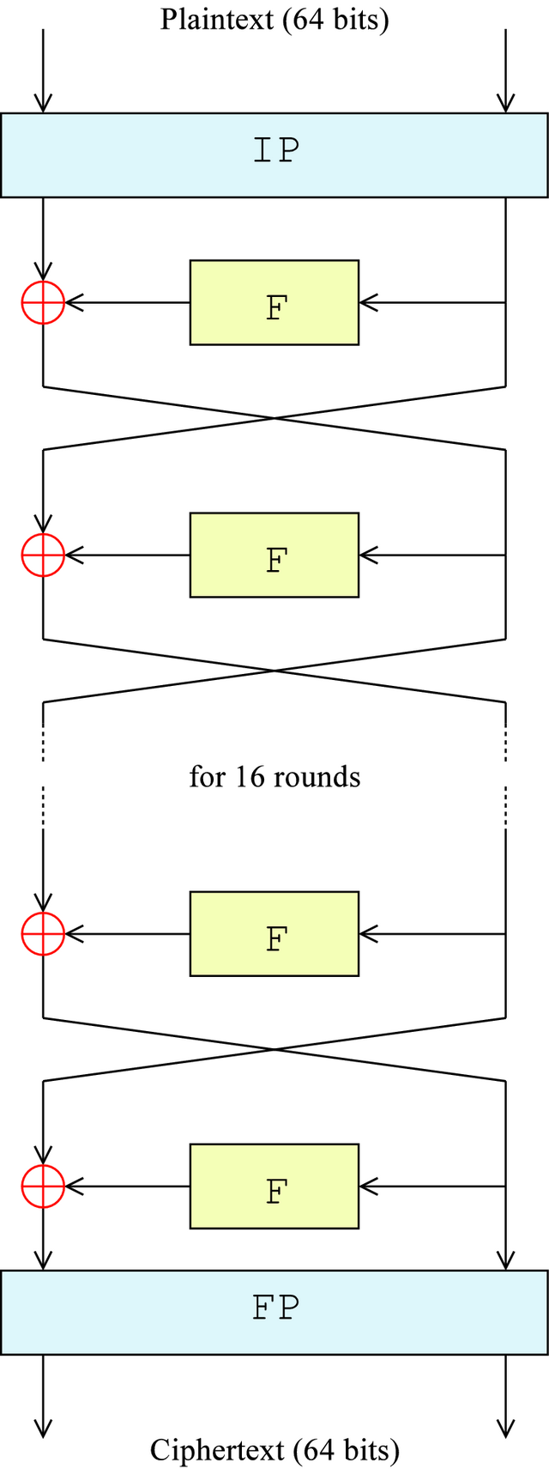
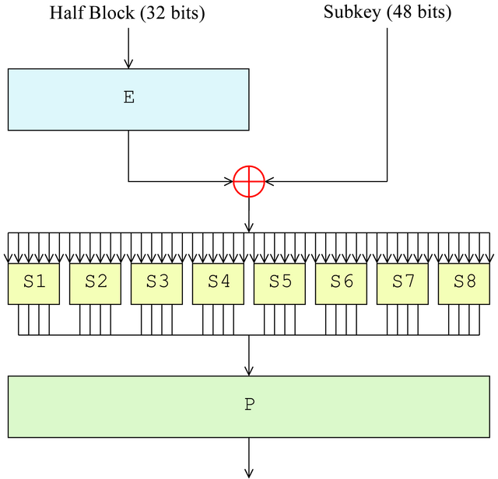
Symmetric Encryption: DES (Data Encryption Standard)
DES is a block cipher that transforms a fixed length (64-bit in this case) plain text to something else through a series of transformations
There are 16 rounds of Feistel function (F) applied to the data. In fact, Feistel applies only on the least significant (LS) 32 bits. The result is then XOR-ed with MS 32-bits and forms the LS 32 bits for the next round. The original LS 32 bits become XOR operand for the next round
Now, each F block uses a 48-bit subkey obtained using a key schedule for each round. The key-schedule is also kept secret
S-boxes (i.e., substitution boxes) replace the incoming 6 bits to 4 bits using a non-linear function, which is the core strength of DES’s security
W/o this, DES is trivial to break
Permutation works in way so that each output of S-box goes to a different S-box in next round
Permutation
Expansion
Substitution
Permutation
Reference: https://en.wikipedia.org/wiki/Data_Encryption_Standard
Permutation

Slide 22
Exchanging Key in Symmetric Encryption
The sender and the receiver need to share the secret key before even sending the first message.
But how to share the key securely?
Can you email it? That is clearly not safe
Can you hire a person to carry the key with him?
In any way, cannot assume that key to be shared confidentially through public channels
The person or the medium can be compromised
Can we exchange the key w/o compromising it?
Yes. Diffie-Hellman algorithm

Slide 23
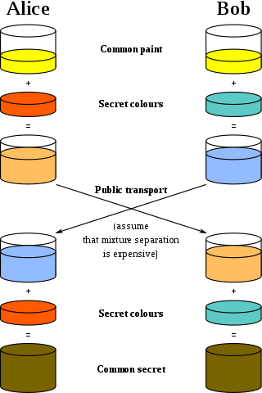
Key Exchange: Diffie-Hellman
1 | Alice and Bob agree on two numbers: a large prime called p a “primitive root” modulo p, call it g . Note: p and g are public
2 | Alice and Bob privately pick random integer x and y, respectively.
3 | Alice and Bob exchange X = g^{x} mod p and Y = g^{y} mod p, respectively.
4 | Alice and Bob privately compute k = Y^{x} mod p and k’ = X^{y} mod p, respectively.
Now, k = k’ mod p, since: k’ = X^{y} mod p= (g^{x})^{y} mod p = g^{xy} mod p = (g^{y})^{x} mod p= Y^{x} mod p = k
Scheme can be broken if Eve succeeds to solve the equation where g and p are known: X = g^{x} mod p This is very difficult for large p and impossible beyond certain size.
Notes:
“primitive root” for practical reasons. We want g^x to spawn a large set of numbers, in order to make computation of discrete logarithm difficult.
Definition of “primitive logarithm”: integer g is primitive root if for every X relatively prime to m there is an integer x that satisfies equation in slide.
For most integers, there is NO primitive root modulo n.
Man-in-the-Middle attack:
-- Lucifer can intercept messages from Alice to Bob and Bob to Alice.
-- Lucifer can separately do a Diffie-Hellman key exchange with Bob and with Alice.
-- Lucifer now can listen in to conversation between Alice and Bob, and maintain illusion for Alice and Bob that they are connected to each other.

Slide 24
Asymmetric Encryption
Keys must be different

Slide 25
Asymmetric Encryption (cont.)
Public-key encryption based on each user having two keys:
public key – published key used to encrypt data
private key – key known only to individual user used to decrypt data
Must be an encryption scheme that can be made public without leaking the decryption scheme
Most common is RSA block cipher
Efficient algorithms exist for testing whether a number is prime
No efficient algorithm is known for finding the prime factors of a number

Slide 26
RSA (cont)
If it is computationally infeasible to derive D(k_{d} , N) from E(k_{e} , N).
E(k_{e} , N) need not be kept secret and can be widely disseminated
E(k_{e} , N) is the public key
D(k_{d} , N) is the private key
N is the product of two large, randomly chosen prime numbers p and q (for example, p and q are 512 bits each)
Encryption algorithm is E(k_{e} , N)(m) = m^{ke} mod N, where k_{e} satisfies k_{e}k_{d} mod (p−1)(q −1) = 1
The decryption algorithm is then D(k_{d} , N)(c) = c^{kd} mod N
Notes:
Pick random number ke, relative prime to (p-1)(q-1)
Compute kd, such that ke*kd mod (p-1)(q-1) = 1

Slide 27
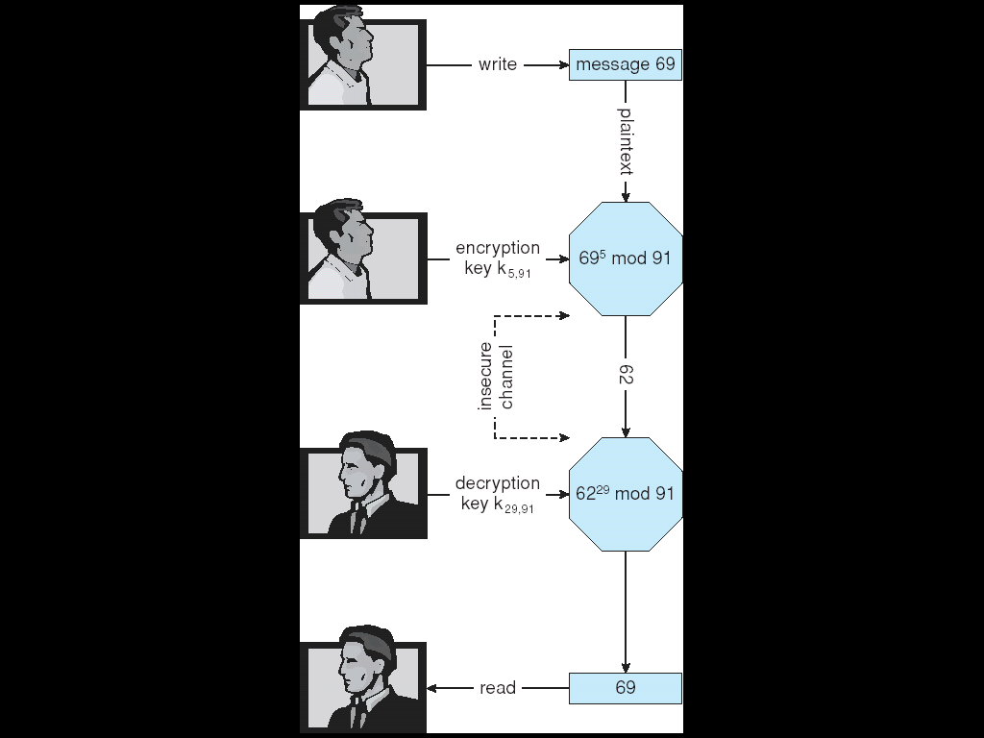
RSA: Example
Make p = 7 and q = 13
We then calculate N = 7∗13 = 91 and (p−1)(q−1) = 72
We next select k_{e} relatively prime to 72 and< 72, yielding 5
Finally, we calculate k_{d} such that k_{e}k_{d} mod 72 = 1, yielding 29
We how have our keys
Public key, (k_{e}, N) = (5, 91)
Private key, (k_{d}, N) = (29, 91)
Encrypting the message 69 with the public key results in the ciphertext 62
69⁵ mod 91 = 62
Ciphertext can be decoded with the private key
62²⁹ mod 91 = 69
Public key can be distributed in clear text to anyone who wants to communicate with holder of public key

Slide 28
RSA in Practice…
kApub, kApriv
kBpub, kBpriv
“Alice”
“Bob”
{m}^{kBpub}: A encrypts message with B’s public key.
{{m}^{kBpub}}^{kBpriv}: B decrypts message with B’s private key.

Slide 29
Symmetric vs. Asymmetric Encryption
Symmetric cryptography based on simple transformations
More practical to break in certain circumstances
Asymmetric based on time consuming mathematical functions
Asymmetric much more compute intensive
Typically not used for bulk data encryption
Used, instead, for short plaintexts, for example symmetric keys.

Slide 30
Authentication
Functionality | Authentication | Authorization | Confidentiality
Primitives | sign() verify() | Access control lists Capabilities “magic cookies” | encrypt() decrypt()
Cryptography | cyphers and hashes

Slide 31
Authentication
1. Who is making the request?
2. Is the received message the same as the sent message?
“Alice”
“Bob”
3. How do I build an audit trail?
Authentication
Message Integrity
Accountability / Non-Repudiation

Slide 32
Message Integrity
“Transfer $100 from account X to account Y”
“Bob”
“Lucifer”
“Alice”
modify
(replay)
reorder
append
Message Integrity can be guaranteed through Error-Detection Code. (e.g. cryptographic hash)
Message Integrity ≠ Authenticity ≠ Confidentiality

Slide 33
Authentication: Model
A(m)
m
m
Sign
Verify
m
“Alice”
YES/NO
“Bob”
k₁
k₂
Symmetric Encryption (k₁ = k₂):
A(m) is “message authenticator”
Asymmetric Encryption (k₁ != k₂):
First, it is infeasible to encrypt bulk messages with RSA. Therefore:
A(m) is “signature”
Example: A(m) = {Hash(m)}^{kApriv}
Cryptographically secure hash:
Prob(Hash(m) = Hash(m’)) is very low (“low collision prob.”)
SHA1, SHA256, etc.

Slide 34
Authentication: Sign() and Verify()
Algorithm components
A set K of keys
A set M of messages
A set A of authenticators
A function S : K → (M→ A)
That is, for each k ∈ K, S(k) is a function for generating authenticators from messages
Both S and S(k) for any k should be efficiently computable functions
A function V : K → (M × A→ {true, false}). That is, for each k ∈ K, V(k) is a function for verifying authenticators on messages
Both S and V(k) for any k should be efficiently computable functions

Slide 35
RSA in Practice…
kApub, kApriv
kBpub, kBpriv
“Alice”
“Bob”
Only B can decipher
{m}^{kBpub}: A encrypts message with B’s public key.
{{m}^{kBpub}}^{kBpriv}: B decrypts message with B’s private key.
Everyone can verify
{m}^{kApriv}: A signs a message with A’s private key.
{{m}^{kApriv}}^{kApub}: B verifies a message with A’s public key.

Slide 36
Authentication (Cont.)
For a message m, a computer can generate an authenticator a ∈ A such that V(k)(m, a) = true only if it possesses S(k).
Thus, computer holding S(k) can generate authenticators on messages so that any other computer possessing V(k) can verify them
Computer not holding S(k) cannot generate authenticators on messages that can be verified using V(k).
Since authenticators are generally exposed (for example, they are sent on the network with the messages themselves), it must not be feasible to derive S(k) from the authenticators.

Slide 37
Key Distribution Problem
Q: How does Bob learn Alice’s public key?
“Alice’s public key is X”
“Alice’s public key is X”
“Alice”
“Bob”

Slide 38
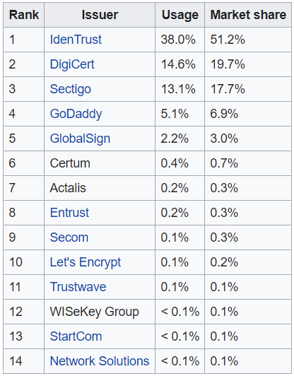
Key Distribution: Certificates
Certificate Authority
3. {m=“kApub=X”, Sign(m, kCpriv)}
“Charles”
2. {Alice?!!}
1. {m, Sign(m, kApriv)}
“Alice”
“Bob”

Slide 39
Establishing a Secure Channel
Authenticate user using public key encryption.
Use shared-key encryption for communication.
Q: How to Exchange Shared Key?
Denning-Sacco Protocol (1982)
“Charles”
1. {A,B}
2. {A, kApub, TS}^{kCpriv} {B, kBpub, TS}^{kCpriv}
(certificates)
“Alice”
“Bob”
3. {A, kApub, TS}^{kCpriv} (certificate) {{kAB, TS}^{kApriv}}^{kBpub} (proposed key)
4. {data, TS}^{kAB}

Slide 40
A Closer Look … [Abadi 1994]
“Charles”
4. {A, kApub, TS}^{kCpriv} (certificate) {{kAB, TS}^{kApriv}}^{kCpub} (proposed key)
1. {A,B}
5. {data}^{kAB}
2. {A, kApub, TS}^{kCpriv} {B, kBpub, TS}^{kCpriv}
(certificates)
“Alice”
“Bob”
3. {A, kApub, TS}^{kCpriv} (certificate) {{kAB, TS}^{kApriv}}^{kBpub} (proposed key)
Assume B has
C’s certificate:
{C, kCpub, TS}^{kCpriv}
Problem:
Message 3 does not specify who it is intended to.
This opens door for impersonation attacks.

Slide 41
SSL
Applications: HTTP, IMAP, FTP, etc…
Client and server negotiate symmetric key that they will use for the length of the data session.
Two phases in SSL:
Phase 1: Connection Establishment
Phase 2: Data Transfer

Slide 42
SSL: Connection Establishment
Step 1: Client sends request to server, containing
SSL version; connection preferences; nonce (i.e. some random number)
Step 2: Server chooses among preferences, and sends reply, containing
Chosen preferences; nonce; public-key certificate
Public-key certificate is a public key that has been digitally signed by a trusted authority.
Step 3: Client can use certification authority’s public key to check authenticity of server’s public key.
Step 4: Server can request public key of client and verify it similarly (optional)
Step 5: Client chooses random number (premaster secret), encrypts it with server’s public key, and sends it to server.
Step 6: Both parties compute session key (used during data transfer) based on premaster secret and the two nonces.
Note: At no point is the session key transferred between client and server.

Slide 43
SSL: Data Transfer
Messages are fragmented into 16kB portions.
Each portion is optionally compressed.
A Message Authentication Code (MAC) is appended
MAC is a hash derived from plaintext, two nonces, and pre-master secret
Plaintext and MAC are encrypted using the symmetric key constructed during connection establishment.

