Slide 1
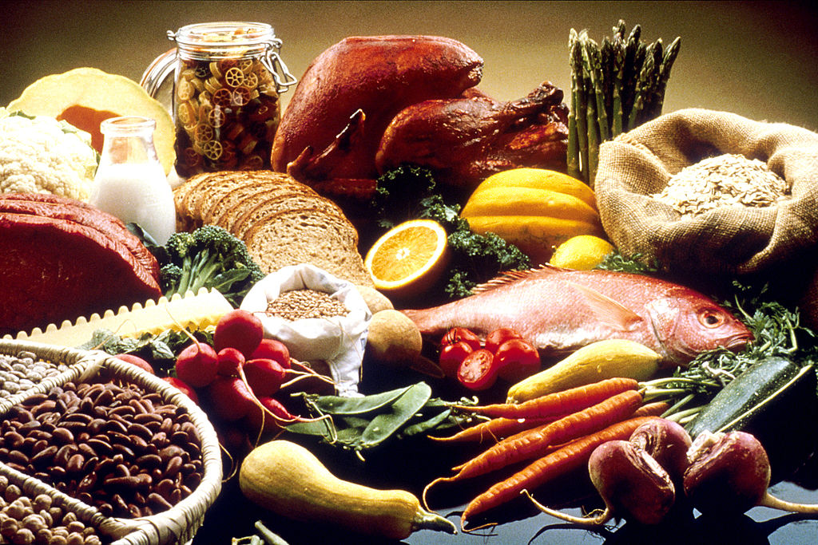
From Tofu to Turkey: Healthy for You? Healthy for the Earth?
An exploration of the nutrient value of food
and the resources used to produce it
Created by: Nick Weaver, Ratnam Mantripragada, Joan Stone-Mays, & Charles Campisi

Slide 2
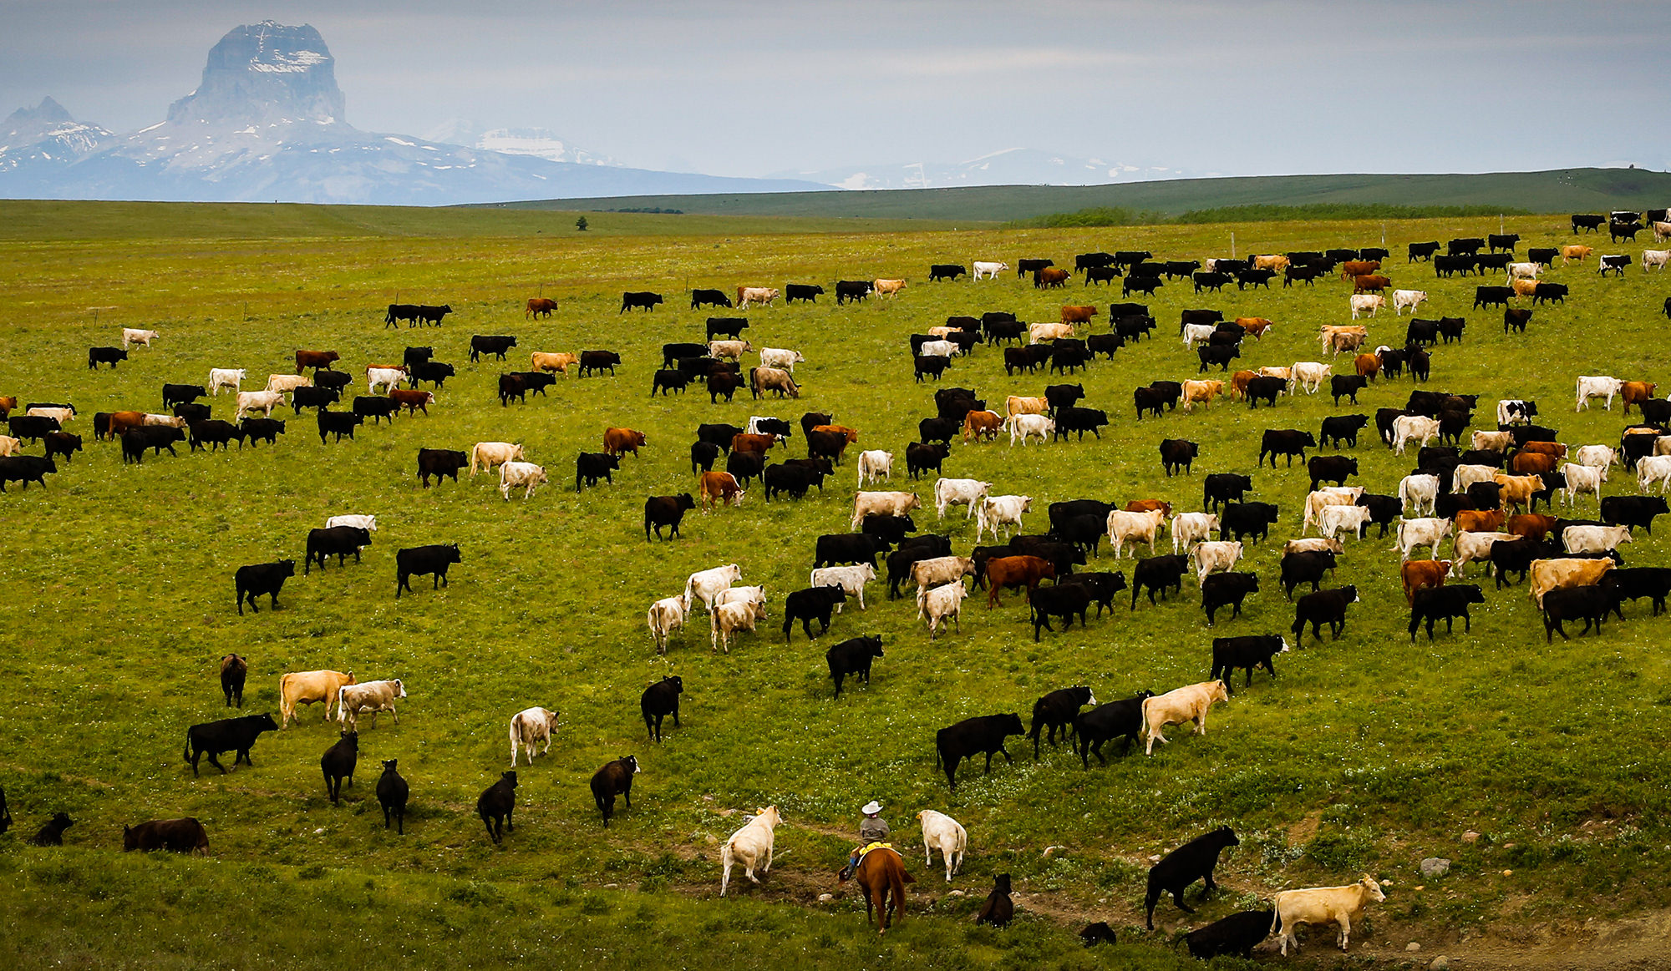
PROJECT CONCEPT
Initial Idea
Growth of Vegetarian/Veganism and the “presumed” corresponding growth in sales of “meatless” products
Lack of accurate data on number of vegetarians/vegans
Difficulty finding robust sales data
Evolution
Discovered USDA data for nutritional value of products and resource usage when producing key ingredients
Final Project
Measuring the nutritional value, emissions, land and water usage of vegan and non-vegan products

Slide 3
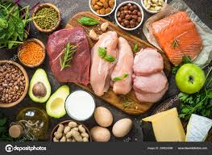
DATA - ETL/CRUD
Used USDA Food Composition Databases
Narrowed database with emissions, land, and water usage down to key categories
Created list of meat-based foods (hamburger, turkey burger, etc.) and their corresponding meatless substitutes (bean burger, mushroom burger, etc.)
Used list to create a query that provide nutrient values for selected foods

Slide 4
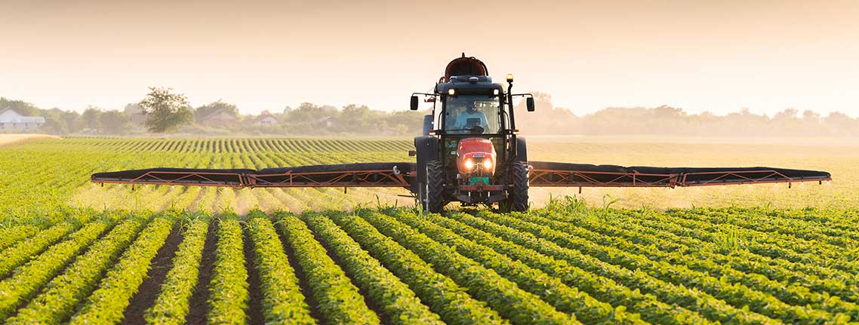
GRAPHS
Nutritional Value of a Non-Vegan Item and its Vegan Substitute
Energy (Kcal), Fat (g), Carbs (g), Fiber (g), Protein (g), & Sugar (g)
Emissions & Land and Water Usage in the Production of Food Items
Nutrient Units, Land Use, CO2 Emissions, SO2 Emissions (sulfur dioxide), PO4 Emissions (phosphate), Freshwater Withdrawals

Slide 5
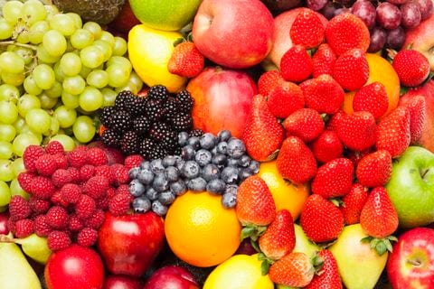
CHALLENGES
Accessing the API
Heroku
Working non-linearly

Slide 6
QUESTIONS?

