Slide 1

DSA5101: Statistics Project
Public Housing Affordability in Singapore
Image: The Pinnacle @ Duxton, a public housing project located next to Singapore’s central business district. When it was launched in 2009, a four-bedroom flat was sold for S$300,000. In 2022, the same flat has been selling for at least S$1,300,000. Housing projects like The Pinnacle has caused much discussions among locals who now view public housing allocation as winning the lottery.

Slide 2
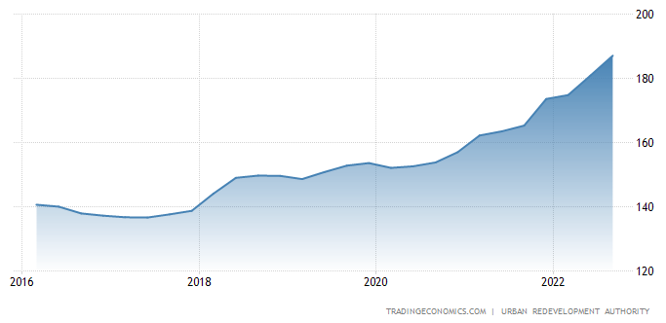
Singapore’s housing affordability is worsening; unaffordability is fueling angst in citizens
Steep upward trend in housing index indicates unprecedented rate of increase [ref 1]
Local reports claimed Singapore’s housing remained affordable [ref 2]
Recent Bloomberg survey indicates opposite sentiments on the ground [ref 3]
Moody’s analysis predicts a worsening situation for first-time buyers [ref 4]
Housing unaffordability has far-reaching societal and economic impacts, ranging from the rental market, cost of living, and worsening of unequal wealth accumulation, based on recent studies by OECD [refs 5 and 6]
refs, accessed 31-Oct-2022:
1. https://tradingeconomics.com/singapore/housing-index
2. https://www.businesstimes.com.sg/real-estate/singapore-housing-deemed-relatively-affordable-in-asia-pacific-report
3. https://www.bloomberg.com/news/articles/2022-09-13/six-out-of-10-people-say-singapore-property-is-unaffordable
4. https://www.bloomberg.com/news/articles/2022-10-25/singapore-home-affordability-to-get-worse-for-first-time-buyers-moody-s-says
5. Causa, O., N. Woloszko and D. Leite (2019), "Housing, wealth accumulation and wealth distribution: Evidence and stylized facts", OECD Economics Department Working Papers, No. 1588, OECD Publishing, Paris, https://doi.org/10.1787/86954c10-en.
6. Cournède, B., S. Sakha and V. Ziemann (2019), "Empirical links between housing markets and economic resilience", OECD Economics Department Working Papers, No. 1562, OECD Publishing, Paris, https://doi.org/10.1787/aa029083-en.

Slide 3
Current cooling measures are reactive and inadequate; additional complementary measures required
Cooling measures introduced reactively in Sep-2022 were an attempt to dampen the property market [ref 7]
Additional stamp duties, decreased mortgage ceiling, increased restrictions on eligibility for public housing
Imposed solely on consumers (i.e. targeting only demand)
Inevitably punitive to first-time buyers who are genuinely seeking home ownership
Yet, housing prices continued to soar despite said “cooling measures” [ref 8]
Increased 3.8% in Q3; after rising 3.5% in Q2
Expected to increase 11% in 2022; rose 10.6% in 2021
To address inadequacies, the government needs to be able to
(1) preemptively predict housing prices, and
(2) identify factors that can boost the supply of housing
The outcome of this work
(1) We built a model that can predict property prices before the completion of projects.
Impact: Provides the government lead time to plan and implement policies more carefully and preemptively
(2) We identified predictors of high-margin projects.
Impact: Establishes where and how the government can play a role in creating a conducive environment for developers to build, to boost the supply of housing.
(3) Evaluated feature importance and inadequacies
Impact: Guides future data collection efforts to more efficiently utilize resources in this regard.
refs, accessed 31-Oct-2022:
7. https://www.channelnewsasia.com/singapore/singapore-property-cooling-measures-loan-borrowing-criteria-hdb-ltv-limit-15-month-wait-out-period-2974776
8. https://www.channelnewsasia.com/singapore/singapore-private-home-prices-rise-38-cent-q3-ura-3030061

Slide 4
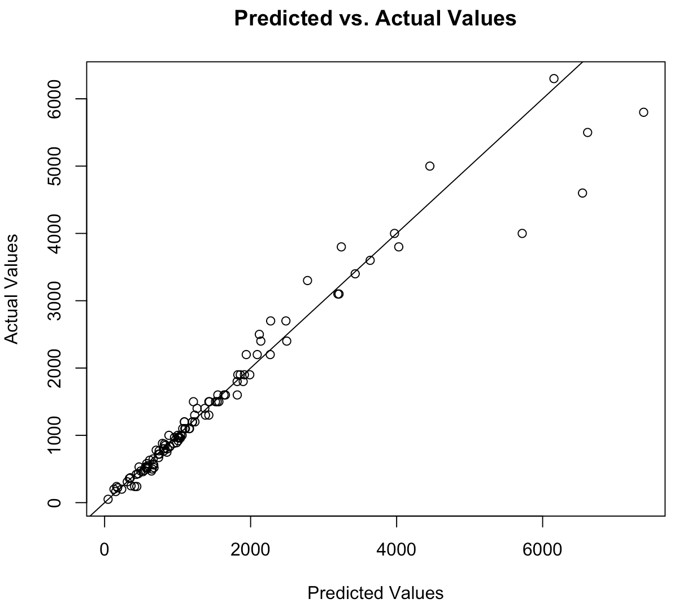
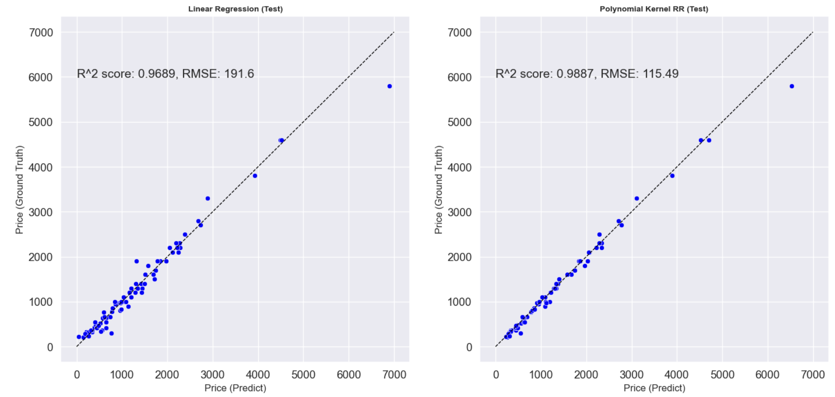
1. Prediction model can help the government to predict housing prices, and hence affordability
Model features
Predictors available prior to the start of housing projects;
Allows the government to make plans 3 years ahead. [ref 9]
Model is reliable (> 95% accuracy i.e. R² score)
Accuracy is consistent with different ML models
refs, accessed 31-Oct-2022:
9. Using BTO projects as reference https://www.channelnewsasia.com/singapore/hdb-bto-flats-projects-median-waiting-time-desmond-lee-delays-2706036

Slide 5
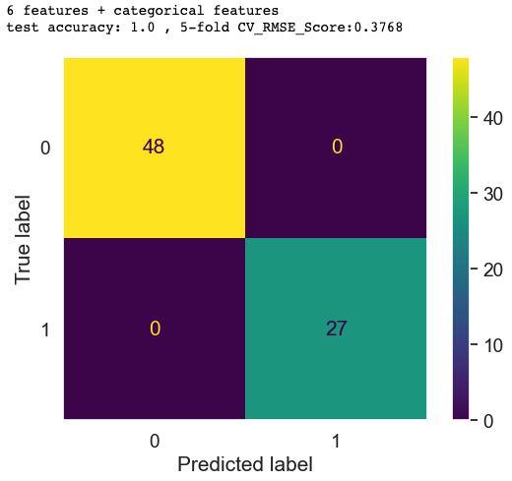
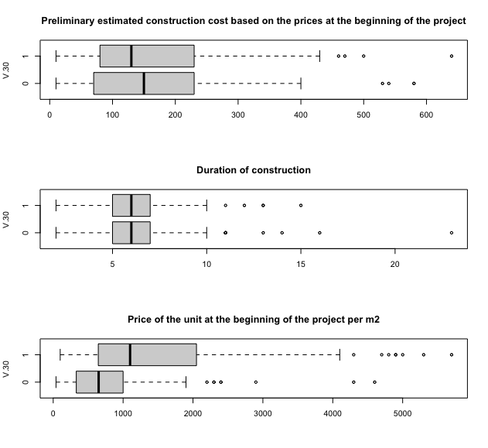
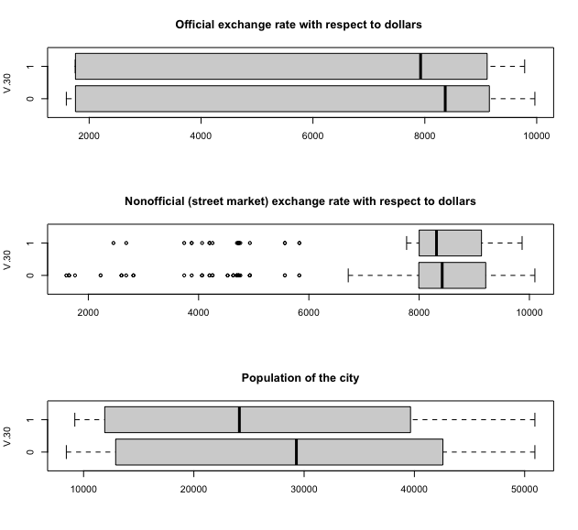
2. 8 features sufficient to predict high-margin projects; allows the government to intervene to control the supply of housing
Selected strong predictors | Example of how the government can intervene to boost housing supply
V.1 Project locality | Provide tax breaks to projects at low-margin locations or for low-margin residential building; Strategic Factors: government should also study impact on social mobility and potential gentrification if locality affects affordability
V.10 Type of Residential building
Selected non-predictors | Example of intervention that may turn out to be futile
V.17 Land price index | Subsidy for land sales
V.18 / V.19 number of loans and loan amounts | Increasing access to corporate bank loans

Slide 6
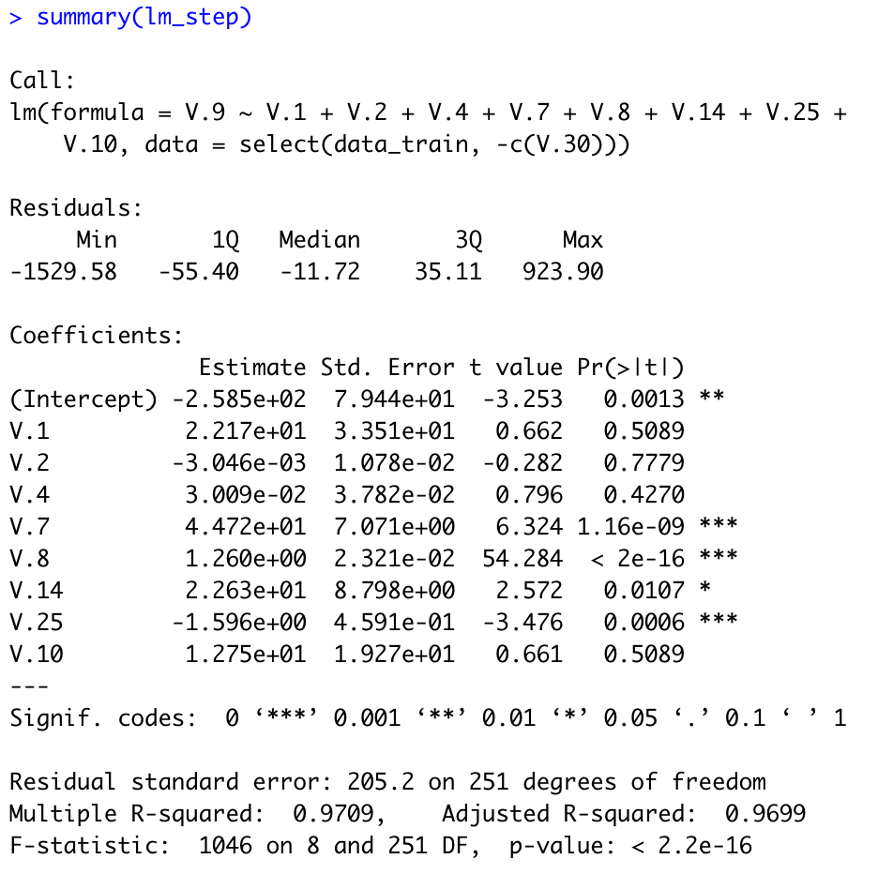
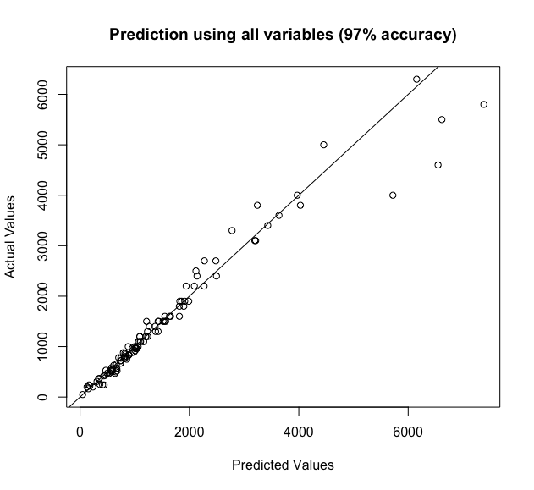
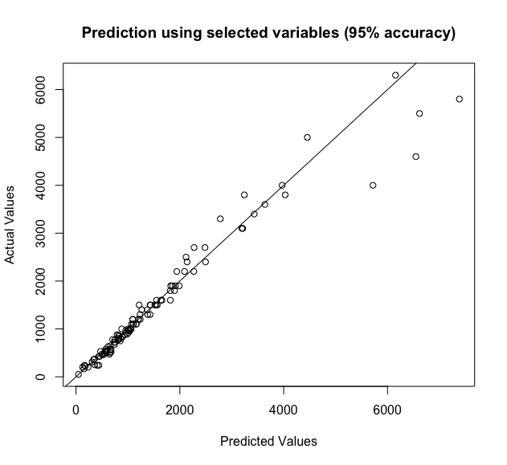
3. Identified 8 key predictors that can predict housing prices with >95% accuracy
8 predictors to achieve 95% R² score
V.1 Project locality
V.2 Total floor area of the building
V.4 preliminary estimated construction cost
V.7 Duration of construction
V.8 Price of the unit at the beginning of the project per m2
V.14 Total floor areas of building permits issued by the city/municipality
V.25 Consumer price index (CPI) i in the base year a
V.10 Type of Residential building

Slide 7
Predictive model can help the government prevent housing unaffordability
Final Recommendations for the Government
(1) To focus data collection efforts and resources on only the key predictors
(2) To predict housing prices in order to forecast if the trend would give rise to affordability concerns
(3) To intervene where appropriate, to craft a more conducive environment for developers to build, to boost the housing supply
(4) Follow-up studies to improve and validate findings
-> To collect local data to validate models
-> To quantify the impact in terms of productivity loss, foreign investment, health care cost, to justify government spendings to solve housing affordability issues

Slide 8
Supplementary slides
Housing affordability is a whole-of-government issue
Far-reaching societal and economic impact
Section 1. Exploratory data analysis
1.1. In R, ggplot of variables against V.9 (prices)
1.2. In R, boxplots of variables against V.30 (high/low margin)
1.3. In R, histograms of price vs selected variables
Section 2. Model selection and prediction
2.1 In R, lm, stepwise reduction of variables, guided by VIF
2.2 In R, PCA
2.3 In Python, linear regression and polynomial kernel ridge regression
Section 3. Hypotheses testing (all in R)
3.1 t-test and ANOVA for residential types
3.2 contingency tables, mosaic plots, fisher tests and chi-sq contingency analysis for categorical variables
3.3 In R, anova test for model reduction
Role of members in project

Slide 9
Housing affordability is a whole-of-government issue; far-reaching societal and economic impact
Impact/Issues | Ministry concerned
Land-use prioritiztation eg. Residential vs commercial vs recreational supporting infrastructure around housing projects. [See ref 10 for an example of limitations of land use in Singapore] | MND (URA, HDB) MTI (EDB) MinLaw (SLA) MOT (LTA);
Rental Markets and impact on desirability for foreign talents [ref 11] | MTI (EDB)
Unequal wealth accumulation and its economic and social impact [ref 12] | MOF [ref 13]
Housing affordability affects physical and mental health [ref 14] | MOH
refs, accessed 31-Oct-2022:
10. https://marketurbanism.com/2020/08/05/the-limits-of-the-singapore-housing-model/
11. https://www.bloomberg.com/news/features/2022-06-27/how-much-will-singapore-rents-rise-surging-prices-put-expats-under-pressure
12. https://www.oecd.org/officialdocuments/publicdisplaydocumentpdf/?cote=ECO/WKP(2019)58&docLanguage=En
13. MOF is a major stake holder to address socio-economic inequality. see https://www.mof.gov.sg/news-publications/parliamentary-replies/Government-s-Efforts-to-Address-Socio-Economic-Inequality
14. Chung RY, Chung GK, Gordon D, et alHousing affordability effects on physical and mental health: household survey in a population with the world’s greatest housing affordability stressJ Epidemiol Community Health 2020;74:164-172. accessed from https://jech.bmj.com/content/74/2/164

Slide 10
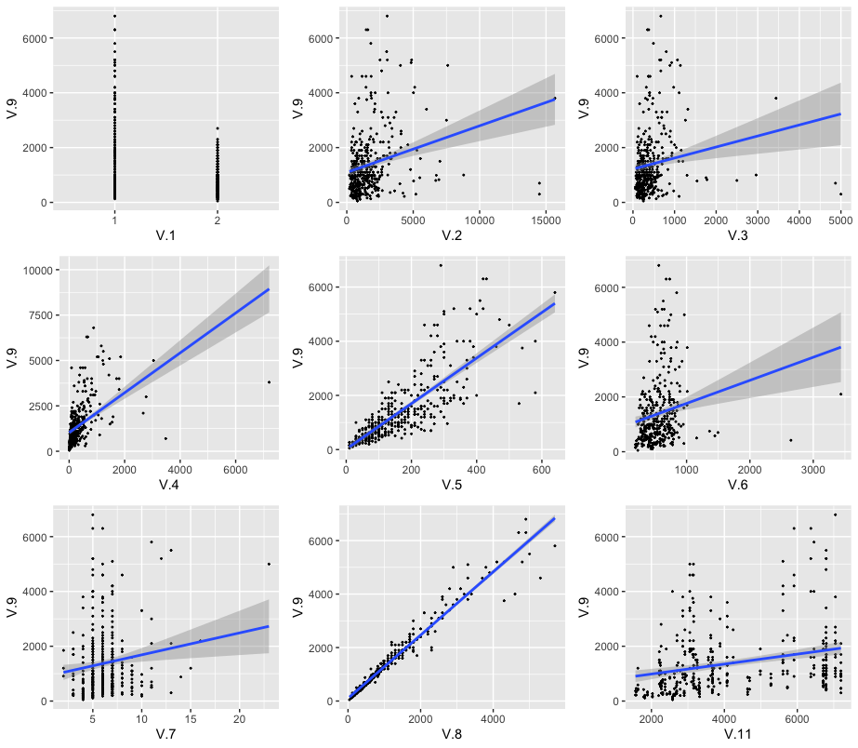
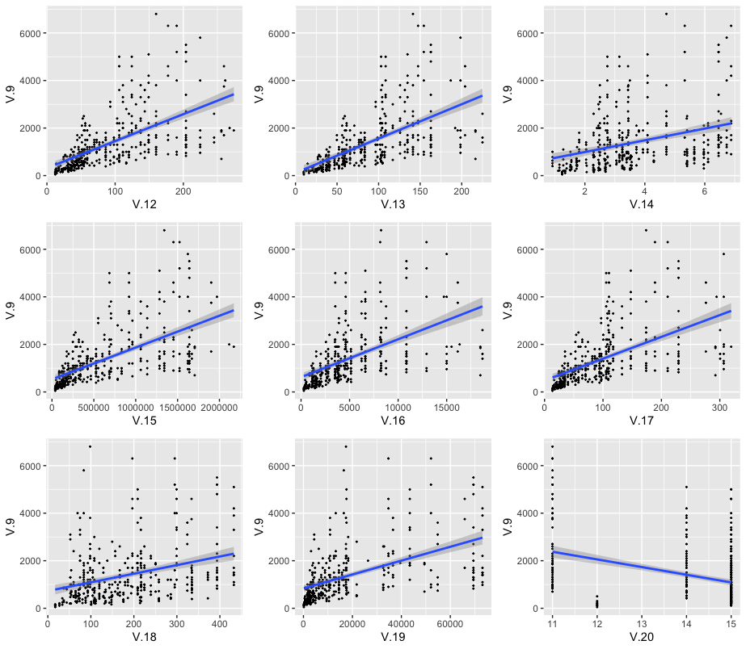
Exploratory Data Analysis: ggplots of variables against price, V.9 (1 of 2)
Findings: all are positively correlated with price; suspect some variables are highly correlated with each other

Slide 11
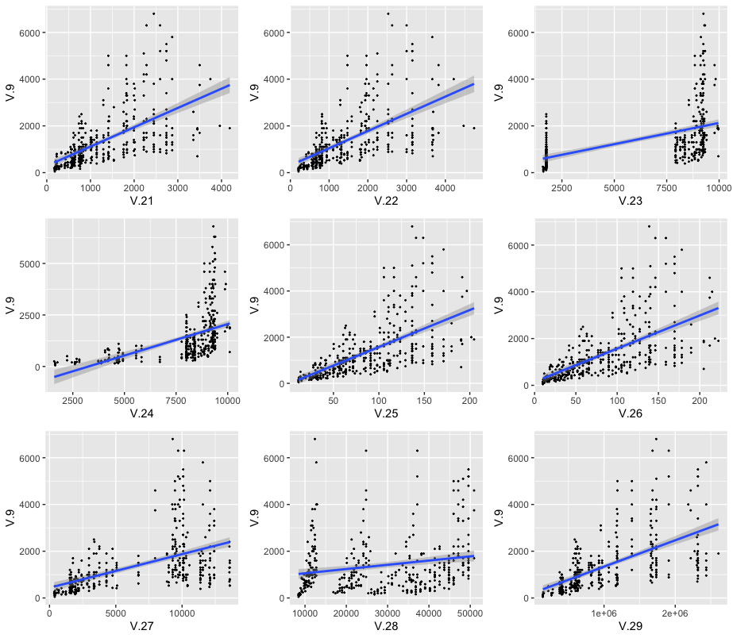
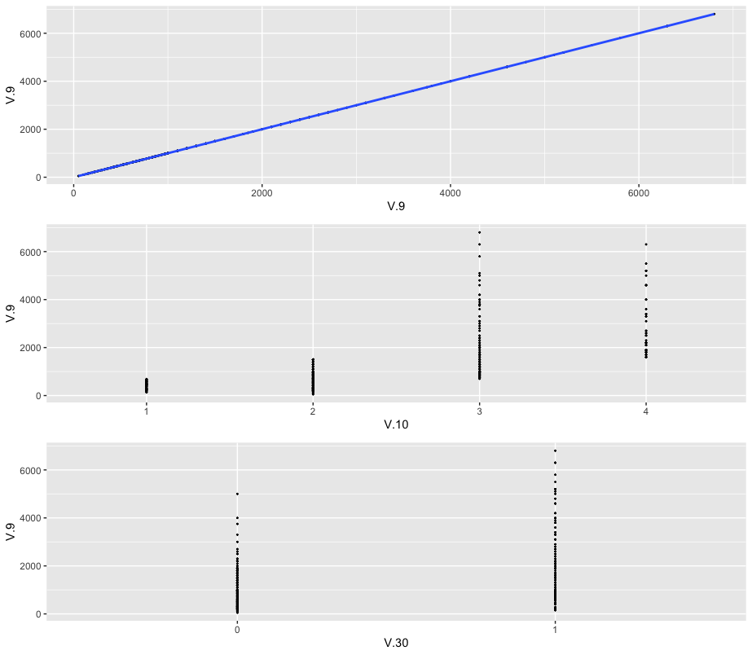
Exploratory Data Analysis: ggplots of variables against price, V.9 (2 of 2)
Findings from ggplot: all are positively correlated with price; suspect some variables are highly correlated with each other; need to carry out a model selection to choose sufficient variables

Slide 12
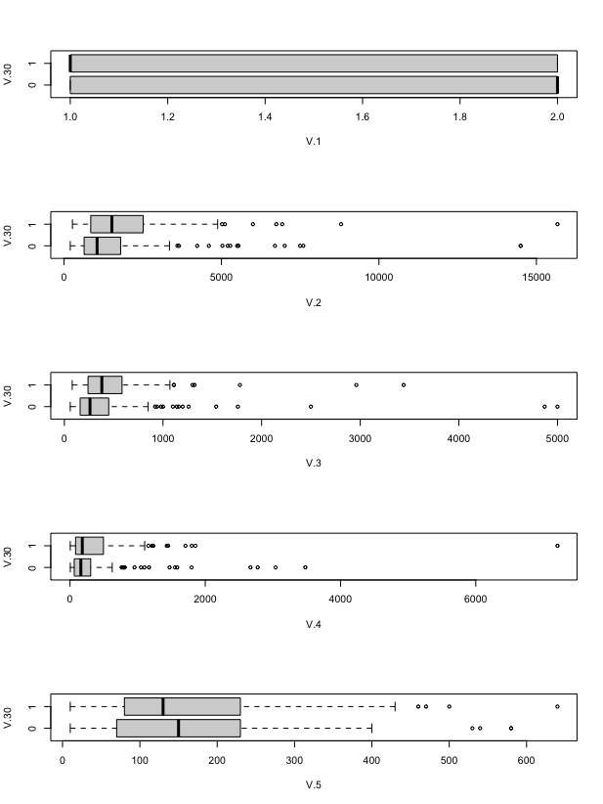
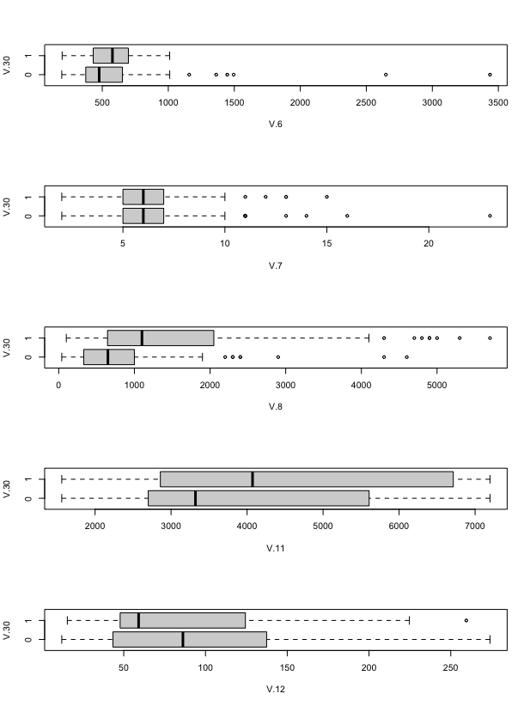
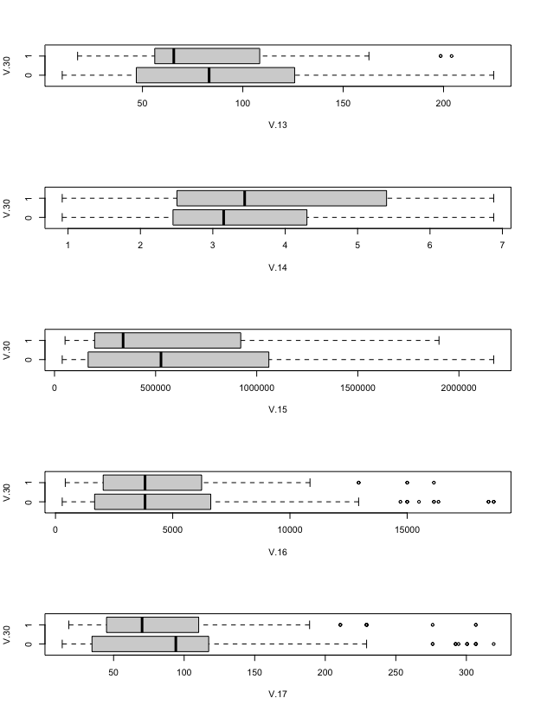
Exploratory Data Analysis: boxplots of variables against margin, V.30 (1 of 2)
Approach: Intuitively, we want to find a set of features with dissimilar/varied distribution of box plots over V.30 so that it is easier to construct a prediction model. Hence, we provide a measure of similarity by computing Jacaard index for each feature. With reference to the results in the Python notebook, we find that roughly 18/28 features is enough for training generalised prediction models with good accuracy.

Slide 13
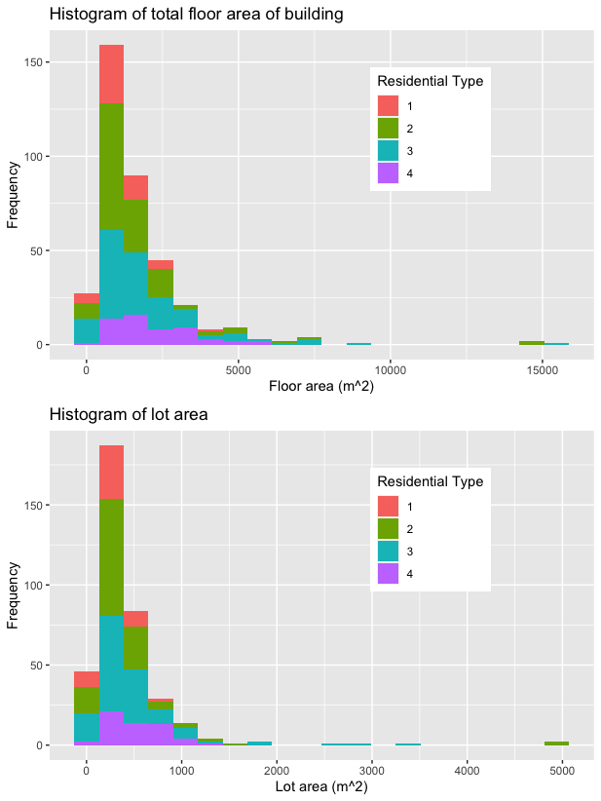
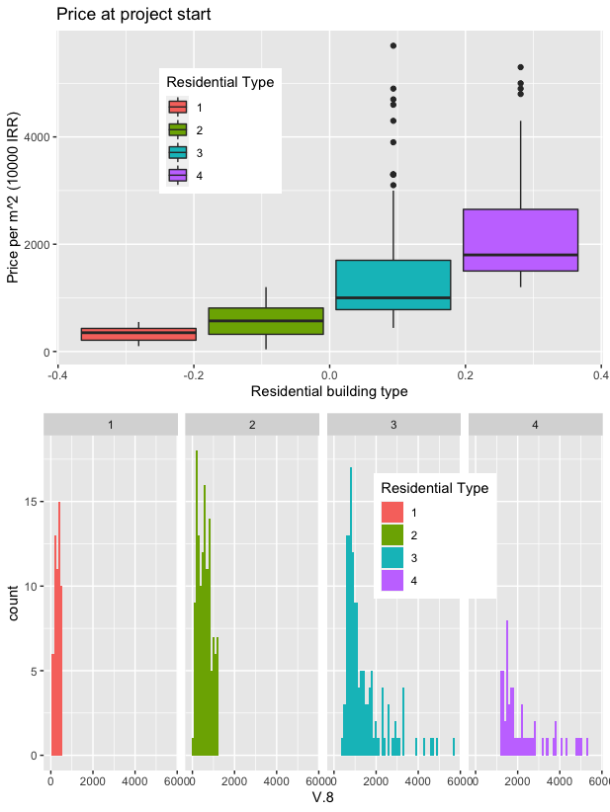
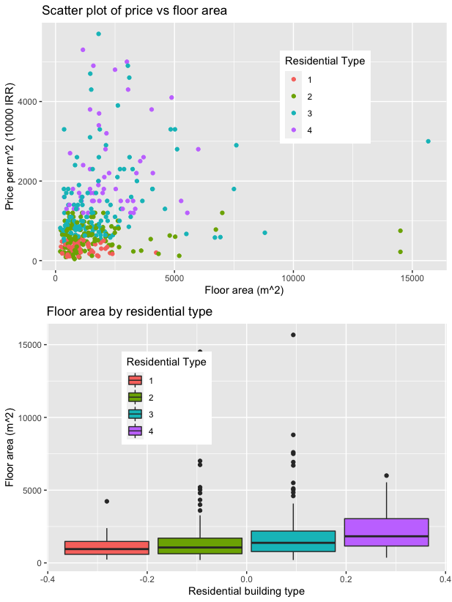
Exploratory Data Analysis: Histogram of residential type, V.10, variables against price, V.9
Findings: suspect the price means of the 4 residential types are different as they are drawn from distinct populations; to carry out all-pairs t-test and ANOVA hypothesis testing

Slide 14
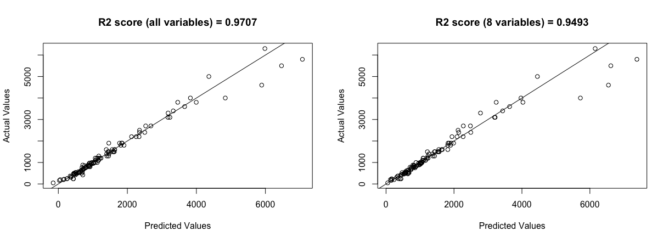
lm model selection and prediction: Good performance with 8 instead of 28 variables as predictors
8 variables as predictors
V.1 Project locality
V.2 Total floor area of the building
V.4 preliminary estimated construction cost
V.7 Duration of construction
V. 8 Price of the unit at the beginning of the project per m2
V.14 Total floor areas of building permits issued by the city/municipality
V.25 Consumer price index (CPI) i in the base year a
V.10 Type of Residential building

Slide 15
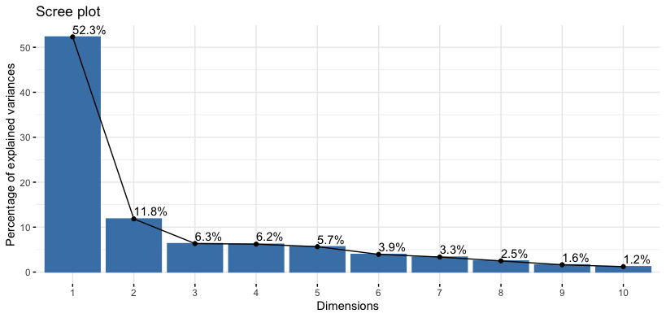
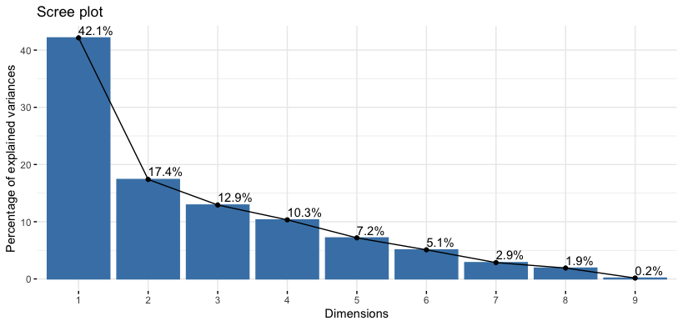
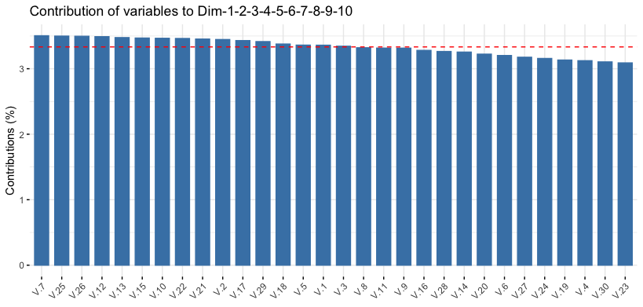
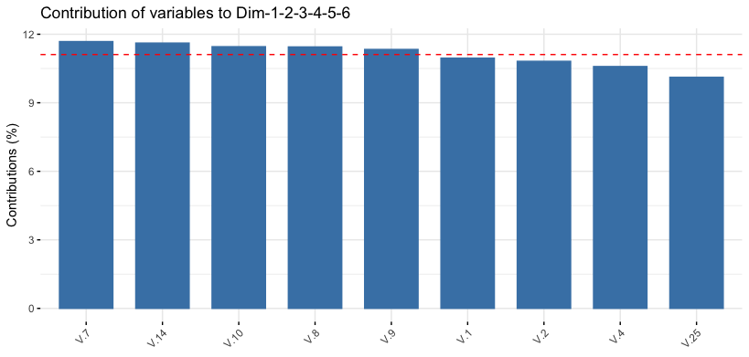
PCA: findings on PCs consistent with lm model selection
PCA performed with ALL variables
PC 1 - 10 required to account for >95%
PCA performed with 8 variables chosen from lm
PC 1 - 6 required to account for >95%

Slide 16
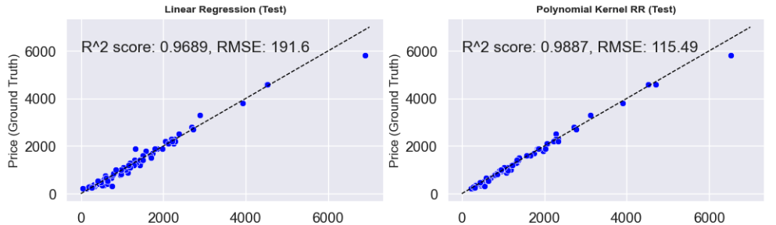
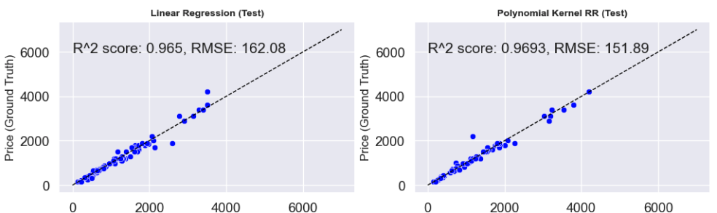
Prediction model built on python also achieved high accuracy for price, V.9
Models using ALL variables as predictors
8 variables as predictors
V.1 Project locality
V.2 Total floor area of the building
V.4 preliminary estimated construction cost
V.7 Duration of construction
V. 8 Price of the unit at the beginning of the project per m2
V.14 Total floor areas of building permits issued
V.25 Consumer price index (CPI) i in the base year a
V.10 Type of Residential building

Slide 17
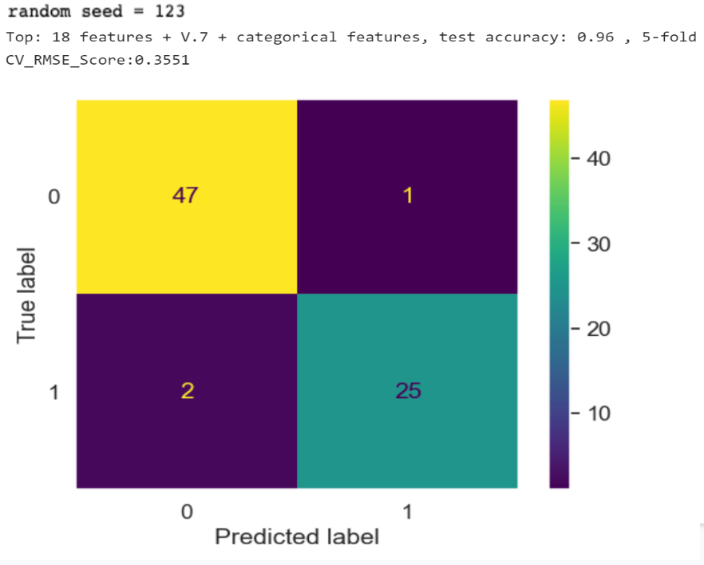
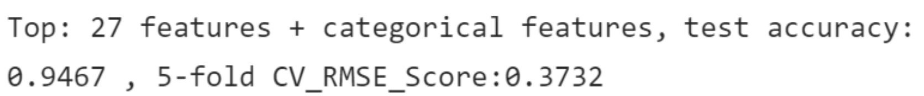
Prediction model (logistic regression) with > 10 variables: Same random seed (123), top 19 features selected based on dissimilarity (low Jaccard index), yields a lower test accuracy of 96% but it is a more generalised model based on 5-fold CV_RMSE_Score of 0.3551 → lowest among all models trained in the notebook
If we were to use all features available, we get worse accuracy and 5-fold CV score:

Slide 18
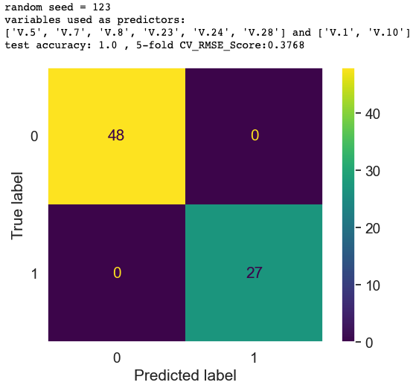
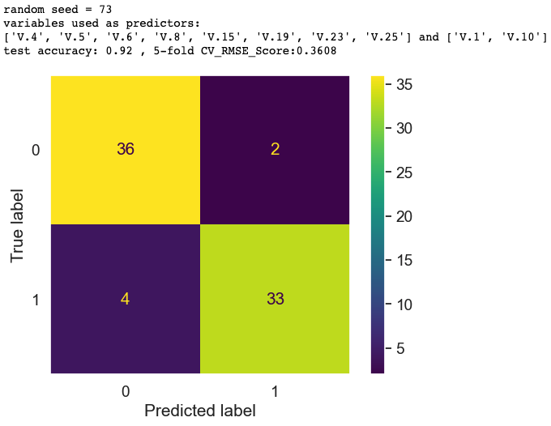
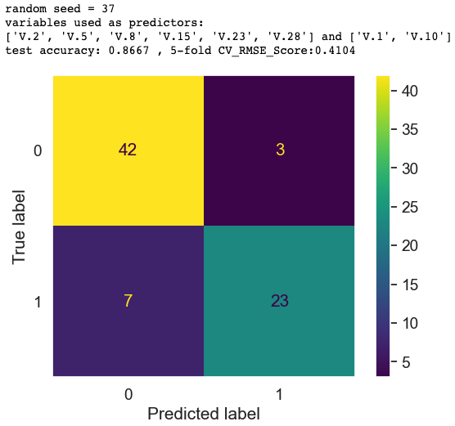
Prediction model is reliable and reproducible
achieved high accuracy for margin, V.30. ~ 90% accuracy with different random seeds
<10 variables as predictors sufficient in all cases

Slide 19
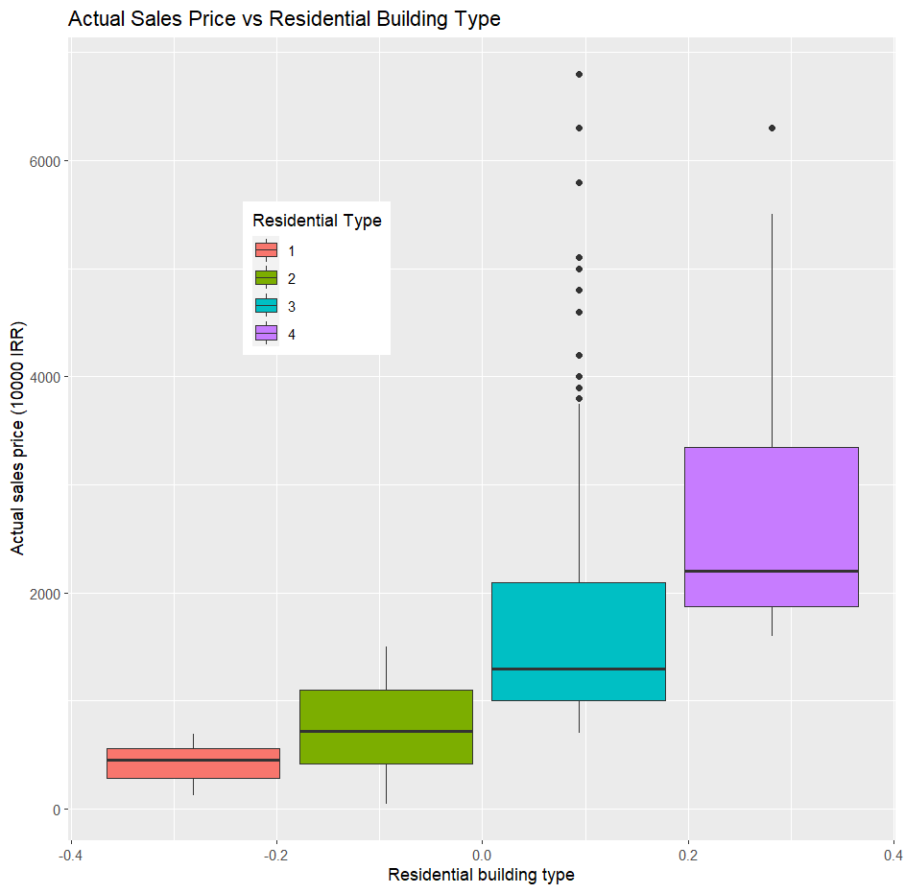
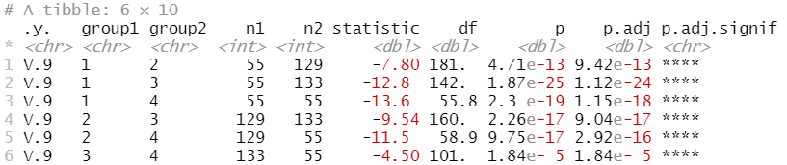
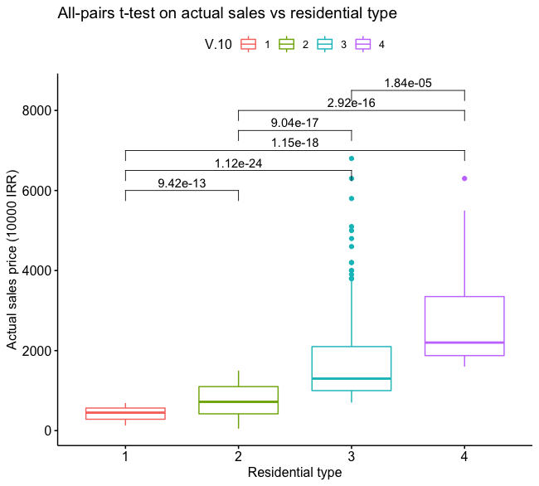
Hypothesis Testing 1: All-pairs t-test
Results: At the 95% confidence level, there is sufficient evidence to conclude that the mean of the actual sales price of different residential types are not the same
Observation from EDA: The actual sales price (V.9) of all residential types (V.10) are observed to be far apart
Hypothesis: The sales price (V.9) of every residential type (V.10) are drawn from populations with different means

Slide 20
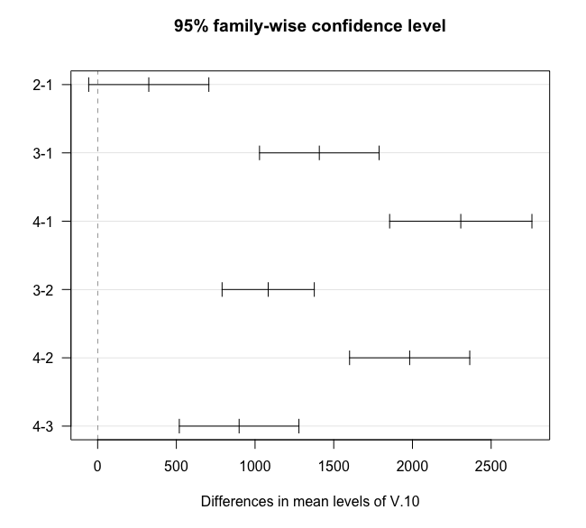
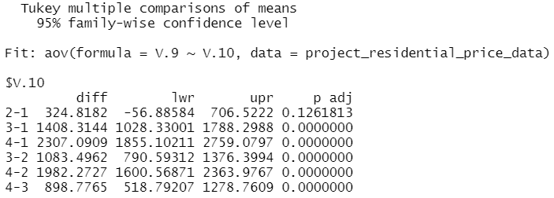
Hypothesis Testing 2: Analysis of Variance (ANOVA)
ANOVA vs All-pairs t-test: ANOVA is more mathematically correct for comparing the means between multiple populations, thus the analysis of whether the sales price (V.9) of every residential type (V.10) are drawn from populations with different means is repeated using ANOVA
Results: Unlike all-pairs t-test, there is insufficient evidence to conclude that the mean actual sales price between residential types 1 and 2 are different at the 95% confidence level. The two residential types may well be of the same kind. The means between the rest of the residential types are found to be statistically different.

Slide 21
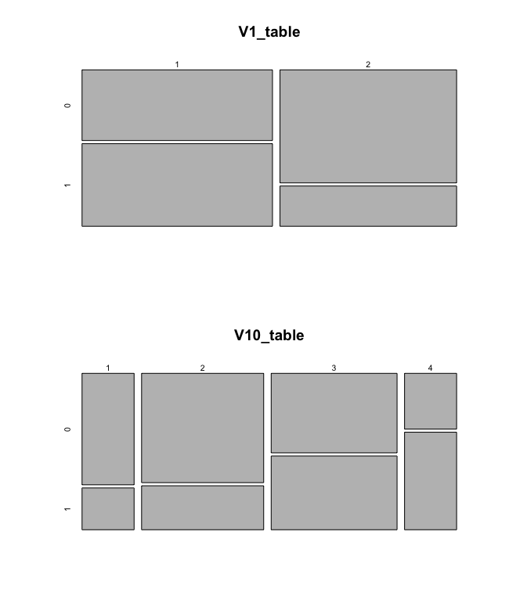
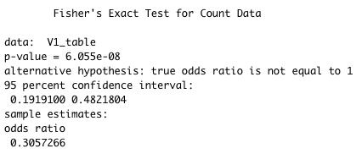
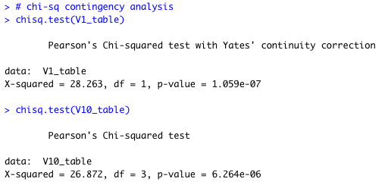
Tests for categorical variables

Slide 22
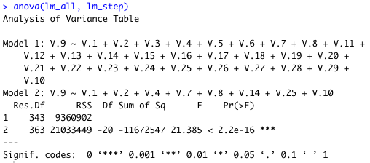
ANOVA test for model reduction
Reduced model led to a “worse” fit based on ANOVA, but still produced high prediction accuracy

Slide 23
Roles
Sector | Business Analyst | Data Scientist | Code Reviewer
EDA in python | russ | Ivan | Chris/russ
EDA in R | russ | russ | Chris/Ivan
Prediction in Python | russ | Ivan | Chris/russ
Prediction in R | russ | russ | Chris/Ivan
Hypothesis testing in R | russ | Chris | russ/Ivan

