Slide 1
The Battle of Neighborhoods
Introduction
Suppose you have never been to the US and you need to have just pizza while you are there. So you need to go to a spot with a high thickness of Pizza puts around you. The issue we plan to settle is to break down the Pizza stores' areas in the significant US urban communities and locate the best spot for our vacationer with the goal that he can have a decent pizz-ourism. Our primary objective are vacationers with a sample of western-style pizza.
Data section
I will use the FourSquare API to collect data about locations of Pizza stores in 5 major US cities which are: New York,NY, San Francisco, CA, Jersey City, NJ, Boston, MA and Chicago,IL. These are one of the most populated US cities and I am hopeful that they will contain the best Pizza places in the US.

Slide 2
Methodology
My main target here is to asses which city would have the highest Pizza store density. I used the Four Square API through the venues channel. I used the near query to get venues in the cities. Also, I use the CategoryID to set it to show only Pizza Places. An Example of my requests:
https://api.foursquare.com/v2/venues/explore?&client_id=&client_secret=&v=20180605&New York, NY&limit=100&categoryId=4bf58dd8d48988d1ca941735
That 4bf58dd8d48988d1ca941735 is the Id of the Pizza Place Category. Also, Foursquare limits us to maximum of 100 venues per query.
Moreover, I repeated this request for the 5 studied cities and got their top 100 venues. I saved the name and coordinate data only from the result and plotted them on the map for visual inspection.
Next, to get an indicator of the density of Pizza Places, I calculated a center coordinate of the venues to get the mean longitude and latitude values. Then I calculated the mean of the Euclidean distance from each venue to the mean coordinates. That was my indicator; mean distance to the mean coordinate.

Slide 3
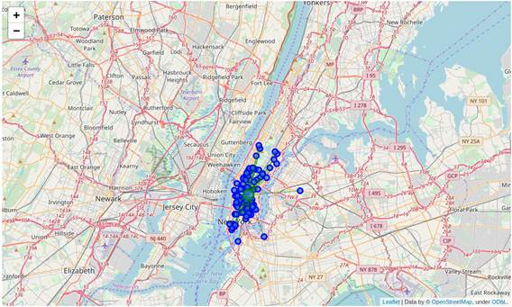
New York
MDMC: 0.021556

Slide 4
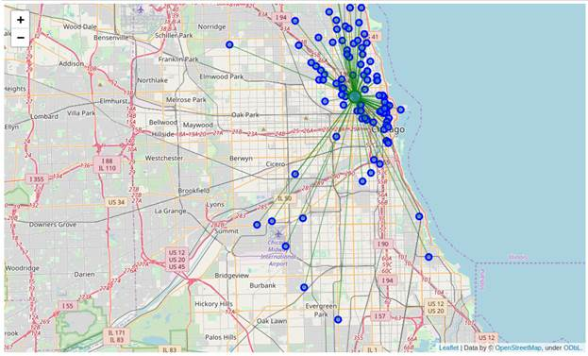
Chicago
MDMC:0.052805

Slide 5
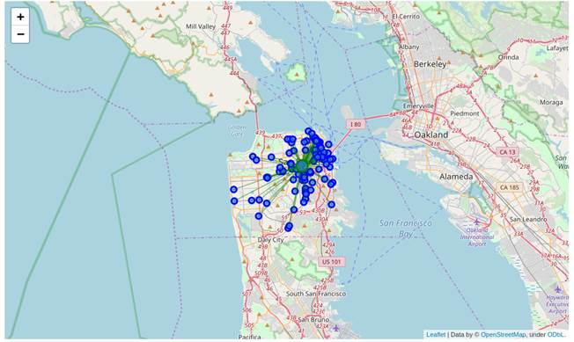
San Francisco
MDMC: 0.028633

Slide 6
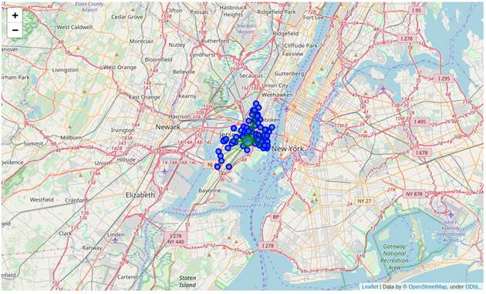
Jersey City
MDMC: 0.029950

Slide 7
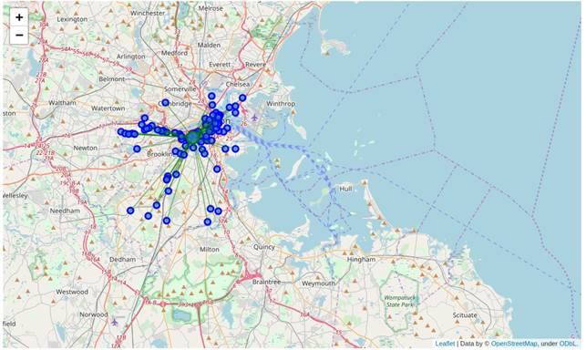
Boston
MDMC: 0.035126

Slide 8
Discussion
One thing I noticed in the figure is that there is a really far away Pizza Store in Jersey City that is probably giving it a higher MDMC. So I cheched what if I removed it, it would not harm anyone to try 99 pizza places than 100 and New York is just at the other shore.
The new MDMC was: 0.0219953, putting it one place up on the list replacing San Francisco.
One consideration to do further work on is to move the location of the Foursquare API query until we get all the pizza places in each city and do the calculations again.
Now there is no doubt that New York is the best place to try many Pizza Places in the US. Also, if our tourist is done with all the New York pizza places he can cross to Jersey City and enjoy 99 more.

