Slide 1


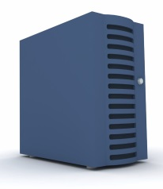

User 1
Browser Access (HTTPS)
User 2
Load Balancer
Production
Nginx
Preproduction
N/A
Database Server 1
Production: MySQL
Preproduction: SQLite
Application Server 1
Production
Django
Nginx
Gunicorn
Preproduction
Django
User n

