Slide 1
Machine Learning-Based Network Intrusion Detection and Anomaly Classification
Technical Deep-Dive · ML / Data Science / Security Peers
• Machine Learning-Based Network Intrusion Detection and Anomaly Classification
• Binary classification of network flows: benign vs. malicious
• Dataset: UNSW-NB15 (257,673 flow records, 10 attack families)
• Selected model: LightGBM — F1 0.7890, recall 96.04%, PR-AUC 0.9485
Arne Ramos · 16 September 2026
Notes:
Open with the finding, not the setup. "We built a flow-based intrusion detector that meets every performance target we set in advance — and then we spent most of our effort working out how much of that number is real. That second part is what I actually want to talk about."

Slide 2
Problem & Objectives
• Enterprise networks produce tens of millions of flow records per day; the malicious fraction is vanishingly small
• Signatures are precise but blind to anything unseen; manual review does not scale
• Objective: estimate P(malicious) per flow from flow statistics alone — no payload, no IPs, no ports, no timestamps
• Pre-registered targets: F1 ≥ 0.90, ROC-AUC ≥ 0.95, PR-AUC ≥ 0.90, recall ≥ 0.90, throughput ≥ 10k flows/s
• Pre-registered methodological criteria: no target leakage, no preprocessing leakage, no duplicate leakage, test split opened once
2
Notes:
[Visual: Two-column slide — left: the SOC funnel (10M flows → alerts → analysts); right: the targets table.]
Stress that targets were set before modelling. That is what makes the evaluation a test rather than a description. Note that the methodological criteria are as binding as the numerical ones.

Slide 3
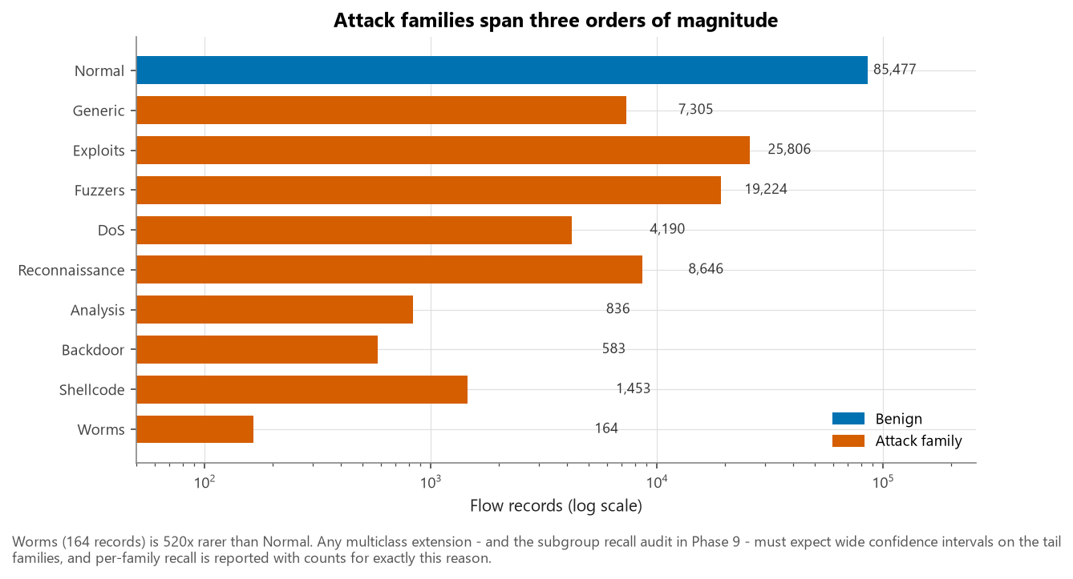
Dataset
• UNSW-NB15 (Moustafa & Slay, 2015), UNSW Canberra ACCS — synthetic testbed traffic, IXIA PerfectStorm
• 257,673 records, 45 columns, 10 attack families; target label, family label attack_cat
• Integrity verified independently: row counts, schema, target encoding, SHA-256 — not trusted from the mirror
• attack_cat excluded as a predictor — it determines label exactly (verified 1.0000 agreement)
• Missing values: 0. But service == '-' (54.8%) and dbytes == 0 (46.7%) are real categories, not absences
3
Notes:
[Visual: figures/fig02_attack_category_distribution.png]
The three-orders-of-magnitude spread across families is why every per-family metric is reported with its sample count. Point out that "no missing values" is not the same as "nothing is absent."

Slide 4
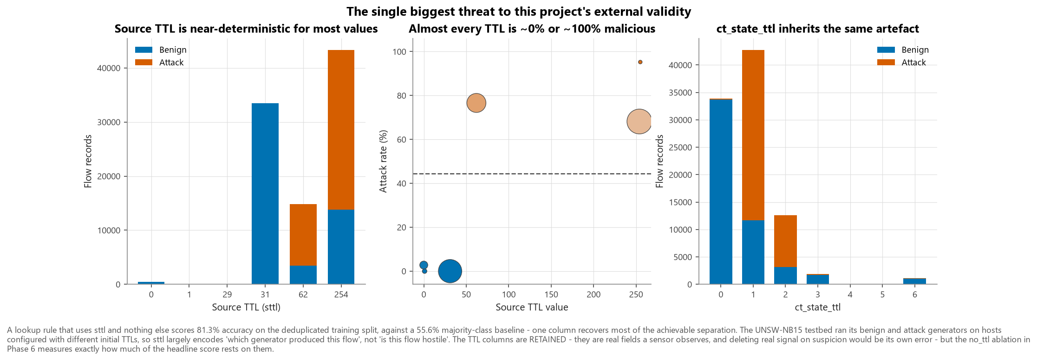
EDA: three findings that changed the design
• 1. 40.4% of the corpus is duplicated, and duplication is class-correlated — Generic 87.6%, Normal 8.1%
• 2. sttl is a near-label proxy — a lookup rule on it alone reaches 81.3% accuracy vs a 55.6% baseline
• 3. Outliers are genuine attacks — 14 MB transfers, 5.99 Gbit/s loads, 10,646-packet bursts. Nothing was clipped
4
Notes:
[Visual: figures/fig05_ttl_artifact.png (three panels) with figures/fig03_duplication_by_attack_category.png inset.]
This is the heart of the talk. The testbed ran benign and attack generators on hosts with different initial TTLs, so sttl encodes which generator produced the flow. Anyone benchmarking on UNSW-NB15 without noticing this is reporting a partly meaningless number. Emphasise that finding 1 and finding 2 both changed what we built, not just what we wrote.

Slide 5
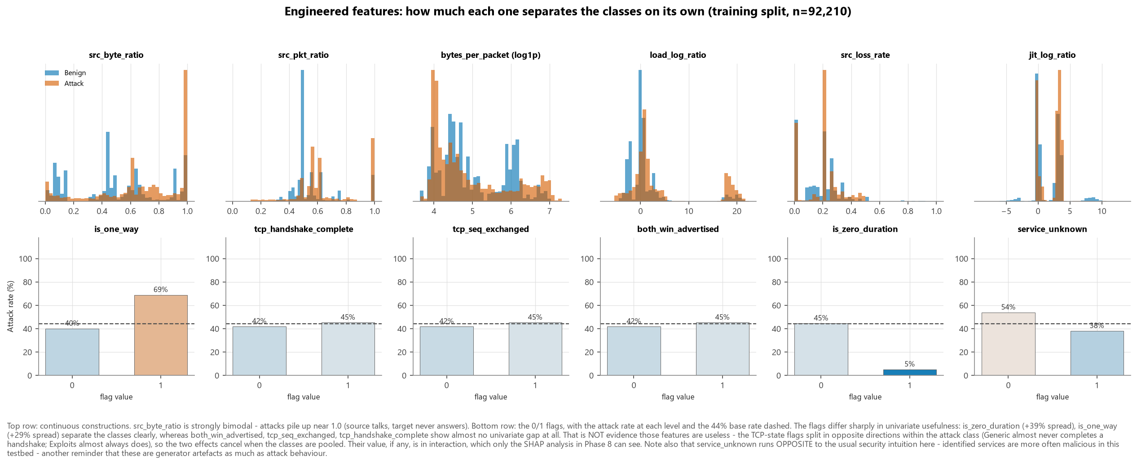
Preprocessing & Feature Engineering
• Deduplicate before splitting → 153,684 unique flows; class balance shifts 63.9% → 44.4% attack
• Stratified 60/20/20 on attack_cat (so Worms reaches all three splits), random_state=42
• log1p → StandardScaler for heavy tails; one-hot with min_frequency=200 for the 133-level proto
• 15 engineered features, all row-wise: src_byte_ratio, is_one_way, tcp_handshake_complete, load_log_ratio, …
• Row-wise matters twice: cannot leak across the split, and computable by a sensor on one flow
5
Notes:
[Visual: figures/fig10_engineered_feature_separation.png]
Everything sits inside one Pipeline, so CV re-fits the scaler and encoder per fold — leakage is structurally impossible rather than prevented by discipline. 46.7% of flows have zero destination packets, so every ratio is a/(a+b), not a/b.

Slide 6
Modelling Approach
• Logistic Regression (interpretable baseline) · Random Forest · XGBoost · LightGBM · Isolation Forest (unsupervised, benign-only)
• RandomizedSearchCV, 5-fold StratifiedKFold, scoring F1 with PR-AUC and ROC-AUC alongside
• Protocol order: score on validation → select on validation → tune threshold on validation → freeze → open test once
• Solver choice made by measurement: lbfgs/L2 3.6 s vs saga/L1 199.4 s (non-converged) for a 0.0004 F1 difference
6
Notes:
[Visual: Flowchart of the five-step protocol, with the test split greyed out until step 5.]
The protocol order is the substance. Steps 1–4 never touch test data; step 5 changes no parameter. That is what makes the test metrics an estimate of generalisation rather than a number that was optimised toward.

Slide 7
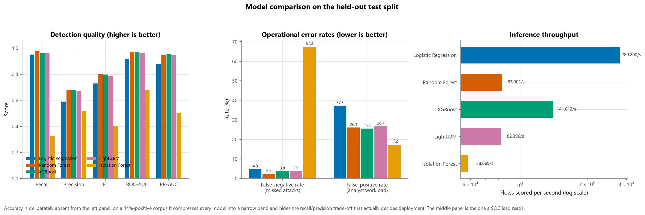
Model Comparison
• Selected LightGBM on validation PR-AUC — not accuracy
• Accuracy compresses every model into a narrow band on a 36%-positive corpus and rewards majority-class performance
Model | Recall | Precision | F1 | PR-AUC | FPR
Logistic Regression | 0.9517 | 0.5901 | 0.7285 | 0.8789 | 37.273%
Random Forest | 0.9752 | 0.6784 | 0.8002 | 0.9493 | 26.068%
XGBoost | 0.9622 | 0.6800 | 0.7968 | 0.9526 | 25.536%
LightGBM | 0.9604 | 0.6695 | 0.7890 | 0.9485 | 26.736%
Isolation Forest | 0.3265 | 0.5164 | 0.4001 | 0.5047 | 17.242%
7
Notes:
[Visual: figures/fig16_model_comparison.png]
Note how close the tree ensembles are, and how far the Isolation Forest sits behind — that gap is what supervised labelling actually buys. If asked why not accuracy: PR-AUC measures ranking quality on the positive class, which is what survives a change of base rate.

Slide 8
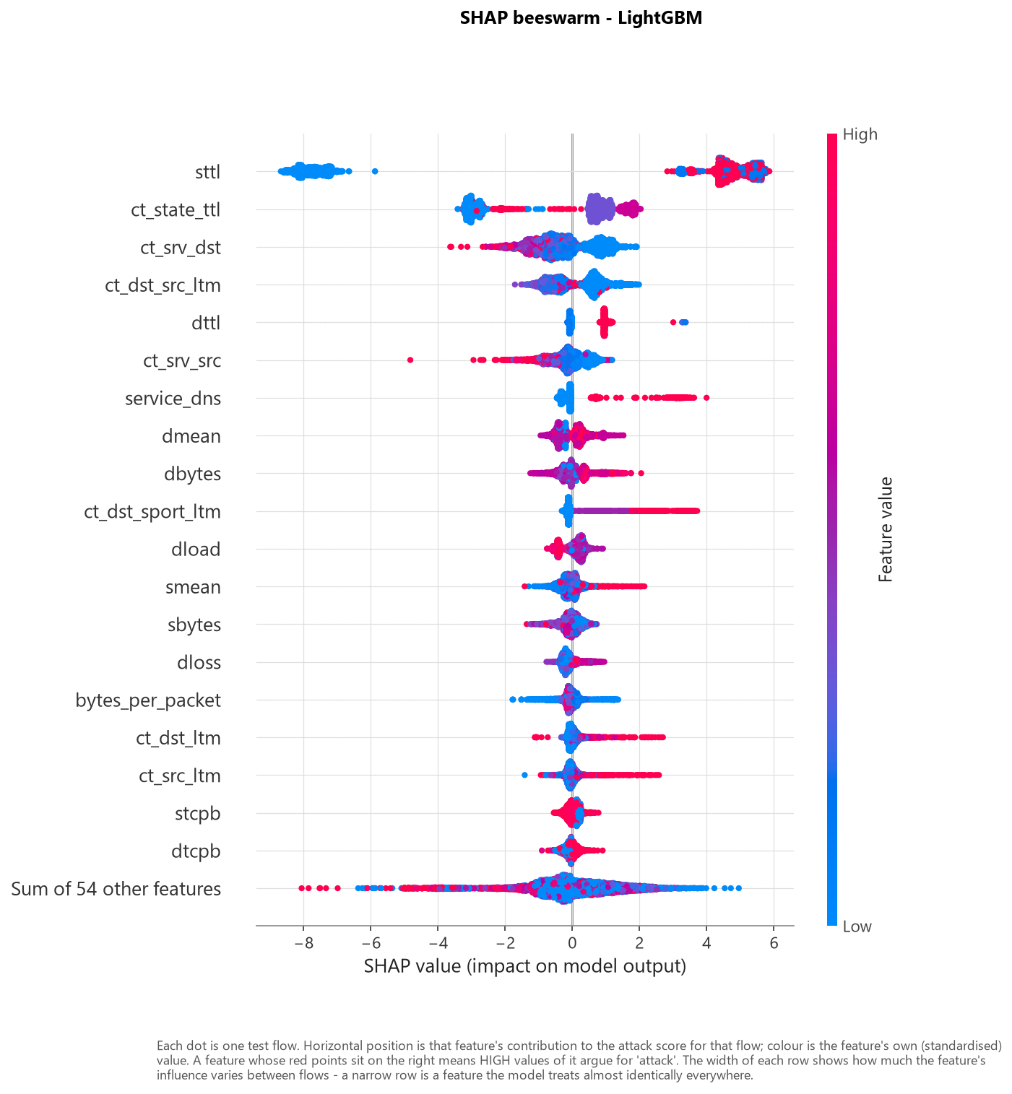
Explainability
• SHAP TreeExplainer: global importance, beeswarm, dependence, and four local cases (TP / TN / FP / FN)
• Top drivers: sttl, ct_state_ttl, ct_srv_dst, ct_dst_src_ltm, dttl
• Toward ATTACK: high source TTL, no destination response, no completed handshake, asymmetric direction
• Toward BENIGN: completed handshake with sequence exchange, balanced bidirectional volume, identified service
• Artefact diagnostic: the TTL family carries 53% of total attributed impact
8
Notes:
[Visual: figures/fig21_shap_beeswarm.png, then figures/fig24_shap_artifact_check.png]
The dependence plot for sttl is a step, not a gradient — the model learned a near-binary switch. SHAP is what turned a suspicion from EDA into a measured quantity on the fitted model. Mention the dual-use point: the same explanation that helps a defender tells an attacker what to manipulate.

Slide 9
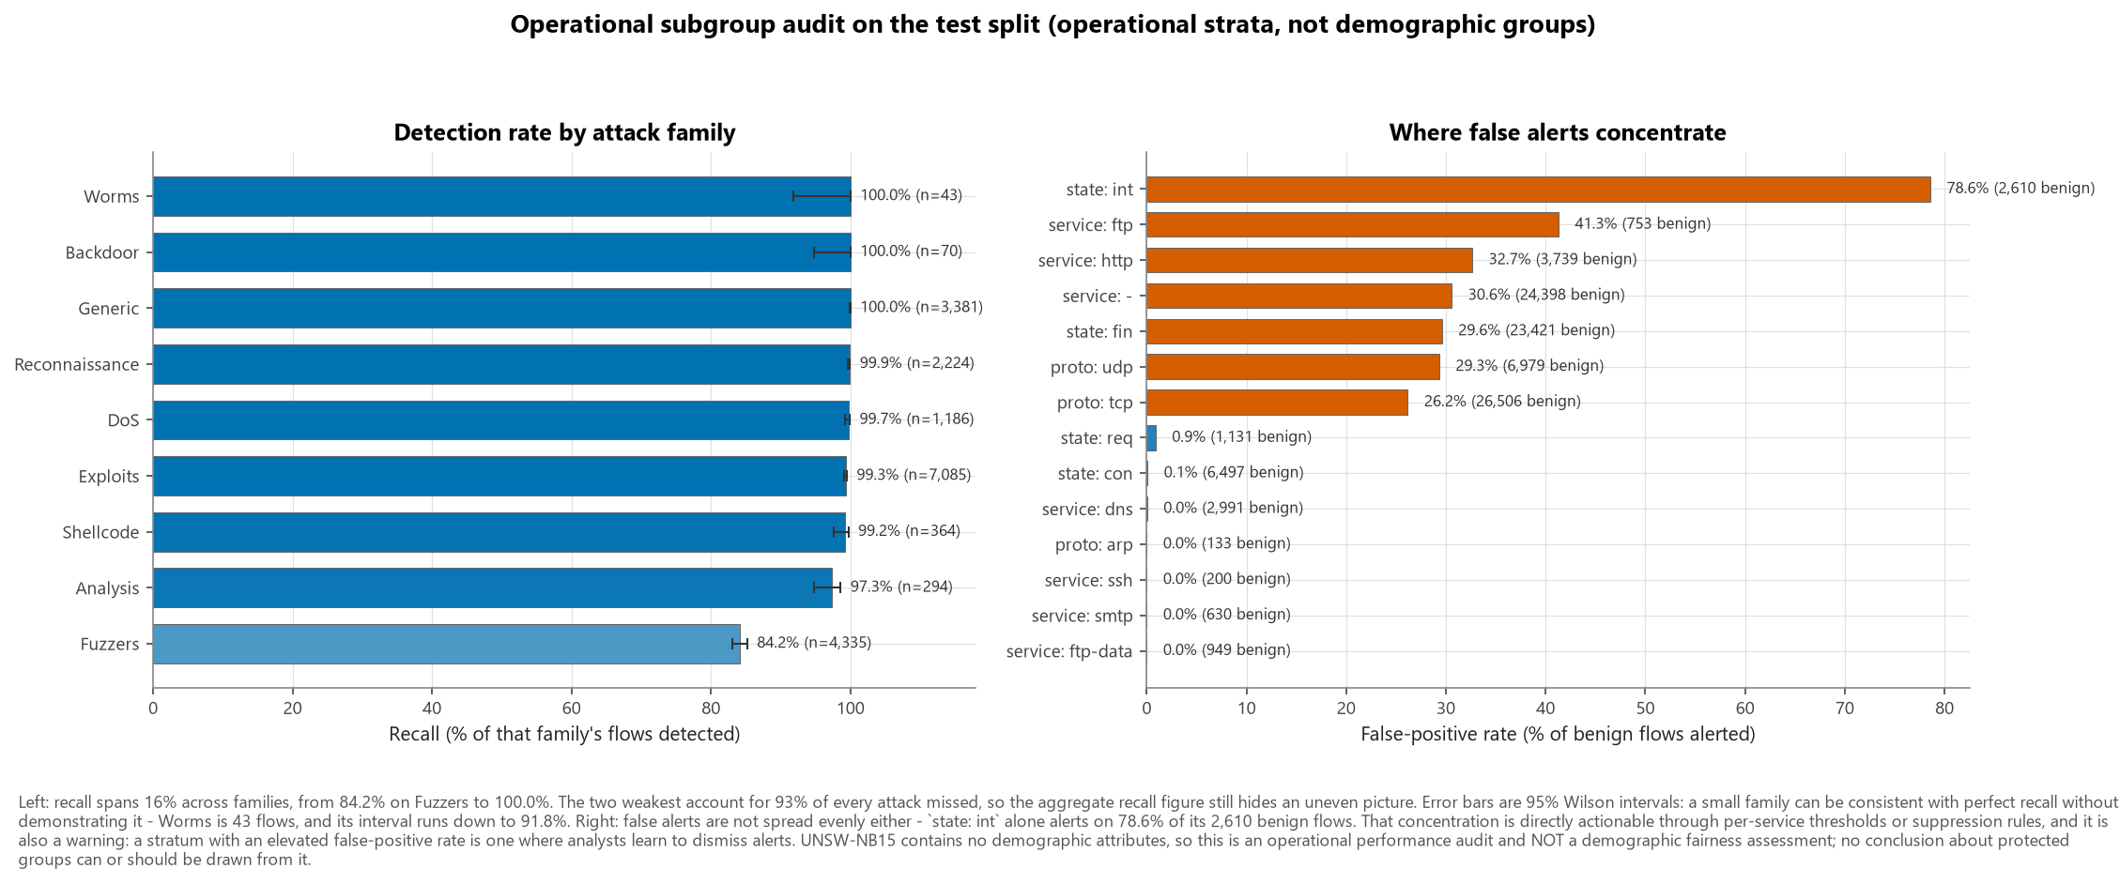
Error & Bias Analysis
• Recall varies substantially by attack family; weakest: Fuzzers (84%), Analysis (97%), Shellcode (99%), Exploits (99%)
• Three distinguishable mechanisms: scarcity (fixable with data), behavioural overlap with benign traffic (not fixable), duplication-distorted training counts
• Missed attacks are near-misses — median score 0.27 against a 0.465 threshold, only 17% below 0.10, so the threshold is the dominant lever and borderline review genuinely helps
• False alerts concentrate in specific services → actionable via per-service thresholds
• UNSW-NB15 has no demographic attributes. This is an operational performance audit; no demographic fairness claim is made or possible
9
Notes:
[Visual: figures/fig18_subgroup_audit.png]
Be explicit about the fairness framing — it is a strength, not a hedge. Then note that genuine fairness risk does enter at deployment: uneven per-service FPR means uneven scrutiny of the humans behind those services.

Slide 10
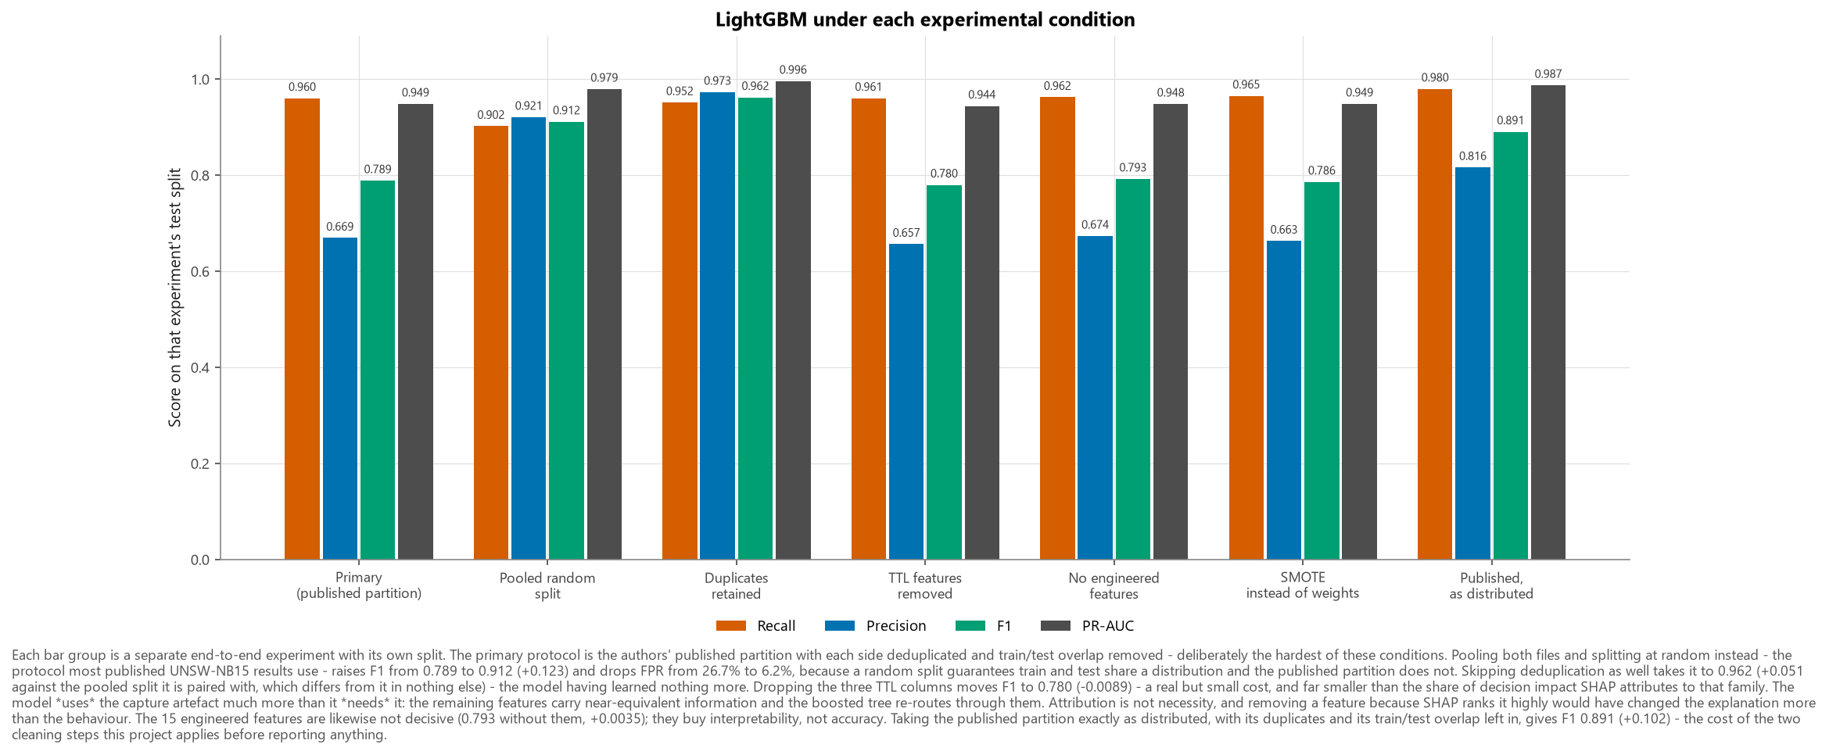
Ablations: what is the number actually measuring?
• Pooled random split → F1 +0.1226. The protocol most published results use. We report the harder published partition instead
• Duplicates retained → F1 +0.0507 (vs the pooled split). Skipping deduplication hands back a better-looking number for no better model
• TTL removed → F1 -0.0089. SHAP's top feature is used far more than it is needed — the model re-routes through correlated features
• No engineered features → F1 +0.0035. The 15 domain features buy interpretability, not accuracy — reported as the negative result it is
• SMOTE → F1 -0.0027. Tested rather than assumed, and not adopted
• Partition as distributed → F1 +0.1017. What the two cleaning steps (dedup each side, remove train/test overlap) are worth
Experiment | Recall | F1 | PR-AUC
Primary protocol (published partition) | 0.9604 | 0.7890 | 0.9485
Pooled random split | 0.9022 | 0.9116 | 0.9793
Duplicates retained | 0.9516 | 0.9623 | 0.9959
TTL features removed | 0.9606 | 0.7801 | 0.9441
Engineered features removed | 0.9625 | 0.7925 | 0.9484
SMOTE instead of class weights | 0.9652 | 0.7863 | 0.9486
Published partition, as distributed | 0.9799 | 0.8907 | 0.9872
10
Notes:
[Visual: figures/fig19_ablation_comparison.png]
This slide separates "the model detects attacks" from "the model detects this dataset." Each row is a separate end-to-end experiment reusing the tuned hyper-parameters, so exactly one thing changes at a time.

Slide 11
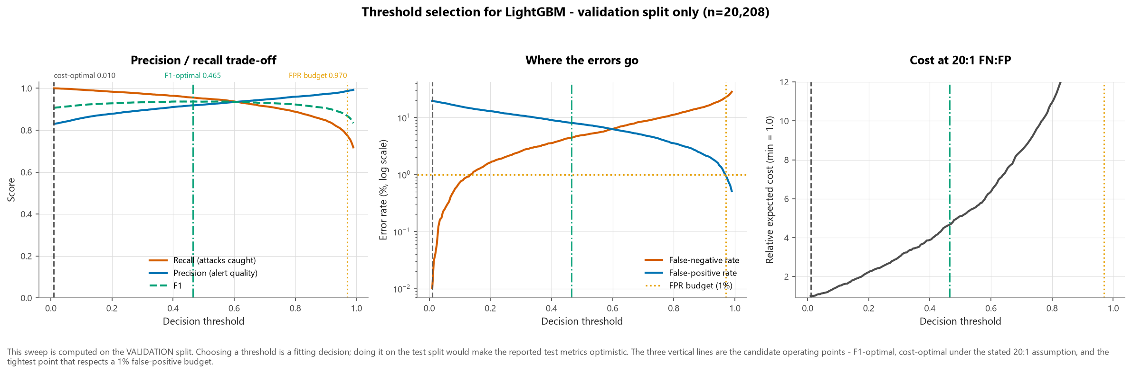
Deployment Architecture & Threshold
• Flow collector → feature extraction → model → risk-banded triage queue → analyst → response
• Operating threshold 0.465, chosen on validation; a low-FPR alternative is published for capacity-limited SOCs
• Cost assumption stated openly: 20:1 FN:FP, with a sensitivity table
• Measured throughput: 82,396 flows/second on one commodity CPU
• Streamlit prototype: single-flow scoring, batch upload, live threshold control, per-alert SHAP
11
Notes:
[Visual: figures/fig17_threshold_analysis.png plus a Streamlit screenshot.]
0.50 is a default, not an optimum. Show how the recall/FPR trade-off moves and make the point that choosing the operating point is a business decision about alert capacity, not a modelling decision.

Slide 12
Limitations & Conclusions
• Achieved: F1 0.7890, ROC-AUC 0.9648, PR-AUC 0.9485, recall 96.04%, FPR 26.736% — 3/4 pre-registered targets met on this harder protocol (F1 short); all met on the pooled random split
• Qualified by: a capture artefact the model leans on far more than it needs (measured by ablation, not assumed), uneven per-family recall, and precision that will not transfer to a production base rate
• Cannot measure: concept drift — timestamps were removed from the partitioned files
• Recommendation: human-in-the-loop triage ranking, recalibrated on target-network traffic. Not autonomous blocking
• Next: multiclass family classification, cross-dataset validation (CIC-IDS2017), adversarial robustness testing
12
Notes:
[Visual: Side-by-side — headline metrics left, the three qualifications right, equally weighted.]
Close on the distinction between a number and a finding. A capstone that reported only its F1 would not have discovered the artefact, the duplication problem, or the per-family gaps — and would have recommended a system that should not be deployed the way it suggested.

