Slide 1
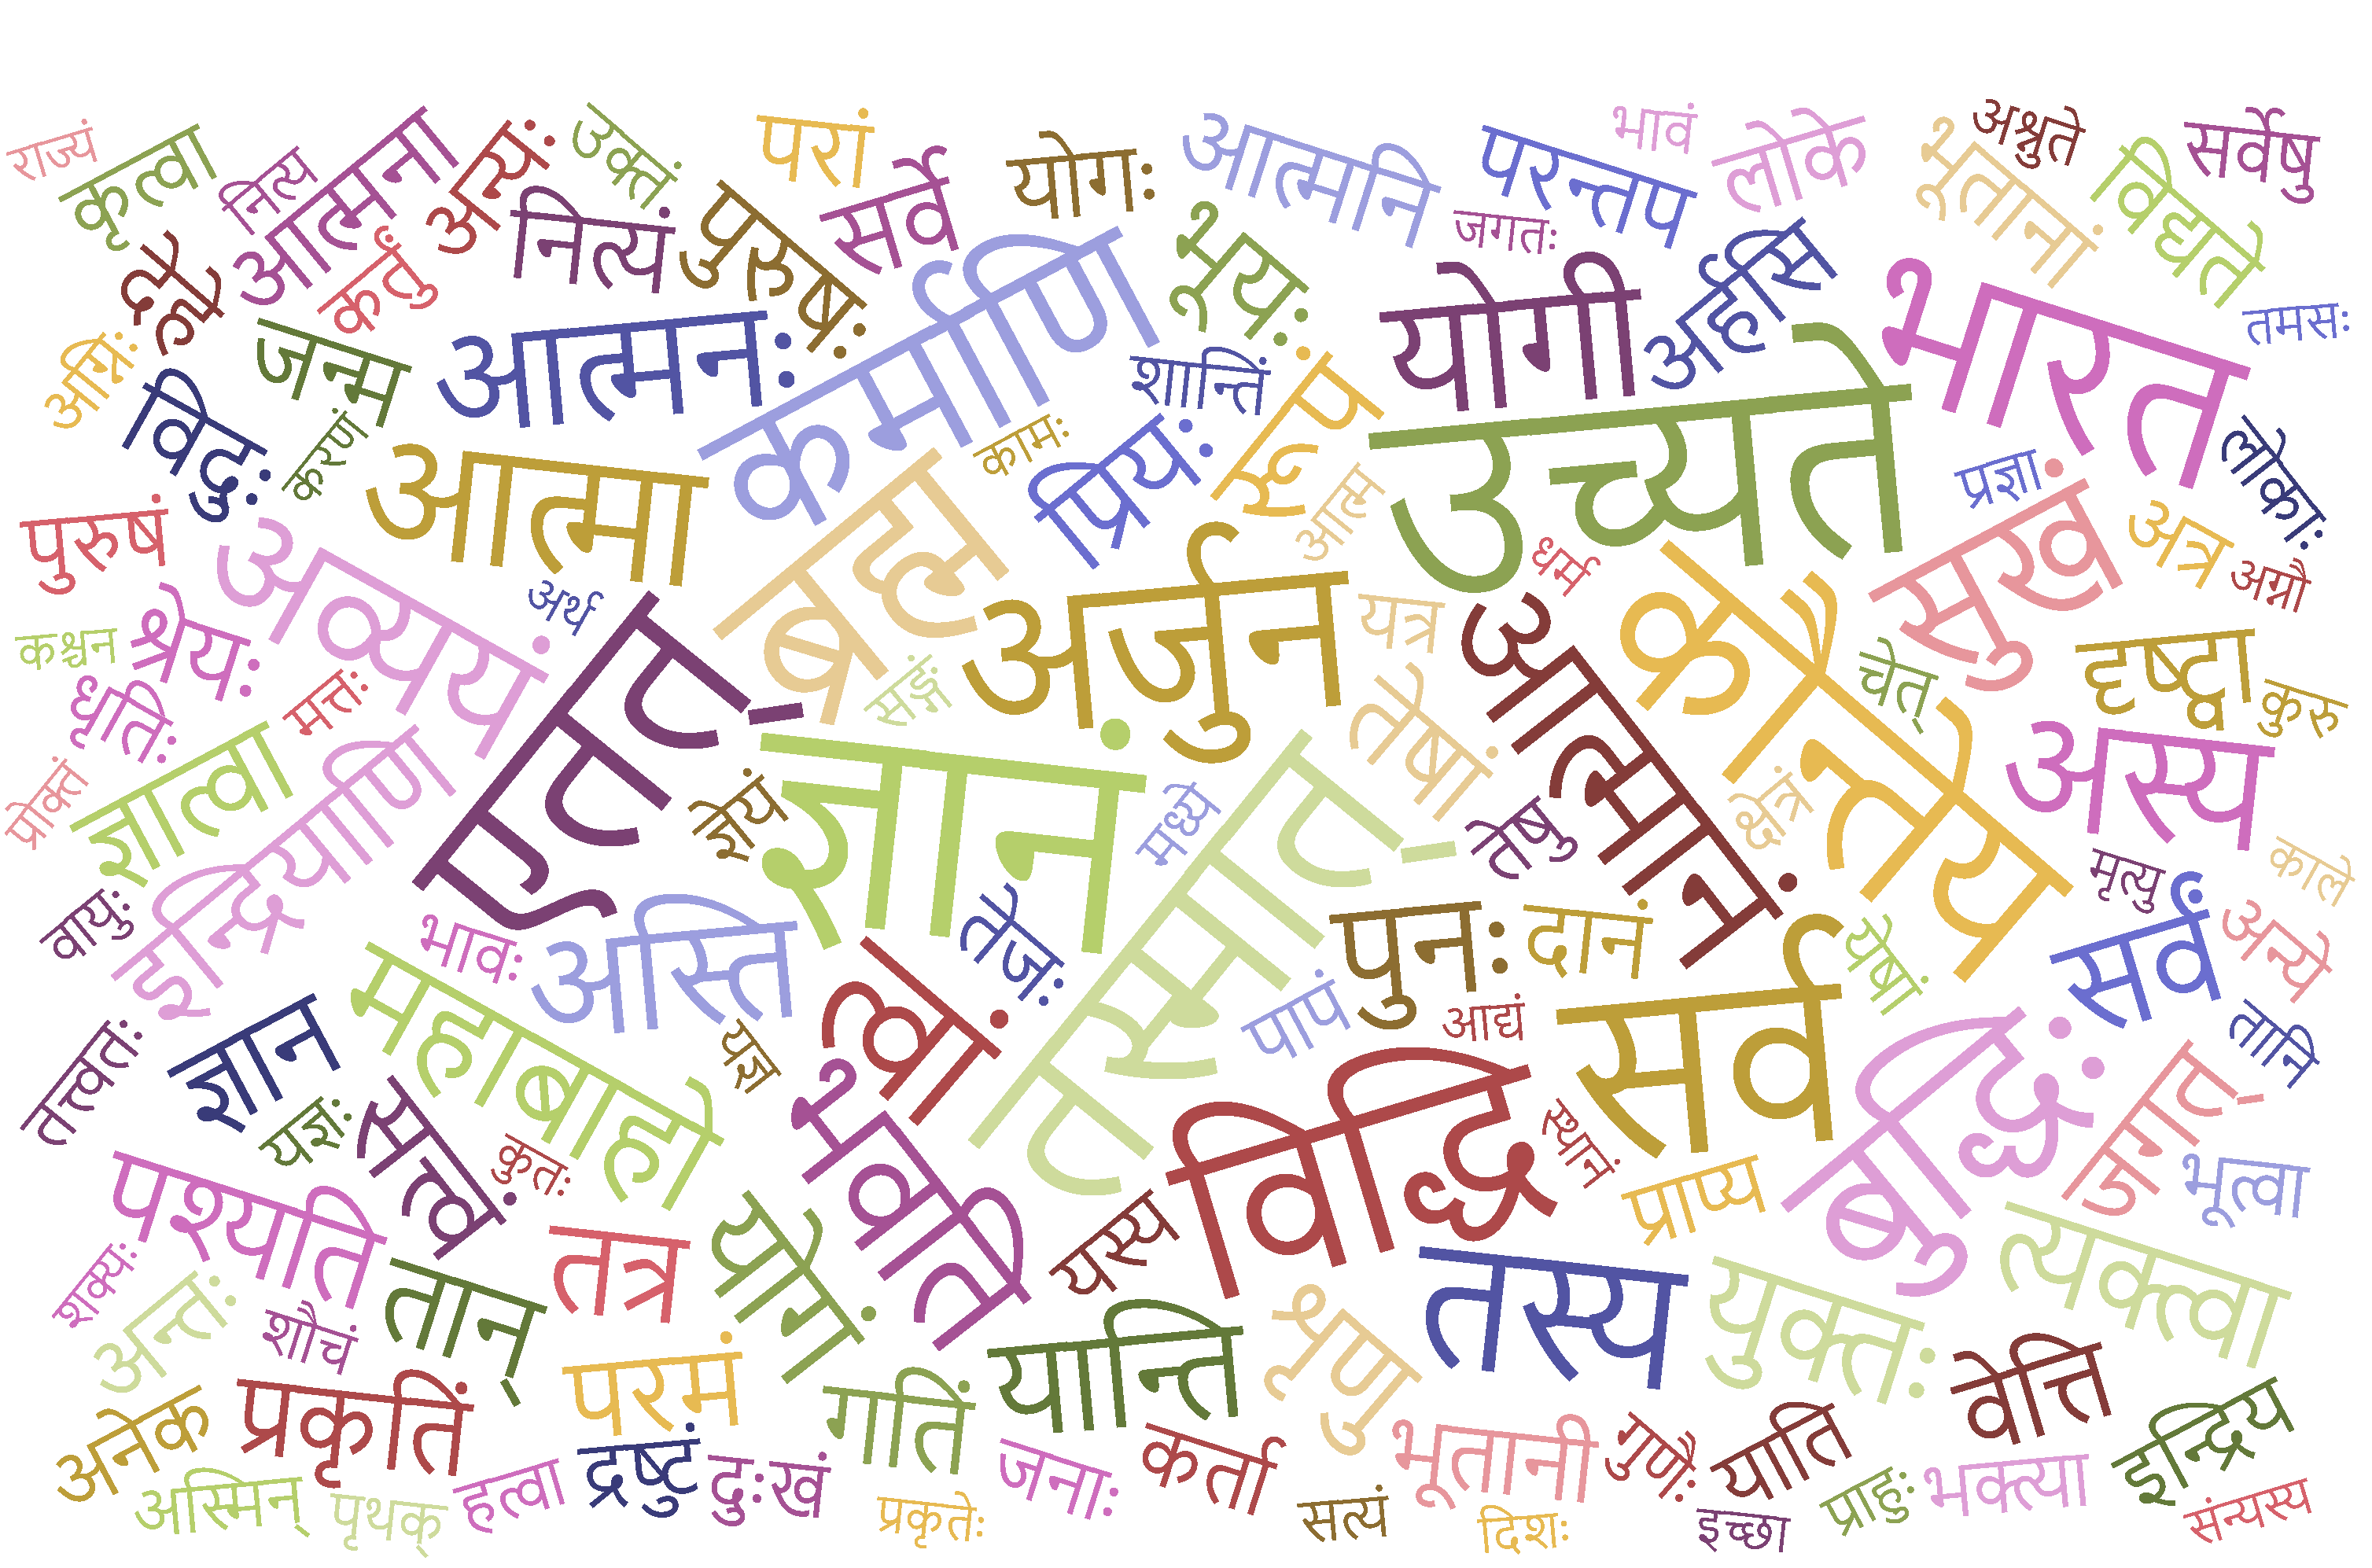
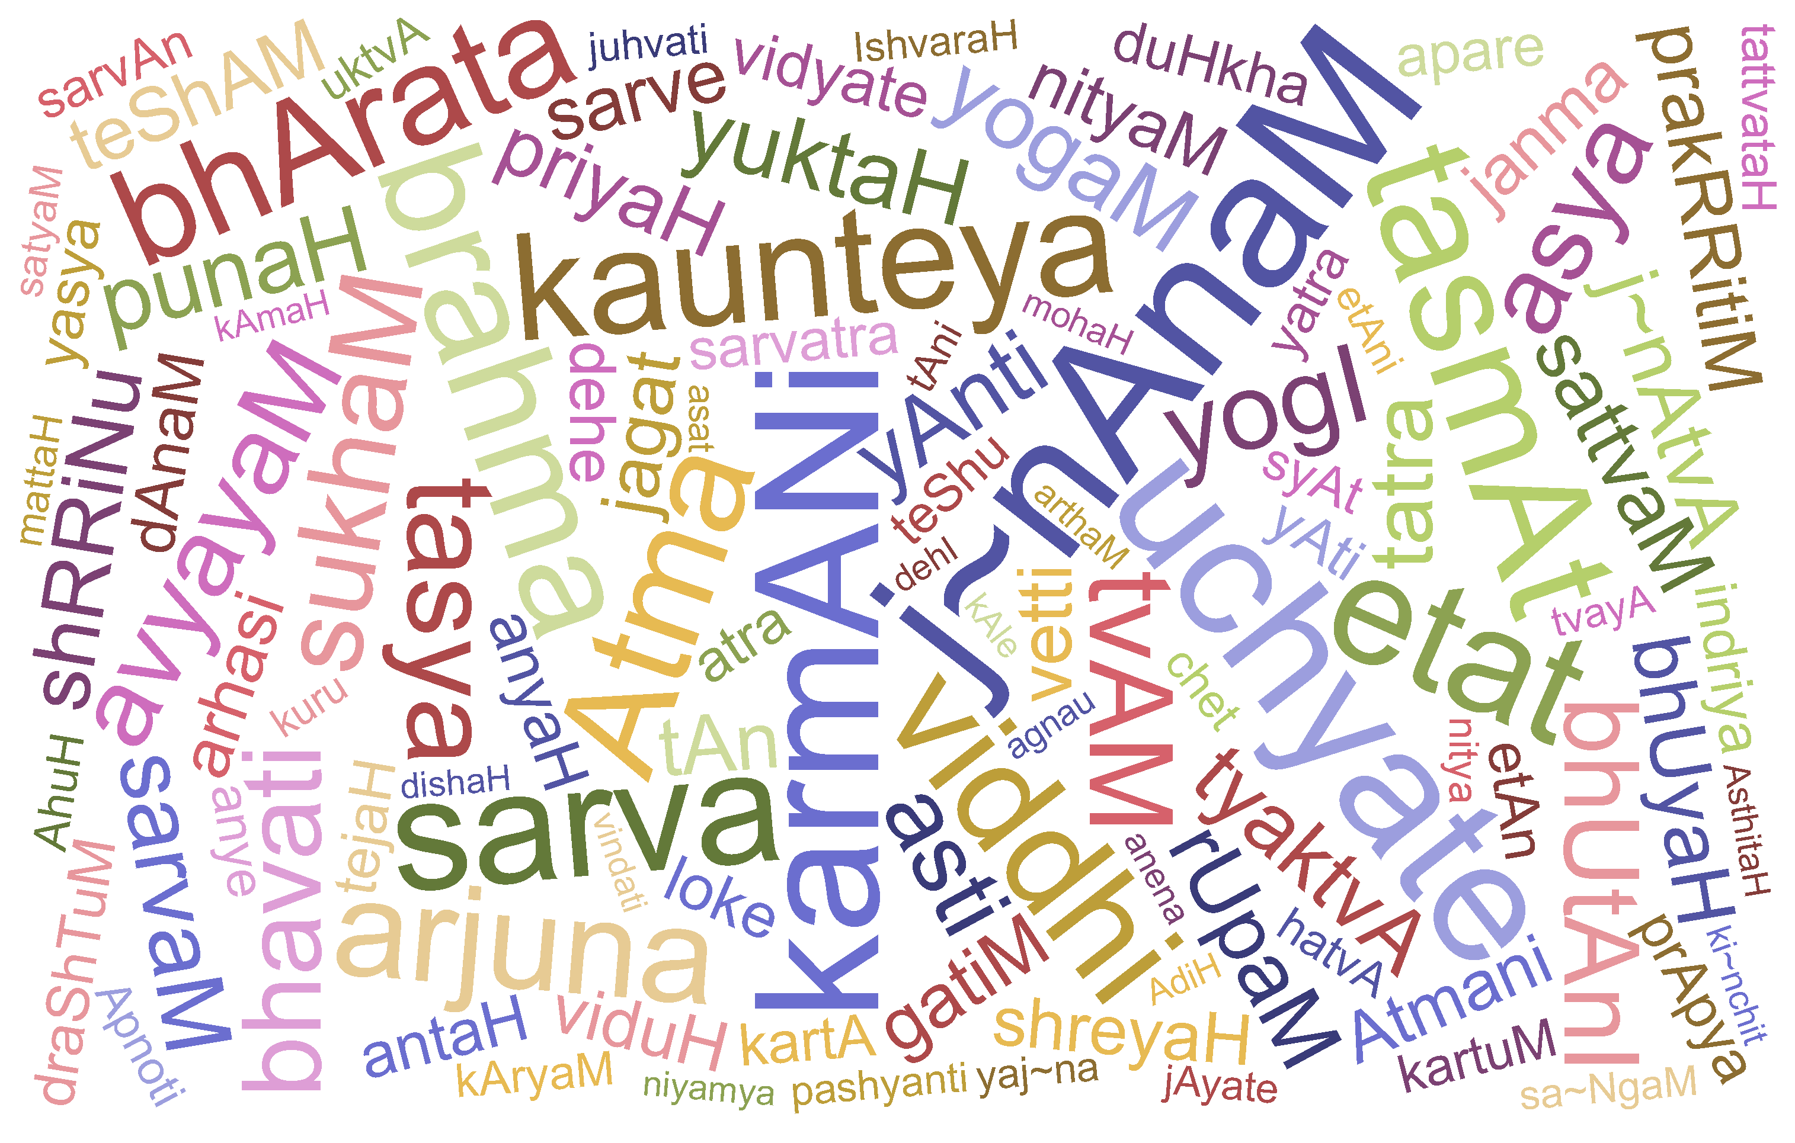
Word Cloud Bhagavad Gita
WWW.IYCCPRINCETON.ORG

