Slide 1
Some Studies on Remote User Authentication Scheme
By:-
KISHLAY VERMA
SURAJ KUMAR

Slide 2
Outline
Introduction
Need of Remote User Authentication
What Remote User Authentication provides?
Applied Approach
Conclusions
References

Slide 3
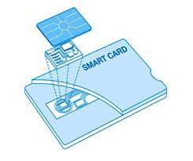
What is Remote User Authentication?
It is a mechanism through which the remote server verifies the authenticity of a user over an insecure communication channel.
In this scheme, the user is assigned a smart card, which is being personalized by some parameters and provide the legal users to use the resources of the remote system.

Slide 4
Continue…
Remote user authentication scheme incorporates :
User Details(ID, Password, Biometrics etc.)
Smart Card
One-way hash functions
Techniques included in Remote user authentication are :
2-factor Authentication : Using ID and Password
3-factor Authentication : Using ID, Password and OTP
4-factor Authentication : Using ID, Password, OTP and Biometric detail

Slide 5
Why Remote User Authentication?
With the enormous increase in use of Internet services like in e-commerce system, Banking systems, ATMs etc., they have become more vulnerable to different types of attacks.
Some of these attacks are….
Denial Of Service Attack(Dos)
Replay Attack
Password guessing Attack
Stolen-Verifier Attack
Insider Attack and others

Slide 6
Remote User Authentication provides…
User Requirements:
Simple and Secure password choice and modification
Single Registration
Anonymity
Security Requirements:
Mutual Authentication
No verification table
Integrity
Session Key Agreement

Slide 7
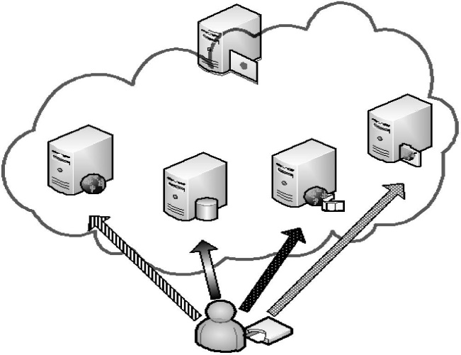
Approach
Main components of Remote user authentication are:
Registration Centre(RC)
Application Server
User
The different phases of Remote user authentication are:
(i) Server Registration phase
(ii) User Registration phase
(iii) Login phase
(iv) Authentication phase

Slide 8
Notations
--------------------------------------------------------------------------------------------------------------------------------------------------
X A secret value of the registration centre
RC The registration centre
ID_{i} The public identification of user i
SID_{i} The public identification of server j
PW_{i} The password of user i
BIO_{i} The biometrics information of user i
AID_{i} The anonymous identification of user i
h() A one-way collision-resistant hash function
N_{i} A random number
PSK A secure pre-shared key among authorized application servers and
the registration centre
⊕ The bitwise XOR operator
|| The string concatenation operator
X -> Y User X sends a message to user Y through a secure channel
X -> Y User X sends a message to user Y through a common channel
---------------------------------------------------------------------------------------------------------------------------------------------------

Slide 9
Server Registration phase
request join Message
reply with PSK
Server
RC

Slide 10
User Registration Phase
(1) ID_{i} ,h(PW_{i}⊕BIO_{i}) (2)
1. A_{i}=h(ID_{i}||x)
2. B_{i}=h²(ID_{i}||x)=h(A_{i})
3. C_{i}=h(PW_{i}⊕BIO_{i})⊕B_{i}
(3)ID_{i},B_{i},C_{i},D_{i} 4. D_{i}=PSK⊕A_{i}
USER_{i}
RC
SMARTCARD

Slide 11
Login Phase
(1)ID_{i},PW_{i},BIO_{i} (2)
1. check ID_{i}
2. check h(PW_{i}⊕B_{i}) ⊕C_{i} =B_{i}
3. Generate N₁
4. M₁=h(B_{i})⊕N₁
5. AID_{i}=h(N₁)⊕ID_{i}
6. M2=h(N₁||AID_{i}||D_{i})
USER_{i}
SMARTCARD

Slide 12
Authentication Phase
(1)AID_{i},M₁,M₂,D_{i} (2)
1.A_{i}=D_{i}⊕PSK
2.N₁=M₁⊕h²(A_{i})
3.check h(N₁||AID_{i}||D_{i})=M₂
4.Generate N₂
5.SK_{ij}=h(N₁||N₂)
6.M₃=N₂⊕h²(N₁)
(3) SID_{j},M₃,M ₄ 7. M₄=h(SID_{j}||N₂)
(4)
1.compute h²(N₁)
2.N₂=M₃ ⊕h²(N₁)
3.check h(SID_{j}||N₂)=M₄
4. SK_{ij}=h(N₁||N₂) (5)SK _{ij}⊕h(N₂) (6)check h(N₂)
Smartcard
Server

Slide 13
Conclusions
This scheme not only provides mutual authentication between the user and server , but also establishes a common session key to provide message confidentiality.
This scheme satisfies the various security properties: anonymity, no verification tables, mutual authentication, resistance to forgery attacks, resistance to modification attacks, resistance to replay attacks, resistance to insider attacks, simple and secure choice and change of passwords, biometric template protection, and session key agreement.

Slide 14
References
Ming-Chin Chuang, Meng Chang Chen. An anonymous multi-server authenticated key agreement scheme based on trust computing using smart cards and biometric (2014).
Lamport: Password authentication with insecure communication (1981).

