Slide 1
UCF439 Capstone Project Recognition of Medical Imaging Pattern Using Machine Learning and Deep Learning Techniques Group No. 158
Supervisor Name :
Sumedha Bhardwaj
sumedha.bhardwaj@dituniversity.edu.in
Kislay Raj (1000015210)
Anmol Bansal (1000015216)

Slide 2
Presentation Outline
Introduction
Literature Study
Motivation
Dataset
Methodology
Result
Project Timeline
Conclusion and Future Work

Slide 3
Introduction
Brain tumors are the most common tumors in humans, research on brain tumors is very important.
Advancements in machine learning and image processing for automated brain tumor detection from MRI images.[1]
Objective to develop a robust algorithm for precise brain tumor detection using deep learning architectures, image segmentation techniques, and computational algorithms.
Aim to create a reliable and efficient system for identifying and delineating brain tumors within MRI scans.
Harnessing the information in MRI data to empower healthcare professionals with advanced diagnostic tools.[8]

Slide 4
Literature Study
S.No | Year | Author | Summary | Tools | Performance Metrics
1. | 2012 | Rajesh C.Patil, Dr A.S. Bhalachandra | This paper refers to the brain tumor segmentation from MR images .Here Pre-processing of images is done to remove noise and image enhancement .Better method is proposed for image segmentation [3] | MATLAB | N/A
2. | 2018 | Yu Han LIU | The thorough recognition process of the CNN is presented in this paper. CNN manages to scan images and extract objects’ features with much lower compute cost. Furthermore, pooling enhances the robustness of the network upon spatial variances.[2] | LeNet-5 | N/A
3. | 2020 | Raheleh Hashemzehi, Seyyed Javad Seyyed Mahdavi, Maryam. Kheirabadi ,Seyed Reza Kamel | A classification model for brain tumor MR images was performed with a hybrid architecture of neural autoregressive distribution estimation and a convolutional neural network that not only removes undesired features and smooths the boundary of brain tumors but also extract beneficial features for image classification. [7] | CNN and NADE | Accuracy:95%
4. | 2021 | P Gokila Brindha, M Kavinraj , P Manivasakam and P Prasanth | A self defined ANN and CNN is applied in detecting the presence of brain tumor and their performance is analyzed. It has different layers of neurons which is connected together. There will be one input and output layer whereas there may be any number of hidden layers. | Convolve layer , Max Pooling | ANN Accuracy=80.7 CNN Accuracy=89%
5. | 2011 | Yudong Zhang , Zhengchao Dong ,Lenan Wu, Shuihua Wang | Proposed a new method for the classification of T2-weighted brain MRI images that consists of three stages. In the first stage it extracts 1024 features from each image by using DWT. These features are reduced to 19 features, in stage 2 using PCA. The reduced set of 19 features is, then, feed to an ANN classifier in third stage, for the classification. It achieved good results in terms of accuracy.[5] | Scaled conjugate gradient (SCG) | Accuracy:100%

Slide 5
Literature Study
S.No | Year | Author | Summary | Tools | Performance Metrics
6. | 2011 | M. F. B. Othman, N. B. Abdullah and N. F. B. Kamal | This model have used SVM to differentiate between the normal and abnormal MRI images. DWT is one the most powerful mathematical tool, which uses dyadic scales and positions, and it implements wavelet transform . | SVM,DWT | N/A
7. | 2011 | S. Lahmiri and M. Boukadoum | Proposed an automated approach to classify healthy images and those which are affected by diseases such as Glioma, Tumor and Alzheimer. DWT is used to extract optimal features from sub-bands LH and HL. Three classifiers PNN, KNN, Learning Vector Quantization (LVQ), combined in a single SVM, were used for the classification to improve the precision and effectiveness. [8] | PNN,KNN and LVQ | Accuracy:96.91%
8. | 2014 | H. B. Nandpuru, S. S. Salankar and V. R. Bora | Proposed a robotized technique to differentiate between effected and healthy MRI images. Median filter was used for the removal of salt-and-pepper noise, and unwanted components such as scalp and skull. For assessment purposes, they used Linear Kernels (LKs), Quadratic Kernels (QKs) and Polynomial Kernels (PKs), whose accuracy was 74%, 84%, and 76%, respectively. | SVM | N/A
9 | 2012 | Bhausaheb Shinde, Dnyandeo Mhaske and A.R. Dani | Proposed a technique of detecting and removing noise from MRI images. The Salt & Pepper noises had been detected and also removed from the medical images by applying the various filtering techniques like Median Filtering, Adaptive Filtering and Average Filtering. | NA | NA
10 | 2021 | M. Assam, H. Kanwal, U. Farooq, S. K. Shah, A. Mehmood, and G. S. Choi | Suggested a new mechanism to differentiate MRI brain images into normal and abnormal using individual and hybrid classifiers. The proposed technique used an individual classifier called: Feed Forward - ANN (FF-ANN), and two hybrid classifiers[4] | FF-ANN | N/A

Slide 6
Motivation
High prevalence of brain tumors and their impact on patient outcomes.
Potential of automated brain tumor detection using advanced machine learning and image processing techniques.

Slide 7
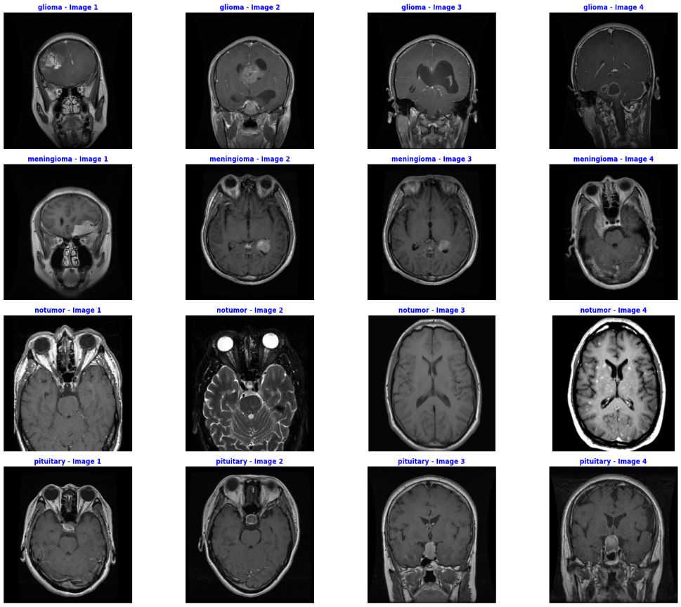
Dataset
The Brain MRI images used for research was obtained from a open-source platform.[9]
There are total 7023 images ,each with a resolution of 512 X 512 .
Figure 1 shows the sample scans of brain which are categorized as: a. glioma b. meningioma c. no tumor d. pituitary
a
b
c
d
Figure 1. Brains tumor sample images

Slide 8
Methodology
Data Preprocessing :
Prior to model training, the MRI image data undergo preprocessing steps, including normalization and resizing to ensure uniformity.
The image is first cropped to remove excess edges in the image, and then, in the preliminary stage, a median filter[4] is used to remove salt and pepper noise .
The resulting image is cleared of unwanted objects and noise and converted into a color (RGB) image.
After preprocessing , the images are stored in a numpy array with proper labeling to ensure the data is properly fed to the training module.

Slide 9
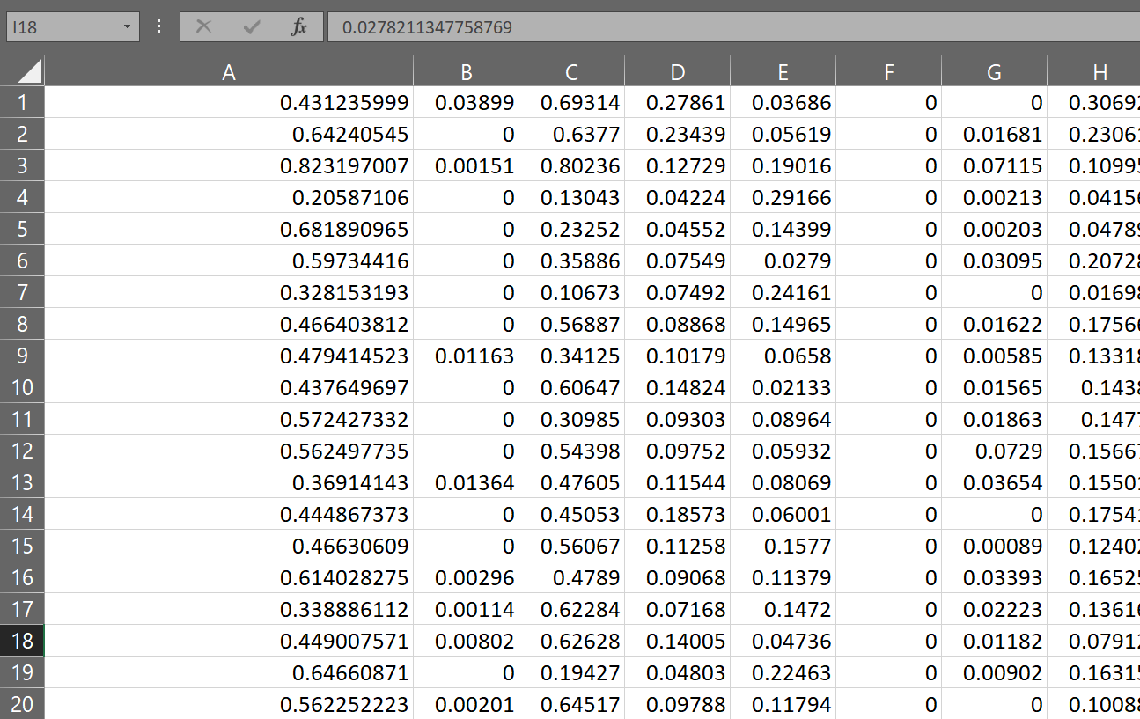
Feature Extraction:
In this work , feature extraction process using a pre-trained VGG16 convolutional neural network (CNN) model was used.
These values are activation values indicating how strongly each feature is present in the respective image.
Column ‘A’ captures some specific high-level information from the image, possibly related to the primary subject or dominant object in the image.
Column ‘C’ capture lower-level details like edges or textures.
Column ‘D’ represents specific color or brightness characteristics
Figure 2 csv file showing extracted features

Slide 10
Classification
Feature extraction with VGG16 captures visual patterns in images.
After feature extraction , the next stage is classification using a custom classifier.
Custom classifier maps extracted features to labels.
Custom classifier architecture includes:
Rescaling layer for normalizing pixel values.
Flattening layer for one-dimensional representation.
Dense layers(4 layers) with ReLU activation for pattern learning.
Dropout layers (dropout rates: 0.7 and 0.5) combat overfitting.
Output layer with softmax activation for multi-class prediction.

Slide 11
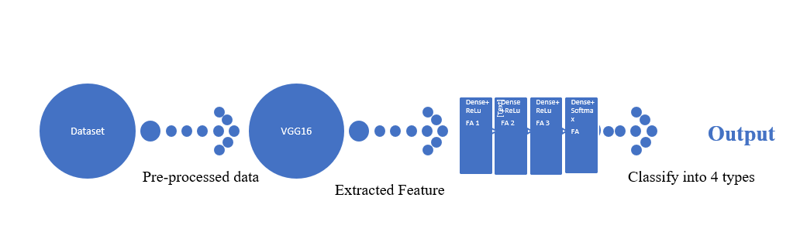
Rescaling normalizes pixel values to [0, 1] range.
Flattening transforms features into one-dimensional array.
Dense layers learn complex patterns and relationships.
Dropout layers prevent over-reliance on specific features.
Softmax activation computes class probabilities.
Output layer produces probability vector for class predictions.
Custom Classifier
Figure 3 Flow of the proposed mechanism

Slide 12
Results
The training progressed steadily over the epochs, with a gradual decrease in both training and validation loss.
The final model achieved a validation loss of approximately 21% and a validation accuracy of approximately 94.67%.
The confusion matrix in Fig 5. signify the model's robust performance in classifying abnormality patterns within MRI images.
Overall, the presented results showcase the effectiveness of the developed model in automated abnormality detection from MRI images, with implications for improving patient care outcomes in clinical practice.
The consistency between training and validation metrics throughout the epochs suggests that the model generalizes well to unseen data.

Slide 13
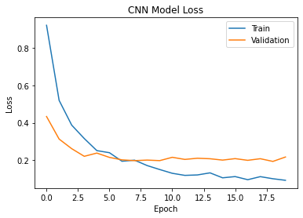
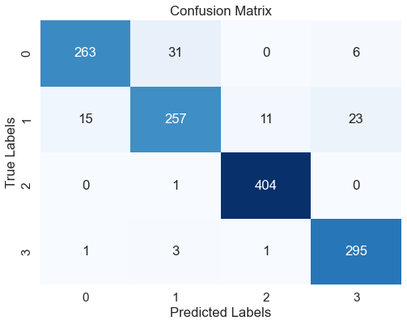
Fig 4 Loss curve of training and validation
Fig 5 Confusion Matrix
Fig 4 illustrates the trajectory of training and validation loss over the course of training.
The curve showcases the decreasing trend of loss over epochs, indicating the model's learning process and convergence to optimal performance.

Slide 14
Project Timeline
Project Initiation and Research (Week 1)
Model Architecture Design (Week 3)
Feature Extraction (Week 4)
Classification (Week 5)
Evaluation and Testing (Week 7)
Project Report (Week 9)
Presentation (Week 10)

Slide 15
Conclusion
In summary, our CNN model showcased strong performance with a test accuracy of approximately 93.51% and a test loss of around 0.29.
Its high accuracy and low loss metrics signify its potential clinical utility for assisting healthcare professionals in diagnosis and treatment planning. Future research could focus on refining the model architecture.
Overall, our study presents a promising approach to automated abnormality detection in MRI images, promising to enhance diagnostic precision and patient care outcomes.
Future Work
Experiment with different algorithms using more MRI images for improved accuracy.
Explore feature reduction techniques to optimize execution time.
Development of a web based Application which will be user-friendly and could help doctors analyze the MRI scans easily.
Expanding the work to not only classify brain but also neck , spinal cord and heart.

Slide 16
References
[1] O. T. Khan and D. Rajeswari, "Brain Tumor detection Using Machine Learning and Deep Learning Approaches," 2022 International Conference on Advances in Computing, Communication and Applied Informatics (ACCAI), Chennai, India, 2022, pp. 1-7, doi: 10.1109/ACCAI53970.2022.9752502.
[2] Y. H. Liu, “Feature Extraction and Image Recognition with Convolutional Neural Networks,” Journal of Physics: Conference Series, vol. 1087, p. 062032, Sep. 2018, doi: 10.1088/1742-6596/1087/6/062032.
[3] R. C.Patil and A. Bhalchandra, “Brain tumour extraction from MRI images using MATLAB”, International Journal of Electronics, Communication and Soft Computing Science & Engineering (IJECSCSE), vol. 2, no. 1, (2012), p. 1
[4] M. Assam, H. Kanwal, U. Farooq, S. K. Shah, A. Mehmood, and G. S. Choi, “An efficient classification of MRI brain images,” IEEE Access, vol. 9, pp. 33313–33322, Jan. 2021, doi: 10.1109/access.2021.3061487.
[5] Y. Zhang, Z. Dong, L. Wu and S. Wang, "A hybrid method for MRI brain image classification", Expert Syst. Appl., vol. 38, no. 8, pp. 10049-10053, Aug. 2011.

Slide 17
[6] Rajeshwar Nalbalwar, Umakant Majhi, Raj Patil ,Prof.Sudhanshu Gonge 2014 Detection of Brain Tumor by using ANN International Journal of Research in Advent Technology
[7] Raheleh Hashemzehi, Seyyed Javad Seyyed Mahdavi, Maryam Kheirabadi, Seyed Reza Kamel,Detection of brain tumors from MRI images base on deep learning using hybrid model CNN and NADE,Biocybernetics and Biomedical Engineering,Volume 40, Issue 3,2020,Pages 1225-1232,ISSN 0208-5216, https://doi.org/10.1016/j.bbe.2020.06.001.
[8] Lahmiri S, Boukadoum M. New approach for automatic classification of Alzheimer's disease, mild cognitive impairment and healthy brain magnetic resonance images. Healthc Technol Lett. 2014 Jun 16;1(1):32-6. doi: 10.1049/htl.2013.0022. PMID: 26609373; PMCID: PMC4611877.
[9] https://www.kaggle.com/datasets/masoudnickparvar/brain-tumor-mri-dataset?utm_medium=social&utm_campaign=kaggle-dataset-share&utm_source=linkedin

